Slide 1

NAVIGATING COMPLIANCE: UNDERSTANDING OIG CHECKS, EXCLUSIONS, AND SANCTION PROTOCOLS

Slide 2


Introduction to Compliance
Compliance is crucial in healthcare. This presentation will explore the OIG checks, exclusions, and sanction protocols that ensure organizations adhere to federal regulations.
Understanding these elements is essential for maintaining integrity and avoiding legal repercussions in the healthcare sector.

Slide 3


WHAT IS OIG?
The Ofﬁce of Inspector General (OIG) plays a vital role in overseeing healthcare programs. It aims to prevent fraud, waste, and abuse within federal health programs. Understanding the OIG's functions helps organizations align their practices with federal standards and maintain compliance.

Slide 4
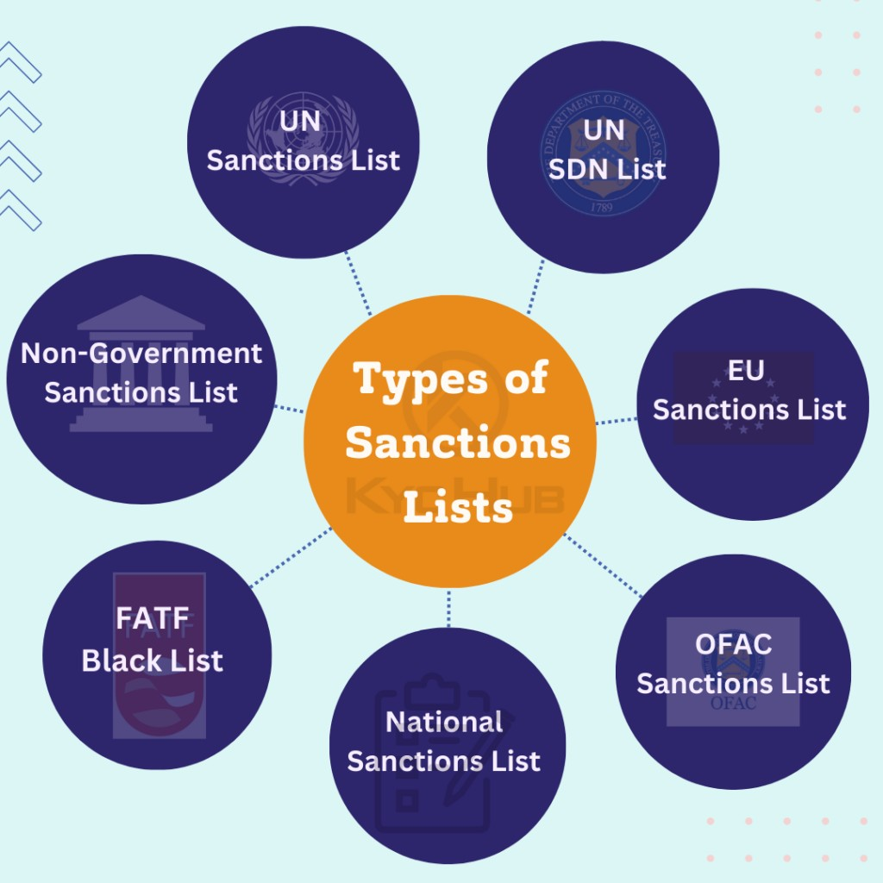
UNDERSTANDING EXCLUSIONS
Exclusions refer to individuals or entities barred from participating in federally funded healthcare programs. These exclusions are based on various factors, including criminal convictions or misconduct. Awareness of these exclusions is essential for organizations to avoid penalties and ensure eligibility for program participation.

Slide 5

SANCTION PROTOCOLS EXPLAINED
Sanction protocols are procedures that organizations must follow when dealing with individuals or entities that have been sanctioned. These protocols help organizations manage risks and ensure compliance with federal regulations, protecting both the organization and its beneﬁciaries.

Slide 6


IMPORTANCE OF REGULAR CHECKS
Conducting regular OIG checks is essential for organizations to maintain compliance and avoid potential risks. These checks help identify any exclusions or sanctions that may affect the organization’s ability to participate in federal programs, ensuring ongoing eligibility and integrity.

Slide 7

CONCLUSION AND BEST PRACTICES
In conclusion, understanding OIG checks, exclusions, and sanction cheks protocols is vital for healthcare organizations. Implementing best practices, such as regular training and compliance audits, can signiﬁcantly enhance an organization's ability to navigate compliance effectively and avoid legal issues.

Slide 8
Thanks!
Do you have any questions? memberservices@venops.com
+855 567 3552
www.venops.com
1395 South Marietta ParkwayBldg. 400, Suite 104Marietta Ga 30067

