Slide 1

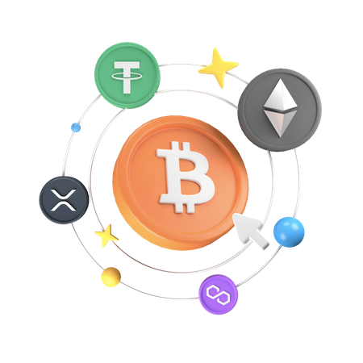


Crypto token History and its Key Features

Slide 2

01
Primitive Stage (2008-2012)
02
The Birth of Ethereum (2015)
History of Crypto Tokens
03
The ICO Boom (2017)
04
The Rise of DeFi and NFTs (2019-Now)
05
Regulatory Developments and Maturity (2021-Now)
06
Future Trends

Slide 3
1. Primitive Stage (2008-2012)
  The idea of crypto token development was first envisaged with the inception of Bitcoin in 2009. Despite Bitcoin’s propelling the revolution of digital currency, it wasn’t a token as we know them today.
  Rather it was a digital currency that had its own blockchain as opposed to being a token in any other currency. It is during this time that issues about the potential of money that can be programmed began to arise.
2. The Birth of Ethereum (2015)
  In 2015, under the command of Vitalik Buterin, a.k.a., a Canadian-Russian programmer, a new platform was released, called Ethereum, which changed the definition of the concept of tokens.
  In this case, when the first tokens were created on the Ethereum blockchain due to the concept of smart contracts, the token generation started. One of the tokens for supporting projects became the standard ERC-20, which allowed creating fungible tokens, and conducive to the emergence of many new projects.

Slide 4
3. The ICO Boom (2017)
  The Initial Coin Offerings (ICOs) that emerged in the year 2017 caused a drastic change in the narrative surrounding crypto tokens. People started funding projects by issuing coins and accepting free tokens in exchange for swathes of bitcoins or ether.
  Basic Attention Token (BAT) and OmiseGo were some of these companies who raised hundreds of millions of subscribers. This era also came with its share of regulatory backlash as well as rampant fraudulent schemes.
4. The Rise of DeFi and NFTs (2019-Now)
  The notion of crypto tokens was also broadened after the advent of DeFi (Decentralized Finance) movement in 2020 and emergence of non-fungible tokens (NFTs).
  In as much as DeFi protocols introduced non-centralized exchanges, so too we can say utility tokens were an addition that enabled the users to lend, borrow, and trade without the need of any middlemen. NFTs, on the other hand, became popular as digital items with the very few people that would own them all, typically ERC-721 on the ether network, art, music and collectibles.

Slide 5
5. Regulatory Developments and Maturity (2021-Now)
  With age, came wisdom in the crypto realm and the legislatures of various governments commenced formulating appropriate boundaries for the classification and taxation of the tokens. Consequently, there has been a better demarcation between security tokens and utility tokens.
  Presently projects have increased their concern about legal issues and how projects are governed which has led to most projects creating tokens that allow users to vote on project issues.
6. Future Trends
  In terms of future trends, the development of crypto tokens is expected to emphasize seamlessness, scalability and responsible use of resources.
  Solutions for transaction scalability such as cross-chain and layer-2 are intended to improve the efficiency of the transaction speeds and costs respectively, while innovations focus on the greener side of decentralization due to environmental issues.

Slide 6
01
Fungibility
02
Programmability
Crypto token development Key Features
03
Interoperability
04
Security
05
Decentralization
06
Governance

Slide 7
1. Fungibility
  Fungible tokens such as ERC20 tokens can be replaced by an unlimited number of copies.
  It will be easy to create an economic scenario where traditional currencies will be the mode of exchange.
2. Programmability
  Definitions about the use of tokens may be included in the technical documents and white papers.
  This includes the multi-steps processes such as carrying out transactions, voting, and governance among others. Such programmability creates room for uniqueness in DeFi gaming.

Slide 8
3. Interoperability
  Most of the coin tokens are created in such a way that they can be used in any wallet or exchange hence increasing access and use of these tokens.
  For growth of the crypto sphere, such integration is very important.
4. Security
  Security is usually provided by the blockchain that the crypto token is based on.
  Smart contracts can be verified before deployment to mitigate situations where user’s funds may be compromised thus restoring faith in the token.

Slide 9
5. Decentralization
  Most tokens are created to reside in a decentralized environment enhancing users to interact with each other without any third parties.
  This decentralization encourages openness and minimizes the chances of any foul play.
6. Governance
  Governance features are present in many tokens offered in the crypto space allowing the holders to influence or partake in decisions concerning the future of the project.
  This provides the users with power and helps build the spirit of belonging in the community.

Slide 10





THANK YOU!
  BlockchainX
  7708889555
  https://www.blockchainx.tech/token-development-company/

