Slide 1


Effective Homeopathic Approaches to PCOD and PCOS: Insights from Rajeev Homeopathy Clinic

Slide 2


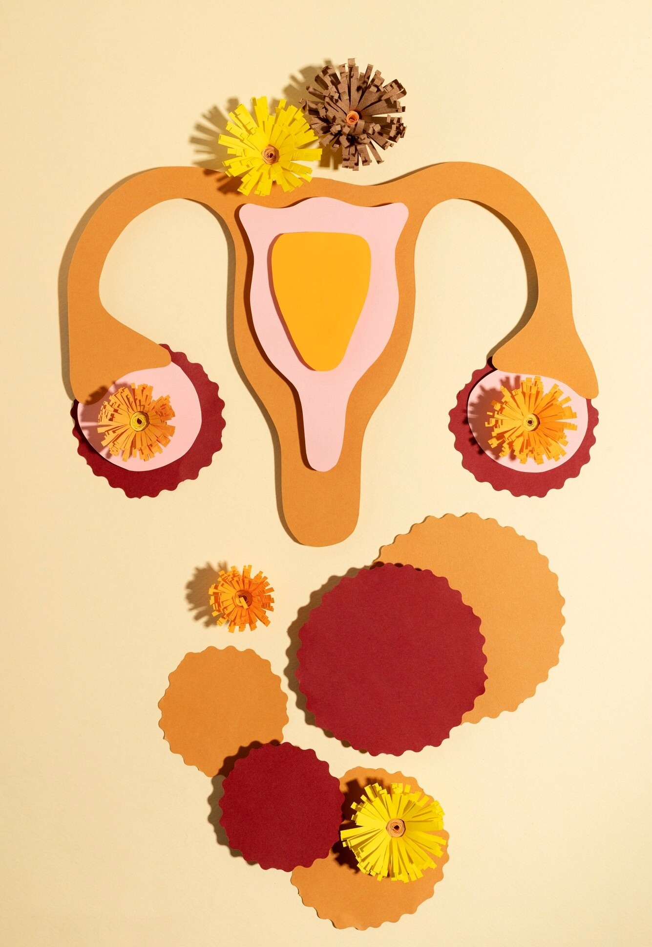

Introduction to PCOD and PCOS
PCOD (Polycystic Ovarian Disease) and PCOS (Polycystic Ovarian Syndrome) are common hormonal disorders affecting women. These conditions can lead to various symptoms such as irregular periods, weight gain, and fertility issues.
Understanding effective treatment options is essential for managing these conditions effectively.
www.rajeevclinic.com

Slide 3




Understanding Homeopathy
Homeopathy is a holistic approach that focuses on treating the individual rather than just the symptoms. It uses natural remedies to stimulate the body's healing processes. This method can be particularly beneficial for managing chronic conditions like PCOD and PCOS.
www.rajeevclinic.com

Slide 4





Homeopathic Remedies for PCOD
Several homeopathic remedies can aid in alleviating symptoms of PCOD. Remedies like Sepia, Pulsatilla, and Calcarea Carbonica address hormonal imbalances and promote regular menstrual cycles. A tailored approach based on individual symptoms is crucial for efficacy.
www.rajeevclinic.com

Slide 5




Lifestyle Changes and Homeopathy
Incorporating lifestyle changes alongside homeopathic treatment can enhance results. This includes a balanced diet, regular exercise, and stress management techniques. Homeopathy supports these changes by addressing underlying imbalances and promoting overall wellness.
www.rajeevclinic.com

Slide 6

Success Stories from Rajeev Homeopathy Clinic
Many patients at Rajeev Homeopathy Clinic have experienced significant improvements in their PCOD and PCOS symptoms. Through personalized treatment plans and ongoing support, individuals have reported better hormonal balance, weight management, and improved quality of life.
www.rajeevclinic.com

Slide 7



Conclusion: A Holistic Approach
In conclusion, effective management of PCOD and PCOS requires a holistic approach that combines homeopathy with lifestyle modifications. The insights from Rajeev Homeopathy Clinic highlight the potential for improved health and well-being through personalized care.
www.rajeevclinic.com

Slide 8


Thanks!
Do you have any questions?
abhihomoeo@gmail.com
+91 9263778607
www.rajeevclinic.com

