Slide 1



www.piccolacucifiagroup.com

Slide 2


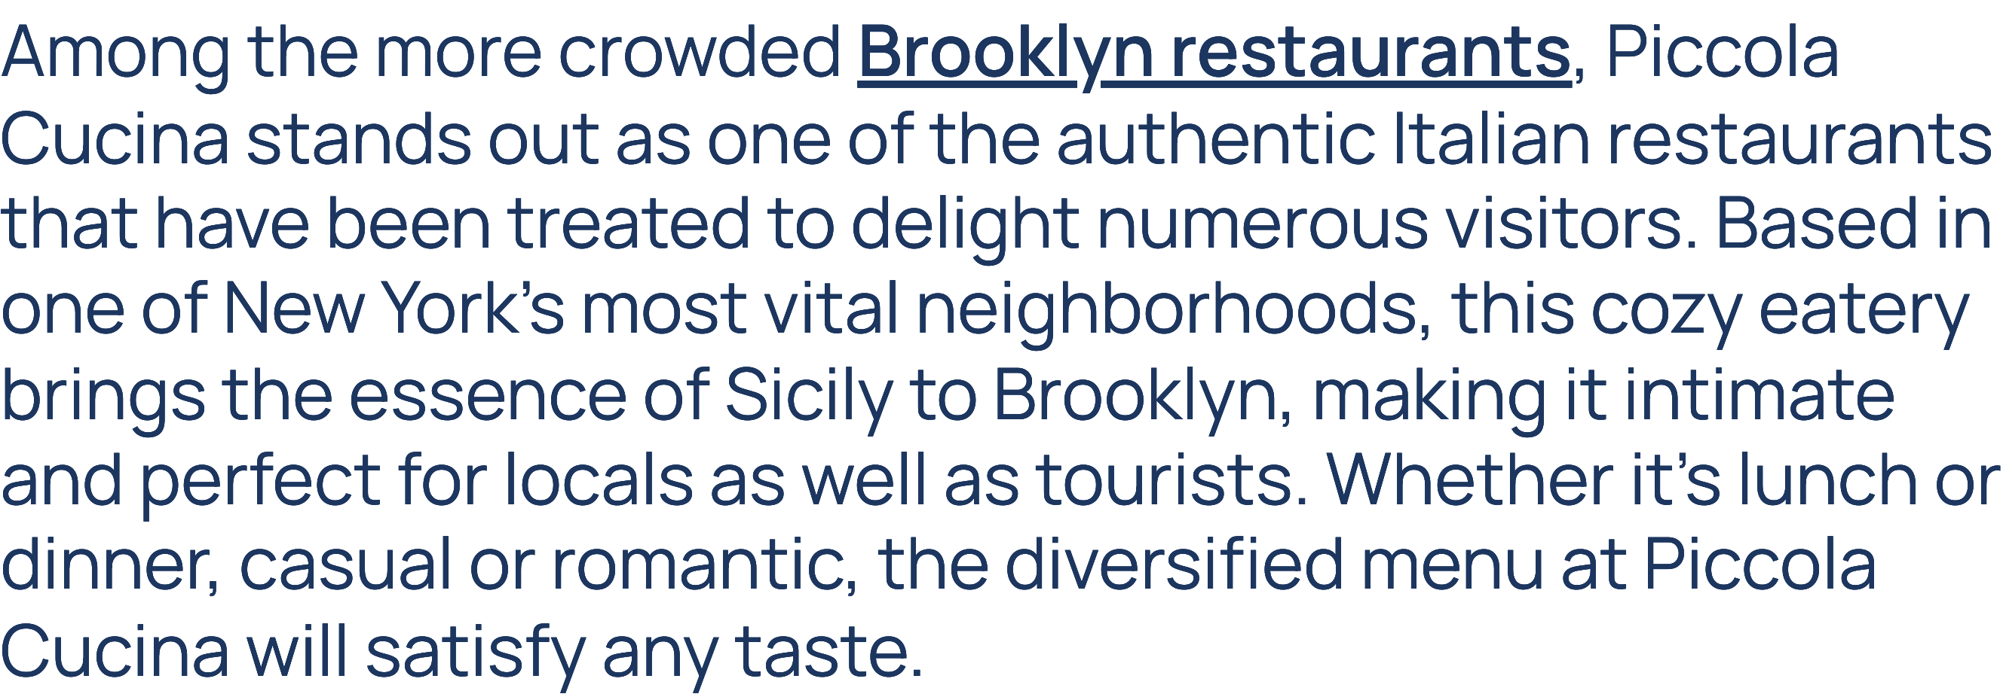

www.piccolacucifiagroup.com

Slide 3


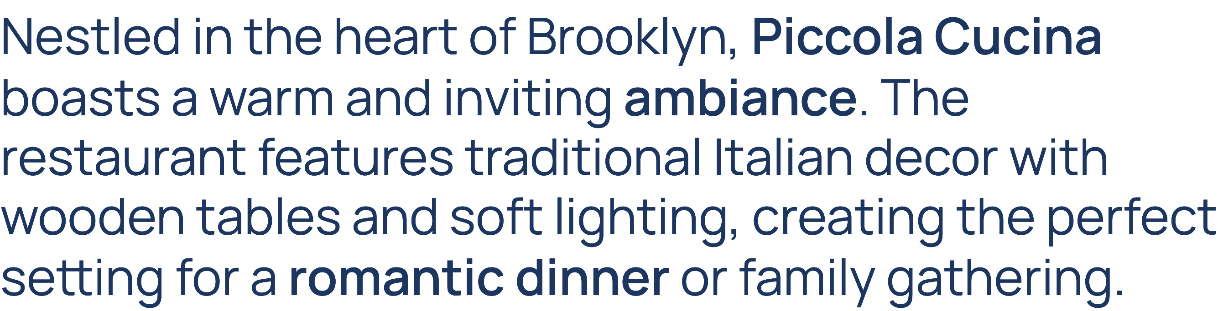
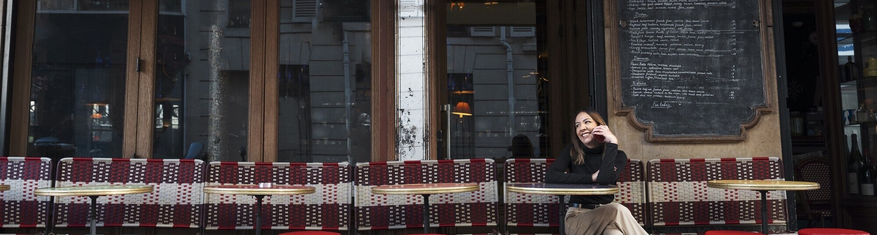
www.piccolacucifiagroup.com

Slide 4


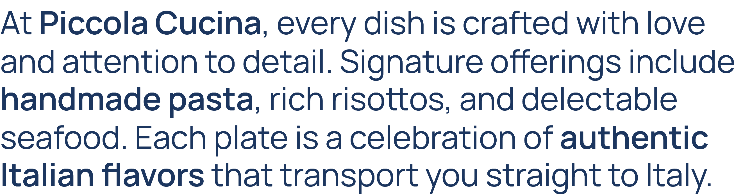
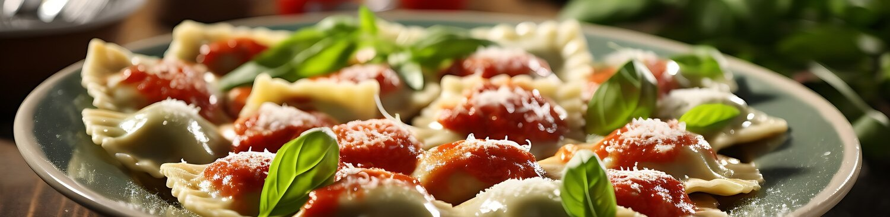
www.piccolacucifiagroup.com

Slide 5




www.piccolacucifiagroup.com

Slide 6



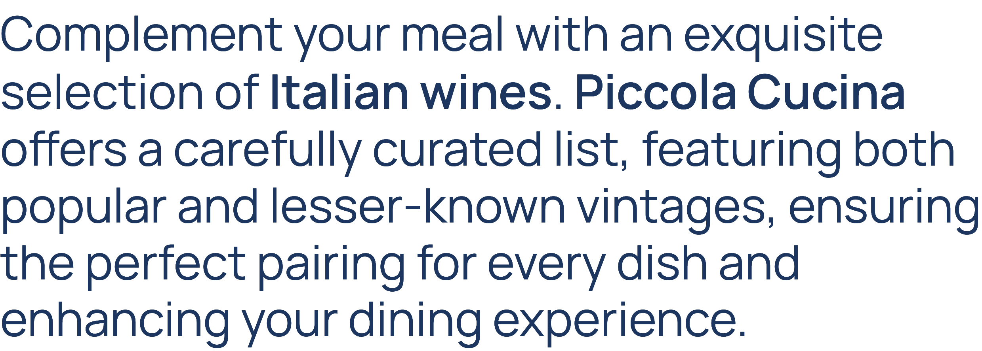
www.piccolacucifiagroup.com

Slide 7



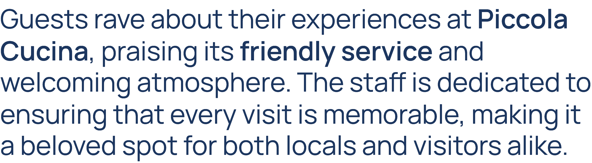
www.piccolacucifiagroup.com

Slide 8


www.piccolacucifiagroup.com

Slide 9

DO YOU HAVE ANY QUESTIONS?
info@piccolacucinagroup.com
(001) 929-295-0015
www.piccolacucinagroup.com 141 Nevins Street, Brooklyn, New York 11217, USA

