Slide 1




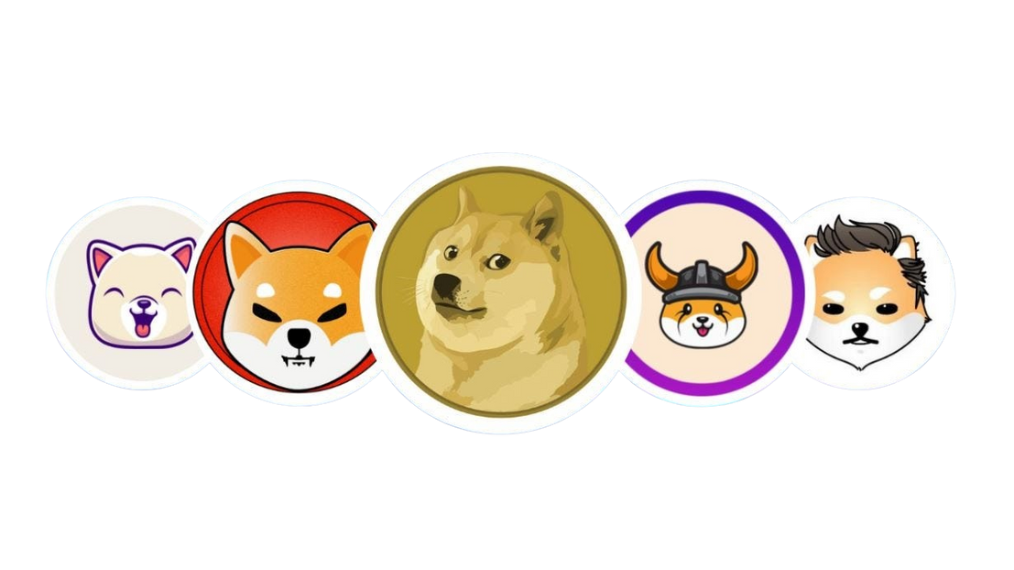

From Jokes to Generations: The Evolution of Meme Coins
www.blockchainx.tech

Slide 2
Introduction to Meme Coins
Meme coins are cryptocurrencies created for fun, often based on jokes or internet memes. They leverage viral marketing and community engagement to grow in popularity.
  Popular Meme Coins:
1.Dogecoin (DOGE): The first meme coin, born out of the viral "Doge" meme.
2.Shiba Inu (SHIB): Another popular meme coin, dubbed the "Dogecoin Killer."
3.PEPE: A rising meme coin inspired by the “Pepe the Frog” meme.
  Importance: Despite starting as jokes, meme coins have gained a significant following and market value. Their evolution shows the power of internet culture in driving financial assets, making it essential for anyone interested in cryptocurrency to understand how to launch your own meme coin and leverage these trends for success.

Slide 3
The Origins of Meme Coins
Dogecoin’s Birth (2013):
  Created by Billy Markus and Jackson Palmer as a parody of the rise of cryptocurrencies like Bitcoin.
  Based on the "Doge" meme, which features a Shiba Inu dog with comical captions in broken English.
  Purpose: The creators intended Dogecoin as a joke and a fun alternative to serious coins like Bitcoin. However, it quickly gained a community of supporters due to its fun and charitable nature.
  Early Adoption: Initially used for tipping online and small-scale charitable donations, the coin gained popularity for its friendly and welcoming community.

Slide 4
The Viral Nature of Meme Coins
  Viral Growth: Meme coins thrive on the internet, spreading through social media platforms like Reddit, Twitter, and TikTok. Their viral nature is often driven by meme culture, jokes, and celebrity endorsements.
Role of Communities:
  Strong communities are the backbone of meme coins. They rally around a shared joke, cause, or sense of identity.
  Reddit forums, such as r/Dogecoin, played a massive role in spreading awareness and pushing Dogecoin into mainstream conversations.
Notable Endorsements:
  Elon Musk: Tesla CEO Elon Musk’s tweets about Dogecoin played a crucial role in its viral growth, often causing massive price spikes.
  Other influencers and celebrities contributed to pushing meme coins into the public eye, fueling speculation and investor interest.

Slide 5
Turning Jokes into Valuable Assets
  Market Speculation: Meme coins have become speculative assets. While initially worth a fraction of a cent, their prices can explode due to viral moments or social media hype.
Dogecoin’s Rise in 2021:
  Dogecoin saw an unprecedented rise in 2021, reaching a market cap of over $80 billion at its peak. It surged from a meme to a top 10 cryptocurrency by market capitalization.
  This rapid growth was largely due to community-driven pumps, celebrity endorsements, and the "meme stock" frenzy.
Shiba Inu and Other Copycats:
  Following Dogecoin’s success, other meme coins like Shiba Inu (SHIB), SafeMoon, and Floki Inu appeared, each trying to replicate Dogecoin’s viral formula.
  Shiba Inu in particular has gained traction by branding itself as a "Dogecoin Killer" and building a strong community around its meme.

Slide 6
The Generational Shift in Cryptocurrency
  Appealing to Younger Generations: Meme coins, especially those like Dogecoin and Shiba Inu, resonate deeply with Gen Z and Millennials, who grew up in the age of internet memes and social media. They are drawn to the humor and accessibility of meme coins.
  Low Entry Barrier: Meme coins are often priced low, allowing younger and new investors to buy large quantities. This creates a sense of excitement and potential for high returns.
  Integration with Decentralized Finance (DeFi): Some meme coins have evolved beyond their original joke origins, integrating into DeFi ecosystems. For example, Shiba Inu offers staking, decentralized exchanges, and governance features, adding utility to the coin.

Slide 7
The Future of Meme Coins
  Community Power: Meme coins show the potential of strong community involvement. A loyal and engaged community can drive a cryptocurrency’s success, even if it started as a joke.
  Virality in Crypto: Branding, memes, and social media are crucial in spreading a coin's popularity. Meme coins illustrate how virality can outpace more "serious" projects with complex technology.
  Risk vs. Reward: Meme coins offer high-risk, high-reward opportunities. While some early investors made significant gains, others experienced large losses due to their volatile nature. Investors need to be cautious and informed.

Slide 8
Conclusion
  Summary: Meme coins started as jokes but evolved into a substantial part of the cryptocurrency ecosystem. They demonstrate how digital culture, community engagement, and social media can drive financial assets.
  Closing Thought: Meme coins are a unique blend of internet culture and financial speculation. As they continue to evolve, understanding how to launch your own meme coin could unlock opportunities to create viral digital assets, potentially shaping the future of finance.

Slide 9





Thank You!
Contact Us
+91 7708889555
contact@blockchainx.tech
www.blockchainx.tech

