Slide 1


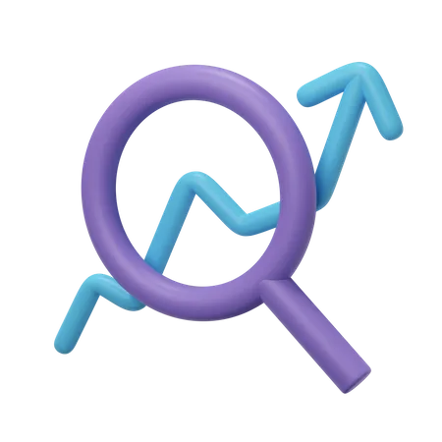


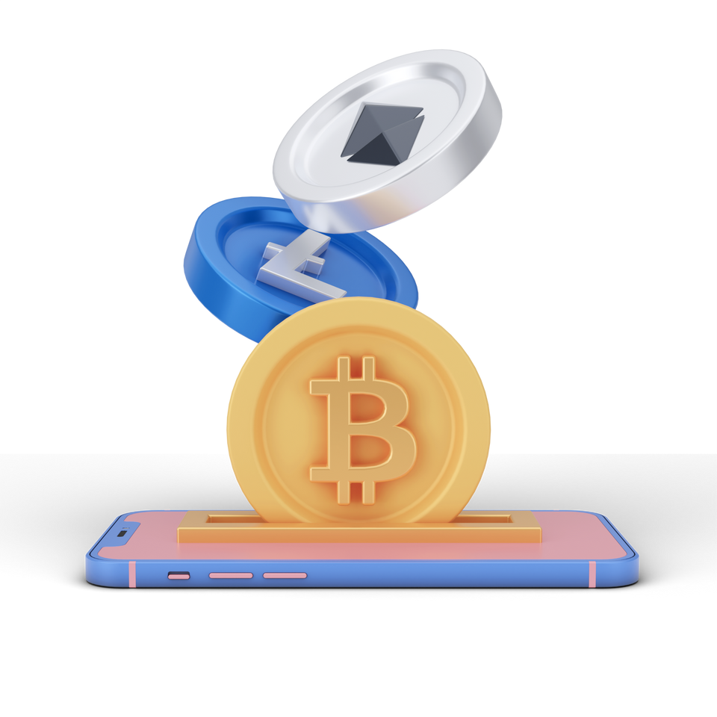

Top 5 Crypto Token Development Future Trends
https://www.blockchainx.tech/

Slide 2
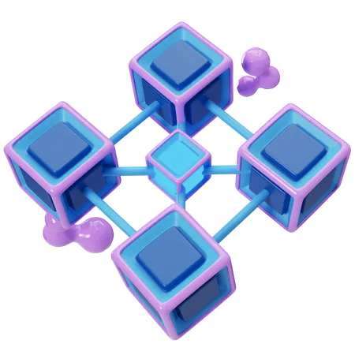
Crypto token development
Crypto token development includes the advent of virtual tokens based totally on the present blockchain era. These tokens can represent diverse belongings or utilities and are regularly used inside a particular surroundings. The development process consists of designing the token's features, inclusive of its application, supply mechanics, and protection protocols, followed through the real coding and deployment on a blockchain.
The improvement of crypto tokens is a complicated process that requires a deep knowledge of the blockchain era, smart contracts, and cryptographic safety features. Developers must additionally bear in mind the criminal and regulatory frameworks of the jurisdictions wherein the tokens could be supplied.

Slide 3

Top 5 Crypto token development future trends
Tokenization of Real-World Assets (RWA)
Cross-Chain Token Interoperability
Layer 2 Scaling Solutions and Rollups
Security Tokens and Regulatory Compliance
Decentralized Autonomous Organizations (DAOs)

Slide 4
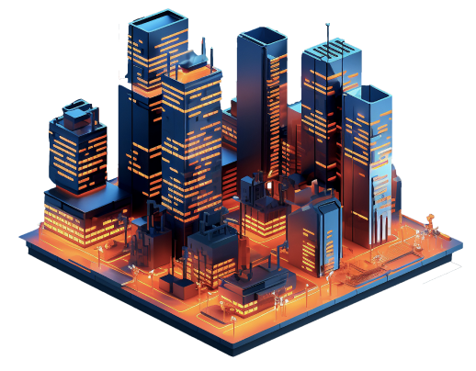
Tokenization of Real-World Assets (RWA)
  Real-World Assets Tokenization (RWA) method converting bodily assets like actual estate, art, or commodities into digital tokens on a blockchain.
  Each token represents a fraction of ownership in the asset. This makes it easier for people to buy, sell, or change parts of treasured property, despite the fact that they don’t have the cash to shop for the entirety.
  It additionally improves accessibility and liquidity, permitting extra human beings to take part in markets that had been formerly restricted to rich buyers.

Slide 5
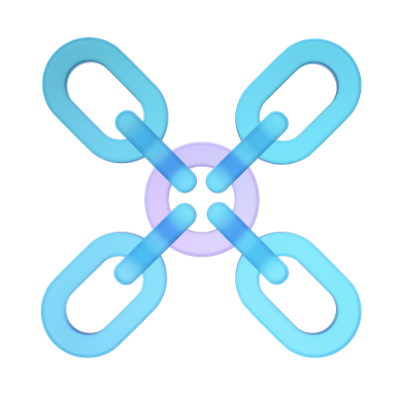
Cross-Chain Token Interoperability
  Cross-Chain Token Interoperability method the capability for crypto tokens to move and paintings across one of a kind blockchain networks. Normally, tokens are restrained to the blockchain they had been created on (like Ethereum or Binance).
  Interoperability lets in tokens be transferred among exclusive blockchains, making it less difficult for users to exchange, use, or have interaction with tokens throughout more than one structure.
  This enables improved flexibility and connects unique blockchain ecosystems, enabling smoother transactions and broader use of crypto property.

Slide 6

Layer 2 Scaling Solutions and Rollups
  Layer 2 Scaling Solutions and Rollups are strategies used to make blockchains faster and cheaper.
  Blockchains like Ethereum can come to be slow and high priced when too many humans use them. Layer 2 is like a "2d layer" constructed on the pinnacle of the primary blockchain. It handles many transactions off the principle network after which it sends a precise (or rollup) of those transactions back to the principle blockchain.
  This reduces congestion, lowers transaction prices, and hastens the manner, at the same time as still maintaining the safety of the main blockchain.

Slide 7
Security Tokens and Regulatory Compliance
  Security Tokens
Security Tokens are digital tokens that represent real-world economic property, like shares, bonds, or possession in an agency. They give traders rights like dividends or voting, much like conventional securities.
  Regulatory Compliance
Regulatory Compliance way following the laws and rules set with the aid of governments, mainly in finance. Since security tokens represent actual belongings, they should meet strict policies to guard traders and prevent fraud. This consists of things like verifying investor identities (KYC), following anti-cash laundering laws (AML), and adhering to securities legal guidelines. By complying with those rules, security tokens offer a safer, criminal manner to make investments through blockchain generation.

Slide 8
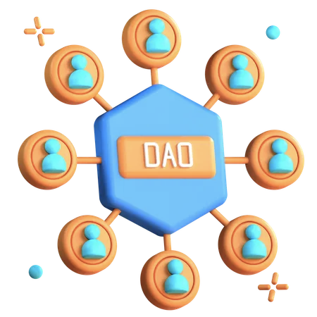
Decentralized Autonomous Organizations (DAOs)
  Decentralized Autonomous Organizations (DAOs) are organizations or companies that run themselves the use of rules encoded in laptop programs, called clever contracts, on a blockchain.
  Instead of getting a boss or relevant leader, DAOs are controlled by their members, who use tokens to vote on decisions like how money ought to be spent or what tasks to aid.
  Everything is obvious and runs mechanically primarily based on the agreed regulations, which allows for fairness and decentralization.
  This lets in humans from around the arena to collaborate and make selections without needing to agree with a central authority.

Slide 9

Thank You!
Get In Touch
With us
Contact@blockchainx.tech

