Slide 1


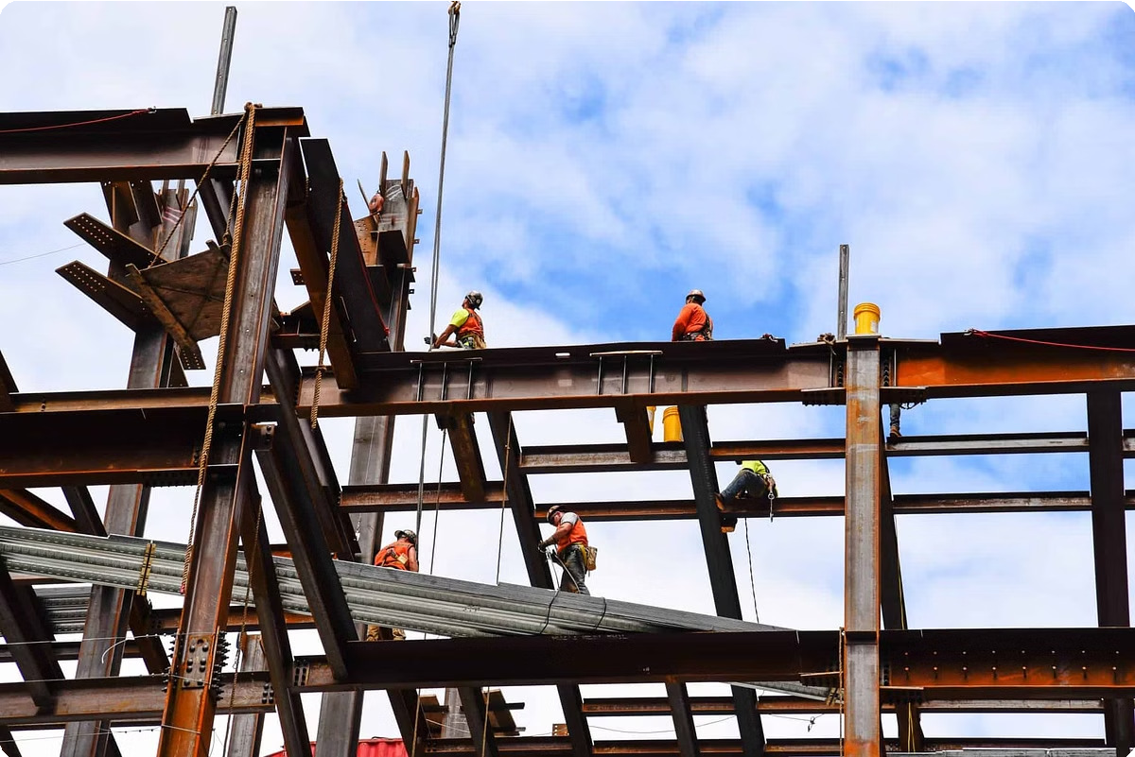
Looking for a Trusted Steel Structure
Supplier in Saudi Arabia?
Find the right partner for your next project. Matco Industry is a leading provider of steel structure solutions in Saudi Arabia. We offer comprehensive services, from design and engineering to fabrication and erection.

Slide 2

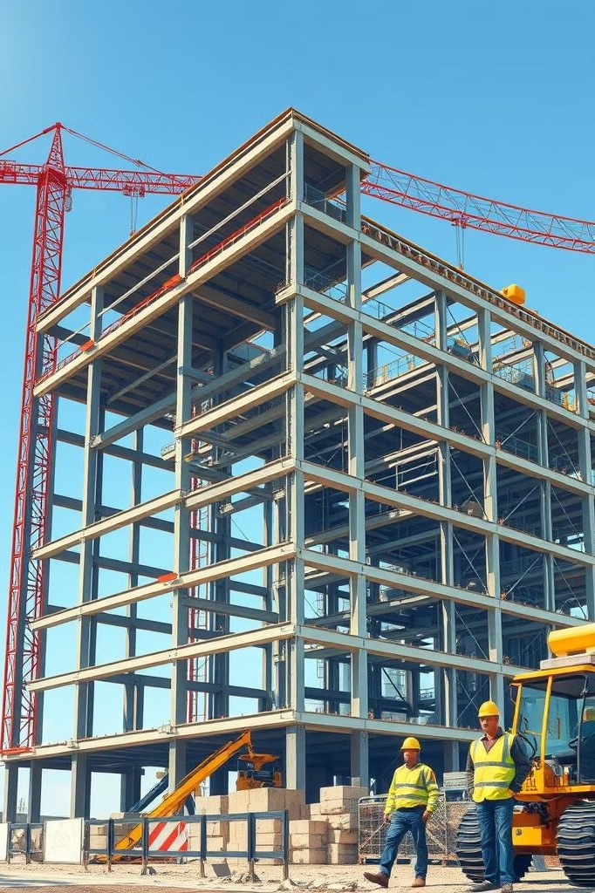
Introducing Matco Industry
Experienced Professionals
Our team of highly skilled engineers and technicians brings years of experience to every project. We use advanced technology and industry best practices to ensure the highest quality results.
Client-Focused Approach
We work closely with our clients to understand their needs and goals. We strive to provide solutions that are tailored to their specific requirements and budget.

Slide 3

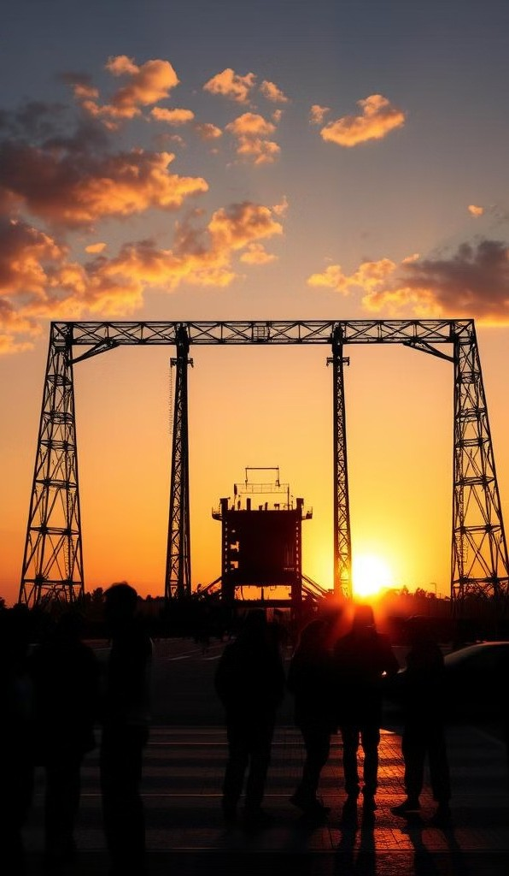

Specializing in Steel Structure Erection
1
Commercial Projects
We have a proven track record of successfully completing large-scale commercial projects, such as shopping malls, office buildings, and industrial facilities.
2
Industrial Facilities
From warehouses to manufacturing plants, our expertise extends to industrial projects of all sizes, ensuring optimal functionality and safety.
3
Residential Projects
We also specialize in residential projects, including custom homes, multi- family units, and gated communities, offering durable and aesthetically pleasing structures.

Slide 4

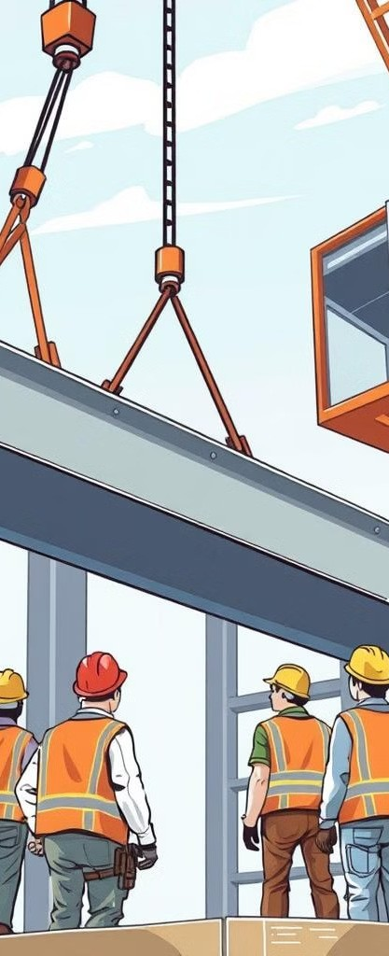
Commitment to Safety and Precision
1
Planning and Design
Our engineers meticulously plan and design each project, taking into account safety regulations and site conditions to ensure a secure construction process.
2
Fabrication
Our team uses state-of-the-art fabrication equipment to produce high-quality steel components that meet the highest industry standards.
3
Erection and Installation
Experienced crews carefully erect and install the Steel structure erection in Saudi Arabia , ensuring precision and adherence to safety protocols throughout the process.
4
Quality Control
We implement rigorous quality control measures at every stage of the project, from material sourcing to final inspection, guaranteeing the structural integrity and durability of your investment.

Slide 5
Durable Solutions for All Projects
Corrosion Resistance
We use high-quality steel that is treated to resist corrosion, ensuring long-lasting performance even in harsh environments.
Seismic Resistance
Our steel structure supplier in Saudi
Fire Resistance
We offer a range of fire-resistant coatings and treatments to protect your steel structures from fire damage, meeting building codes and regulations.
Arabia are designed to withstand seismic activity, providing peace of mind and ensuring the safety of your investment.

Slide 6


Years of Experience in the Industry
Industry Knowledge
1
We have a deep understanding of the latest industry trends and technologies, enabling us to provide innovative and efficient solutions.
Proven Track Record
Our portfolio showcases a wide range of successful projects, demonstrating our expertise and commitment to quality.
2
Client Satisfaction
We are proud of our strong track record of client satisfaction, building long-term relationships based on trust and reliability.
3

Slide 7

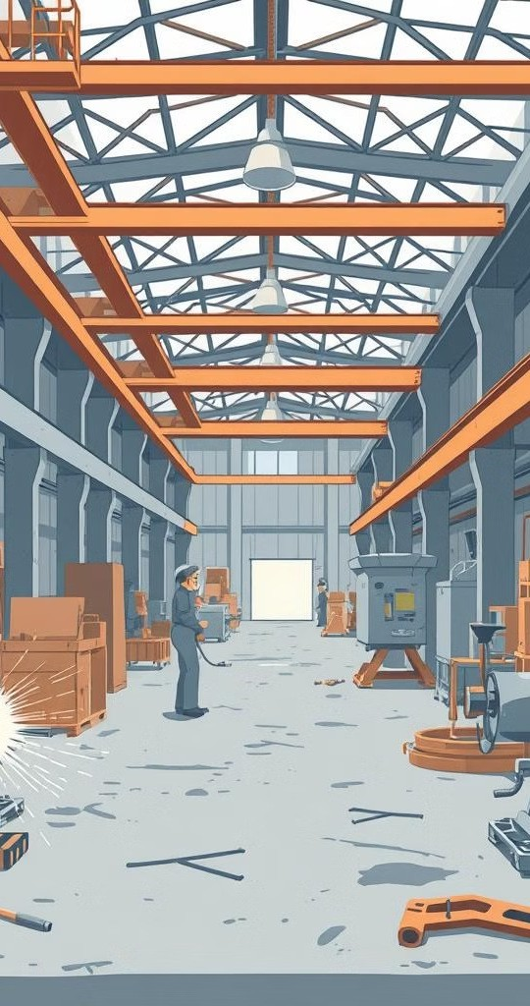
Quality Materials and Expertise
Material Sourcing
We source our steel from reputable suppliers who meet our stringent quality standards, ensuring the highest quality and durability.
Fabrication Expertise
Our skilled fabricators utilize state-of-the-art technology and techniques to produce precise and durable steel components.
Project Management
Our experienced project managers oversee every step of the process, ensuring timely completion and adherence to budget and specifications.

Slide 8

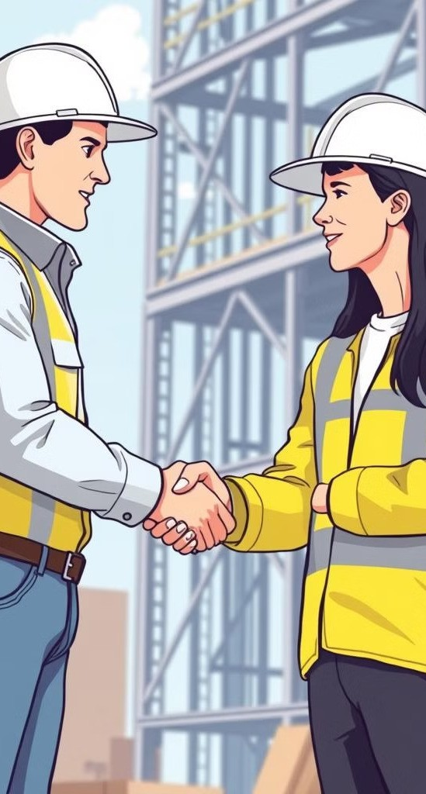
Why Choose Matco Industry?
Reliable Partner
We are committed to providing our clients with reliable and trustworthy service, building strong relationships based on mutual respect.
Exceptional Quality
We strive for excellence in every aspect of our work, delivering high- quality steel structures that meet the highest standards.
Timely Completion
We understand the importance of meeting deadlines and work diligently to ensure that your project is completed on time and within budget.
Comprehensive Services
We offer a comprehensive range of services, from design and engineering to fabrication and erection, providing a one-stop solution for your steel structure needs.

Slide 9
Contact Us-
Call-+971501922352
Website-www.matcoindustry.com
Address-Plot no 8 , Block 6, Sector 711, New Industrial Area Umm Al Quwain, UAE

