Slide 1
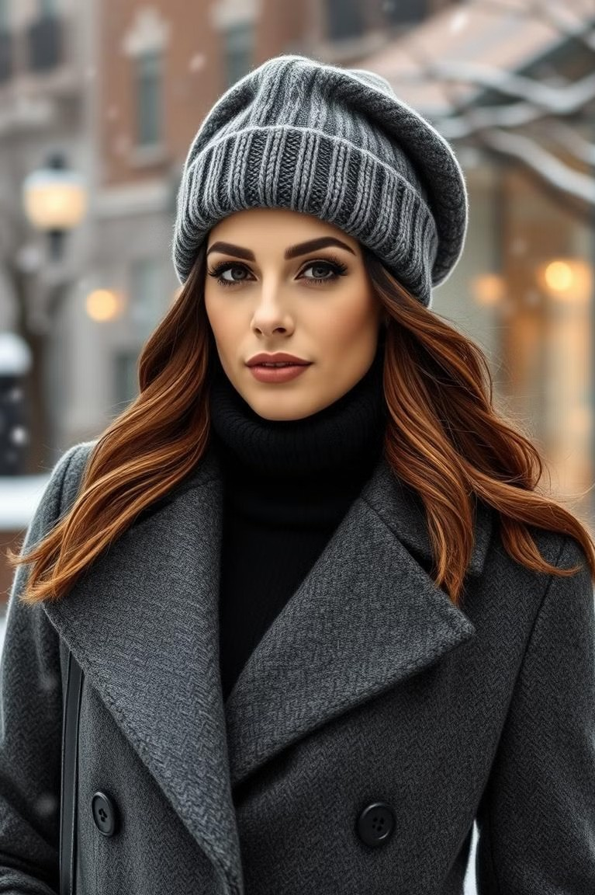
Elevate Your Elegance with Our Cashmere Hats
Discover the exquisite craftsmanship and unparalleled comfort of our collection of cashmere and wool hats. Whether you're braving the winter elements or adding a touch of sophistication to your everyday style, our hats are designed to keep you warm and stylish.

Slide 2
Introducing the Kaschmirmütze: The Softer Side of Headwear
Traditional Cashmere Hat
While comfortable, traditional cashmere hats can sometimes feel heavy and itchy for some people.
The Kaschmirmütze
The Kaschmirmütze offers a lighter, softer alternative, ensuring comfort without sacrificing warmth or style.

Slide 3
Cashmere's Luxurious Touch: Comfort Without Compromise
Exceptional Softness
Cashmere fibers are incredibly fine and soft, making it exceptionally gentle on the skin.
Natural Insulation
Cashmere provides excellent thermal insulation, keeping you warm even in the coldest weather.
Lightweight Comfort
Despite its warmth, cashmere is remarkably lightweight, making it comfortable to wear for extended periods.

Slide 4
Staying Warm in Style: The Benefits of Cashmere Hats
Exceptional Warmth
Cashmere's natural fibers provide exceptional warmth and insulation, keeping you comfortable even in frigid temperatures.
Luxurious Comfort
The softness of cashmere against your skin creates a luxurious feel, making it a pleasure to wear.
Lightweight Design
Despite its warmth, cashmere hats are remarkably lightweight, preventing any discomfort or bulkiness.

Slide 5
Versatility of the Kaschmirmütze: From Trekking to Strolling
Outdoor Adventures
The Kaschmirmütze is perfect for winter trekking, providing warmth and comfort while you explore the mountains.
Everyday Style
Wear your Kaschmirmütze for a casual stroll around town, adding a touch of warmth and elegance to your winter wardrobe.

Slide 6
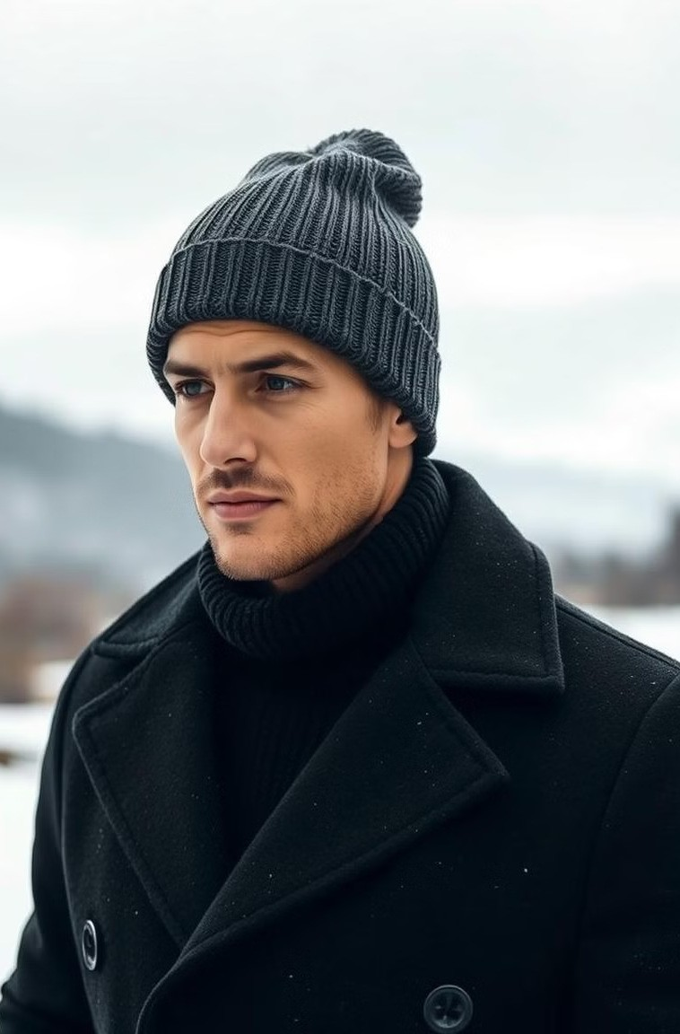
Wollmütze: The Perfect Winter Accessory
Warmth and Durability
Wool hats are known for their exceptional warmth and durability, making them ideal for harsh winter conditions.
Moisture-Wicking Properties
Wool naturally wicks away moisture, keeping your head dry and comfortable even when you're sweating.
Stylish Variety
Wollmützen come in a wide range of styles and colors, allowing you to express your personal style while staying warm.

Slide 7
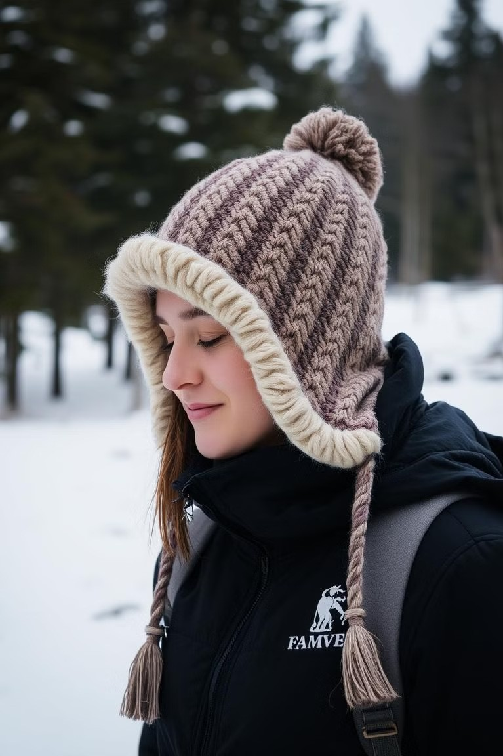
Wool Hats for All-Day Warmth and Durability
Exceptional Warmth
Wool's natural fibers provide exceptional warmth and insulation.
Moisture-Wicking Properties
Wool naturally wicks away moisture, keeping your head dry and comfortable.
Durable and Long-Lasting
Wool hats are known for their durability and longevity.

Slide 8
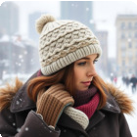
Complementing Your Winter Wardrobe with Cashmere and Wool
Casual Chic
Pair a cashmere beanie with your favorite jeans and a cozy sweater for a relaxed yet stylish winter look.
Smart Casual
Elevate your everyday outfit with a wool fedora, a chunky knit scarf, and a stylish winter coat.
Formal Elegance
Complete your formal winter attire with a cashmere beret, a tailored coat, and a sophisticated scarf for a touch of refined elegance.

Slide 9
Choosing the Right Fit: Ensuring Comfort and Style
Kaschmirmütze
A snug fit is key for warmth and comfort. Measure your head circumference and choose a size that fits comfortably without being too tight or loose.
Wollmütze
Wool hats are often available in a variety of sizes. Choose a size that allows for a comfortable fit without feeling too snug or loose.

Slide 10
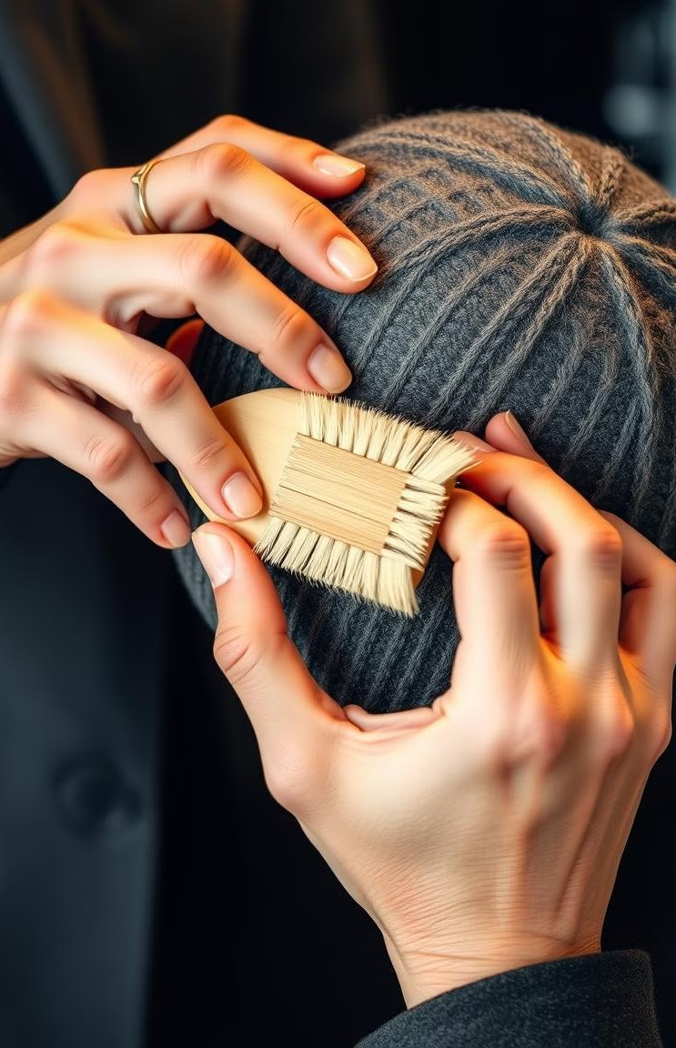
Caring for Your Kaschmirmütze and Wollmütze: Longevity and Luxury
Gentle Handwashing
1
Handwash cashmere and wool hats in cool water with a mild detergent.
2
Air Dry
Gently squeeze out excess water and lay flat to air dry.
Avoid Direct Heat
Do not dry in a dryer or expose to direct sunlight, which can damage the fibers.
3
4
Store Carefully
Store your hat in a dry place, preferably in a breathable bag, to maintain its shape and prevent dust.

Slide 11
Know more About Yanopurna
Geschäft für handgefertigte & nachhaltige Kaschmirprodukte | Yanopurna
Address: Schwentinestraße 18 , 22851 Norderstedt
Email: info@yanopurna.de
Telephone: (004)915236108939

