Slide 1
Exploring the Benefits of International Education: A Focus on Pune's International Schools

Slide 2
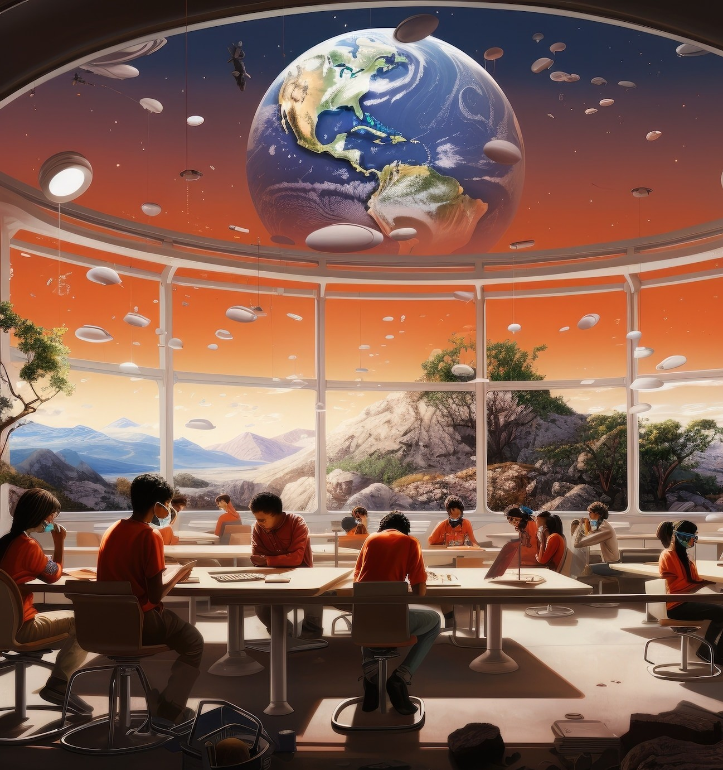
Introduction to International Education
International education oers students opportunities to learn in a global context. This presentation explores the beneﬁts of such education, particularly focusing on the international schools in Pune.
These institutions not only enhance academic knowledge but also promote cultural understanding and
personal growth.

Slide 3
Cultural Diversity in Schools
One of the key beneﬁts of international education is the exposure to cultural diversity. Students learn to appreciate dierent perspectives, traditions, and languages, fostering a sense of global citizenship. This diversity enriches the educational experience and prepares students for a connected world.

Slide 4
Enhanced Language Skills
International schools often emphasize bilingualism or multilingualism. Students gain proﬁciency in multiple languages, which is a crucial skill in today’s global job market. This linguistic advantage not only boosts communication skills but also enhances cognitive abilities.

Slide 5
Global Networking Opportunities
Studying in international schools provides students with valuable networking opportunities. They connect with peers from around the world, which can lead to future collaborations and friendships.
These relationships often extend beyond
school, beneﬁting students in their personal and professional lives.

Slide 6
Personal Development and Confidence
International education encourages personal development by challenging students to step out of their comfort zones. This experience builds conﬁdence and resilience, essential traits for navigating the complexities of global citizenship and future career paths.

Slide 7
Conclusion: The Future of Education
In conclusion, international education oers numerous beneﬁts that extend beyond academics. Schools in Pune are paving the way for a globalized future, equipping students with the skills needed to thrive in an interconnected world. Embracing this education model is crucial for personal and societal growth.

Slide 8
Thanks!

