Slide 1

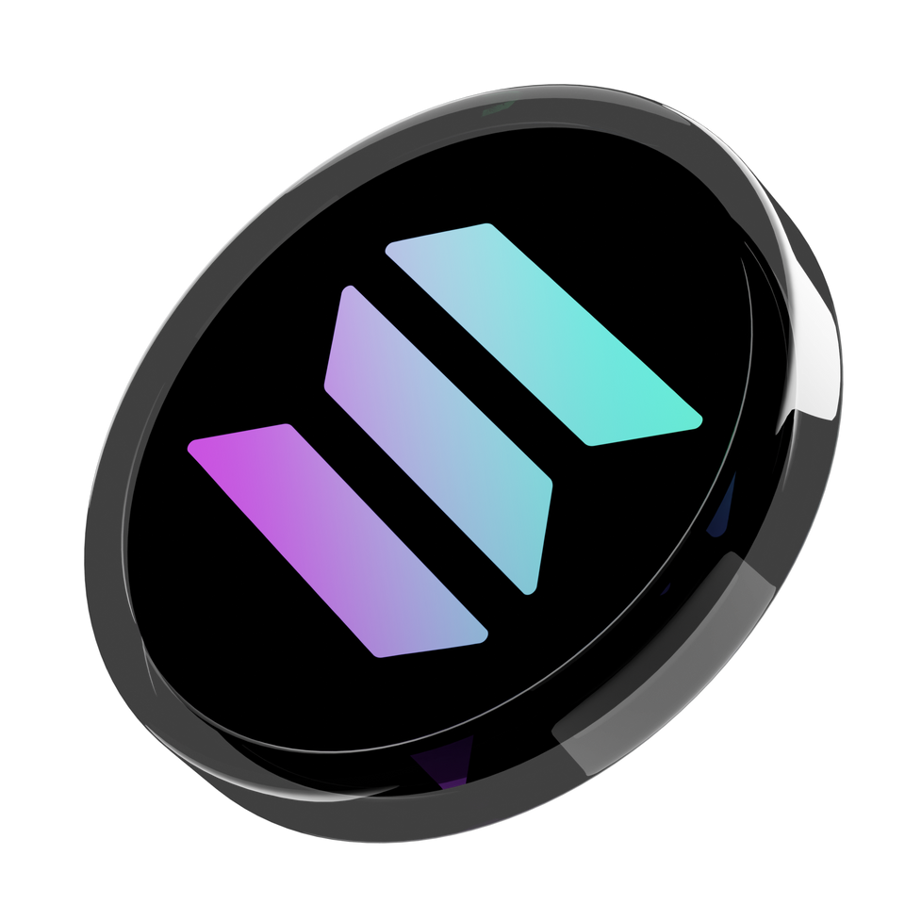
Creating Meme Coin on Solana
Step by Step

Slide 2
1
Creating Meme Coin on Solana
The Solana blockchain, which is praised for its high transaction speeds and efficiency, constitutes a sturdy base for creators and businessmen to realize their token dreams.
Even though there are various ways of create solana meme coin each having its own set of intricacies and technical settings, this text centers on an easy and uncomplicated approach.

Slide 3
2
Step 1: Create Your SPL Token
  Process Initiation: To initiate this procedure of creating a new token, go to FluxBeam’s toolkit page.
  Wallet Connection: This is a vital step to link your new token with its wallet.
  Token Definition: Provide necessary information like Token Name, Token Symbol and Decimals. For normal tokens, use 9 decimals while if it is for whitelist tokens use 0.
  Add Information: Write a description and upload an image for your token.
  Amount Specification: Decide on how many total tokens there will be.
  Token Creation: Click on the “Create Token” button and approve the operation afterwards. One needs about 0.01 SOL as a service fee.

Slide 4
3
Step 3:
Revoke Mint & Freeze Authority
One way of ensuring security and trust particularly when creating an LP is to have to revoke the mint and freeze permissions.
  Access Token Tool: Visit a token maker website or app and link up your wallet.
  Select Your Token: Choose the option of the token that you have newly created and take away the right of minting or freezing.

Slide 5
4
Step:3
Generate Yours Market ID on OpenBook
To have a fair exchange of your money you have to create an ID for the market.
  OpenBook’s tools: go to OpenBook’s market-creation site
  Fill in the fields: Input Mint Address of your token, the pairing token (similar to USDC or SOL) and specify market parameters like minimum order size and price tick.
  Generate Market ID: Follow through to make your market ID that will be used in order for a liquidity pool to be generated.

Slide 6
5
Step 4:
Create a Liquidity Pool on Raydium
Liquidity pools are vital for token exchange.
  Head to Raydium: Go to the page for creating liquidity on Raydium’s website.
  Connect Wallet & input Market ID: Once you have connected your wallet, enter the ID of the market that you desire to trade in.
  Set up the Pool: Choose your base and quote tokens and set up the liquidity pool. Approve this transaction on your wallet.

