Slide 1
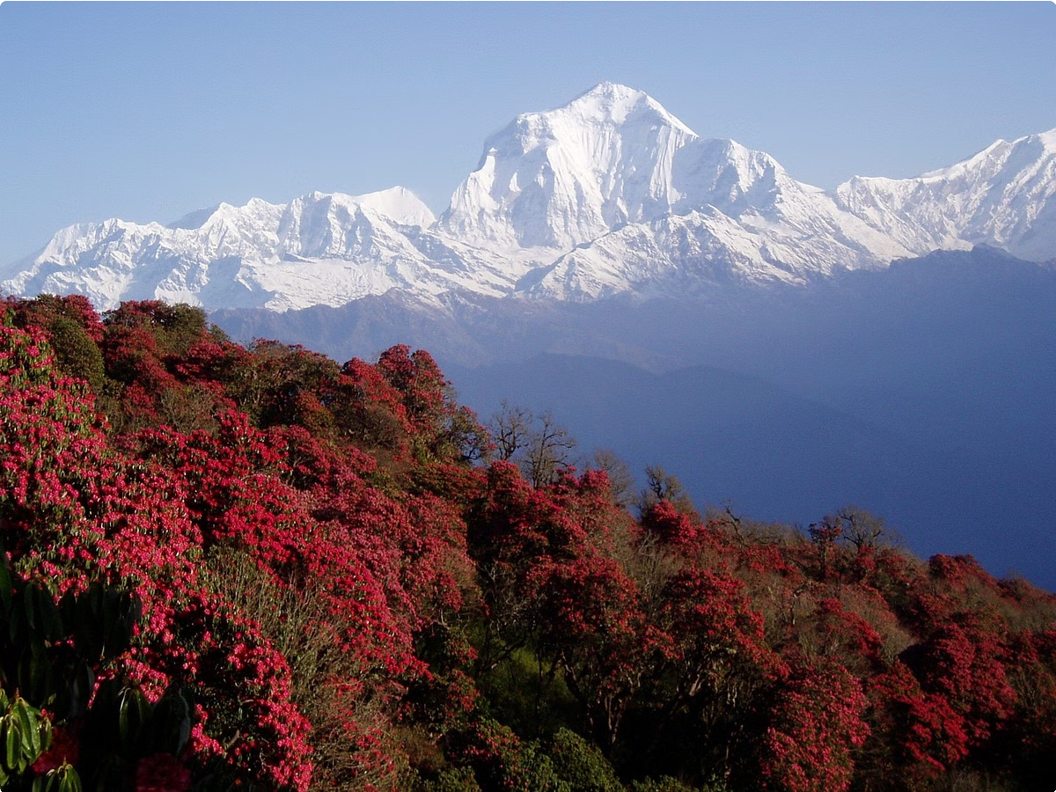
Our Cashmere Products
Our cashmere products come from the stunning Himalayan region of Nepal. There, in the majestic mountains, you will find the home of the cashmere goats that provide one of the most precious and softest fibers in the world - cashmere wool.

Slide 2
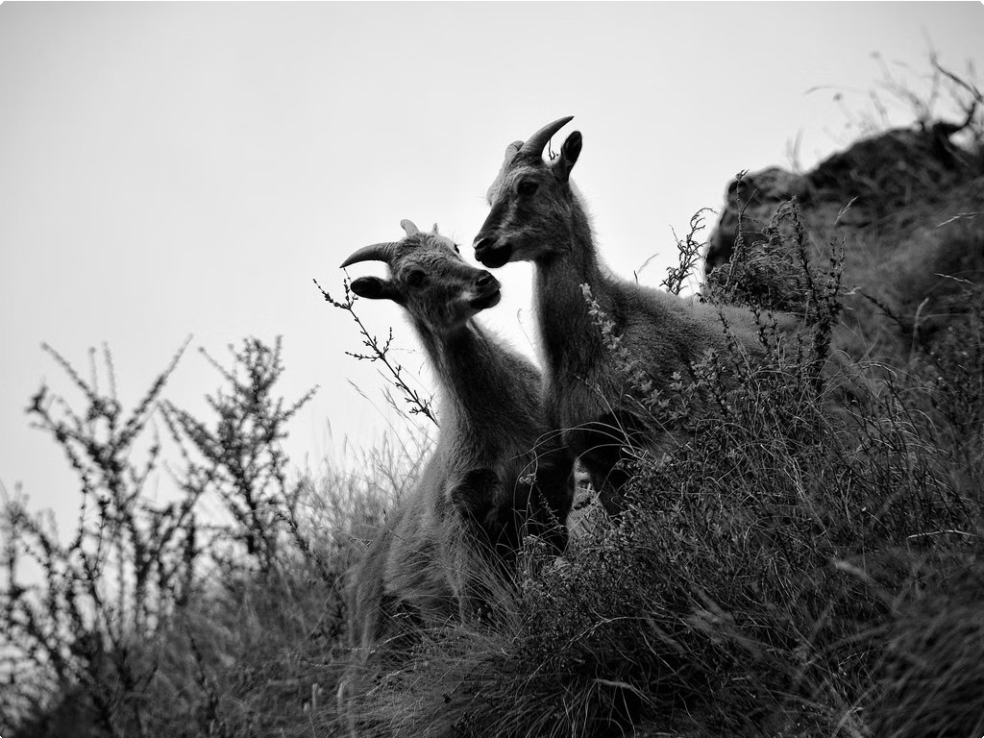
The Himalayan Region of Nepal
1
Majestic Mountains
The Himalayan mountains in Nepal boast some of the highest peaks in the world, creating a breathtaking landscape.
2
Diverse Ecosystems
From lush valleys to alpine meadows, the Himalayan region is home to a wide variety of plant and animal life.
3
Rich Cultural Heritage
The people of Nepal have a long history of living in harmony with the Himalayas, developing unique traditions and practices.

Slide 3
The Cashmere Goats
Hardy Creatures
Gentle Temperament
Precious Fiber
Cashmere goats are well-adapted to the harsh Himalayan climate, with a thick, soft undercoat that protects them from the elements.
These goats are known for their calm and gentle nature, making them easy to care for by the local herders.
The fine, downy cashmere fiber from these goats is prized for its exceptional softness and warmth.

Slide 4
The Precious Cashmere Fiber
Exceptional Quality
Cashmere is renowned for its unparalleled softness, lightness, and durability, making it a highly coveted textile fiber.
Sustainable Harvest
The cashmere fiber is carefully harvested from the goats, ensuring a responsible and eco-friendly production process.
Meticulous Processing
The raw cashmere fiber undergoes a multi-step cleaning and sorting process to remove impurities and ensure consistent quality.
Luxury Textile
The final cashmere product is a luxurious, high-end textile that is highly sought after for its unparalleled softness and warmth.

Slide 5
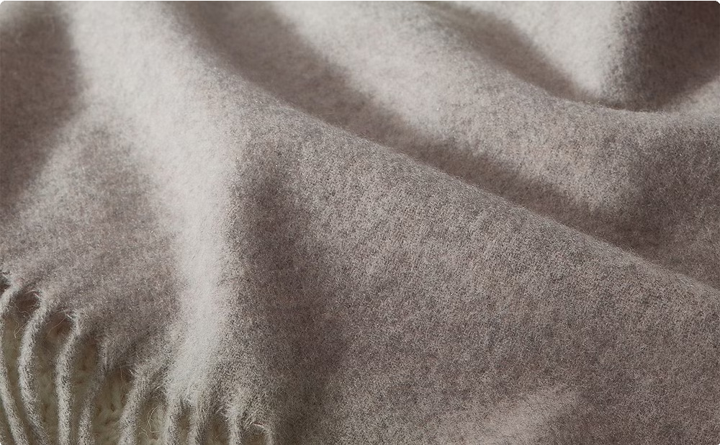
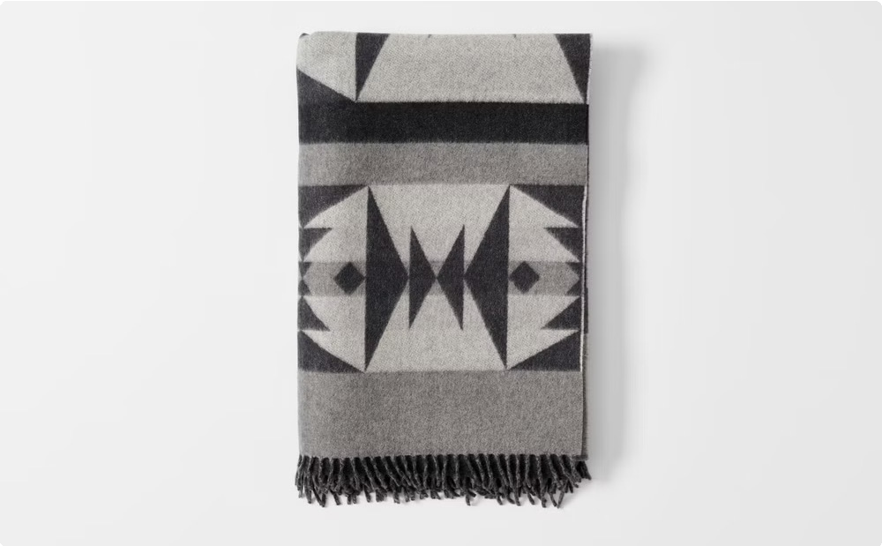
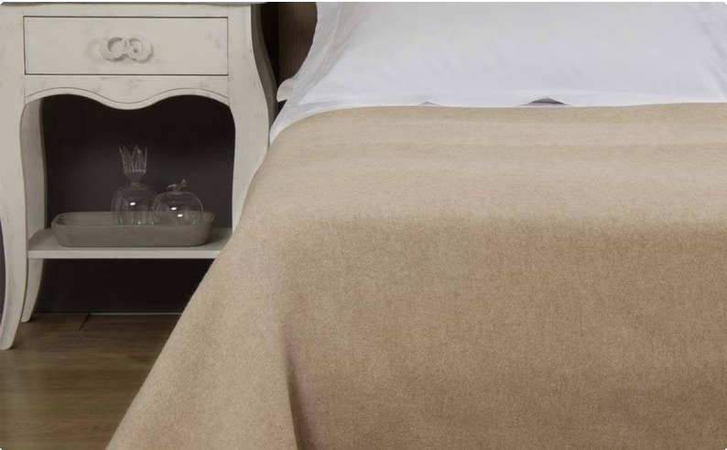
Kaschmirdecke
Exquisite Craftsmanship
Our Kaschmirdecke, or cashmere blanket, is meticulously handwoven by skilled artisans using the finest cashmere fibers.
Unparalleled Softness
The Kaschmirdecke is renowned for its incredible softness and luxurious feel, making it a true indulgence.
Cozy Comfort
Wrap yourself in the warmth and comfort of our Kaschmirdecke, perfect for relaxing at home or traveling.

Slide 6
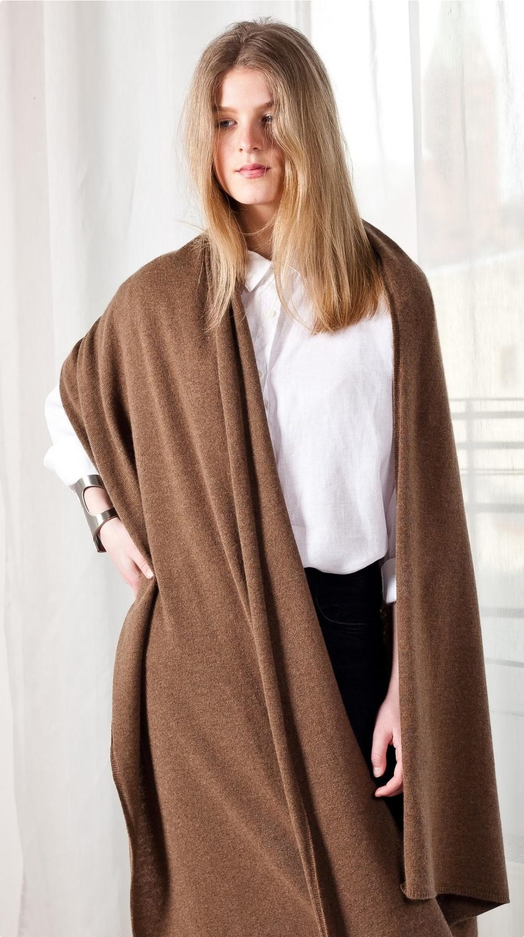
Kaschmirschal
Exceptional Warmth
The Kaschmirschal, or cashmere scarf, provides unparalleled warmth and insulation, perfect for cold weather.
Exquisite Softness
Crafted from the finest cashmere fibers, the Kaschmirschal is incredibly soft and luxurious to the touch.
Versatile Style
Our Kaschmirschal can be worn in a variety of ways, making it a timeless and versatile accessory.

Slide 7
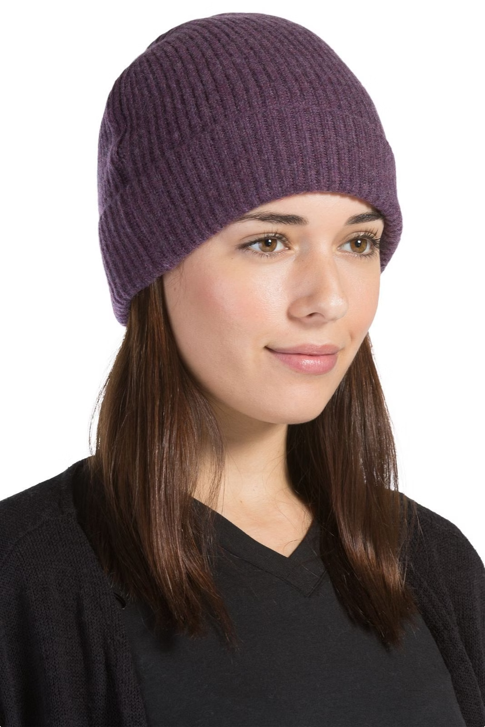
Kaschmirmütze
Exceptional Warmth
The Kaschmirmütze, or cashmere hat, provides unparalleled warmth and insulation, perfect for cold weather.
1
Luxurious Softness
Crafted from the finest cashmere fibers, the Kaschmirmütze is incredibly soft and comfortable to wear.
2
Timeless Style
Our Kaschmirmütze is a classic accessory that adds a touch of elegance to any outfit.
3

Slide 8
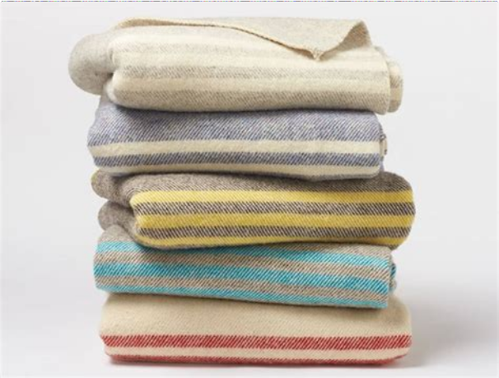
Wolldecke
Material | 100% Wool
Warmth | Excellent insulation and thermal regulation
Durability | Highly durable and long-lasting
Softness | Soft and comfortable against the skin
Care | Easy to maintain and machine washable

Slide 9
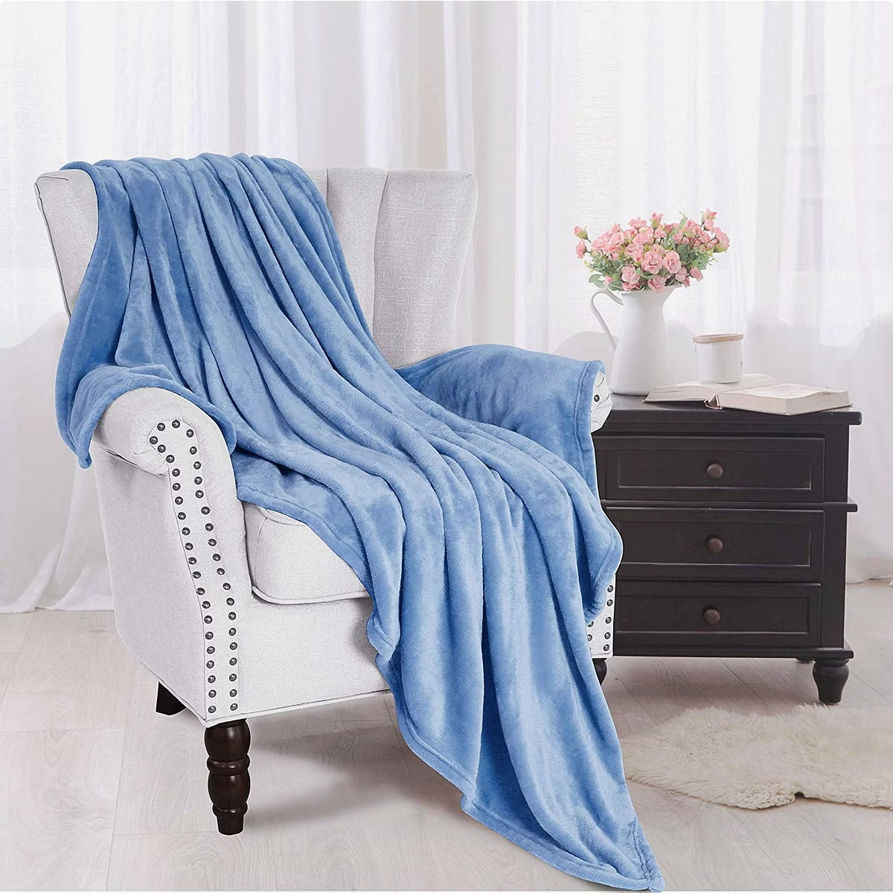
Kuscheldecke
1
Snuggle In
Wrap yourself in the soft and comforting embrace of our
Kuscheldecke.
2
Relax and Unwind
The Kuscheldecke is the perfect companion for a cozy night in, whether you're reading, watching a movie, or just relaxing.
3
Luxurious Comfort
Sink into the plush, luxurious fabric of the Kuscheldecke and experience unparalleled comfort and warmth.

Slide 10
Sofadecke
Versatile Use
Luxurious Fabric
Effortless Style
Our Sofadecke can be used as a throw blanket, a cozy cover for your sofa, or even a comforter on your bed.
Crafted from the finest materials, the Sofadecke is soft, durable, and adds a touch of elegance to any room.
The Sofadecke is the perfect way to add a cozy, inviting ambiance to your living space.

Slide 11
Mehr über uns:-
Besuchen Sie unsere Website: Yanopurna
Address: Schwentinestrasse 18, 22851 Norderstedt
E-Mail: info@yanopurna.de
Telefon: 004915236108939

