Slide 1
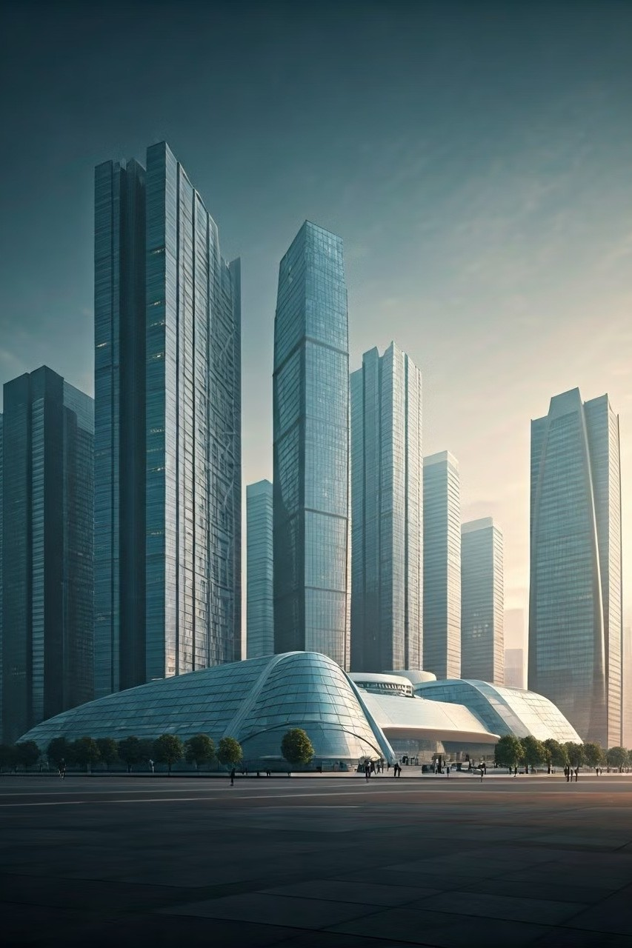

The Rise of Sustainable Building
Materials
Sustainable building materials offer a compelling alternative to traditional construction methods, prioritizing environmental responsibility without compromising durability. From PVC Eco Fencing to steel structures in Saudi Arabia, the industry is embracing innovations that balance sustainability with performance.

Slide 2
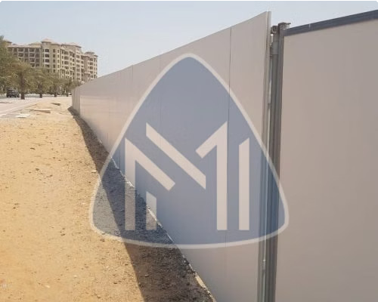
PVC Eco Fencing: An Eco-Friendly Boundary Solution
Environmentally Friendly
PVC Eco Fencing is a sustainable and eco-conscious choice, minimizing environmental impact by utilizing recycled materials and reducing greenhouse gas emissions.
Durability and Longevity
PVC Eco Fencing is resistant to weather elements, insects, and decay, ensuring a long lifespan and reducing the need for frequent replacements.
Aesthetic Versatility
PVC Eco Fencing comes in various styles, colors, and textures, allowing homeowners to create aesthetically pleasing and functional boundaries that complement their landscapes.

Slide 3
Steel Construction in Saudi Arabia: Strength and Reliability
High Strength and Durability
Steel's inherent strength and durability make it ideal for Saudi Arabia's ambitious infrastructure projects, ensuring structures can withstand extreme weather conditions and seismic activity.
Versatility and Design Flexibility
Steel's versatility allows for intricate designs and complex structures, enabling architects and engineers to create iconic landmarks and functional buildings that meet specific needs.
Cost-Effectiveness and Efficiency
Steel construction in saudi arabia often leads to faster construction times and reduced labor costs due to its prefabrication capabilities, making it a cost-effective choice for large-scale projects.

Slide 4
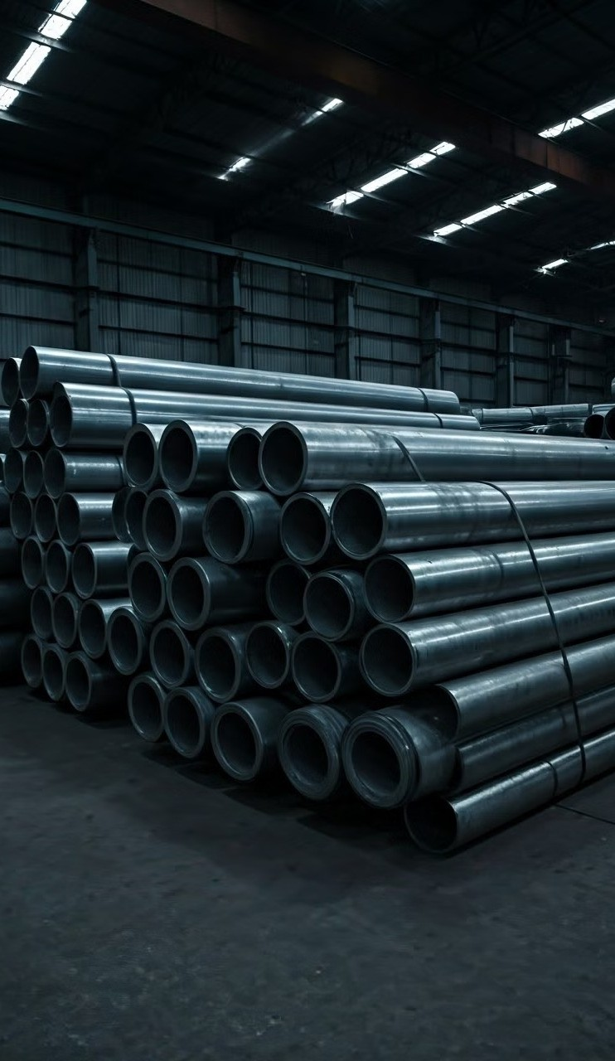
Pipe and Tube in Dubai: Essential for Industrial and Infrastructure Growth
1
Water Supply
High-quality pipes and tubes are crucial for efficient water distribution networks, ensuring access to clean water for Dubai's expanding population and industries.
2
Oil and Gas Industry
The region's booming oil and gas industry relies heavily on robust and reliable pipe systems for transportation and processing of hydrocarbons.
3
Infrastructure Development
Pipes and tubes In Dubai are essential components of infrastructure projects, including transportation, energy, and telecommunications, enabling seamless connectivity and growth.

Slide 5
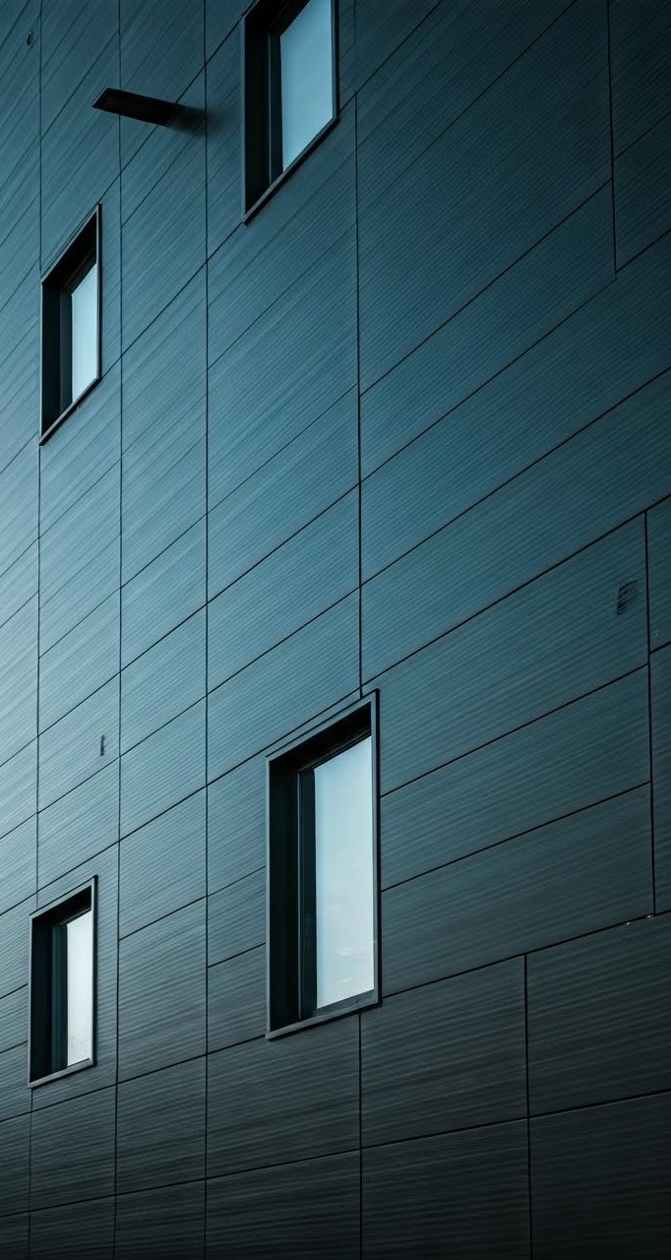
Durability and Longevity of Modern Building Materials
1
Advanced Manufacturing Processes
Modern building materials are produced using sophisticated manufacturing processes, ensuring consistent quality, high performance, and extended lifespans.
2
Innovative Material Blends
New material blends, combining the strengths of different elements, create robust materials that offer superior durability, strength, and resistance to wear and tear.
3
Enhanced Durability Features
Many modern materials incorporate features that enhance durability, such as corrosion resistance, UV protection, and fire retardants.

Slide 6
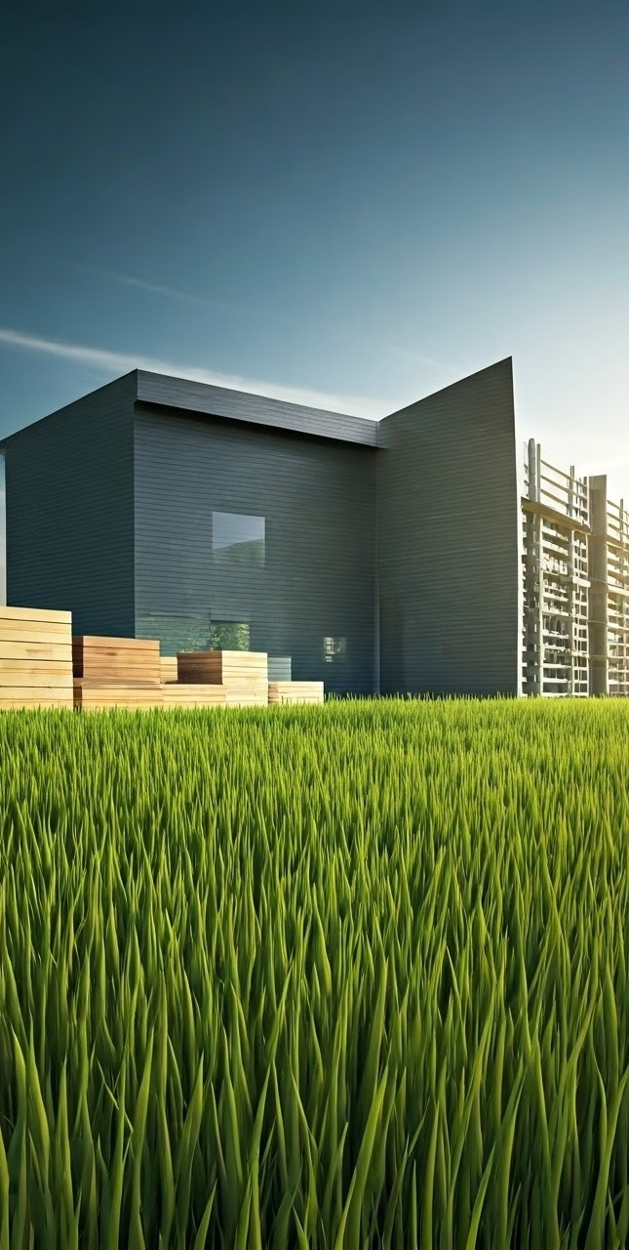
Eco-Friendly Alternatives to Traditional Building Products
Bamboo
A rapidly renewable resource, bamboo offers a lightweight and
1
sustainable alternative to traditional timber, reducing deforestation and promoting ecological balance.
Recycled Materials
Reusing and repurposing materials, such as recycled plastics and glass, reduces waste and minimizes the environmental impact of construction.
2
Bio-Based Materials
Bio-based materials derived from renewable sources, such as hemp and flax, offer eco-friendly alternatives to traditional building materials, promoting sustainable construction practices.
3

Slide 7
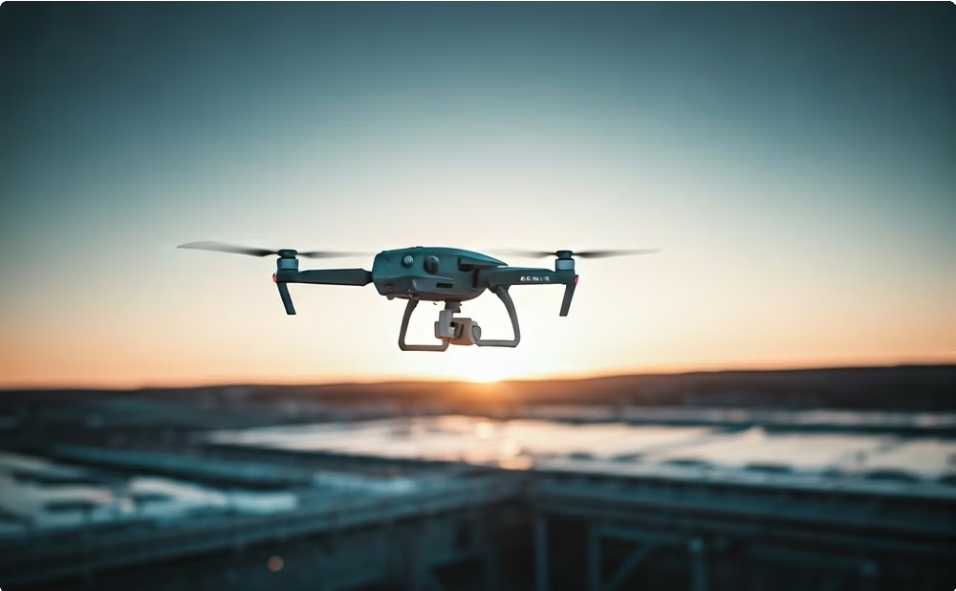
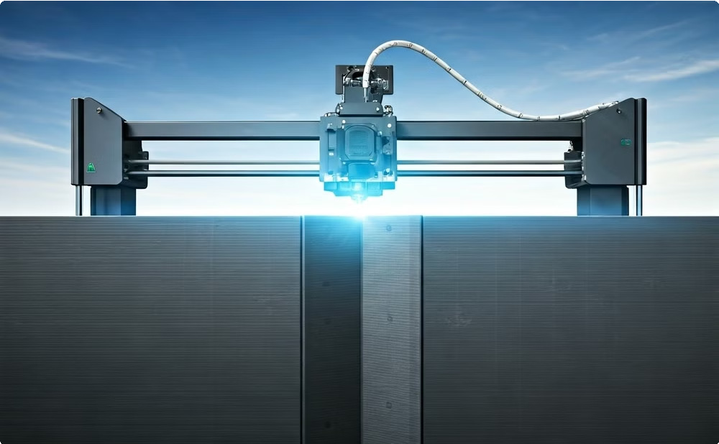
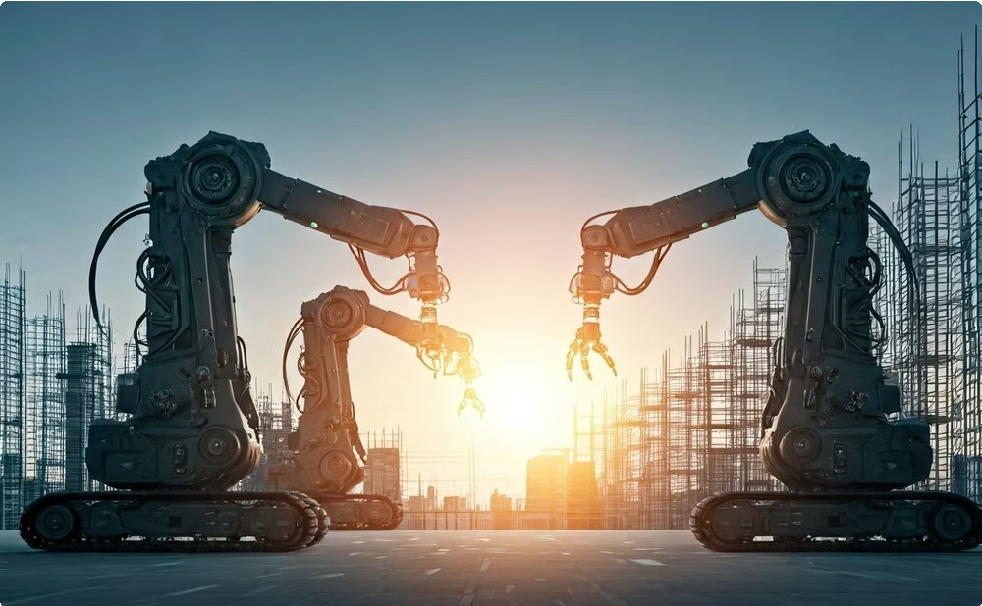
Advancements in Construction Technology and Materials
Drone Technology
Drones are used for site inspections, surveying, and aerial photography, providing valuable insights and accelerating construction processes.
3D Printing
3D printing technology is revolutionizing construction by enabling the creation of complex and intricate designs with precision and efficiency.
Robotics
Robots are being employed to perform repetitive and dangerous tasks, improving safety, efficiency, and productivity on construction sites.

Slide 8
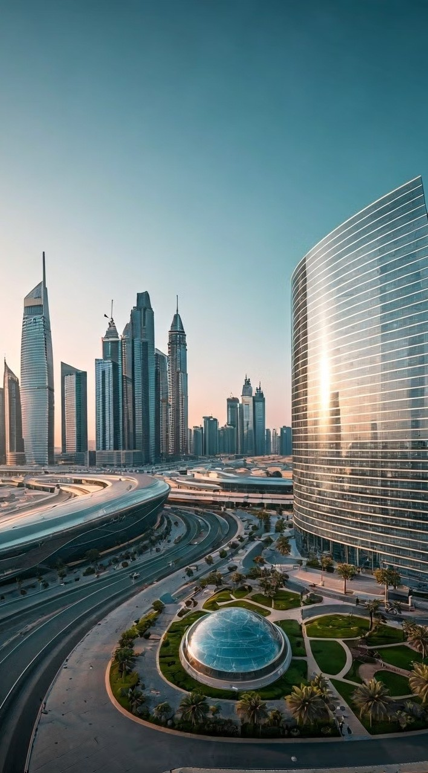
Sustainable Infrastructure Development in the Middle East
Renewable Energy Sources | Integration of solar and wind power into infrastructure projects reduces reliance on fossil fuels and promotes clean energy generation.
Green Building Standards | Adopting green building standards encourages the use of energy- efficient materials, water conservation, and sustainable design practices.
Smart City Initiatives | Smart city initiatives incorporate technological solutions to optimize resource utilization, reduce waste, and enhance sustainability in urban environments.

Slide 9
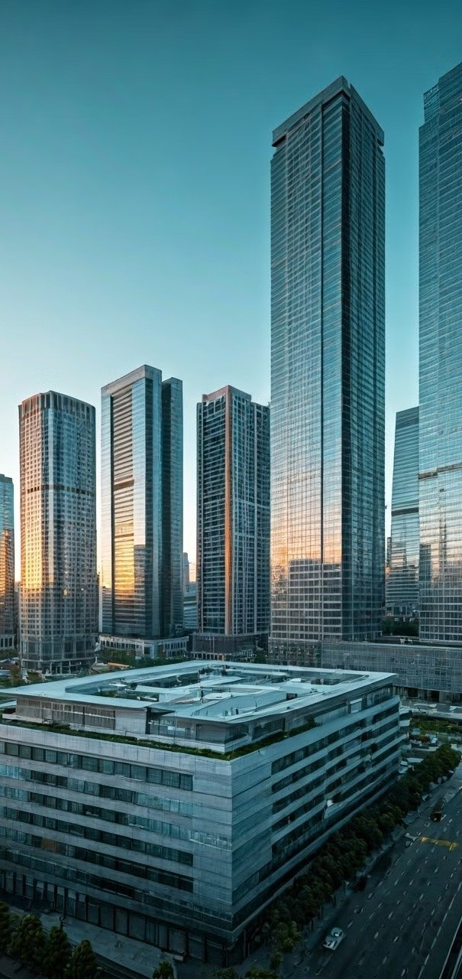



Increased Demand for Durable and Environmentally-Friendly Options
Environmental Concerns
Growing awareness of climate change and environmental degradation drives the demand for eco-friendly building materials that minimize carbon footprint and resource consumption.
Infrastructure Development
Rapid urbanization and infrastructure development in the Middle East create a significant demand for durable and sustainable building materials to support long-term growth.
Cost-Effectiveness
Sustainable building materials can offer long-term cost savings through reduced maintenance, energy efficiency, and increased durability, making them an attractive option for both residential and commercial projects.

Slide 10
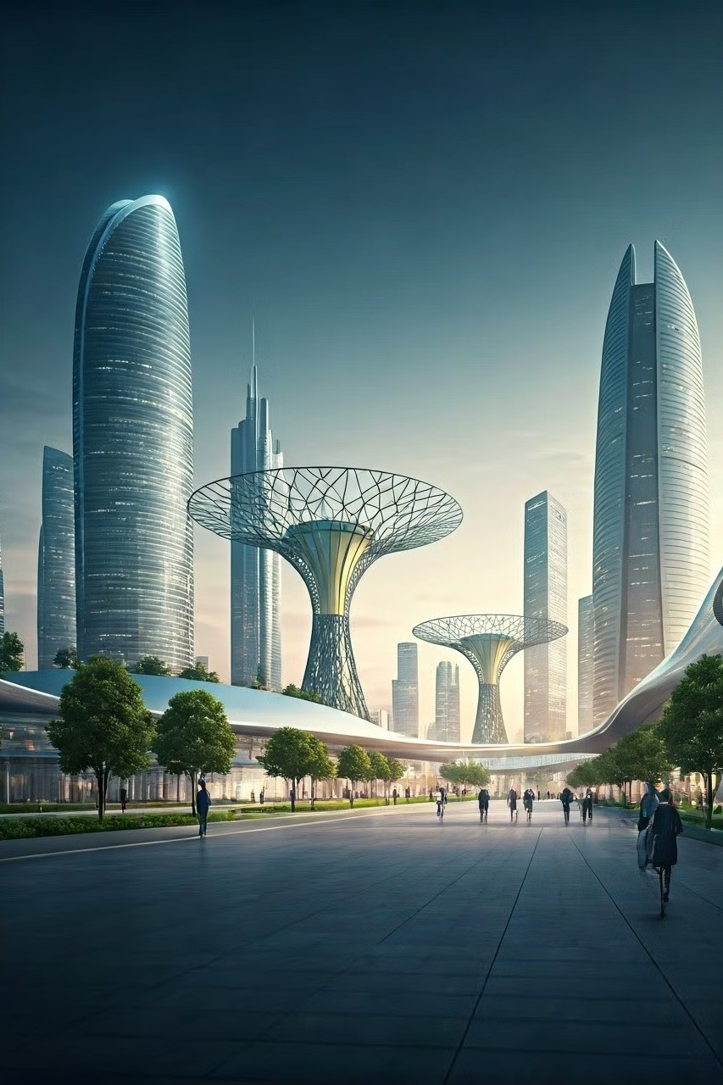
Conclusion: The Future of Sustainable Building Materials
The future of sustainable building materials is bright, with continued innovation and a growing demand for environmentally responsible solutions. As the construction industry embraces eco-conscious practices, durable and sustainable building materials will play a pivotal role in shaping a more sustainable and resilient future.

Slide 11
Fencing Manufacturers and Suppliers
Contact Us-
Call- +971501922352
+971504328270
Email Id-info@matcoindustry.com Address-info@matcoindustry.com Website-www.matcoindustry.com

