Slide 1


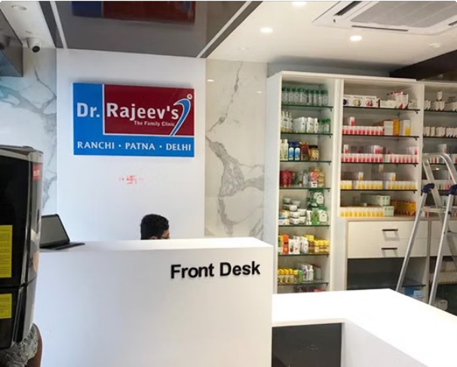
Welcome to Rajeev Homeopathy Clinic
Welcome to Rajeev Homeopathy Clinic, your trusted source for holistic healthcare. We specialize in providing effective and natural homeopathic treatments for a wide range of ailments.

Slide 2


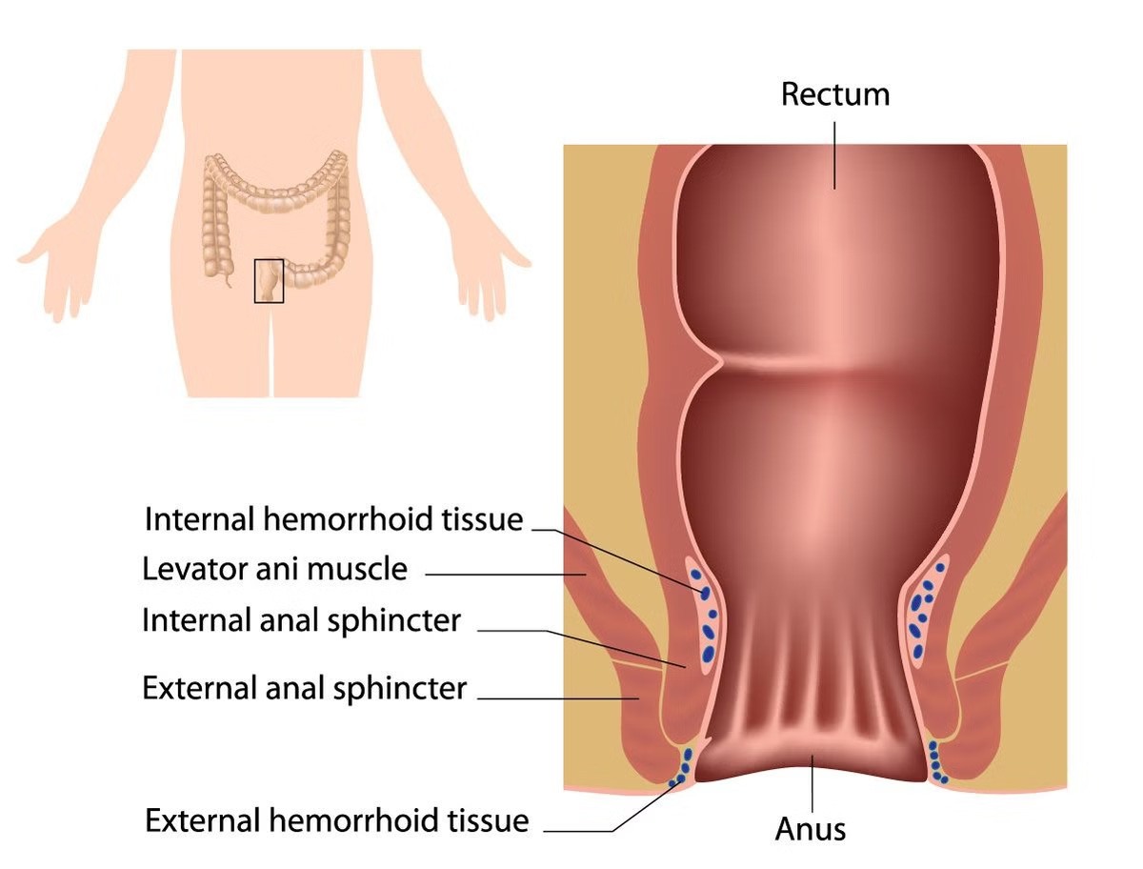
Understanding Piles (Hemorrhoids)
Types of Piles
There are two main types: internal piles, which develop inside the rectum, and external piles, which develop under the skin around the anus.
What are Piles?
Piles are swollen veins in the rectum and anus, often causing discomfort, itching, and bleeding.

Slide 3


Causes and Symptoms of Piles
1
Straining During Bowel Movements
This can put pressure on the veins in the rectum.
2
Prolonged Sitting or Standing
This can restrict blood flow and cause the veins to swell.
4
Obesity
Excess weight puts extra pressure on the veins in the rectum.
3
Pregnancy
Hormonal changes and pressure from the growing fetus can contribute to piles.

Slide 4

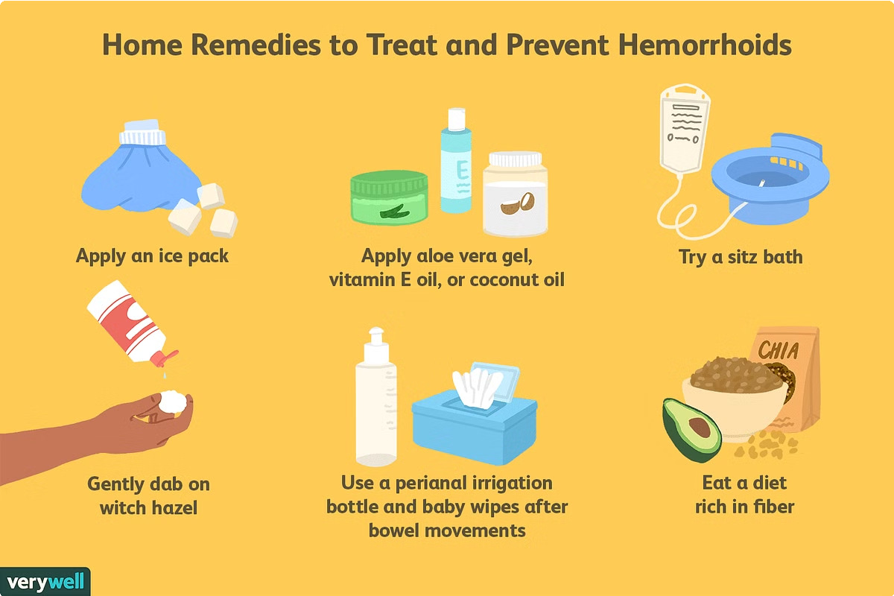
Conventional Treatments for Piles
Lifestyle Modifications | Dietary changes, increased fiber intake, and regular exercise.
Over-the-Counter Medications | Creams, suppositories, and stool softeners to relieve symptoms.
Surgical Procedures | In severe cases, surgery may be required to remove piles.

Slide 5

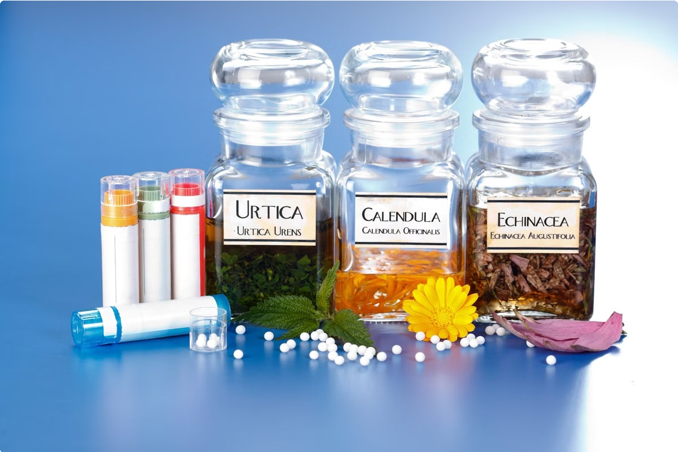
Homeopathic Approach to Piles Treatment
1
Individualized Treatment
Homeopathic treatment for piles focuses on addressing the root cause of piles, considering individual symptoms and overall health.
2
Natural Remedies
Homeopathic medicines are made from natural substances, minimizing side effects and promoting gentle healing.
3
Long-Term Relief
Homeopathy aims to provide long-lasting relief, preventing recurring episodes of piles.

Slide 6
Homeopathic Remedies for Piles
Aesculus Hippocastanum
Effective for piles with a feeling of fullness and pressure in the rectum.
Hamamelis Virginiana
Used for bleeding piles and pain associated with the condition.
Nux Vomica
Helps to alleviate constipation and straining during bowel movements.

Slide 7


Benefits of Homeopathic Treatment for Piles
Gentle and Safe
Homeopathic remedies are natural and safe, with minimal side effects.
Long-Term Relief
Homeopathy aims to address the underlying cause of piles for lasting relief.
Holistic Approach
Homeopathic treatment considers the whole person, addressing individual needs and symptoms.
Improved Quality of Life
Homeopathic treatment can help individuals regain comfort and enjoy a better quality of life.

Slide 8


Consultation and Diagnosis at Rajeev Homeopathy
Detailed Consultation
1
Our experienced homeopathic doctors will carefully listen to your concerns and medical history.
Physical Examination
A thorough physical examination is conducted to assess your condition and identify individual symptoms.
2
Personalized Diagnosis
Based on the information gathered, a personalized diagnosis is made to determine the most effective homeopathic remedy.
3

Slide 9


Treatment Plan and Personalized Care
Tailored Treatment Plan
Your personalized homeopathic treatment plan will be designed to address your specific needs and symptoms.
Regular Follow-Ups
We provide regular follow-up appointments to monitor your progress and adjust the treatment plan as needed.

Slide 10


Know more👉 Homeopathic Doctors in Ranchi and Delhi, Homeopathic Clinic | RajeevClinic.com
Branches in India:-
Ranchi Clinic
Elixir Tower, Sethia Compound, Opp. Ranchi Club, Ranchi-834001 (Jharkhand)
+91 9204439171
+91 651-2330818
abhihomoeo@gmail.com
Patna Clinic
ICICI BANK BUILDING, Abha Kunj, Gola Road, Near Shiv Mandir, Patna-801503 (Bihar)
+91 9153881402
+91 9153881403
abhihomoeo[at]gmail.com

Slide 11



Greater Noida Clinic
Tower(K), Flat No. 92, 11th Avenue, Gaur City-2, Kishan Chowk, Sector-16-C, Greater Noida - 201009 (Uttar Pradesh)
+91 9234400007
abhihomoeo[at]gmail.com
Noida Clinic
Shop No. C-11, 5th Floor, Tower C Spectrum@metro GH Eco City Plot C and D, Sector 75, Noida - 201304, Uttar Pradesh
+91 9263778607
abhihomoeo[at]gmail.com
Kolkata Clinic
147/1, B.B. GANGULY STREET, PS-MUCHIPARA, SEALDAH, Kolkata-700012 (West Bengal)
+91 9153881401
abhihomoeo[at]gmail.com

