Slide 1
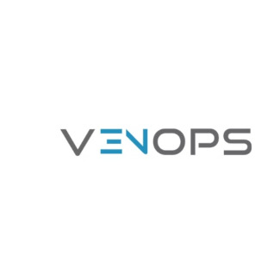
Venops: Streamlining Compliance and Risk Mitigation
Venops is a comprehensive solution designed to simplify compliance and mitigate risks in the healthcare industry. We leverage cutting-edge technology to streamline critical processes and ensure your organization stays ahead of the curve.

Slide 2
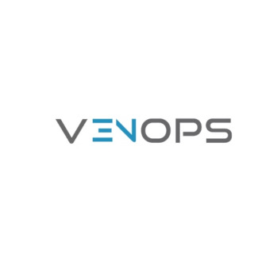
CMS Open Payments: Tracking Financial Relationships
The Centers for Medicare & Medicaid Services (CMS) Open Payments program requires healthcare providers to publicly report financial relationships they have with pharmaceutical and medical device manufacturers.
1
Transparency Accountability
The program promotes transparency in the healthcare industry, making financial relationships between manufacturers and healthcare providers public.
2
Data Collection Reporting
Venops helps healthcare providers streamline the process of collecting, verifying, and reporting data for CMS Open Payments.
3
Compliance Requirements
Our solution ensures you adhere to CMS guidelines, minimizing your risk of penalties.
4
Public Database
The Open Payments data is publicly available, allowing patients and stakeholders to access information about financial relationships.

Slide 3
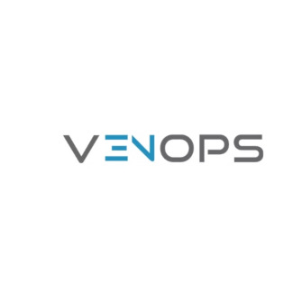
Penalties for Non-Compliance
Failure to comply with CMS Open Payments regulations can lead to significant penalties, including fines, audits, and reputational damage.
Financial Penalties
CMS can impose financial penalties on healthcare providers who fail to report their financial relationships accurately.
Audit s Investigations
Non-compliance can trigger audits and investigations, leading to increased scrutiny and potential legal repercussions.
Reputational Damage
Public disclosure of non-compliance can damage your organization's reputation and erode trust with patients and stakeholders.

Slide 4
Venops: Your Comprehensive Solution
Venops provides a comprehensive solution to help healthcare providers effectively manage their CMS Open Payments data and mitigate compliance risks.
Data Collection Management
Streamline the collection and management of financial relationship data, ensuring accurate and timely reporting.
Automated Reporting
Automated reporting simplifies the process, reducing manual effort and the potential for errors.
Compliance Monitoring
Venops provides real-time insights into compliance status, helping you proactively address any potential issues.
Data Analytics Reporting
Gain actionable insights from your data, identifying trends and patterns that can inform decision-making.

Slide 5
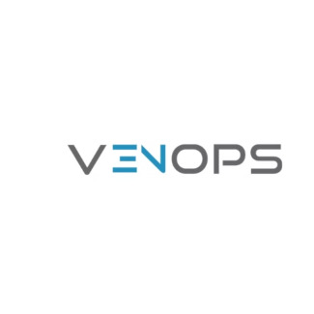
Monitoring CMS Open Payments
Venops simplifies the monitoring of CMS Open Payments data, helping healthcare providers stay informed about financial relationships and compliance requirements.
1
Data Collection
Capture and securely store all relevant data related to financial relationships.
2
Data Validation
Venops verifies data accuracy to ensure compliance with CMS guidelines.
3
Reporting Disclosure
Automate the generation of reports and submit them to CMS within the specified deadlines.
4
Data Analysis Monitoring
Track compliance status, identify potential risks, and proactively address any issues.

Slide 6
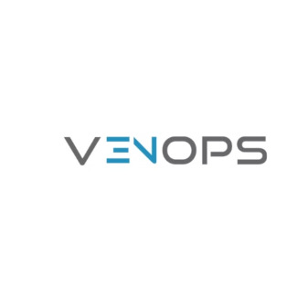
Sanction Checks: Safeguarding Your Organization
Beyond CMS Open Payments, Venops provides comprehensive sanction checks to ensure that your healthcare professionals are not under any sanctions.
Global Sanction Databases
Venops accesses and integrates data from multiple global sanctions databases.
1
Automated Screening
Our system automatically screens your healthcare professionals against these databases.
2
Alerting Reporting
Venops flags any potential sanctions, allowing you to take immediate action.
3

Slide 7
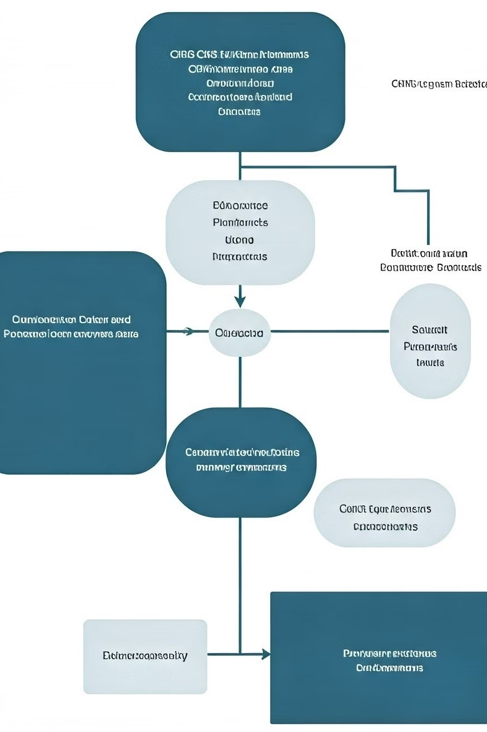
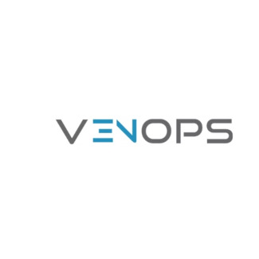
Integrated Approach: CMS Data and Sanction Checks
Venops integrates CMS Open Payments data and sanction checks into a single platform, providing a comprehensive solution for compliance and risk mitigation.
CMS Open Payments Data | Sanction Checks
Transparency & Accountability | Safeguarding Your Organization
Compliance Monitoring | Proactive Risk Management
Data Reporting & Disclosure | Mitigating Legal Risks

Slide 8
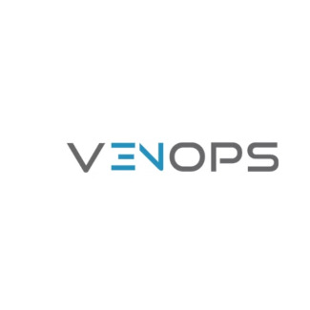
Mitigating Legal Risks
By ensuring compliance with CMS Open Payments and identifying potential sanctions, Venops helps healthcare organizations mitigate legal risks and avoid costly penalties.
Legal Protection
Venops helps you stay compliant, reducing your exposure to legal risks and penalties.
Regulatory Compliance
Our solution ensures you adhere to all applicable regulations, minimizing legal liabilities.
Risk Mitigation
Venops identifies and mitigates potential risks, helping you avoid legal disputes and sanctions.
Transparency Accountability
Venops promotes transparency and accountability, reducing the risk of legal challenges.

Slide 9
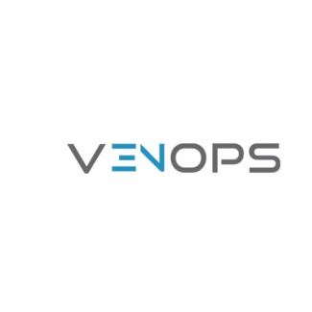
Simplifying Compliance Processes
Venops streamlines compliance processes, reducing administrative burdens and freeing up your team to focus on patient care.
1
Automated Workflows
Automated workflows streamline data collection, validation, and reporting, reducing manual effort.
2
Centralized Platform
Venops provides a centralized platform for managing compliance data, simplifying access and visibility.
3
Real-Time Insights
Real-time insights into compliance status enable proactive risk management and issue resolution.
4
Improved Efficiency
By automating and simplifying compliance processes, Venops improves efficiency and reduces costs.

Slide 10
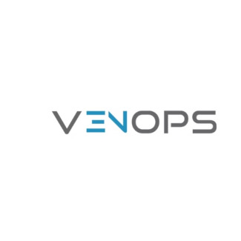
Protecting Your Organization's Reputation
Maintaining a strong reputation is crucial in the healthcare industry. Venops helps you safeguard your organization's reputation by ensuring compliance and transparency.
Positive Public Image
By adhering to compliance regulations and ensuring transparency, you build trust with patients and stakeholders.
Avoid Negative Publicity
Venops helps you minimize the risk of negative publicity and reputational damage from non-compliance.

Slide 11
Contact Us-
Call-855 567 3552
Email Id-memberservices@venops.com
Address-1395 South Marietta Parkway Bldg. 400, Suite 104
Marietta Ga 30067
Website-www.venops.com

