Slide 1
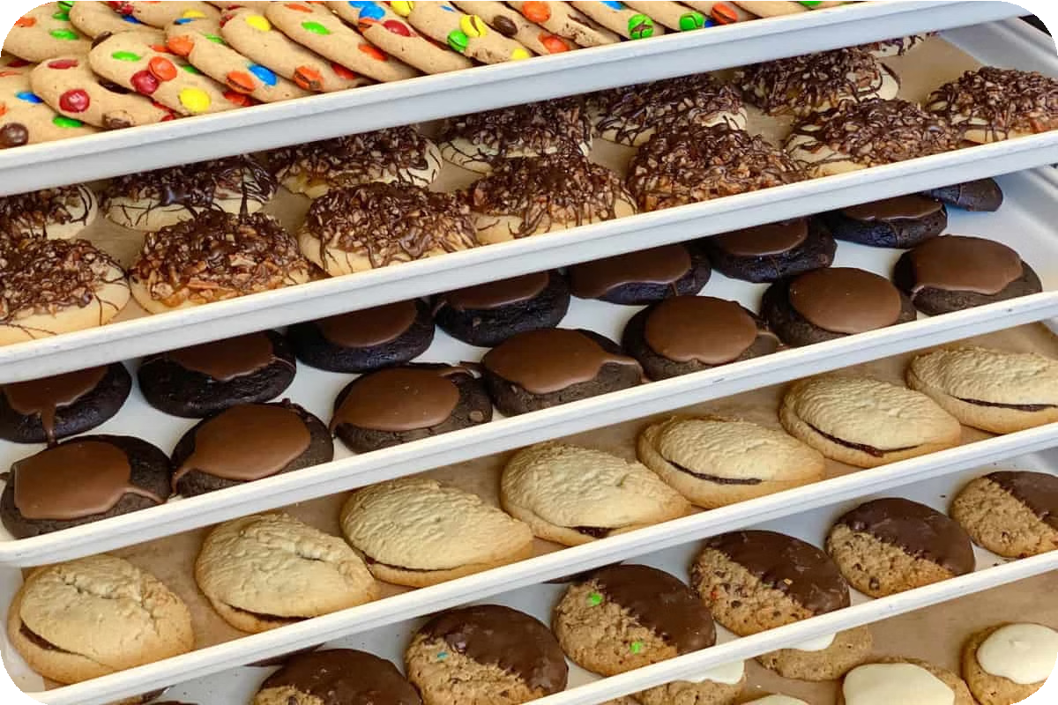
Local Cookies: The
Bakery Shop Near You
Indulge in the irresistible flavors of freshly baked cookies at Local Cookies, the premier bakery in your neighborhood. From classic chocolate chip to creative seasonal varieties, our bakery offers an array of delectable treats to satisfy your sweet cravings.

Slide 2
Delicious Cookies for Your Sweet Cravings
Classic Favorites
Savor the timeless flavors of our classic chocolate chip, peanut butter, and oatmeal raisin cookies.
Seasonal Specialties
Indulge in our rotating selection of seasonal offerings, like pumpkin spice, gingerbread, and red velvet.
Gluten-Free Options
Enjoy our delectable gluten-free cookies, perfect for those with dietary restrictions.

Slide 3
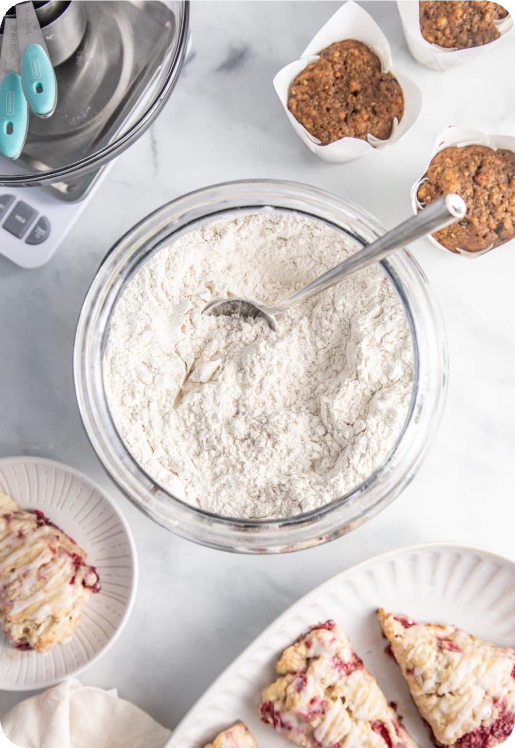
Fresh and Organic Cookies Baked Daily
1
Locally Sourced Ingredients
We use only the finest, locally sourced ingredients to ensure the highest quality and flavor.
2
Organic Baking
Our cookies are made with organic flour, sugar, and butter for a healthier and more natural taste.
3
Small-Batch Craftsmanship
Each batch of cookies is lovingly handcrafted by our skilled bakers for the perfect texture and taste.

Slide 4
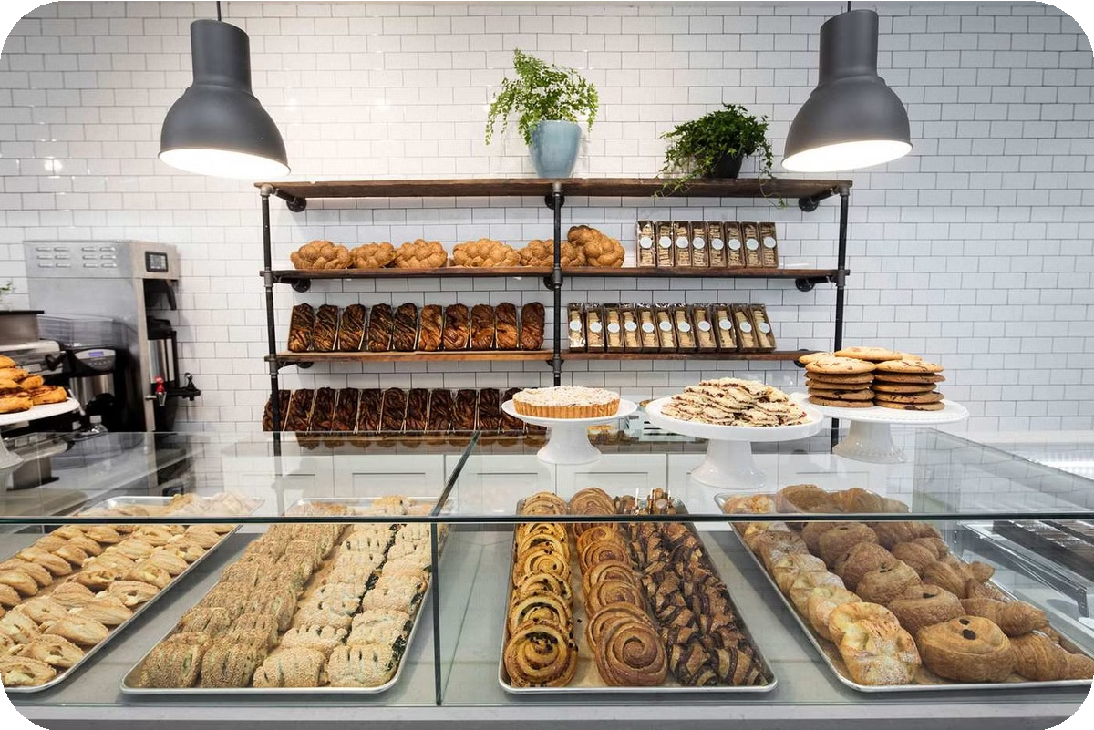
Variety of Baked Goods: Cakes, Doughnuts, Bread
Decadent Cakes
Indulge in our mouthwatering cakes, from classic chocolate to elegant tiered creations for special occasions.
Fluffy Doughnuts
Start your day with our fresh, warm doughnuts in a variety of flavors, from traditional glazed to creative fillings.
Artisanal Breads
Enjoy our selection of freshly baked breads, including crusty sourdough, soft brioche, and hearty whole grain loaves.

Slide 5
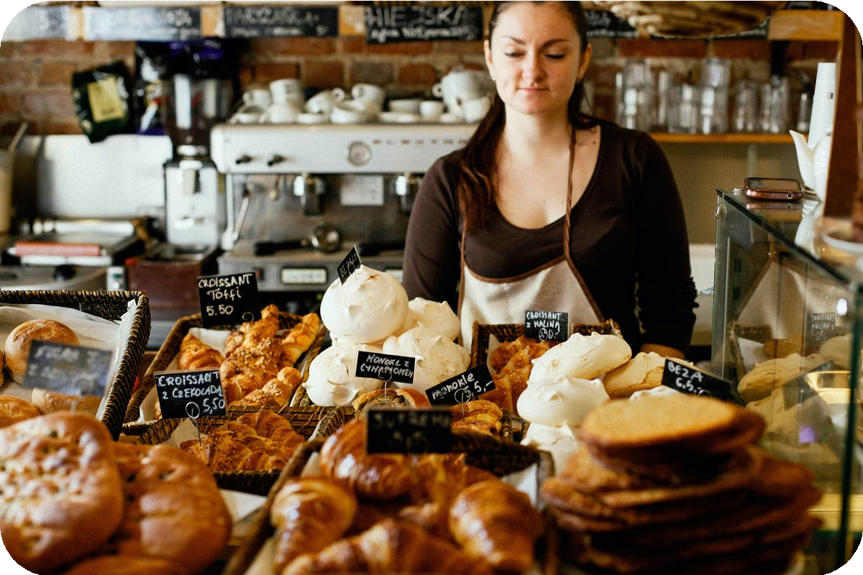
Convenient Online Ordering Available
Easy Ordering
Place your order online for quick and hassle-free pickup or delivery.
Secure Checkout
Our online platform offers a secure and seamless checkout experience.
Reliable Delivery
Get your favorite baked goods delivered right to your doorstep.

Slide 6
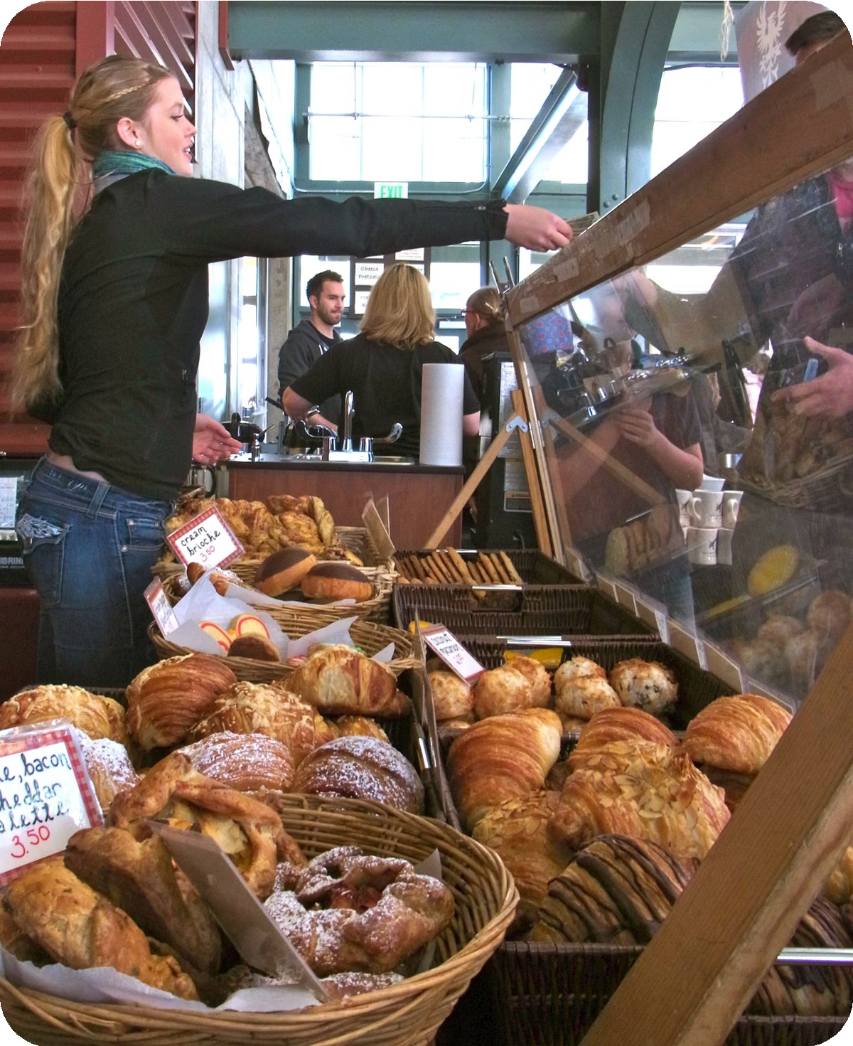
Locally Sourced Ingredients for Quality Assurance
1
Local Farmers
We partner with local farmers to source the freshest, high- quality ingredients.
2
Carefully Curated
Our bakers meticulously select and prepare each ingredient to ensure maximum flavor and freshness.
3
Strict Quality Control
We have rigorous quality control measures in place to guarantee the highest standards of our baked goods.

Slide 7
Friendly and Knowledgeable Staff
Exceptional Customer Service
Our friendly and attentive staff are dedicated to providing a personalized and enjoyable shopping experience.
Baking Expertise
Our skilled bakers are passionate about their craft and happy to share their knowledge and recommendations.
Customized Orders
Whether it's a special occasion or a unique dietary request, our team is here to help create the perfect baked treat.

Slide 8
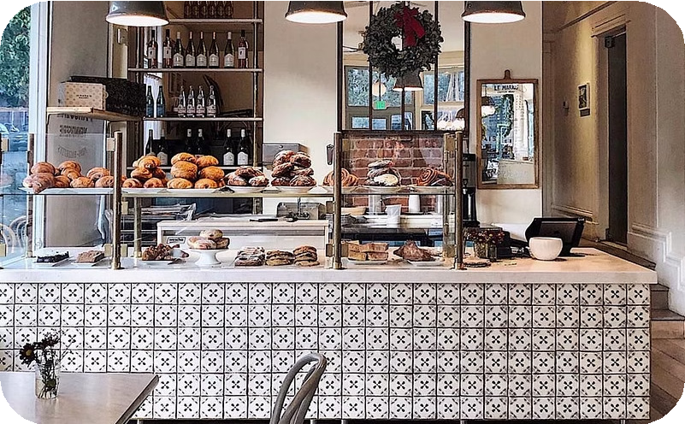
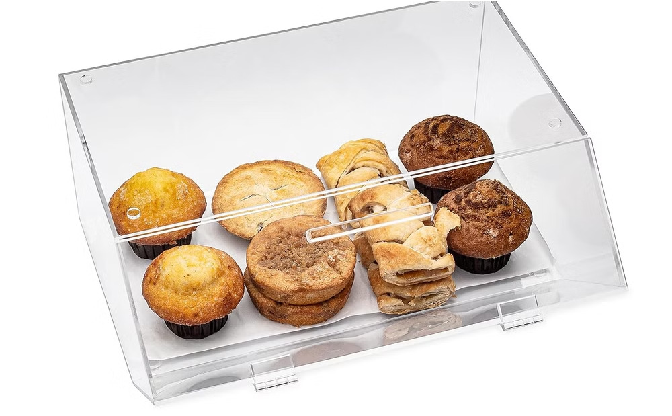
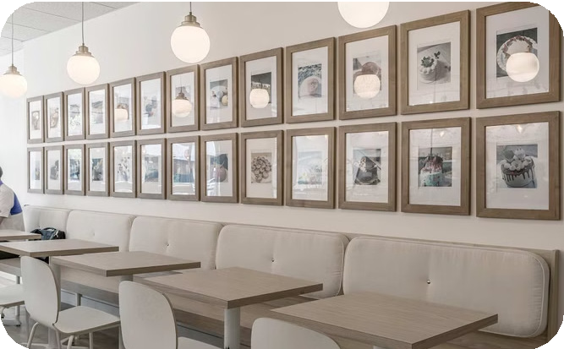
Cozy and Inviting Bakery Atmosphere
Warm and Welcoming
Step into our charming bakery, where the aroma of freshly baked goods and the sound of lively conversation create a cozy and inviting atmosphere.
Tempting Displays
Admire our beautifully crafted display cases showcasing our irresistible baked goods, enticing you to indulge in the perfect treat.
Comfortable Seating
Enjoy a moment of relaxation in our comfortable seating area, perfect for savoring your favorite cookie or pastry with a hot beverage.

Slide 9
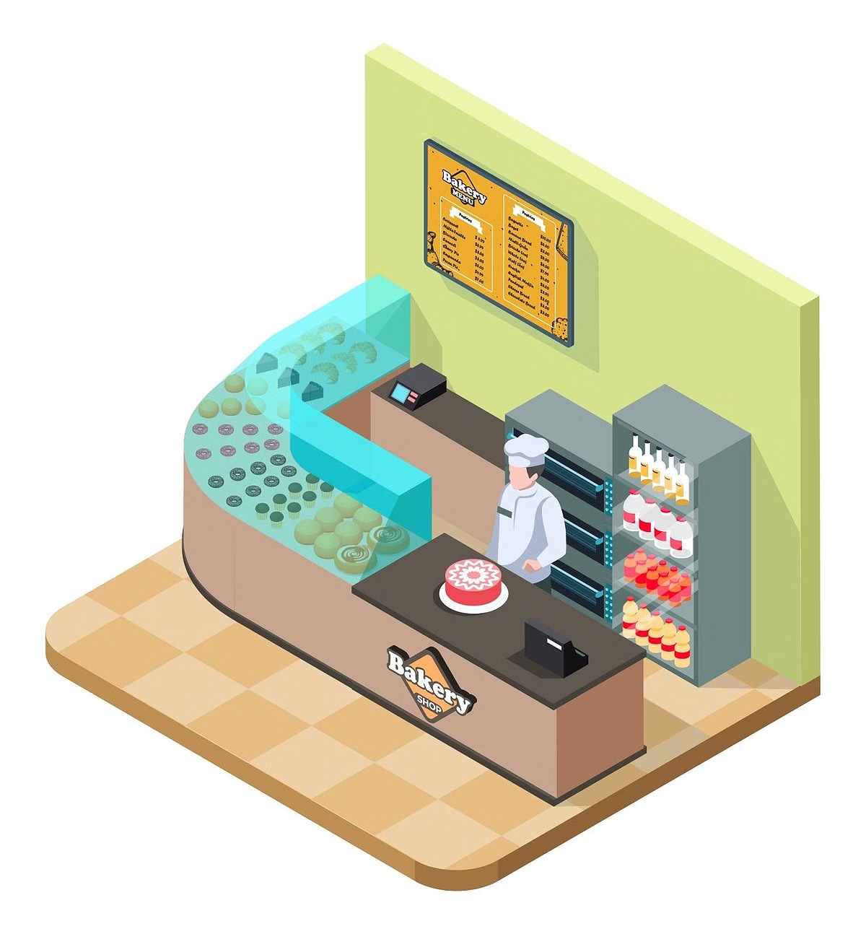
Competitive Pricing for Affordable Treats
Quality Ingredients
1
We select the finest ingredients to ensure the highest quality in our baked goods.
Efficient Production
Our streamlined operations and bakery processes allow us to offer competitive prices.
2
Affordable Treats
Our customers can indulge in delicious baked goods without breaking the bank.
3

Slide 10
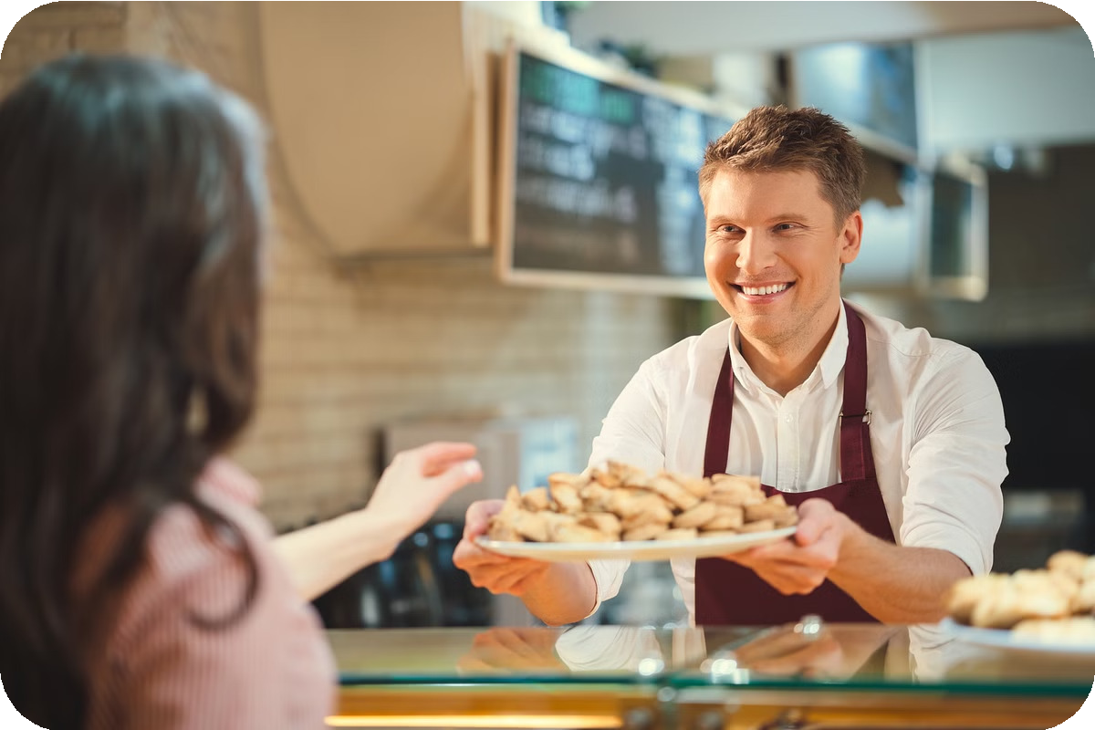
Commitment to Customer Satisfaction
Quality Guarantee | We stand behind the quality of our baked goods and offer a satisfaction guarantee.
Personalized Service | Our friendly staff is dedicated to providing a personalized and exceptional customer experience.
Community Involvement | We are active in the local community, supporting charitable causes and events.

Slide 11
To know more:-
Address: Muwaileh Commercial - Industrial Area - Sharjah - United Arab Emirates
Phone: +971 6 530 0115
Menu: localcookies.ae

