Slide 1
Metal and Machine: Your Construction
Solution
Metal and Machine is a leading supplier of high-quality U Channel and Unistrut systems in Dubai. Our products are designed to provide durable and reliable support for a variety of construction projects.

Slide 2
.
U Channel
Our U Channel is a versatile structural element that is widely used in construction for a variety of purposes. It is made from high-quality steel and is designed to withstand heavy loads.
Unistrut
Unistrut is a type of metal framing system that is commonly used in electrical, mechanical, and plumbing installations. It offers a strong and durable solution for hanging and supporting equipment.

Slide 3
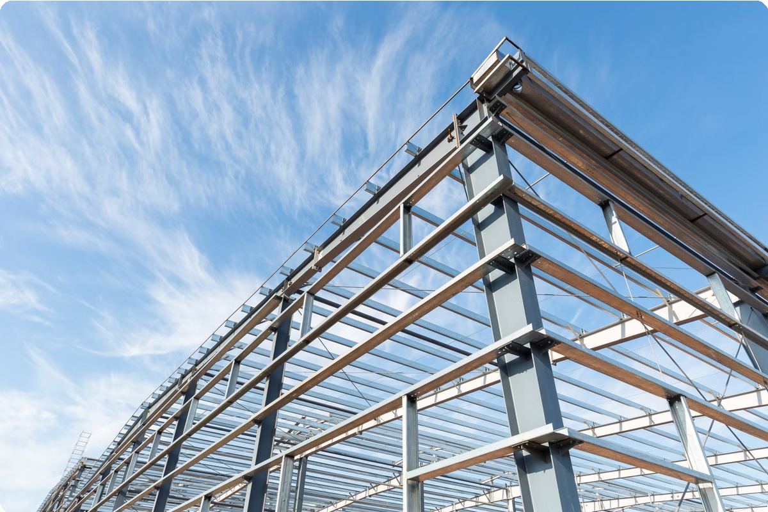
Durability and Reliability
Heavy Duty Steel
U Channel and Unistrut are made from high-quality steel that is designed to withstand the rigors of construction and long- term use.
Corrosion Resistance
Our products are treated with a durable coating to protect them against corrosion and extend their lifespan.
Reliable Perforfiance
U Channel and Unistrut are known for their strength and reliability, ensuring that your projects are supported properly.

Slide 4
Applications for Construction Projects
1
Residential
U Channel and Unistrut are ideal for supporting electrical systems, HVAC units, and other components in residential buildings.
2
Cofifiercial
Our products are frequently used in commercial construction for supporting lighting, plumbing, and HVAC systems.
3
Industrial
U Channel and Unistrut are widely used in industrial construction for supporting heavy machinery, conveyor systems, and other industrial equipment.

Slide 5
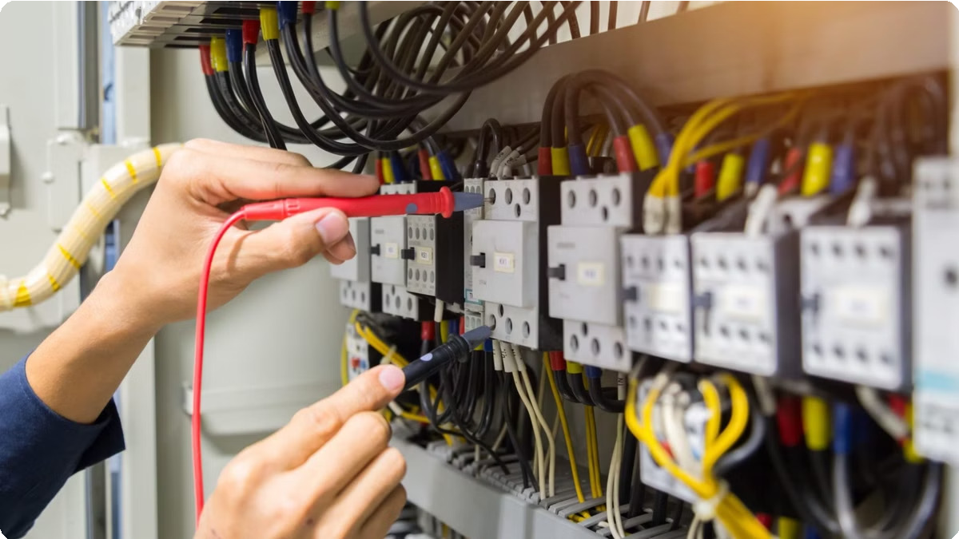
Electrical Systefis Support
Cable Managefient
U Channel and Unistrut In Dubai are used to securely manage and organize electrical cables and wiring systems, ensuring a safe and efficient installation.
Panel Support
Our products provide a robust foundation for electrical panels, switchboards, and other electrical components.
Lighting Fixtures
U Channel and Unistrut are commonly used to support lighting fixtures, ensuring that they are securely mounted and evenly distributed.

Slide 6
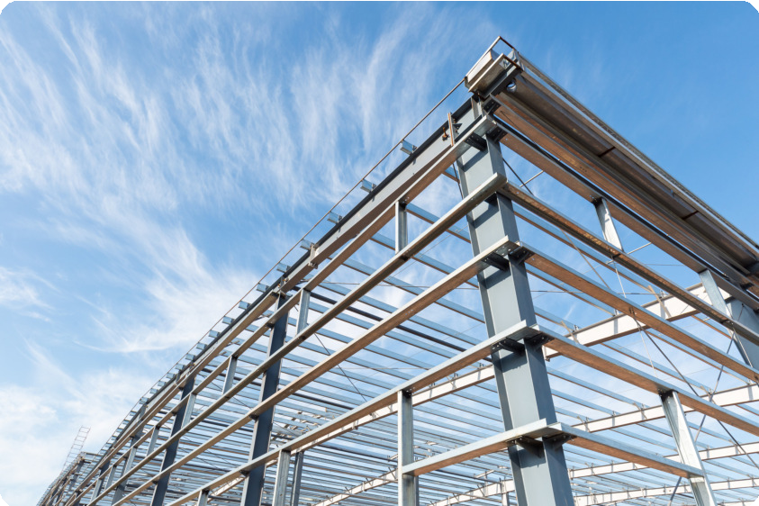
Building Frafies
1
2
3
Support for Walls & Ceilings
U Channel and Unistrut provide a sturdy framework for walls and ceilings, contributing to the overall structural integrity of the building.
Enhanced Stability
Our products provide added strength and stability to the building structure, ensuring that it is able to withstand external forces.
Versatile Design
U Channel and Unistrut systems can be easily customized and adapted to various building designs and architectural requirements.

Slide 7
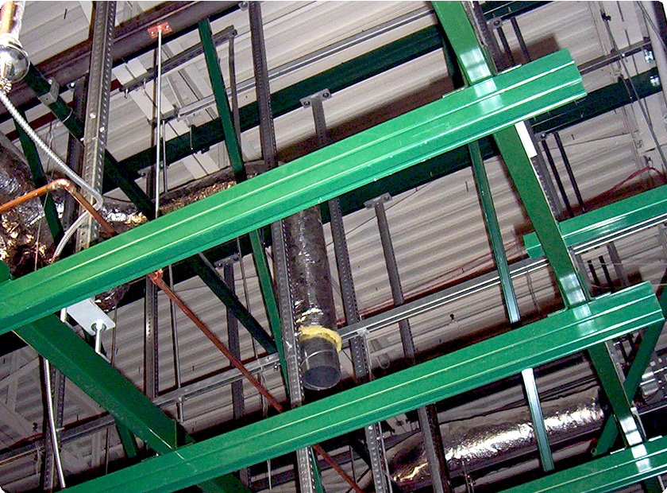
Mechanical Installations
1
HVAC Systefis
U Channel and Unistrut are used to securely mount and support HVAC units, ensuring proper ventilation and air conditioning.
2
Plufibing Systefis
Our products provide robust support for pipes, valves, and other plumbing components, ensuring a reliable and secure installation.
3
Heavy Machinery
U Channel and Unistrut are commonly used in industrial settings to support heavy machinery, ensuring stability and safety.

Slide 8
Cofipetitive Pricing
Competitive Prices | Metal and Machine is committed to providing competitive pricing on our U Channel and Unistrut systems.
Value for Money | Our products offer excellent value for money, providing durability and reliability at an affordable price.
Transparent Pricing | We provide clear and transparent pricing information, ensuring that you know exactly what you are paying for.

Slide 9
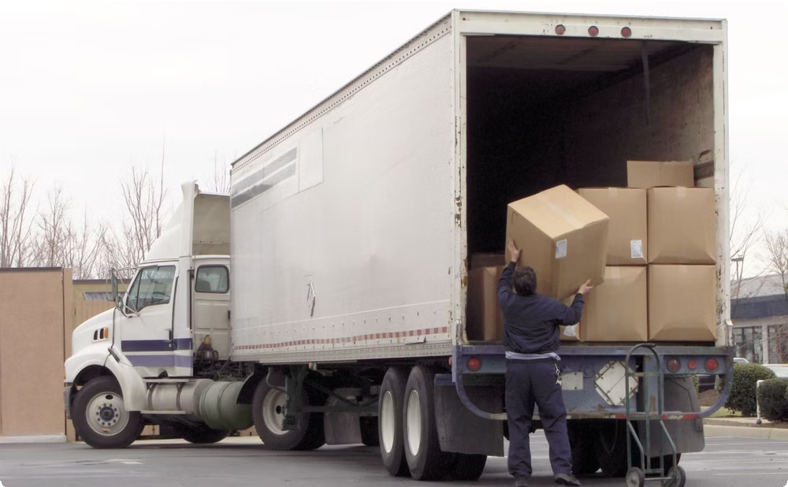
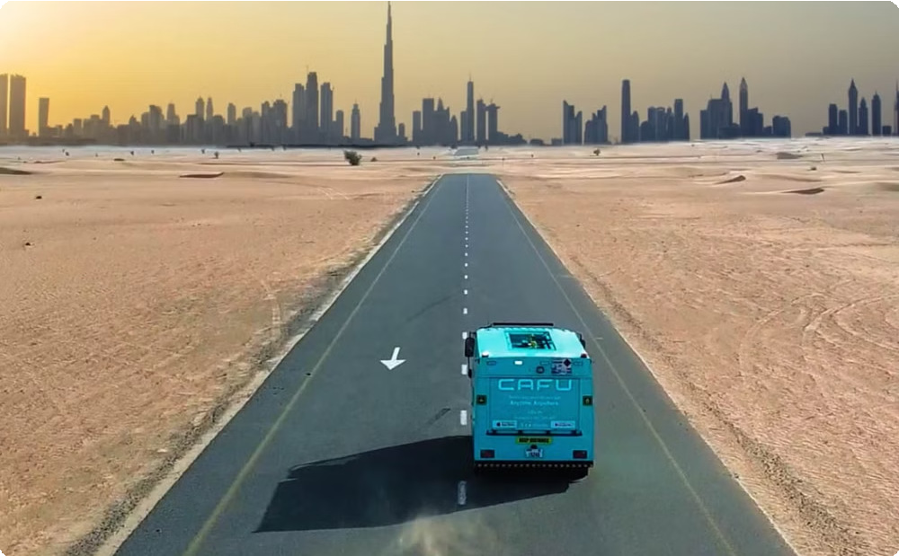
Quick Delivery Across Dubai
Efficient Logistics
We have an efficient logistics system in place to ensure timely delivery of your U Channel in Dubai and Unistrut orders.
Fast Turnaround
We prioritize fast turnaround times, ensuring that you receive your materials when you need them.

Slide 10
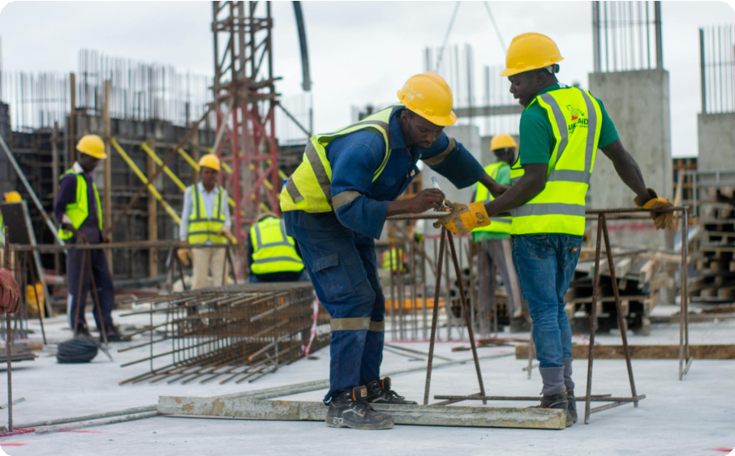
Contact Us for Your Structural Needs
For all your structural needs in Dubai, contact Metal and Machine. We are here to help you choose the right U Channel and Unistrut solutions for your project and ensure a successful construction journey.
Call-+971501922352
Mail Id-metalandmachine@gmail.com
Address-Plot no 8 , Block 6, Sector 711, New Industrial Area Umm Al Quwain, UAE Website-www.metalandmachine.net

