Slide 1






5 Main Platform to Create Smart Contract
smart contract development

Slide 2



WHAT ARE CONTRACT FOR
  Contracts serve to establish and record the commitments of both parties in a relationship.
  Contracts provide transparency to the relationship, prevent conflicts and mitigate risks.
  Clarify expectations.
  They serve as a tool for collaboration, communication and coordination in business .
  They help the entire organization focus and maintain compliance.

Slide 3
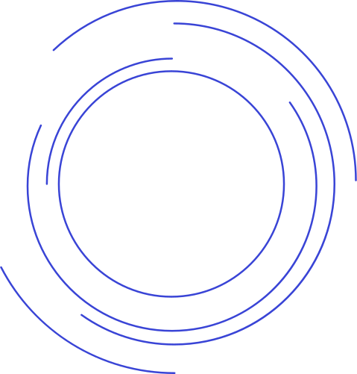


WHAT IS SMART CONTRACT
  Smart contracts are simply lines of code. Small programs stored on a blockchain .
  They have the superpower to execute and enforce themselves, autonomously and automatically, based on a set of programmed parameters.
  They execute themselves when predetermined conditions are met.
  They comply with the if-then rule . If (A) occurs, (B) will robotically be carried out Period.
  Smart contracts are commonly used in decentralized finance (DeFi), NFTs, deliver chain tracking, and diverse different blockchain programs. The most famous platform for smart contracts is Ethereum, which uses the Solidity programming language.

Slide 4

TYPES OF SMART CONTRACT
  Legal Smart Contract: is the one that legally binds two parties to fulfill an agreement. The most common.
  Decentralized Autonomous Organizations: Links communities implemented in blockchain.
  Logical Application Contracts: Allows interaction and communication between multiple devices.
  Tokenized Contracts: These create and manipulate tokens, like ERC20 tokens, for diverse uses of which includes foreign money, rewards, or assets on a blockchain.

Slide 5
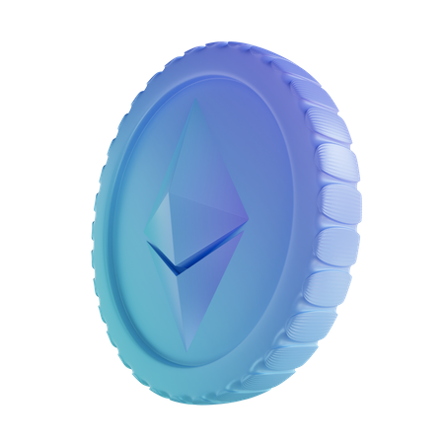
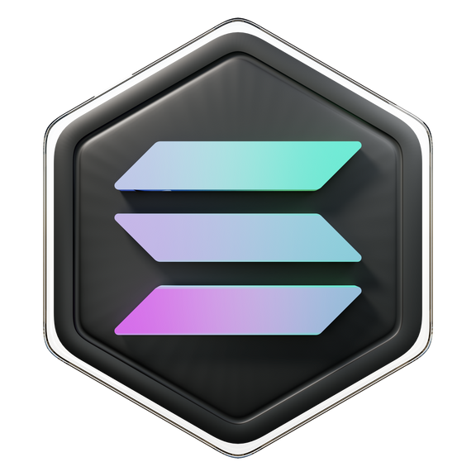
5 MAIN PLATFORM FOR SMART CONTRACT
1. Ethereum
  Ethereum is an open-source blockchain platform for building applications and organizations, forming assets, and conducting transactions and end-to-end communications without interference from any central authority.
2. solana
  Solana is an open source, decentralized blockchain platform for building scalable and easy-to-use applications.
  It differs from crypto applications based on Ethereum virtual machines , because in these the program logic and the state coexist in a single contract, Whereas Solana is displayed in study-simplest mode and only includes this system logic.

Slide 6


3. Polkadot
  Polkadot is an open source task that was created by using the Web3 Foundation.
  It is a blockchain ecosystem where several structures are linked to every other, with a shared protocol.
  And in fact, it lets in builders to create their personal blockchains with custom tokens and governance fashions.
4. Stellar
  Stellar is a very easy and constrained platform. However, it is one of the quality systems for fundamental clever contracts, inclusive of replacing cash or currencies.
  It combines 3 attributes: pace, profitability and transaction safety.

Slide 7
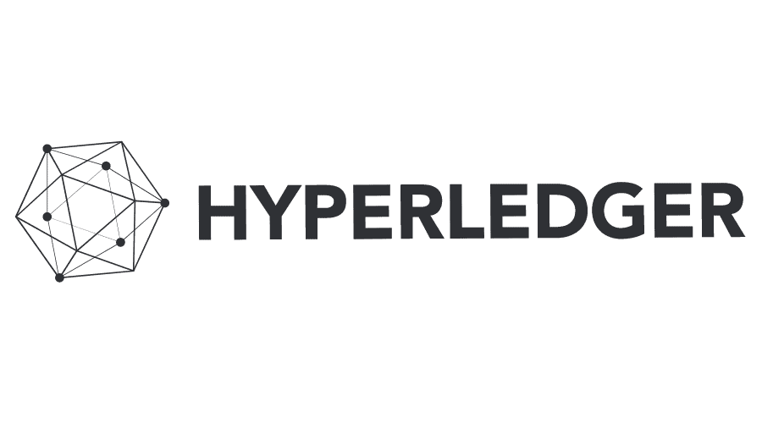
5. Hyperledger
  The Hyperledger platform is an open-source blockchain framework hosted through The Linux Foundation.
  It is a not unusual, open platform that groups can construct collectively and use
  with self assurance as a shared infrastructure for multi-birthday celebration structures.
  For sectors such as: supply chain, health, foreign trade,finance, among others.

Slide 8

Why Choose BlockchainX for Smart Contract Development
Here is a simple outline of why choose BlockchainX for smart contract development:
Expertise in Blockchain Development
Custom Solutions
Security First
Fast and Cost-Efficient Development
Transparency and Trust

Slide 9



THANK
7708889555
https://www.blockchainx.tech/
YOU!
contact@blockchainx.tech

