Slide 1



Top 5 Solana Meme Coin Development Services
contact@blockchainx.tech

Slide 2

Introduction:
  Solana Meme coin development is for launching meme coins on Solana.
  Solana Meme Coin Development Services offer token creation, smart contract setup, and DEX integration ensuring that meme-based projects have low fees, quick transactions and can be scaled up.

Slide 3


NFT Marketplace Development
Top 5 Solana Meme Coin Development Services
Smart Contract Development
Meme Coin Wallet Development
Governance Token
Cross-chain Bridge

Slide 4


NFT Marketplace Development:
  NFT Marketplace Development We design and build NFT marketplaces for meme coin projects allowing creators to mint, sell and trade meme-themed NFTs.
  Using Solana’s low-cost and high-speed network we provide a seamless platform for creators and collectors.

Slide 5
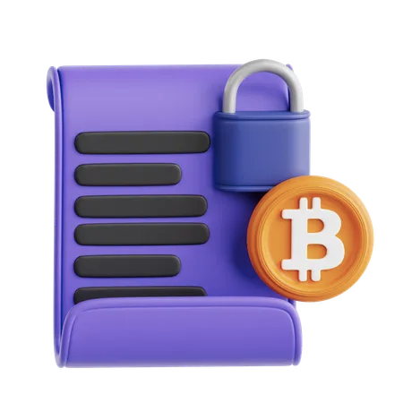
Smart Contract Development:
  Smart Contract development Our professionals make custom smart contract made specifically for meme currency undertakings occurring on Solana.
  These accords can manage several operations such as minting, keeping tokens in safe deposit boxes and partitioning them into numerous small portions; thus guaranteeing safety, adaptability and automation of all processes involved in your meme coin ecosystem.

Slide 6
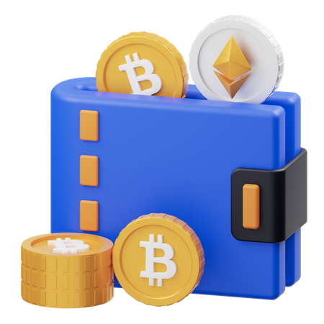
Meme Coin Wallet Development:
  Our service for creating wallets for meme coins guarantees an easy storage and transfer process of meme coins either through personal made wallets or via well-known Solana wallets including Phantom or Solflare.
  We design friendly solutions to keep and supervise the meme coin tokens.

Slide 7

Governance Token:
  Decentralized Decision-Making is now made possible through our governance token creation services for your meme coin ecosystem.
  As such, community members are able to participate in project evolution by voting for project changes, tokenomics alterations and community initiatives thereby promoting transparency and engagement with the holders of the token.

Slide 8
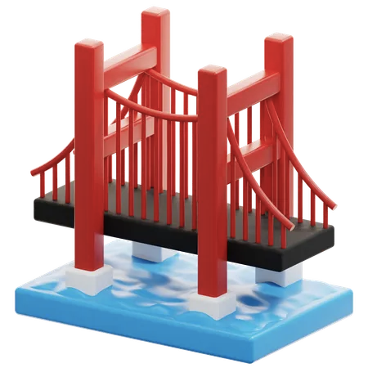
Cross-chain Bridge:
Cross-chain bridges allow users to link their Solana-supported meme with other blockchains such Ethereum or Binance Smart Chain so as to facilitate interoperability among many networks and ensure a larger take-up.

Slide 9
Solana Meme coin Development with BlockchainX:
  Solana Meme Coin Development by BlockchainX presents an all-inclusive approach to the creation and launching of meme coins on the platform.
  Token creation, smart contract development, DEX integration, NFT marketplaces as well as community expansion are some of the services that can be accessed from
  BlockchainX to ensure that meme coin projects run efficiently and can grow without limits on solana blockchain.

