Slide 1

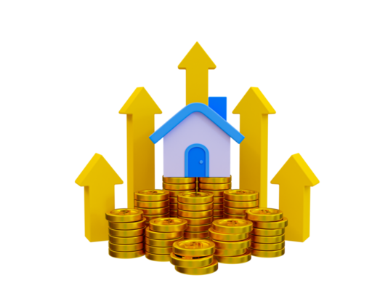

How Real Estate Tokenization is Changing Property Investment in 2024
www.blockchainx.tech

Slide 2
Introduction
Real estate tokenization will completely change the way properties are invested into by 2024. This is a cutting-edge mechanism that converts physical property assets into digitized tokens on a blockchain thus enabling potential buyers to acquire and sell partial ownership of real estate. In this way, it is knocking down conventional constraints in order to create an open, transparent as well as efficient way of investing in this field. In this blog will see the guide for real estate tokenization is changing property investment in 2024.

Slide 3
More Access to Real Estate for Investors
One of its greatest impacts is property investment democratization encouraged through tokenization. Formerly, people required large amounts of money to invest in real estates but now online platforms allow them invest even little amounts at lower costs making it possible for fractional ownership of expensive items like office buildings and high-end flats or even full-fledged portfolios with several properties under one roof.

Slide 4
Enhanced Clarity as well as Safeguarding
Within the background of tokenized realty it is the blockchain technologies which lead in offering more safety and transparent transactions. Each transaction is documented in an unchangeable register that tracks ownership transfer events hence giving a clear and verifiable ownership history. Thus, it reduces chances for fraud and makes due diligence much easier and less costly for investors. As well, smart contracts work to automate and uphold conditions under which property exchanges occur thus limiting reliance on middlemen while minimizing transaction costs.

Slide 5
Global Reach as well as Differentiation
By using blockchain technology, tokenizing real estate is helping investors achieve diverse investments across nations. They can now buy fractional shares from different properties located all over the world thereby spreading risks across various asset classes such as commercial or residential buildings. Such worldwide access expands new horizons not just for shareholders but also for property creators thereby leading to tighter linkages between growth rates of construction sectors worldwide.

Slide 6
Conclusion
Real estate tokenization will change how people invest in properties in 2024 through enhanced accessibility and liquidity improvements together with improved clarity and global diversification opportunities.In this we have seen a guide for real estate tokenization , as this trend would gain more strength, it is possible to transform what happens next in real estate thus the need for investors from every scale to consider different options.

Slide 7





THANK YOU!
  +91 7708889555
  www.blockchainx.tech
  contact@blockchainx.tech

