Slide 1


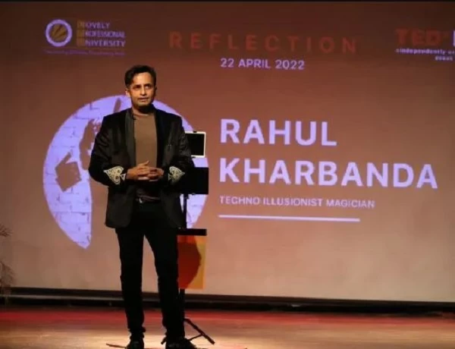

How Magic Can Make Product Launches Memorable?
https://www.magicianrahul.com/

Slide 2
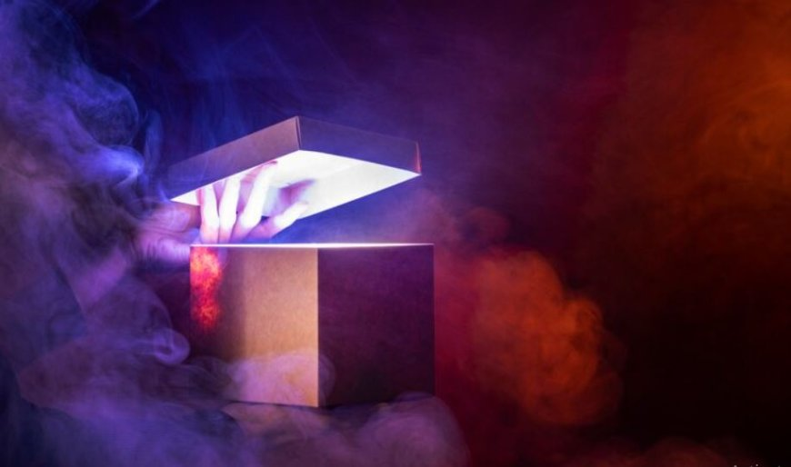
Creates a Sense of Wonder
Magic creates a feeling of wonder and surprise. When people see magic, they feel amazed and curious. This feeling makes the event more exciting. It grabs everyone’s attention and makes them focus on what’s happening. When magic tricks are performed, they seem almost impossible. This makes people remember the event better. The sense of wonder helps make the product launch stand out. People will talk about how amazing the magic was, keeping the product and event in their minds.

Slide 3
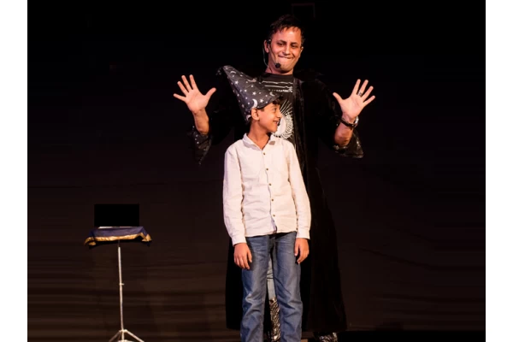
Enhances Engagement
Magic helps keep the audience engaged. When a magician performs, people watch closely. They are interested in seeing what happens next. This keeps them focused on the event. Magic tricks are often interactive, making the audience part of the show. This active participation helps them stay attentive. As they watch, they become more involved with the product being launched. Magic makes the event livelier and fun. People are less likely to get bored and more likely to remember the event.

Slide 4
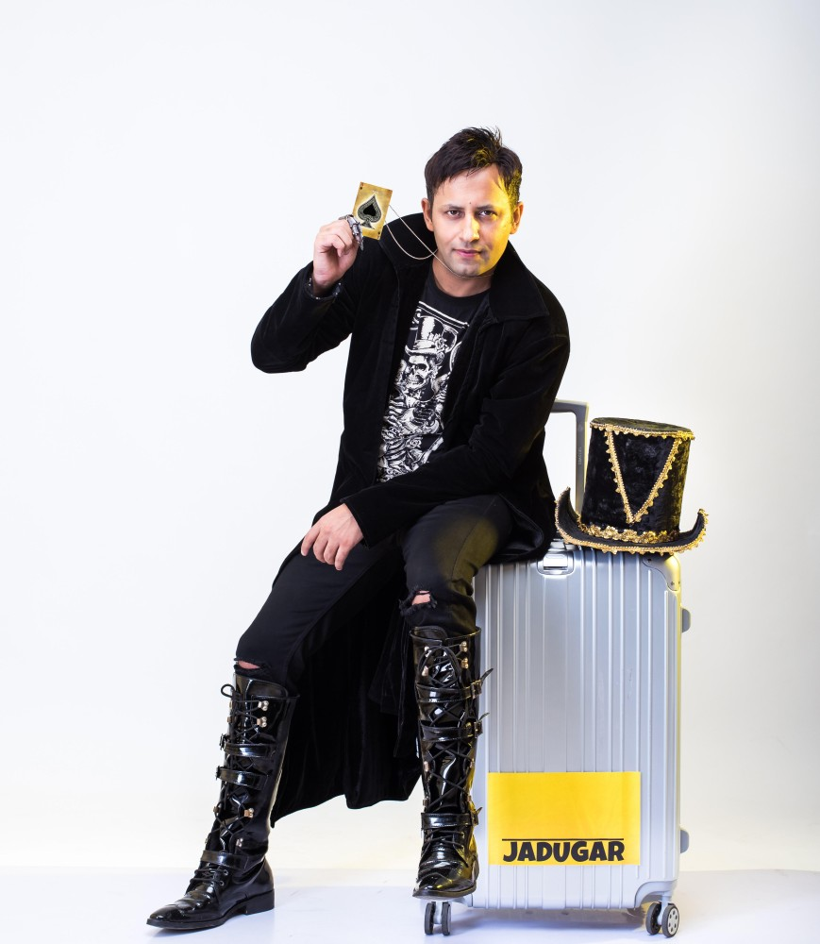
Breaks the Ice
Magic acts as an icebreaker at events. It makes people feel relaxed and happy. When a magician performs, everyone laughs and enjoys the show. This helps people feel comfortable with each other. The magic tricks can take away any nervousness or formality. It sets a fun and casual mood for the event. People are more open to talking and interacting.

Slide 5
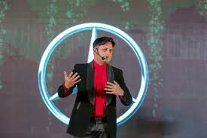
Encourages Conversation
Magic tricks are memorable and exciting. People love to talk about amazing things they have seen. When a magician performs, it creates unforgettable moments. Attendees will share their experiences with friends and on social media. This word-of-mouth can help spread the news about the product. The more people talk about the magic, the more they think about the product.

Slide 6

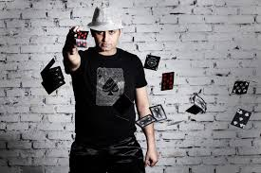
Highlights Key Features
Magicians can include product features in their tricks. This makes it easier for people to understand what the product does. For example, a magician can use the product in a trick to show how it works. This way, the audience sees the product in action. It highlights the product’s special features in a fun way. The magic makes the features stand out and be remembered. Instead of just talking about the product, the magician shows it in an interesting way.
03

Slide 7

Creates Unique Experiences
Magic creates a unique experience at events. It is different from usual product launches. The tricks and surprises make the event special. People remember the event because it was fun and different. Magic adds excitement and interest. It makes the launch stand out from others. Attendees are more likely to talk about it because it was unusual. This unique experience helps the product launch be memorable. Instead of a regular presentation, magic makes the event special and interesting.

Slide 8
Fosters Emotional Connection
Magic can create strong emotions like joy and amazement. When people see a magician perform, they feel excited and happy. These feelings help them connect better with the event. Emotional experiences make it easier for people to remember the product. When people feel good, they remember the product launch more clearly. Magic makes the event enjoyable and emotional. This helps build a strong connection between the audience and the product. The positive emotions make the product seem more appealing and memorable.

Slide 9

Provides Visual Impact
Magic tricks are very visual and impressive. They create a lot of visual excitement with bright colors and surprising actions. This makes the event look dramatic and eye-catching. People are drawn to the visual spectacle of magic. It makes the product launch more interesting to watch. The stunning visual effects of magic tricks can make the product stand out. Instead of just talking about the product, the magic adds a showy, memorable element. This visual impact helps people remember the product and the event.

Slide 10


Increases Shareability
Magic tricks often get shared on social media. When people see something amazing, they want to show it to their friends. They take photos or videos and post them online. This helps spread the news about the product launch. The magic tricks create buzz and interest. More people see and talk about the product because of these shares. The event gets extra attention from the online posts. This helps make the product launch more popular and widely known.

Slide 11
Leaves a Lasting Impression
Magic leaves a strong impression on people. When they see an amazing trick, they remember it for a long time, just like wedding magician in India. The surprise and wonder of magic make the event unforgettable. People will think about the magic tricks even after the event ends. This helps them remember the product launch better. The special moments created by magic stand out in their minds. Magic makes the event unique and different from regular launches.

Slide 12

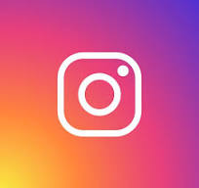
Contact
THANK TOU
Rahul kharbanda
Add = Unit No. 02, F - 35, Kirti Nagar Central Market, New Delhi - 110015 (INDIA)
Ph No = 9810360430
Website = https://www.magicianrahul.com/
Email = rahoolkharbanda@gmail.com
For watching this presentation
Everest Cantu
+123-456-7890
hello@reallygreatsite.com
www.reallygreatsite.com
123 Anywhere St., Any City, State, Country 12345

