Slide 1
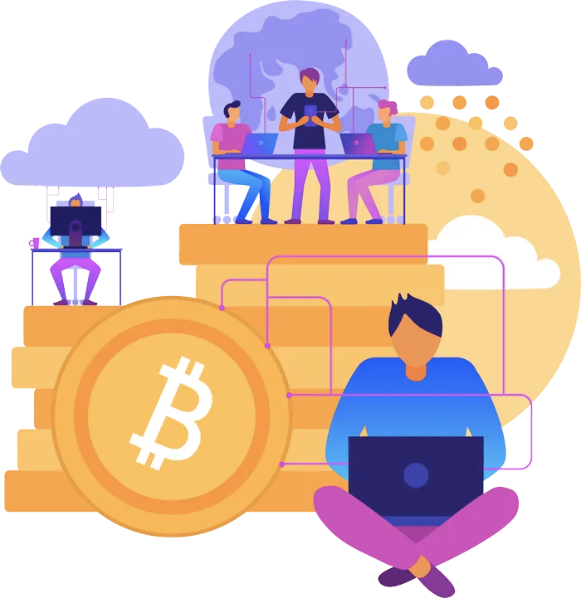



TOKEN DEVELOPMENT SERVICES:
Essential Insights

Slide 2
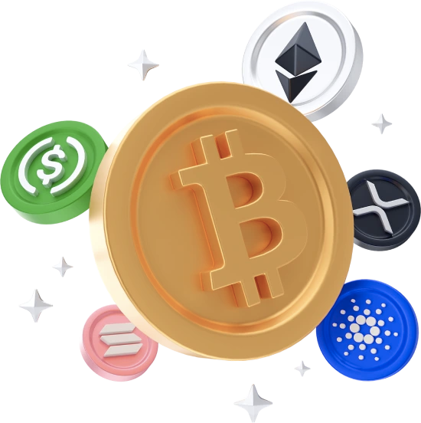
What is Token Development
  Token Development is a process of technique of turning common Real Estate or physical assets into Crypto token development on a Blockchain technology Network.
  Accompanying records which include asset ownership information that is transformed and added into a blockchain in a virtual shape. Typically, this process is Tokenization.
  Crypto Tokens can also be used for making payments as well as to enable Peer-to-Peer (P2P) transactions between participants. Basically, it is simple and incredibly safe to transfer ownership of specific physical items using crypto tokens over the blockchain network.

Slide 3
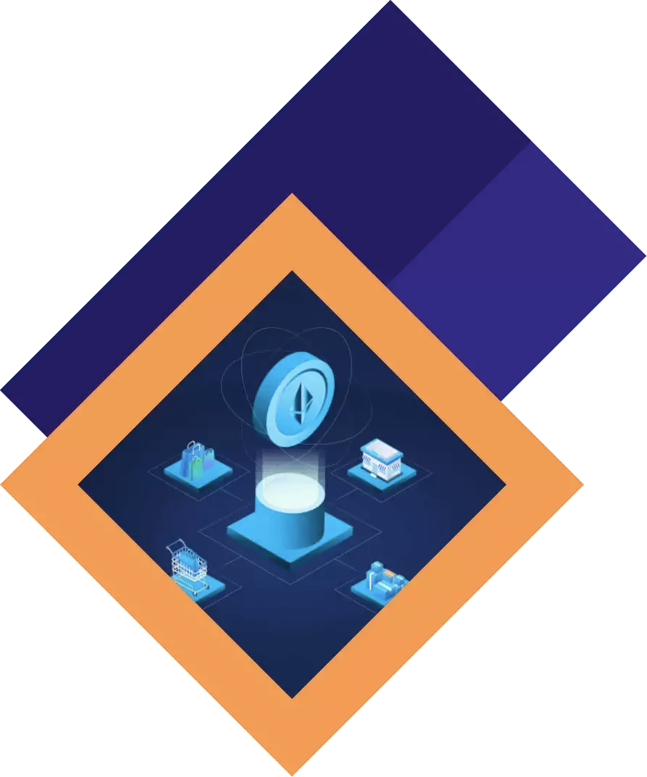
Token Development Types
  Utility Token
  Non-Fungible Token (NFT)
  Governance Tokens
  Security Token

Slide 4
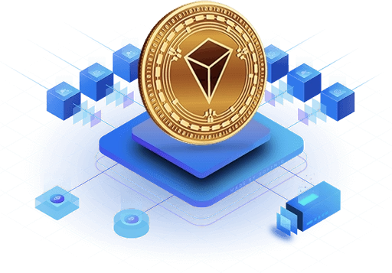
Top Token Development Services by BlockchainX
  Bep20 Token Development
  ERC20 Token Development
  TRON Token Development
  Non Fungible Token Development
  Defi Token development

Slide 5
Advantages Of Token Development
Here are a number of the primary benefits of making your very own token if you’re uncertain why you need it or whether or not tokenization is appropriate for you.
  Improves Liquidity
  Advanced Security
  Enhanced Scalability and Performance
  Multi-Asset Support
  No Need For An Intermediary
  High-Efficiency

Slide 6
Why Opt for Professional Token Development Services
Opting for professional token development services offers several advantages:
Expertise: create high-quality tokens with Experienced developers with high knowledge skills.
Customization: Tailored answers to meet your particular necessities.
Security: Professional services make certain sturdy security features to protect in opposition to vulnerabilities.
Regulatory Compliance: Guidance on legal and regulatory components to make certain your token adheres to relevant legal guidelines.

Slide 7
Conclusion:
  Token improvement is a complex however profitable method which can open doorways to numerous opportunities within the blockchain area.
  By know-how the fundamentals and operating with professional offerings, you can successfully navigate the challenges and release a token that meets your objectives.
  Whether you’re seeking to create a software token, security token, or any other kind, staying informed and making strategic decisions will pave the way for your token’s fulfillment.

Slide 8





THANK YOU
contact@blockchainxgmail.com

