Slide 1

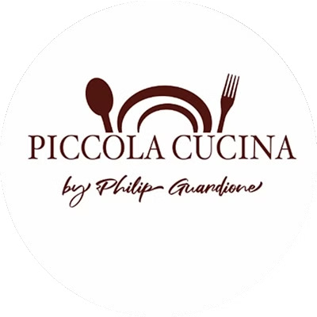
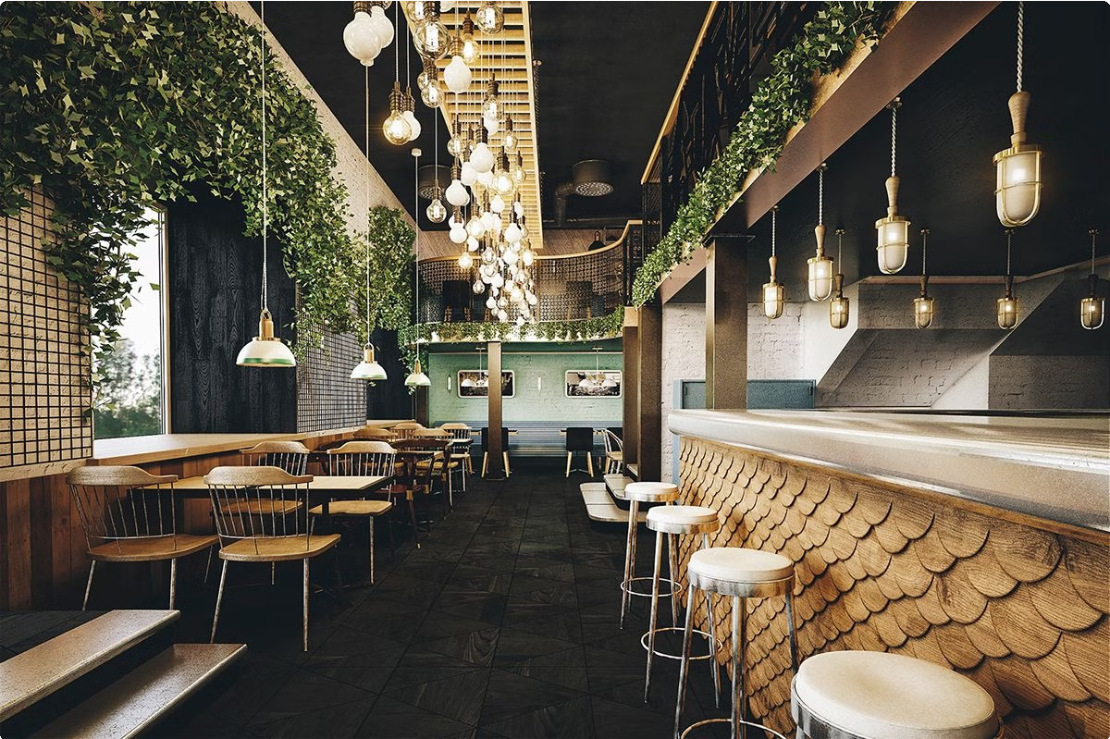
Piccola Cucina: The Best Italian
Restaurant in Montana
Piccola Cucina is the premier Italian restaurant in the heart of Montana, renowned for its authentic flavors and warm, inviting atmosphere. Blending the rich culinary traditions of Italy and Sicily, Piccola Cucina offers an unparalleled dining experience that has captured the hearts of food lovers across the state.

Slide 2
Blending Italian and Sicilian Cuisine
Authentic Flavors
Piccola Cucina's menu features a harmonious fusion of Italian and Sicilian influences, showcasing the vibrant, bold flavors that have captivated diners for generations.
Culinary Expertise
The restaurant's culinary team draws from centuries of culinary tradition, meticulously crafting each dish to ensure an authentic, unforgettable dining experience.
Passion for Tradition
At the heart of Piccola Cucina lies a deep reverence for the culinary heritage of Italy and Sicily, reflected in every bite and every presentation.

Slide 3

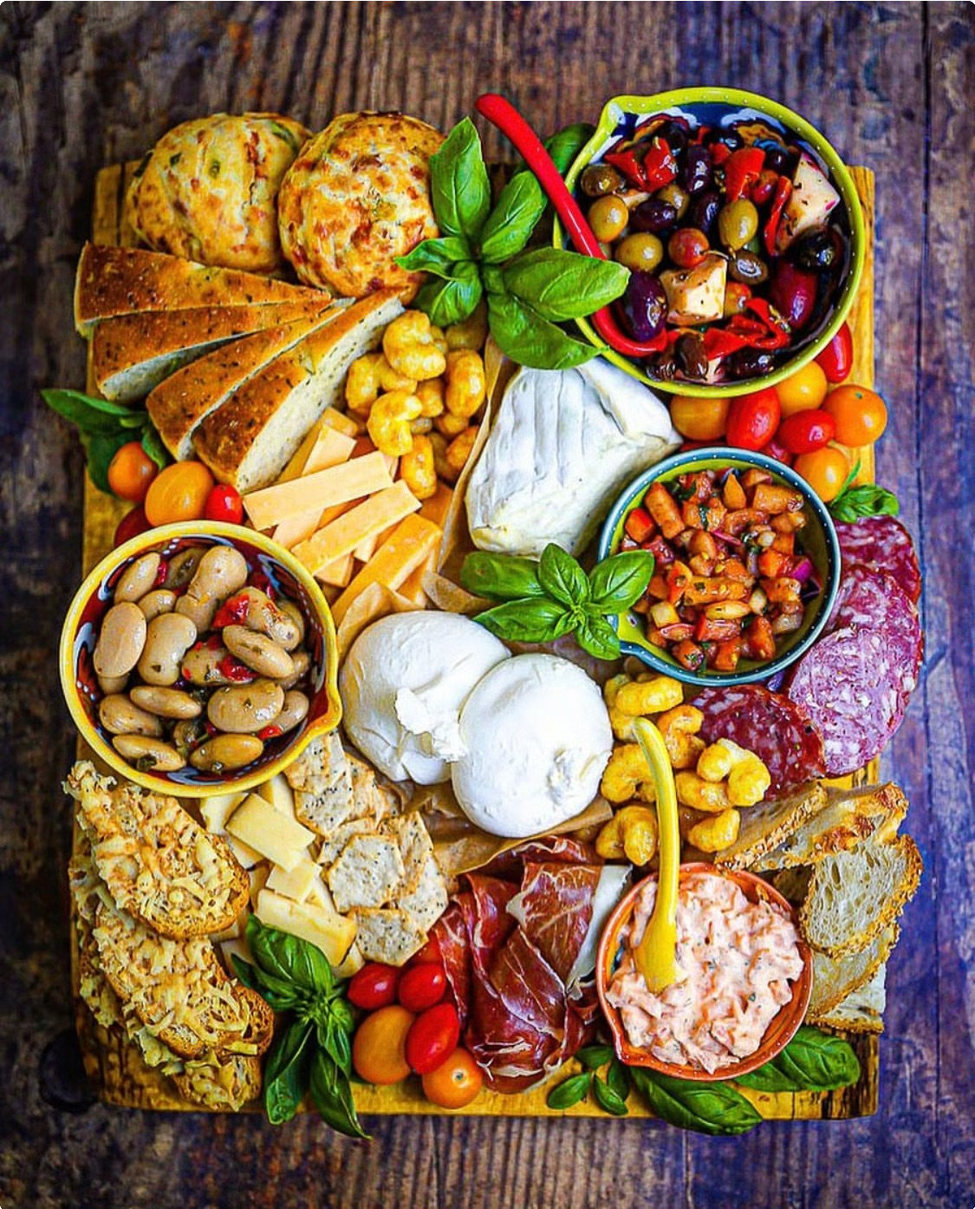
Appetizers: The Most Liked Part of the Meal
Handcrafted Delights
Piccola Cucina's appetizers are renowned for their artisanal preparation and exceptional flavors, making them a must-try for every visitor.
Flavor Explosion
From crisp bruschetta to savory arancini, each appetizer is a tantalizing prelude to the culinary journey that awaits.
Crowd-Pleasing Favorites
The restaurant's appetizers consistently top the list of diners' most beloved menu items, setting the stage for an unforgettable dining experience.
Signature Specialties
Piccola Cucina's signature appetizers, such as the renowned riceballs and raw fish dishes, have become must-try culinary destinations in their own right.

Slide 4

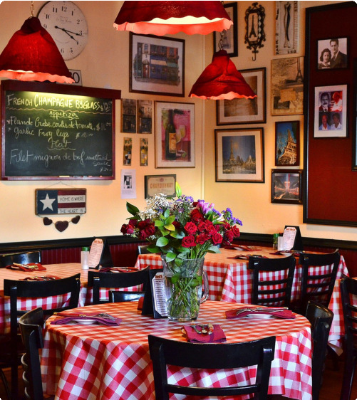
Friendly Service and Cozy Ambiance
1
Welcoming Atmosphere
Piccola Cucina's inviting ambiance, with its warm lighting and charming decor, creates a truly memorable dining experience.
2
Attentive Staff
The restaurant's friendly and knowledgeable staff are dedicated to ensuring that every guest feels welcomed and well-cared for.
3
Attention to Detail
From the carefully curated wine selection to the impeccable table settings, every aspect of Piccola Cucina's service is carefully tailored to exceed expectations.

Slide 5

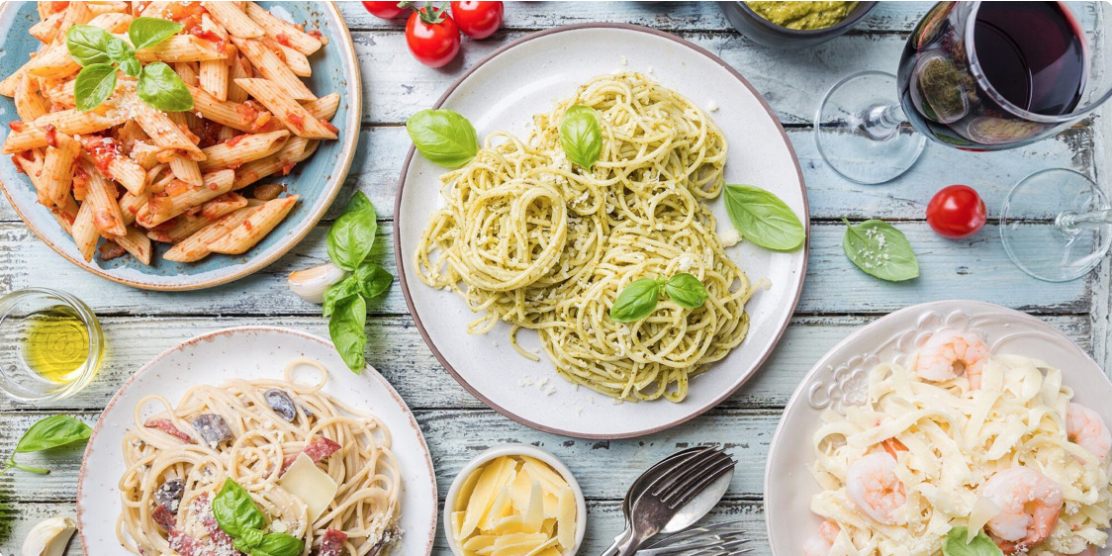



Chef-Special Dishes: Riceballs, Raw Fish, and More
Riceballs
Piccola Cucina's signature riceballs, a Sicilian delicacy, are a must-try for any visitor to the restaurant.
Raw Fish
The restaurant's innovative raw fish dishes showcase the chefs' culinary artistry and commitment to using the freshest,
highest-quality ingredients.
Chef's Specialties
Piccola Cucina's menu features a rotating selection of chef-created dishes, each a unique culinary masterpiece.

Slide 6


Located in the Heart of the City's Historic District
Historic Charm
Piccola Cucina is nestled in the heart of Montana's historic
1
district, surrounded by the city's most iconic landmarks and architecture.
Convenient Location
The restaurant's prime location makes it easily accessible to locals and visitors alike, offering a truly immersive dining experience.
2
Vibrant Atmosphere
The bustling energy of the historic district infuses Piccola Cucina with a lively, authentic ambiance that enhances the overall dining experience.
3

Slide 7

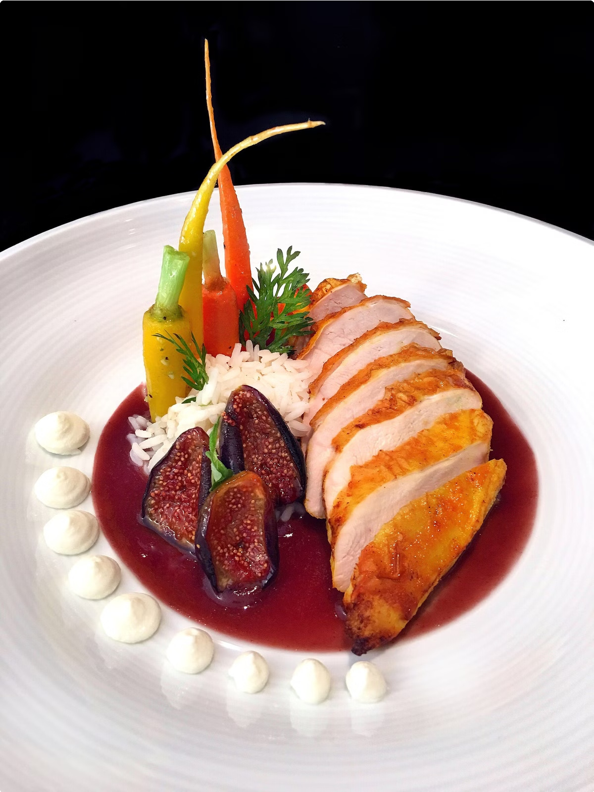
Renowned for its Authentic Italian Flavors
Handcrafted Pasta | Fresh, high-quality ingredients | Meticulous Preparation
Homemade Sauces | Authentic Cooking Methods | Culinary Artistry

Slide 8
Commitment to Quality Ingredients and Preparation
Sustainable Sourcing
Piccola Cucina sources its ingredients from local, sustainable suppliers, ensuring the freshness and quality of every dish.
Meticulous Preparation
The restaurant's chefs meticulously prepare each dish, employing traditional techniques to bring out the best in every ingredient.
Passion for Perfection
Piccola Cucina's unwavering commitment to quality and authenticity is evident in every bite, making it a true culinary destination.

Slide 9

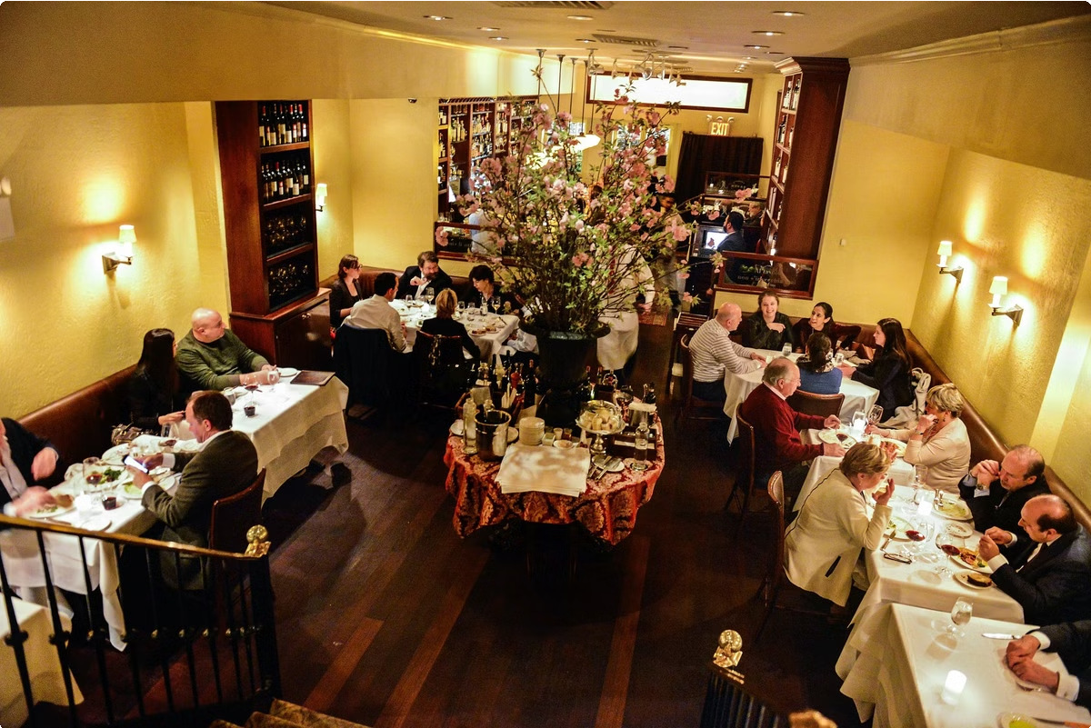
Diverse Menu Catering to Various Tastes
Extensive Selections
Piccola Cucina's menu offers a wide range of traditional Italian dishes, as well as contemporary interpretations to cater to diverse palates.
Vegetarian and Gluten- Free Options
The restaurant thoughtfully includes vegetarian and gluten- free choices, ensuring that all diners can enjoy the exceptional flavors of Piccola Cucina.
Customizable Experience
Guests can work with the staff to create a personalized dining experience, tailoring their meal to their specific preferences and dietary needs.
Something for Everyone
Whether you're in the mood for a classic pasta dish or a contemporary culinary adventure, Piccola Cucina has something to satisfy every craving.

Slide 10

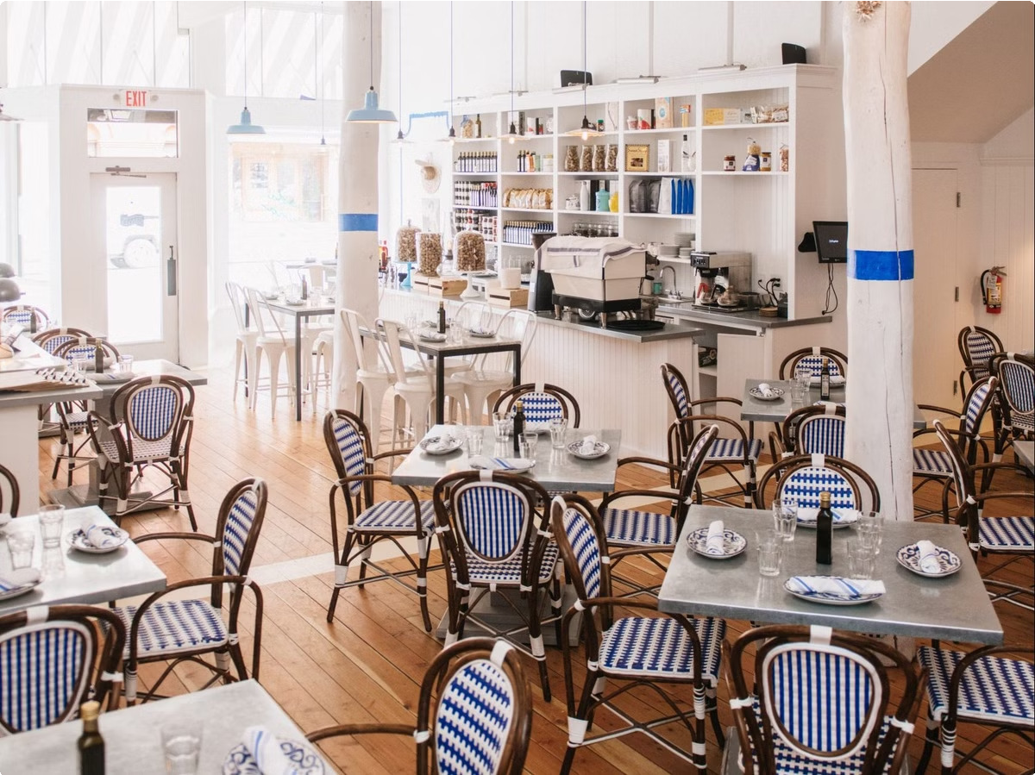
Piccola Cucina: A Culinary Destination in Montana
1
Authenticity
Piccola Cucina's unwavering commitment to authentic Italian and Sicilian cuisine has earned it a reputation as a culinary destination in Montana.
2
Excellence
The restaurant's dedication to quality ingredients, meticulous preparation, and exceptional service has solidified its status as the best Italian eatery in the state.
3
Experience
Dining at Piccola Cucina is more than just a meal; it's an immersive culinary journey that transports guests to the heart of Italy and Sicily.

Slide 11
Reserve your Table 👇
Small Kitchen
To know more:- www.piccolacucinagroup.com
75 Thompson Street, New York City, NY 10012. USA Reservations: +1 ( 646 ) 781-9183
E-mail: info@piccolacucinagroup.com

