Slide 1



Top 10 Benefits of using AI Tools When Designing a Website
www.edtech.in

Slide 2
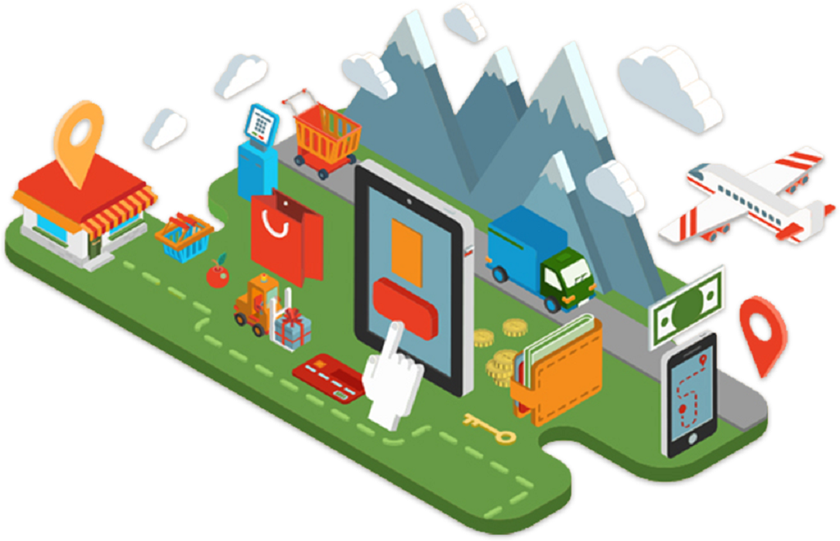

01
AI tools make designing websites easier and faster. They help with things like layout, color choices, and content, making websites more user-friendly and effective.
By using AI, you can create a modern, engaging website with less effort and cost.
Want to know the top 10 benefits of using AI tools when designing a website? Read this informative article -

Slide 3


Faster Design Process
02
AI tools speed up the website design process.
The experts of a website designing agency in Delhi experiences automate repetitive tasks like adjusting layouts and choosing colors.
Instead of doing these tasks manually, AI handles them quickly.
This saves time for designers.
They can then focus on more creative work, like coming up with new ideas.
With AI, designers don't need to spend hours on small details.
The tool does it for them, making the overall design process faster and more efficient.

Slide 4



Enhanced User Experience
03
AI helps improve user experience on websites.
It looks at how people use the site and what they like.
AI can suggest changes to make the site easier and more enjoyable to use.
For example, it might recommend adjusting the layout or adding features based on user behavior.
This makes the website more engaging and useful for visitors.
By analyzing how users interact with the site, AI helps create a design that fits their needs and preferences.

Slide 5


Personalized Content
04
AI helps make content more personalized for each user.
It looks at what users like and how they browse the site.
Based on this information, AI can suggest content that matches their interests.
For example, if a user likes certain topics, the AI can show them more related articles or products.
This makes the website feel more relevant and interesting to each visitor.
Personalized content keeps users engaged and makes their experience better.
By showing what users want to see, AI helps create a website that feels customized just for them.

Slide 6


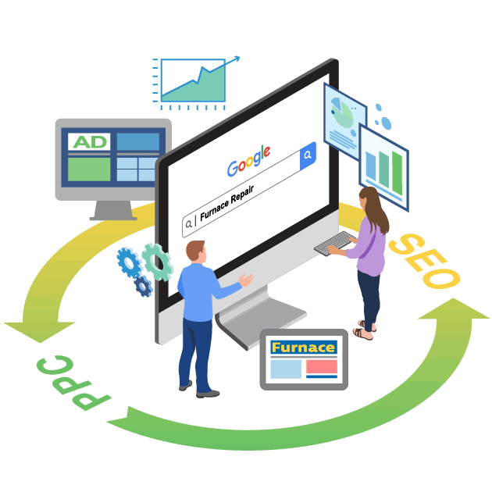
Improved SEO
05
AI helps improve SEO, which makes your website easier to find on search engines like Google.
  It suggests important keywords to use in your content.
It helps your site show up in search results.
AI also helps with meta tags, which are small bits of information about your site that search engines use.
It can analyze how well your site is doing and suggest changes to improve your ranking.
With AI, you can see which parts of your site need work and get tips to make them better.
  This means more people will find your website when they search for related topics.

Slide 7

Efficient Testing and Optimization
06
AI makes testing and optimizing your website easier.
It can run A/B tests to compare different versions of your site and see which one works better.
AI analyzes the results quickly and tells you which version is more effective.
This helps you make smart decisions about changes to improve your site.
AI also provides suggestions on how to fix issues and make your site perform better.
By using AI, you can test new ideas and see what users like best.
This means your website can be improved based on real data.

Slide 8

Automated Design Recommendations
07
AI provides design recommendations to keep your website modern.
It looks at current design trends and best practices.
Based on this, AI suggests changes to improve your site’s look and feel.
For example, it might recommend updating colors, fonts, or layouts.
AI can also give ideas on how to make your site more attractive and user-friendly.
By following AI’s suggestions, you can ensure your website stays up-to-date with the latest design trends.

Slide 9

Better Accessibility
08
AI helps make websites more accessible for everyone.
It can find and fix issues like poor color contrast or small font sizes.
These issues might make it hard for some people to use the site.
AI can automatically suggest changes to improve readability and navigation.
This makes the website easier to use for people with different needs, including those with vision problems.
By improving accessibility, AI helps ensure that all users, including those with disabilities, can enjoy your site.

Slide 10

Cost Savings
08
AI tools can help save money on website design.
They automate many tasks, reducing the need for manual work.
For example, AI can handle layout adjustments and color choices quickly.
This cuts down on the time and effort needed from designers.
With less manual work, the overall cost of designing and maintaining the website is lower.
AI also helps with efficient testing and optimization.
It also avoids extra costs for fixing problems later.
By streamlining processes and reducing manual tasks, AI tools make website design more affordable.

Slide 11


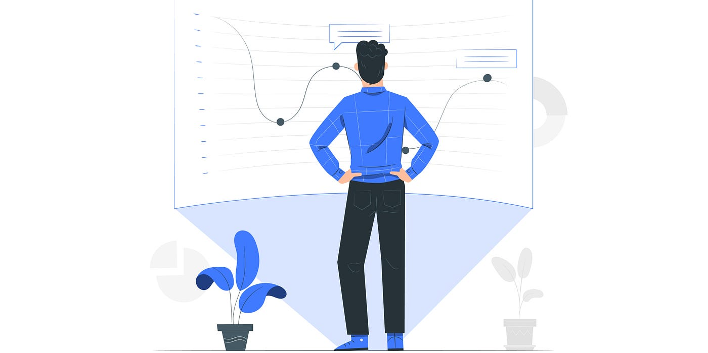
Advanced Analytics
09
AI tools provide advanced analytics to understand how users interact with your website.
They track user behavior, like what pages they visit and how long they stay.
AI analyzes this data to give you clear insights into what is working well and what needs improvement.
For example, it can show which pages are popular and which ones users leave quickly.
This information helps you make informed decisions about changes to improve your site.
AI also helps identify trends and patterns that might be missed manually.
By using these insights, you can make your website more effective and user-friendly.

Slide 12




Creative Inspiration
10
AI tools can offer creative ideas for designing your website.
They analyze current design trends and provide suggestions for colors, layouts, and styles.
If you're stuck or need inspiration, AI can generate new design ideas based on what is popular and effective.
It helps you see fresh options and creative solutions.
With AI, you get a variety of design suggestions without having to brainstorm everything yourself.
This makes it easier to find new and exciting ways to enhance your site.

Slide 13
Contact
E-definers Technology
ADD- 132, 2nd floor, mall road, kingsway camp, GTB nagar, delhi 110009, IN
Call – 9999051533
Email -info@edtech.In
Website -https://www.edtech.in/
FB -https://www.Facebook.Com/edefiners/

