Slide 1




B2K Holdings: Rugged Military Technology Solutions
B2K Holdings is a leading provider of Rugged Military Displays and Video Surveillance Systems for defense contractors. Our solutions are designed to meet the demanding needs of mission-critical operations in harsh environments.

Slide 2

Rugged Military Displays
Built to Last
Exceptional Clarity
Enhanced Visibility
Our Rugged Military Displays are engineered with military-grade components, designed to withstand extreme temperatures, vibrations, and shocks.
High-resolution screens provide clear and crisp visuals, even in challenging lighting conditions.
B2K's displays utilize advanced anti-glare technology to deliver superior readability in direct sunlight.

Slide 3


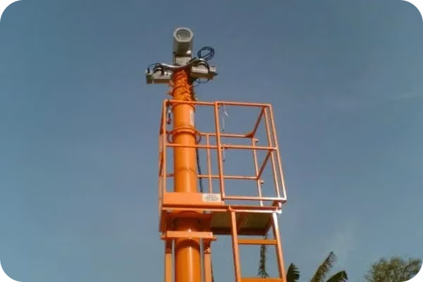
Video Surveillance Systems
Advanced Surveillance
Secure Communication
Our Video Surveillance Systems provide comprehensive monitoring capabilities with high-definition video capture, reliable recording, and remote access.
Secure data transmission ensures critical information is protected and readily available to authorized personnel.
Real-Time Monitoring
Real-time video streaming allows operators to monitor activity remotely and react quickly to any security threats.

Slide 4






Built for Tough Environments
Extreme Temperatures
Our solutions operate flawlessly in extreme heat and cold, ensuring consistent performance in diverse environments.
Harsh Conditions
They are resistant to dust, rain, and other environmental factors that can compromise performance.
Vibration and Shock
Designed to withstand the vibrations and shocks encountered in demanding military operations.

Slide 5



Trusted by Defence Contractors
1
Proven Reliability
2
Long-Term Support
3
Collaborative Partnerships
Our products have been tested and validated to meet the rigorous standards of defense contractors and military organizations.
We provide comprehensive technical support and maintenance services to ensure your systems operate seamlessly over the long term.
We work closely with defense contractors to understand their unique needs and deliver tailored solutions.

Slide 6


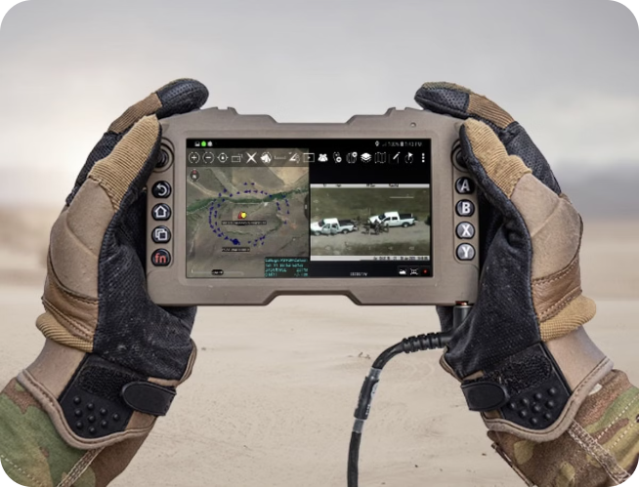
High-Performance Technology
Enhanced Processing Power
Our systems utilize powerful processors and advanced graphics capabilities for fast and efficient operation.
Advanced Imaging
High-resolution displays and cameras capture detailed images and videos, critical for situational awareness.
Secure Data Storage
Robust data storage solutions ensure critical information is protected and readily available.

Slide 7





Mission-Critical Operations
Situational Awareness
Decision Making
Command and Control
Real-time data and video feeds provide operators with a clear understanding of the environment and critical information.
Our solutions provide the information needed for informed decisions, enhancing mission effectiveness.
Secure communication channels enable seamless coordination between commanders and field personnel.

Slide 8



Durability, Precision, Reliability
1
Rugged Construction
Designed to withstand the rigors of military operations, our solutions are built with durable materials and robust construction.
2
Accurate Performance
Our systems deliver accurate and reliable data and video capture essential for mission success.
3
Proven Reliability
Extensive testing and field experience guarantee consistent performance in even the most demanding environments.

Slide 9


Military Applications: Field to Secure Facilities
Field Operations
Secure Facilities
Our rugged displays and surveillance systems are ideal for use in field operations, providing critical situational awareness and communication capabilities.
Our systems are deployed in secure facilities, enhancing perimeter security and providing 24/7 monitoring capabilities.

Slide 10


Providing the Tools for Success
B2K Holdings empowers Defense contractors with the technology they need to succeed in today's dynamic and demanding military landscape.

Slide 11
Britannia 2000 Holdings
Contact Us-
Call-+44 7717 292751
Email Id-sales@b2kholdings.co.uk
Address-4, Millside Park, Winkfield, Windsor SL4 4PX, United Kingdom
Website-www.b2kholdings.co.uk

