Slide 1



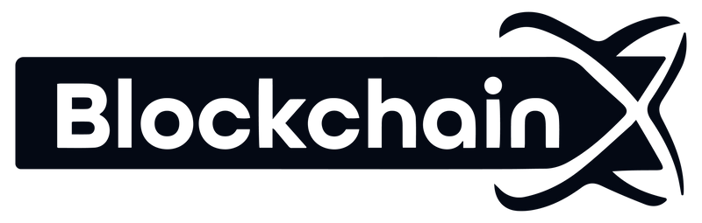
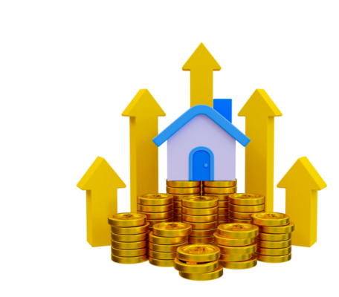
Implementation of Real Estate Tokenization in Real World
www.blockchainx.tech

Slide 2
Real estate tokenization is the process of converting physical assets into digital ones using blockchain technology. Tokenization of real estate assets will soon be a norm because of its advantages. This innovation will affect not only real estate; it will affect all sectors. In this article, we shall discuss how to implement a real estate token.

Slide 3



What is real estate tokenization?
The practice of real estate tokenization is when you put ownership of an asset which deals with real estate into digital tokens on a blockchain. The tokens represent fractional portions of property hence making it easier for investors to purchase and sell sections of this asset thus increasing their accessibility and liquidity. By removing initial costs for real estate investments, allowing small scale investors access to multi-million dollar projects and making use of the technology behind blockchain to ensure openness and safety in transactions, then this is how you can practice democracy in investing into real estate.

Slide 4
Steps to implement real estate tokenization
1. Understanding Legal Or Regulatory Requirements
Research Regulations: Make sure to comply with the laws of the country in which the asset is situated as well as where it will be sold the tokens with regard to securities’ laws, property regulations and those governing blockchain.
Obtain Legal Counsel: Collaborate with real estate and blockchain lawyers so that the token offer can be structured legally.

Slide 5
Select The Real Estate Asset
Asset Valuation: Select the actual estate property and conduct a professional valuation for determining the market value.
Ownership Structure: Determine how this asset will be owned – by direct ownership, means through an SPV or through any other agency.
Create A Tokenization Structure
Determine Token Type: Find out whether they will represent equity, debt, revenue share or other forms of ownership.
Fractionalize Ownership: Divide its value into smaller tokens which are tradable units.
Smart Contract Development: Build smart contracts which set rules for token issuance, ownership transitions and compliance.

Slide 6
Choose A Blockchain Platform
Select A Blockchain: Choose a platform like either Ethereum or Binance Smart Chain or Polygon based on your need for scalability, cost efficacy or security protocols.
Create Tokens: Mint the tokens based on specifications provided by the selected block-chain while ensuring compliance with such standards as ERC-20, ERC-721 etc.
The Development of Digital Platform
Build a Marketplace or Go for an Existing One: Build the platform for exchanging, selling and managing tokens or join with an already established platform.
User Interface (UI): Create an investor-friendly interface that enables users to access, purchase and exchange tokens.

Slide 7
6. KYC/AML Compliance
Investor Onboarding: Acknowledge Know Your Customer (KYC) and Anti-Money Laundering (AML) in order to authenticate who an investor is.
Smart Contract Integration: Make sure KYC/AML methods are incorporated within the smart contracts such that allowing only authorized transactions takes place.
7.Marketing And Investor Relations
Token Sale Strategy: Formulate primary token sale or Initial Coin Offering (ICO) plans in order to raise funds.
Engage Investors: To entice potential investors, utilize digital marketing strategies, reach out to investors and provide educational materials.

Slide 8
Token Distribution And Management
Distribute Tokens: After the sale, such tokens should be distributed into each one of the investors’ wallets.
Ongoing Management: Engage with your customers’ shareholders through different means including dividends distribution while also facilitating secondary market transactions whenever they arise.
Secondary Market Trading
Enable Liquidity: Launch tokens on secondary trading platforms or decentralized exchanges (DEXs) as a way of providing liquidity for investors who buy them.
Compliance: Ensure compliance by ensuring that trading abides by all established regulations including restriction on transferability

Slide 9
10. Continuity of Compliance and Reporting
Periodic Audits: Regular assessments of the smart contracts and legal framework should be carried out.
Updating Investors: Token holders should be provided with continuous updates about how the asset underlying their tokens is performing.

Slide 10
10. Continuity of Compliance and Reporting
Periodic Audits: Regular assessments of the smart contracts and legal framework should be carried out.
Updating Investors: Token holders should be provided with continuous updates about how the asset underlying their tokens is performing.

Slide 11
Conclusion
Real estate tokenization is a fast-emerging and revolutionary way of investing in property that provides easier access, security, and efficiency. Blockchain technology enables fractional ownership through which small investors can be part of big time property projects and easily sell off their shares. This idea might still seem like a mystery to some but it carries with it the potential for making real estate investing fairer to all people; not only does it provide more liquidity but it also enhances transparency within this sector. As people learn more about this concept, there are high chances that real estate tokenization will play an important role in stimulating growth and innovation.

Slide 12




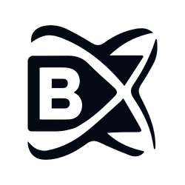
Thank you!
Contact us
contact@blockchainx.tech
+91 7708889555
www.blockchainx.tech

