Slide 1



CMS Open Payments Data
The CMS Open Payments Program is a public database that tracks payments from pharmaceutical and medical device companies to healthcare providers. The program was established by the Affordable Care Act to increase transparency in healthcare payments.

Slide 2


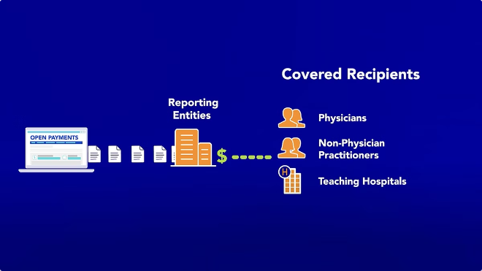
Overview of CMS Open Payments
Transparency
Public Database
The program aims to increase transparency in healthcare payments by making data on payments between pharmaceutical and medical device companies and healthcare providers publicly available.
The CMS Open Payments database provides detailed information on payments made to physicians, hospitals, and other healthcare providers.
Public Interest
The data is intended to help patients, researchers, and policymakers understand financial relationships between healthcare providers and pharmaceutical and medical device companies.

Slide 3


Purpose and Objectives
1
Reduce Conflicts of Interest
2
Improve Healthcare Quality
The program seeks to reduce potential conflicts of interest by making information about payments transparent.
The program aims to improve healthcare quality by providing patients with more information about their providers' financial relationships.
3
Promote Public Trust
The program seeks to promote public trust in the healthcare system by making information about payments transparent.

Slide 4


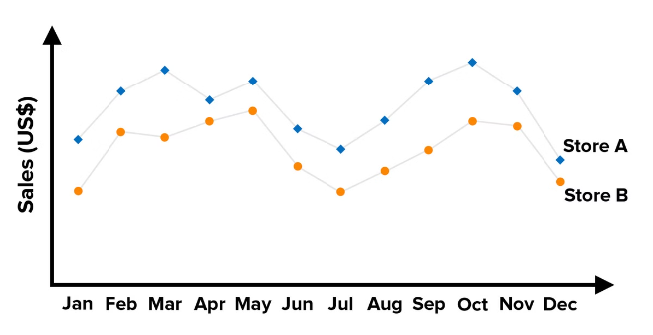
Data Collection and Reporting
1
Data Collection
Pharmaceutical and medical device companies are required to report all payments made to healthcare providers.
2
Data Validation
CMS verifies the accuracy and completeness of the reported data.
3
Public Reporting
The validated data is made publicly available through the CMS Open Payments website.

Slide 5
Transparency in Healthcare Payments
Public Disclosure
Detailed Information
Patient Access
All payments made to healthcare providers are disclosed in the CMS Open Payments database.
The database includes information on the type of payment, the amount of the payment, and the date of the payment.
Patients can use the CMS Open Payments website to search for information about their healthcare providers' financial relationships.

Slide 6

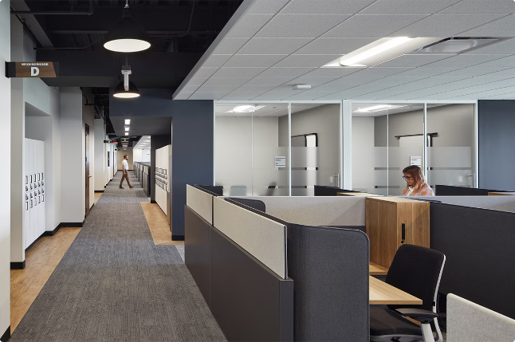
Covered Recipients and Payments
Physicians
Hospitals
Other Healthcare Providers
Consulting Fees
Research Grants
Educational Programs
Speaking Engagements
Drug Samples
Travel Expenses

Slide 7






Data Submission and Validation
Data Submission
Pharmaceutical and medical device companies submit data to CMS through an online portal.
Data Validation
CMS validates the submitted data for accuracy and completeness.
Data Correction
Companies are required to correct any errors in the submitted data.

Slide 8







Public Reporting and Accessibility
Public Website
Downloadable Data
The CMS Open Payments website provides a user-friendly interface for accessing the data.
The data is available for download in various formats, such as CSV and XML.
Application Programming Interface
Data Visualization
The data can be accessed through an API, allowing developers to integrate the data into their applications.
The website offers tools for visualizing the data, making it easier to understand and interpret.

Slide 9



Compliance and Enforcement
1
Compliance Requirements
2
Enforcement Actions
Pharmaceutical and medical device companies are required to comply with the reporting requirements of the Open Payments Program.
CMS can take enforcement actions against companies that fail to comply with the reporting requirements.
3
Civil Penalties
4
Data Accuracy
Companies that violate the reporting requirements can face civil penalties.
CMS is committed to ensuring the accuracy and completeness of the data in the Open Payments database.

Slide 10




Significance and Impact
Research and Analysis
Patient Empowerment
Policy Formulation
Researchers can use the Open Payments data to study the influence of financial relationships on healthcare decision-making.
Patients can use the data to make informed decisions about their healthcare providers.
Policymakers can use the data to develop policies that promote transparency and ethical behavior in the healthcare industry.
To Know More:-
Website:- https://www.venops.com/cms-open-payments
Email:- memberservices@venops.com
Address:- ​​​​​​​​​​​​​​​​​​​​​​​​​​​​​​​​​​​​​​​​​​​​​​​​​​​​​​​​​​​​​​​​​​​​​​​​​​​​​​​​​​​​​​​​​​​​​​​​​​​​​​​​​​​​​​​​​​​​​​​​​​​​​​​​​​​​​​​​​​​​​​​​​​​​​​​​​​​​​​​​​​​​​​​​​​​​​​​​​​​​​​​​​​​​​​​​​​​​​​​​​​​​​​​​​​​​​​​​​​​​​​​​​​​​​​​​​​​​​​​​​​​​​​​​​​​​​​​​​​​​​​​​​​​​​​​​​​​​​​​​​​​​​​​​​​​​​​​​​​​​​​​​​​​​​​​​​​​​​​​​​​​​​​​​​​​​​​​​​​​​​​​​​​​​​​​​​​​​​​​​​​​​​​​​​​​​​​​​​​​​​​​​​​​​​​​​​​​​​​​​​​​​​​​​​​​​​​​​​​​​​​​​​​​​​​​​​​​​​​​​​​​​​​​​​​​​​​​​​​​​​​​​​​​​​​​​​​​​​​​​​​​​​​​​​​​​​​​​​​​​​​​​​​​​​​​​​​​​​​​​​​​​​​​​​​​​​​​​​​​​​​​​​​​​​​​​​​​​​​​​​​​​​​​​​​​​​​​​​​​​​​​​​​​​​​​​​​​​​​​​​​​​​​​​​​​​​​​​​​​​​​​​​​​​​​​​​​​​​​​​​​​​​​​​​​​​​​​​​​​​​​​​​​​​​​​​​​​​​​​​​​​​​​​​​​​​​​​​​​​​​​​​​​​​​​​​​​​​​​​​​​​​​​​​​​​​​​​​​​​​​​​​​​​​​​​​​​​​​​​​​​​​​​​​​​​​​​​​​​​​​​​​​​​​​​​​​​​​​​​​​​​​​​​​​​​​​​​​​​​​​​​​​​​​​​​​​​​​​​​​​​​​​​​​​​​​​​​​​​​​​​​​​​​​​​​​​​​​​​​​​​​​​​​​​​​​​​​​​​​​​​​​​​​​​​​​​​​​​​​​​​​​​​​​​​​​​​​​​​​​​​​​​​​​​​​​​​​​​​​​​​​​​​​​​​​​​​​​​​​​​​​​​​​​​​​​​​​​​​​​​​​​​​​​​​​​​​​​​​​​​​​​​​​​​​​​​​​​​​​​​​​​​​​​​​​​​​​​​​​​​​​​​​​​​​1395 South Marietta Parkway​​​​​​​​​​​​​​​​​​​​​​​​​​​​​​​​​​​​​​​​​​​​​​​​​​​​​​​​​​​​​​​​​​​​​​​​​​​​​​​​​​​​​​​​​​​​​​​​​​​​​​​​​​​​​​​​​​​​​​​​​​​​​​​​​​​​​​​​​​​​​​​​​​​​​​​​​​​​​​​​​​​​​​​​​​​​​​​​​​​​​​​​​​​​​​​​​​​​​​​​​​​​​​​​​​​​​​​​​​​​​​​​​​​​​​​​​​​​​​​​​​​​​​​​​​​​​​​​​​​​​​​​​​​​​​​​​​​​​​​​​​​​​​​​​​​​​​​​​​​​​​​​​​​​​​​​​​​​​​​​​​​​​​​​​​​​​​​​​​​​​​​​​​​​​​​​​​​​​​​​​​​​​​​​​​​​​​​​​​​​​​​​​​​​​​​​​​​​​​​​​​​​​​​​​​​​​​​​​​​​​​​​​​​​​​​​​​​​​​​​​​​​​​​​​​​​​​​​​​​​​​​​​​​​​​​​​​​​​​​​​​​​​​​​​​​​​​​​​​​​​​​​​​​​​​​​​​​​​​​​​​​​​​​​​​​​​​​​​​​​​​​​​​​​​​​​​​​​​​​​​​​​​​​​​​​​​​​​​​​​​​​​​​​​​​​​​​​​​​​​​​​​​​​​​​​​​​​​​​​​​​​​​​​​​​​​​​​​​​​​​​​​​​​​​​​​​​​​​​​​​​​​​​​​​​​​​​​​​​​​​​​​​​​​​​​​​​​​​​​​​​​​​​​​​​​​​​​​​​​​​​​​​​​​​​​​​​​​​​​​​​​​​​​​​​​​​​​​​​​​​​​​​​​​​​​​​​​​​​​​​​​​​​​​​​​​​​​​​​​​​​​​​​​​​​​​​​​​​​​​​​​​​​​​​​​​​​​​​​​​​​​​​​​​​​​​​​​​​​​​​​​​​​​​​​​​​​​​​​​​​​​​​​​​​​​​​​​​​​​​​​​​​​​​​​​​​​​​​​​​​​​​​​​​​​​​​​​​​​​​​​​​​​​​​​​​​​​​​​​​​​​​​​​​​​​​​​​​​​​​​​​​​​​​​​​​​​​​​​​​​​​​​​​​​​​​​​​​​​​​​​​​​​​​​​​​​​​​​​​​​​​​​​​​​​​​​​​​​​​​​​​​​​​​​​ ​​​​​​​​​​​​​​​​​​​​​​​​​​​​​​​​​​​​​​​​​​​​​​​​​​​​​​​​​​​​​​​​​​​​​​​​​​​​​​​​​​​​​​​​​​​​​​​​​​​​​​​​​​​​​​​​​​​​​​​​​​​​​​​​​​​​​​​​​​​​​​​​​​​​​​​​​​​​​​​​​​​​​​​​​​​​​​​​​​​​​​​​​​​​​​​​​​​​​​​​​​​​​​​​​​​​​​​​​​​​​​​​​​​​​​​​​​​​​​​​​​​​​​​​​​​​​​​​​​​​​​​​​​​​​​​​​​​​​​​​​​​​​​​​​​​​​​​​​​​​​​​​​​​​​​​​​​​​​​​​​​​​​​​​​​​​​​​​​​​​​​​​​​​​​​​​​​​​​​​​​​​​​​​​​​​​​​​​​​​​​​​​​​​​​​​​​​​​​​​​​​​​​​​​​​​​​​​​​​​​​​​​​​​​​​​​​​​​​​​​​​​​​​​​​​​​​​​​​​​​​​​​​​​​​​​​​​​​​​​​​​​​​​​​​​​​​​​​​​​​​​​​​​​​​​​​​​​​​​​​​​​​​​​​​​​​​​​​​​​​​​​​​​​​​​​​​​​​​​​​​​​​​​​​​​​​​​​​​​​​​​​​​​​​​​​​​​​​​​​​​​​​​​​​​​​​​​​​​​​​​​​​​​​​​​​​​​​​​​​​​​​​​​​​​​​​​​​​​​​​​​​​​​​​​​​​​​​​​​​​​​​​​​​​​​​​​​​​​​​​​​​​​​​​​​​​​​​​​​​​​​​​​​​​​​​​​​​​​​​​​​​​​​​​​​​​​​​​​​​​​​​​​​​​​​​​​​​​​​​​​​​​​​​​​​​​​​​​​​​​​​​​​​​​​​​​​​​​​​​​​​​​​​​​​​​​​​​​​​​​​​​​​​​​​​​​​​​​​​​​​​​​​​​​​​​​​​​​​​​​​​​​​​​​​​​​​​​​​​​​​​​​​​​​​​​​​​​​​​​​​​​​​​​​​​​​​​​​​​​​​​​​​​​​​​​​​​​​​​​​​​​​​​​​​​​​​​​​​​​​​​​​​​​​​​​​​​​​​​​​​​​​​​​​​​​​​​​​​​​​​​​​​​​​​​​​​​​​​​​​​​​​​​​​​​​​​​​​​​​​​​​​​​​​​​Bldg. 400, Suite 104​​​​​​​​​​​​​​​​​​​​​​​​​​​​​​​​​​​​​​​​​​​​​​​​​​​​​​​​​​​​​​​​​​​​​​​​​​​​​​​​​​​​​​​​​​​​​​​​​​​​​​​​​​​​​​​​​​​​​​​​​​​​​​​​​​​​​​​​​​​​​​​​​​​​​​​​​​​​​​​​​​​​​​​​​​​​​​​​​​​​​​​​​​​​​​​​​​​​​​​​​​​​​​​​​​​​​​​​​​​​​​​​​​​​​​​​​​​​​​​​​​​​​​​​​​​​​​​​​​​​​​​​​​​​​​​​​​​​​​​​​​​​​​​​​​​​​​​​​​​​​​​​​​​​​​​​​​​​​​​​​​​​​​​​​​​​​​​​​​​​​​​​​​​​​​​​​​​​​​​​​​​​​​​​​​​​​​​​​​​​​​​​​​​​​​​​​​​​​​​​​​​​​​​​​​​​​​​​​​​​​​​​​​​​​​​​​​​​​​​​​​​​​​​​​​​​​​​​​​​​​​​​​​​​​​​​​​​​​​​​​​​​​​​​​​​​​​​​​​​​​​​​​​​​​​​​​​​​​​​​​​​​​​​​​​​​​​​​​​​​​​​​​​​​​​​​​​​​​​​​​​​​​​​​​​​​​​​​​​​​​​​​​​​​​​​​​​​​​​​​​​​​​​​​​​​​​​​​​​​​​​​​​​​​​​​​​​​​​​​​​​​​​​​​​​​​​​​​​​​​​​​​​​​​​​​​​​​​​​​​​​​​​​​​​​​​​​​​​​​​​​​​​​​​​​​​​​​​​​​​​​​​​​​​​​​​​​​​​​​​​​​​​​​​​​​​​​​​​​​​​​​​​​​​​​​​​​​​​​​​​​​​​​​​​​​​​​​​​​​​​​​​​​​​​​​​​​​​​​​​​​​​​​​​​​​​​​​​​​​​​​​​​​​​​​​​​​​​​​​​​​​​​​​​​​​​​​​​​​​​​​​​​​​​​​​​​​​​​​​​​​​​​​​​​​​​​​​​​​​​​​​​​​​​​​​​​​​​​​​​​​​​​​​​​​​​​​​​​​​​​​​​​​​​​​​​​​​​​​​​​​​​​​​​​​​​​​​​​​​​​​​​​​​​​​​​​​​​​​​​​​​​​​​​​​​​​​​​​​​​​​​​​​​​​​​​​​​​​​​​​​​​​​​​​​ ​​​​​​​​​​​​​​​​​​​​​​​​​​​​​​​​​​​​​​​​​​​​​​​​​​​​​​​​​​​​​​​​​​​​​​​​​​​​​​​​​​​​​​​​​​​​​​​​​​​​​​​​​​​​​​​​​​​​​​​​​​​​​​​​​​​​​​​​​​​​​​​​​​​​​​​​​​​​​​​​​​​​​​​​​​​​​​​​​​​​​​​​​​​​​​​​​​​​​​​​​​​​​​​​​​​​​​​​​​​​​​​​​​​​​​​​​​​​​​​​​​​​​​​​​​​​​​​​​​​​​​​​​​​​​​​​​​​​​​​​​​​​​​​​​​​​​​​​​​​​​​​​​​​​​​​​​​​​​​​​​​​​​​​​​​​​​​​​​​​​​​​​​​​​​​​​​​​​​​​​​​​​​​​​​​​​​​​​​​​​​​​​​​​​​​​​​​​​​​​​​​​​​​​​​​​​​​​​​​​​​​​​​​​​​​​​​​​​​​​​​​​​​​​​​​​​​​​​​​​​​​​​​​​​​​​​​​​​​​​​​​​​​​​​​​​​​​​​​​​​​​​​​​​​​​​​​​​​​​​​​​​​​​​​​​​​​​​​​​​​​​​​​​​​​​​​​​​​​​​​​​​​​​​​​​​​​​​​​​​​​​​​​​​​​​​​​​​​​​​​​​​​​​​​​​​​​​​​​​​​​​​​​​​​​​​​​​​​​​​​​​​​​​​​​​​​​​​​​​​​​​​​​​​​​​​​​​​​​​​​​​​​​​​​​​​​​​​​​​​​​​​​​​​​​​​​​​​​​​​​​​​​​​​​​​​​​​​​​​​​​​​​​​​​​​​​​​​​​​​​​​​​​​​​​​​​​​​​​​​​​​​​​​​​​​​​​​​​​​​​​​​​​​​​​​​​​​​​​​​​​​​​​​​​​​​​​​​​​​​​​​​​​​​​​​​​​​​​​​​​​​​​​​​​​​​​​​​​​​​​​​​​​​​​​​​​​​​​​​​​​​​​​​​​​​​​​​​​​​​​​​​​​​​​​​​​​​​​​​​​​​​​​​​​​​​​​​​​​​​​​​​​​​​​​​​​​​​​​​​​​​​​​​​​​​​​​​​​​​​​​​​​​​​​​​​​​​​​​​​​​​​​​​​​​​​​​​​​​​​​​​​​​​​​​​​​​​​​​​​​​​​​​​​​​​Marietta Ga 30067​​​​​​​​​​​​​​​​​​​​​​​​​​​​​​​​​​​​​​​​​​​​​​​​​​​​​​​​​​​​​​​​​​​​​​​​​​​​​​​​​​​​​​​​​​​​​​​​​​​​​​​​​​​​​​​​​​​​​​​​​​​​​​​​​​​​​​​​​​​​​​​​​​​​​​​​​​​​​​​​​​​​​​​​​​​​​​​​​​​​​​​​​​​​​​​​​​​​​​​​​​​​​​​​​​​​​​​​​​​​​​​​​​​​​​​​​​​​​​​​​​​​​​​​​​​​​​​​​​​​​​​​​​​​​​​​​​​​​​​​​​​​​​​​​​​​​​​​​​​​​​​​​​​​​​​​​​​​​​​​​​​​​​​​​​​​​​​​​​​​​​​​​​​​​​​​​​​​​​​​​​​​​​​​​​​​​​​​​​​​​​​​​​​​​​​​​​​​​​​​​​​​​​​​​​​​​​​​​​​​​​​​​​​​​​​​​​​​​​​​​​​​​​​​​​​​​​​​​​​​​​​​​​​​​​​​​​​​​​​​​​​​​​​​​​​​​​​​​​​​​​​​​​​​​​​​​​​​​​​​​​​​​​​​​​​​​​​​​​​​​​​​​​​​​​​​​​​​​​​​​​​​​​​​​​​​​​​​​​​​​​​​​​​​​​​​​​​​​​​​​​​​​​​​​​​​​​​​​​​​​​​​​​​​​​​​​​​​​​​​​​​​​​​​​​​​​​​​​​​​​​​​​​​​​​​​​​​​​​​​​​​​​​​​​​​​​​​​​​​​​​​​​​​​​​​​​​​​​​​​​​​​​​​​​​​​​​​​​​​​​​​​​​​​​​​​​​​​​​​​​​​​​​​​​​​​​​​​​​​​​​​​​​​​​​​​​​​​​​​​​​​​​​​​​​​​​​​​​​​​​​​​​​​​​​​​​​​​​​​​​​​​​​​​​​​​​​​​​​​​​​​​​​​​​​​​​​​​​​​​​​​​​​​​​​​​​​​​​​​​​​​​​​​​​​​​​​​​​​​​​​​​​​​​​​​​​​​​​​​​​​​​​​​​​​​​​​​​​​​​​​​​​​​​​​​​​​​​​​​​​​​​​​​​​​​​​​​​​​​​​​​​​​​​​​​​​​​​​​​​​​​​​​​​​​​​​​​​​​​​​​​​​​​​​​​​​​​​​​​​​​​​​​​​​​
call to speak with our office
M-F from 8:30-5:00 EST
855 567 3552

