Slide 1
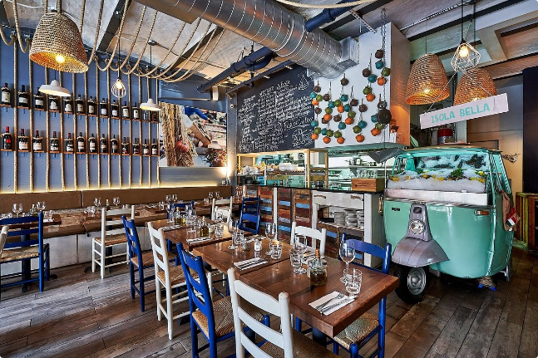
Piccola Cucina: The Best Italian Restaurant in NYC
Piccola Cucina is a hidden gem in the heart of New York City, offering an unparalleled dining experience with its seasonal seafood, handpicked local ingredients, and an extensive selection of wines and cocktails. The cozy and comfortable ambiance, coupled with the aroma of authentic Italian cuisine and the friendly, attentive service, make it a favorite among loyal and satisfied customers.

Slide 2
Seasonal Seafood and Handpicked Local Ingredients
Seasonal Seafood
Handpicked Local Ingredients
Commitment to Freshness
Piccola Cucina's menu features a rotating selection of the freshest seafood, sourced from local purveyors and delivered daily to ensure maximum flavor and quality.
The restaurant's chefs take pride in carefully selecting the finest locally-sourced produce, dairy, and other ingredients to create their signature dishes.
By focusing on seasonality and local sourcing, Piccola Cucina ensures that every meal is made with the most flavorful and nutritious ingredients.

Slide 3
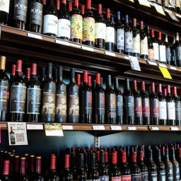
Wide Selection of Wines and Cocktails
Expertly Curated Wine List
Signature Cocktails
Perfect Pairing
Piccola Cucina's wine list features a carefully curated selection of both classic and innovative Italian vintages, catering to every palate.
The restaurant's talented bartenders craft unique, handmade cocktails using high-quality spirits and fresh, seasonal ingredients.
The wide variety of wine and cocktail options allows diners to perfectly complement their meal and enhance their dining experience.

Slide 4
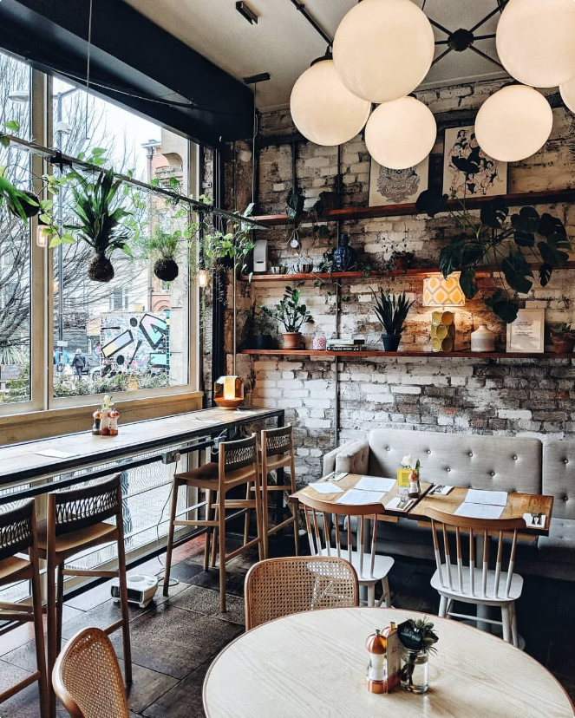
Cozy and Comfortable Ambiance
1
Warm and Inviting
The restaurant's intimate, candlelit atmosphere creates a cozy and welcoming environment for guests to unwind and savor their meals.
2
Rustic Charm
Piccola Cucina's decor features rustic, Italian-inspired elements that evoke a sense of old-world charm and authenticity.
3
Attention to Detail
Every aspect of the restaurant's design, from the custom-made furniture to the carefully curated artwork, contributes to the overall sophisticated and comfortable ambiance.

Slide 5
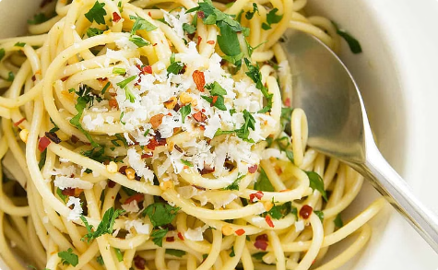
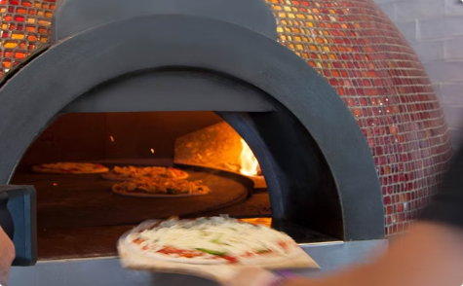
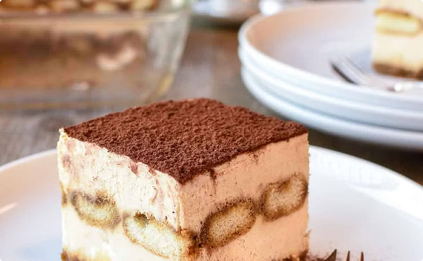
Aroma of Authentic Italian Cuisine
Handcrafted Pasta
Wood-Fired Pizza
Decadent Desserts
Piccola Cucina's pasta dishes are meticulously prepared using traditional techniques and the finest ingredients, resulting in a truly authentic Italian taste.
The restaurant's wood-fired pizza ovens produce crisp, flavorful crusts that serve as the perfect canvas for their selection of classic and specialty toppings.
Piccola Cucina's menu features a variety of housemade Italian desserts, including rich, creamy tiramisu and other indulgent treats.

Slide 6
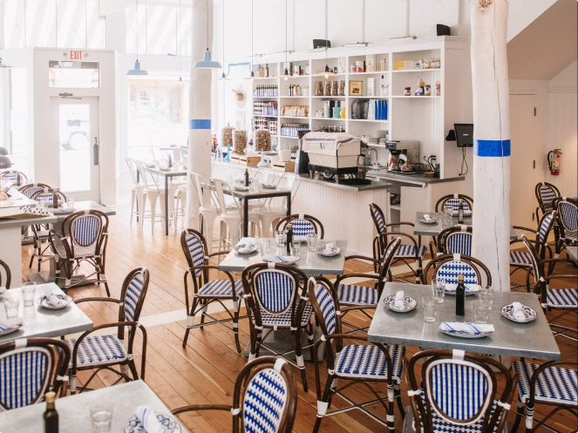
Friendly and Attentive Service
Welcoming Staff
Piccola Cucina's team of experienced and knowledgeable servers greet each guest with a warm smile and a genuine desire to make their dining experience exceptional.
Attentive Service
The restaurant's staff is highly attuned to the needs of their guests, ensuring that every detail is attended to with the utmost care and efficiency.
Knowledgeable Recommendations
Piccola Cucina's servers are well-versed in the menu and can provide thoughtful suggestions to help diners make the most of their meal.

Slide 7
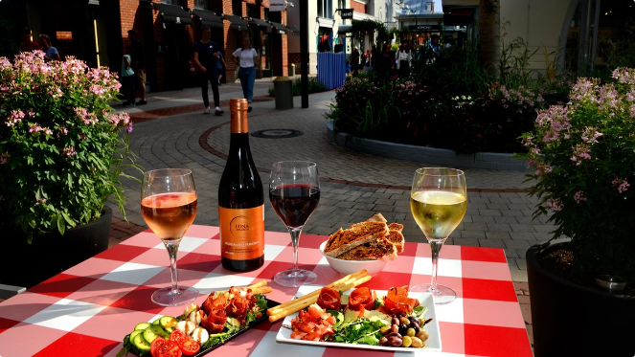
Loyal and Satisfied Customers
1
Repeat Visits
Many of Piccola Cucina's guests return time and time again, drawn to the restaurant's consistently excellent food, service, and ambiance.
2
Positive Reviews
The restaurant has garnered numerous glowing reviews from both local and national publications, solidifying its reputation as a top-tier dining destination.
3
Loyal Community
Piccola Cucina has become a beloved gathering place for the local community, fostering a sense of camaraderie and belonging among its patrons.

Slide 8
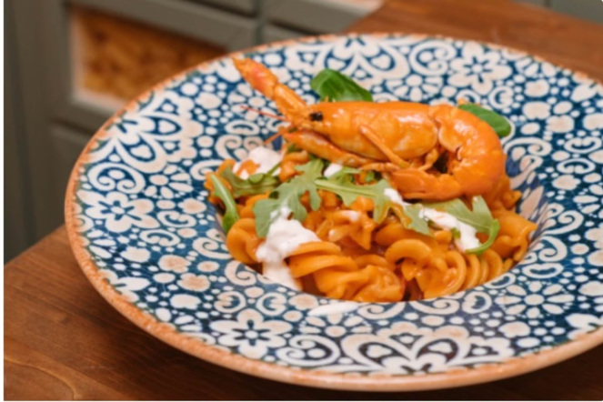
Locally Sourced, Freshly Prepared Meals
Local Sourcing
Piccola Cucina's chefs work closely with nearby farms and purveyors to source the freshest, seasonal ingredients for their menu.
Handcrafted Preparation
Each dish is meticulously prepared using traditional techniques and cooking methods to capture the true essence of authentic Italian cuisine.
Uncompromising Quality
The restaurant's commitment to quality and attention to detail ensures that every meal served is a true culinary masterpiece.

Slide 9
A Dining Experience to Remember
Exceptional Food
Piccola Cucina's menu features a harmonious blend of classic Italian dishes and innovative, seasonal offerings that delight the senses.
Impeccable Service
The restaurant's attentive and knowledgeable staff go above and beyond to ensure that each guest's dining experience is truly memorable.
Warm Atmosphere
The cozy, inviting ambiance of Piccola Cucina creates the perfect setting for an unforgettable culinary journey through the flavors of Italy.

Slide 10
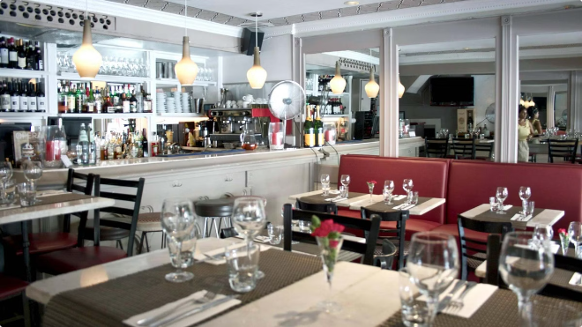
Best Restaurants in NYC : Know more
Best Restaurants in NYC | Piccola Cucina - New York, Ibiza
Opening Hours
Address
Sunday-Friday: from 5:00 PM to 11:00 PM
196 Spring Street, New York City, New York 10012, USA
Saturday and Sunday: from 11:30 AM to 11:00 PM
Telephone
Phone: (001) 646-478-7488

