Slide 1
Metal and Machine: Your Trusted Partner in Dubai
Metal and Machine is a leading construction company in Dubai, offering a wide range of products and services for various construction needs.

Slide 2
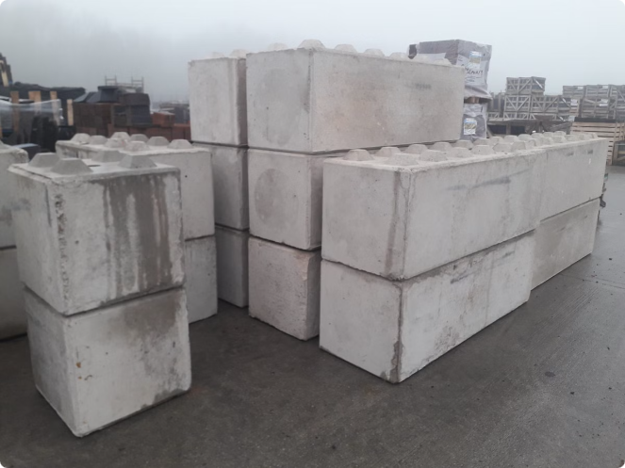
Precast Concrete Blocks: Unmatched Strength and Efficiency
Durable
Precast concrete blocks are known for their exceptional durability and resistance to weathering, making them ideal for a wide range of construction projects.
Versatile
Our precast concrete blocks are available in various shapes and sizes, catering to different design requirements and construction needs.
Cost-Effective
Precast concrete blocks in Dubai offer a cost-effective solution, reducing construction time and labor costs.
Environmentally Friendly
Our precast concrete blocks are produced with sustainable practices, minimizing environmental impact.

Slide 3
Steel Structure Solutions: Robust and Customizable Frameworks
Robust & Durable
Customizable Designs
Fast & Efficient
Our steel structures are designed to withstand heavy loads and harsh weather conditions, ensuring long-lasting performance and stability.
Steel structures supplier in Dubai are known for their rapid construction times, allowing for quicker project completion and reduced overall costs.
We offer tailored steel structures to meet specific project requirements, from industrial buildings to commercial spaces.

Slide 4
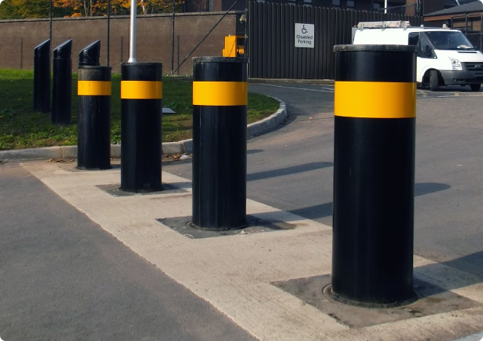
Bollards in Dubai: Enhancing Boundary and Security
1
Enhanced Security
Our bollards in Dubai provide a strong physical barrier, deterring unauthorized entry and protecting valuable assets.
2
Aesthetic Appeal
Our bollards come in various styles and finishes, seamlessly integrating with the surrounding environment while ensuring security.
3
Durable & Reliable
We use high-quality materials and construction techniques to ensure our bollards offer long-lasting performance and durability.
4
Customizable Options
We offer customizable bollards in Dubai, allowing for tailored solutions to meet specific security needs.

Slide 5
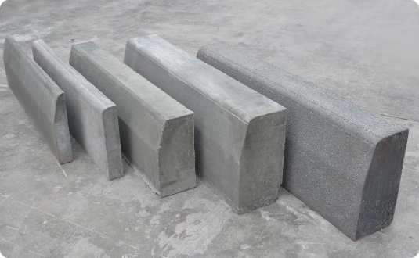
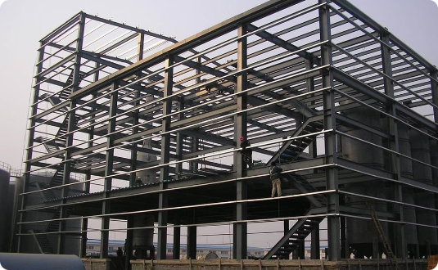
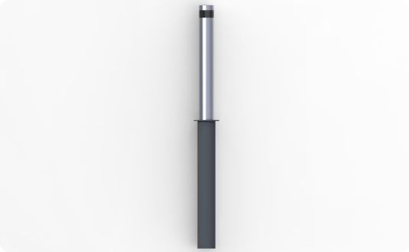
Diverse Construction Needs Covered
Precast Concrete Blocks
Steel Structure Solutions
Bollards
Enhance boundary security and deter unauthorized entry.
Durable, versatile, and cost-effective solutions for various construction projects.
Robust and customizable frameworks for industrial and commercial buildings.

Slide 6
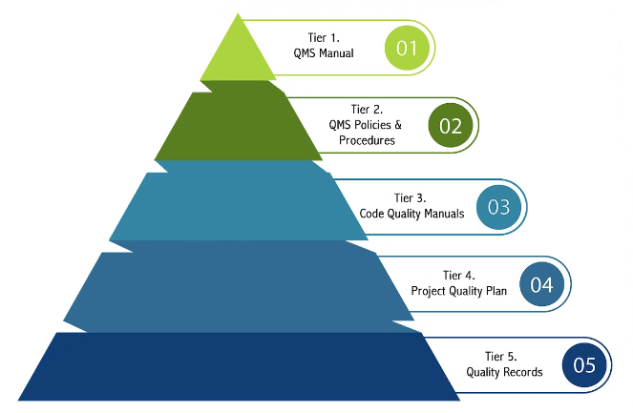
Commitment to Quality and Reliability
Quality Materials
We use only the highest quality materials in all our products and services, ensuring durability and performance.
Precise Construction
Our skilled team utilizes advanced techniques and precision tools to deliver accurate and reliable construction.
Guarantees & Warranties
We offer comprehensive guarantees and warranties, providing peace of mind for your construction projects.
Trusted Partner
We strive to build long-lasting relationships with our clients, based on trust, reliability, and exceptional service.

Slide 7
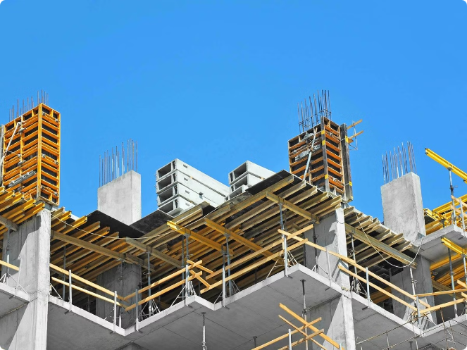
Tailored Solutions for Your Project
1
Needs Assessment
We carefully assess your project requirements, ensuring a thorough understanding of your specific needs and goals.
2
Design & Planning
Our team creates customized designs and plans, tailoring the solution to your project's unique requirements.
3
Execution & Delivery
We execute the project efficiently and effectively, ensuring timely completion and meeting all quality standards.
4
Ongoing Support
We provide ongoing support even after project completion, ensuring your satisfaction and addressing any concerns.

Slide 8
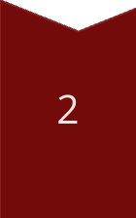
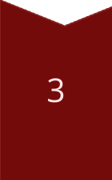
Exceptional Customer Service
Responsive Communication
We respond promptly to your inquiries, providing clear and concise information.
Personalized Attention
We dedicate personalized attention to your project, ensuring your needs are understood and met.
Professionalism & Courtesy
Our team maintains a high level of professionalism and courtesy throughout the entire process.

Slide 9
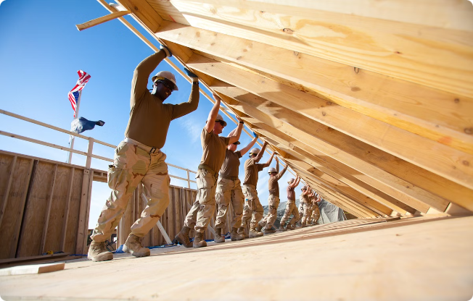
Industry-Leading Expertise
Experienced Professionals
Our team consists of highly skilled and experienced professionals with extensive knowledge in the construction industry.
Cutting-Edge Technology
We utilize the latest technology and innovative techniques to deliver efficient and high-quality construction solutions.
Continual Development
We are committed to continuous learning and development, staying at the forefront of industry trends.

Slide 10
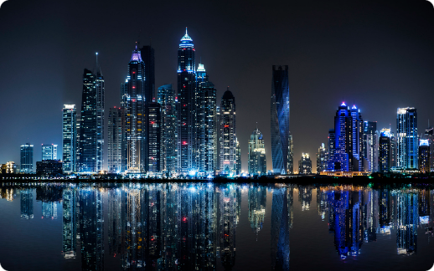
Transforming the Construction Landscape in Dubai
Metal and Machine is dedicated to transforming the construction landscape in Dubai, providing innovative solutions and exceptional service to our valued clients.

Slide 11
contact us-
call-+971501922352,+971504328270
Email Id-metalandmachine@gmail.com
Location-Plot no 8 , Block 6, Sector 711, New Industrial Area Umm Al Quwain, UAE​
Website-www.metalandmachine.net

