Slide 1
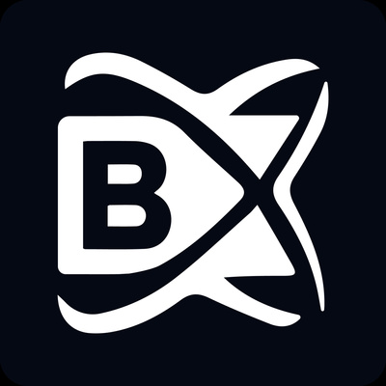
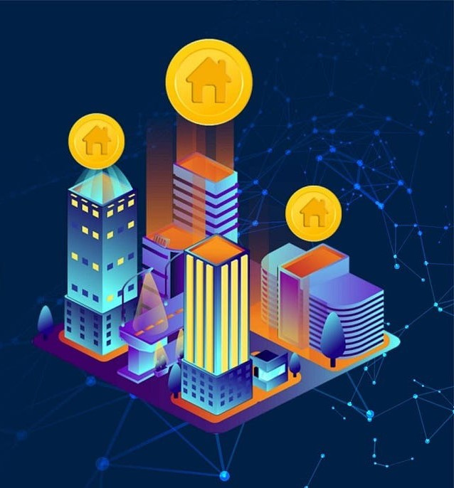
Blockchainx
The Beginner's Guide for Real Estate Tokenization

Slide 2

The Beginner's Guide for Real Estate Tokenization
The technology of tokenization in real estate has generated a lot of excitement from the industry’s players because it is viewed as providing a good chance for transforming opportunities and driving growth. It is widely believed that this approach will completely change the way people buy and sell real estate equity. On the other hand, tokenization is still not well understood by most individuals and remains complex. We will discuss a guide for real estate tokenization in this blog post.

Slide 3
What is Real Estate Tokenization ?
The practice of real estate tokenization is when you put ownership of an asset which deals with real estate into digital tokens on a blockchain. The tokens represent fractional portions of property hence making it easier for investors to purchase and sell sections of this asset thus increasing their accessibility and liquidity. By removing initial costs for real estate investments, allowing small scale investors access to multi-million dollar projects and making use of the technology behind blockchain to ensure openness and safety in transactions, then this is how you can practice democracy in investing into real estate.

Slide 4
How Does Real Estate Tokenization Work ?
Real estate tokenization works by creating digital tokens on a blockchain that represent fractional ownership of a property. The property is typically held by a legal entity, such as an LLC, and the ownership of this entity is divided into tokens. These tokens can be bought, sold, or traded on digital exchanges, much like stocks, allowing investors to easily enter or exit their investments. Blockchain technology ensures secure and transparent transactions, while smart contracts automate processes like income distribution and ownership transfers. This makes real estate investment more accessible, flexible, and efficient.

Slide 5
Conclusion
Guide for Real estate tokenization is a fast-emerging and revolutionary way of investing in property that provides easier access, security, and efficiency. Blockchain technology enables fractional ownership through which small investors can be part of big time property projects and easily sell off their shares. This idea might still seem like a mystery to some but it carries with it the potential for making real estate investing fairer to all people; not only does it provide more liquidity but it also enhances transparency within this sector. As people learn more about this concept, there are high chances that real estate tokenization will play an important role in stimulating growth and innovation within the real estate market.

Slide 6



Thank you
for exploring the beginners guide for real estate tokenization with us. For
more information or to get involved, please contact us at
https://www.blockchainx.tech/
contact@blockchainx.tech
+91 77088 89555

