Slide 1

GIIAVA IS ONE OF THE WORLD LARGEST MANUFACTURES & EXPORTER OF EMULSIFIERS

Slide 2
Home Page
GIIAVA is one of the world’s largest manufacturers & exporters of emulsifiers. Our de-oiling plants are located in Singapore and India. The company operates plants dedicated to manufacturing Soya GM, Soya Non-GM, and Sunflower Lecithin. We offer a wide range of Soya and Sunflower Lecithin powders and liquids for various applications in the food, feed, and nutrition industries.
We currently export to more than 25 countries in Europe, South East Asia, and the Middle East. We develop new processes in our research facilities in India and Singapore. Additionally, through our sister companies, we are also involved in producing animal feed ingredients. Our high-quality assured marketing network and distribution facilities are managed by a dedicated, competent, and highly qualified professional workforce.
https://giiava.com/

Slide 3
Lecithin – General Information
What is Lecithin?
Lecithin is a mixture of phospholipids, glycolipids, glycerides, and other minor components.
It is due to its high phospholipid content that lecithin possesses specific functions.
Phospholipids are amphiphilic, meaning they have different affinities for oil and water.
Lecithin forms stable O/W and W/O emulsions and durable dispersions in a wide range of applications.
It is generally found in all living cells as a major component of the cell membrane, which regulates the nutrients entering and exiting the cell or the metabolic processes.
https://giiava.com/lecithin/

Slide 4
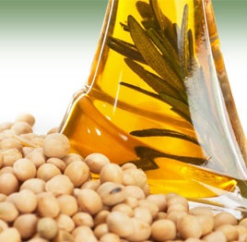
Selection of Emulsifiers
How Are Emulsifiers Selected?
One method is by using HLB (Hydrophilic Lipophilic Balance).Different emulsifiers have different HLB values, and proper emulsifiers are selected depending on the composition of the proposed emulsion.
What Is HLB Value?
HLB stands for Hydrophilic Lipophilic Balance. A low HLB value indicates greater lipophilicity or a higher affinity towards lipids (oil). Conversely, a high HLB value indicates a greater affinity towards water.

Slide 5
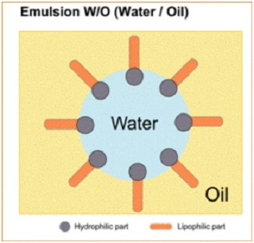
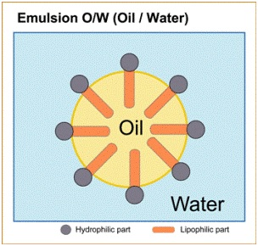
Types of Emulsions
Water in Oil. Butte, Margarines, oil is in continuous form while water is dispersed in small droplets.
Oil in Water e.g. Milk, cream (buttercream). Milk and milk fat -water is the continuous phase and fat is in suspended form.

Slide 6
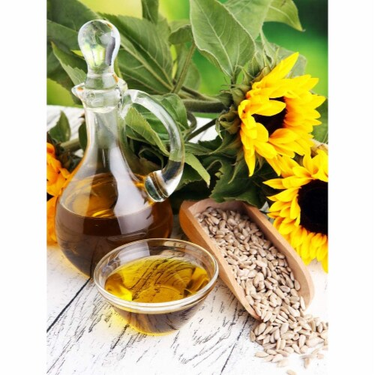
Products Of Giiava
We offer a wide range of emulsifiers for various applications in the food, feed, and nutrition industries.
GIIOFINE
GIIOFEED
GIIOINSTA
Fat Products

