Slide 1


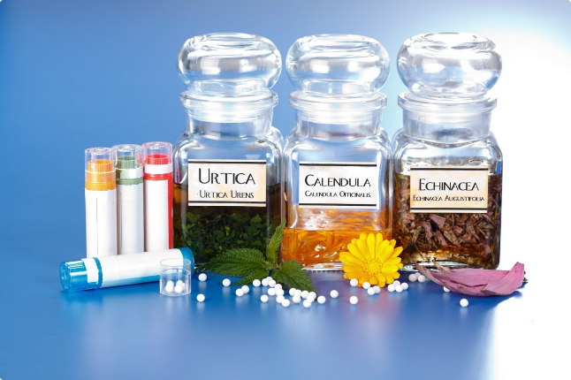
Introduction to Homeopathy and PCOS/PCOD
Homeopathy is a holistic approach to treating Polycystic Ovarian Syndrome (PCOS) and Polycystic Ovarian Disease (PCOD) by addressing the root cause rather than just the symptoms. Unlike conventional treatments that focus on managing symptoms, homeopathy aims to restore the body's natural balance and improve hormonal imbalances.

Slide 2
Conventional Treatment vs Homeopathic Approach
Conventional Treatment
Homeopathic Approach
Key Difference
Typically focuses on managing symptoms with medications, birth control pills, and surgical interventions.
Addresses the underlying imbalances and triggers to restore the body's natural hormonal regulation.
Homeopathy treats the whole person, not just the disease, to achieve long-term, sustainable results.

Slide 3



Addressing the Root Cause of PCOS/PCOD
1
Identifying Triggers
2
Holistic Evaluation
3
Restoring Balance
Homeopathic practitioners investigate the individual's unique triggers, such as stress, diet, or lifestyle factors.
They assess the patient's overall physical, emotional, and mental well-being to formulate a personalized treatment plan.
Homeopathic remedies work to rebalance the body's systems and address the underlying imbalances.

Slide 4



Restoring the Body's Natural Balance
1
Detoxification
Homeopathic remedies help the body eliminate toxins and waste products that can contribute to hormonal imbalances.
2
Stress Management
Homeopathic treatment addresses the role of stress and helps the body better cope with it.
3
Nutrition Support
Homeopathic practitioners may recommend dietary changes and supplements to nourish the body's systems.

Slide 5


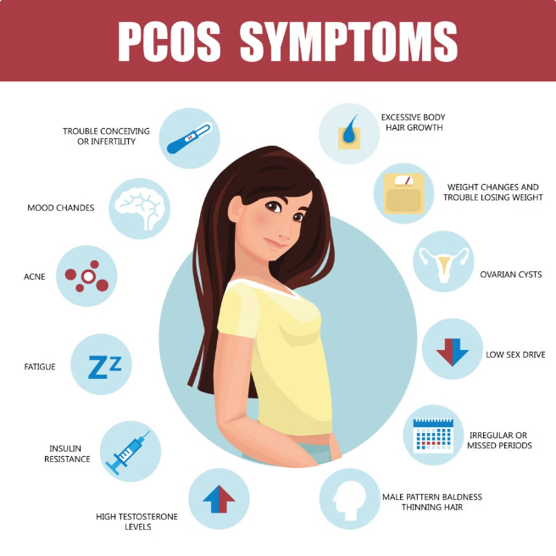
Improving Hormonal Imbalance
Regulating Hormones
Enhancing Fertility
Homeopathic remedies work to restore the balance of hormones like estrogen, progesterone, and testosterone.
By addressing the root causes, homeopathy can help improve fertility and increase the chances of conception.
Reducing Symptoms
Individualized Approach
Homeopathic treatment can alleviate PCOS/PCOD symptoms like irregular periods, acne, and weight gain.
Each patient's homeopathic treatment is tailored to their unique needs and constitution.

Slide 6


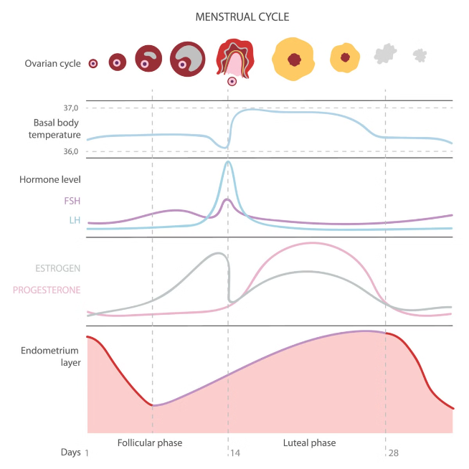



Regularizing Menstrual Cycles
Hormonal Balance
Homeopathic remedies work to restore the natural balance of reproductive hormones.
Ovulation Regulation
Improved hormonal regulation can help regulate ovulation and menstrual cycles.
Cycle Normalization
As the body's systems are rebalanced, menstrual cycles become more regular and predictable.

Slide 7

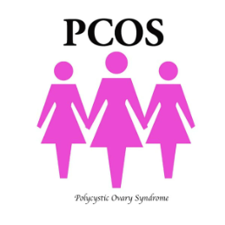




Patient Experiences and Outcomes
Improved Symptoms
Enhanced Fertility
Weight Management
Many patients report a significant reduction in PCOS/PCOD symptoms like acne, excess hair growth, and irregular periods.
Homeopathic treatment has helped some patients conceive naturally or increase the success of fertility treatments.
Homeopathic remedies can support healthy weight management, a common challenge for those with PCOS/PCOD.

Slide 8



Variability in Homeopathic Treatment Results
Factors Influencing Results
Explanation
Severity of Condition
The severity of PCOS/PCOD symptoms can affect the time and effort required for improvement.
Individual Response
Each person's body and constitution may respond differently to homeopathic remedies.
Adherence to Treatment
Consistent adherence to the prescribed homeopathic regimen is key for optimal results.

Slide 9
Advantages of Homeopathic Treatment for PCOS/PCOD
Holistic Approach
Gentle and Safe
Personalized Care
Homeopathy addresses the whole person, not just the symptoms, to achieve long-term, sustainable results.
Homeopathic remedies are natural, non-invasive, and have minimal side effects compared to conventional treatments.
Each patient's homeopathic treatment is tailored to their unique needs, triggers, and constitution.

Slide 10


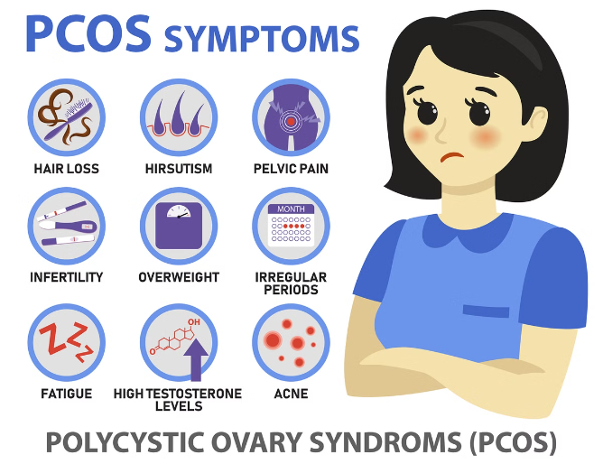
Conclusion and Key Takeaways
1
Holistic Treatment
2
Improved Outcomes
Homeopathy addresses the root causes of PCOS/PCOD, aiming to restore the body's natural balance.
Many patients have experienced significant relief from PCOS/PCOD symptoms and improved fertility with homeopathic treatment.
3
Personalized Approach
Homeopathic treatment is tailored to each individual, taking into account their unique triggers and constitution.
Contact us:
Homeopathic Doctors in Ranchi and Delhi, Homeopathic Clinic | RajeevClinic.com
Phone:- +91 9263778607
Address:- Shop No. C-11, 5th Floor, Tower C Spectrum@metro GH Eco City Plot C and D, Sector 75, Noida - 201304, Uttar Pradesh

