Slide 1


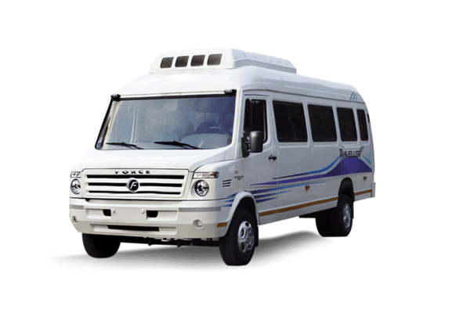
LUXURY TEMPO TRAVELLER
RENTALS
Your Comfortable Journey Awaits

Slide 2
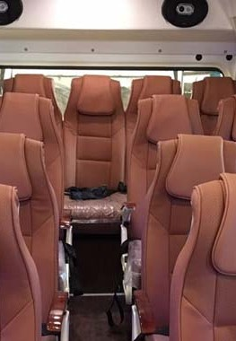



Introduction
Luxury Tempo Traveller
Ideal for big families and groups ( 9 to 26
passengers)
Comfortable and spacious interiors

Slide 3

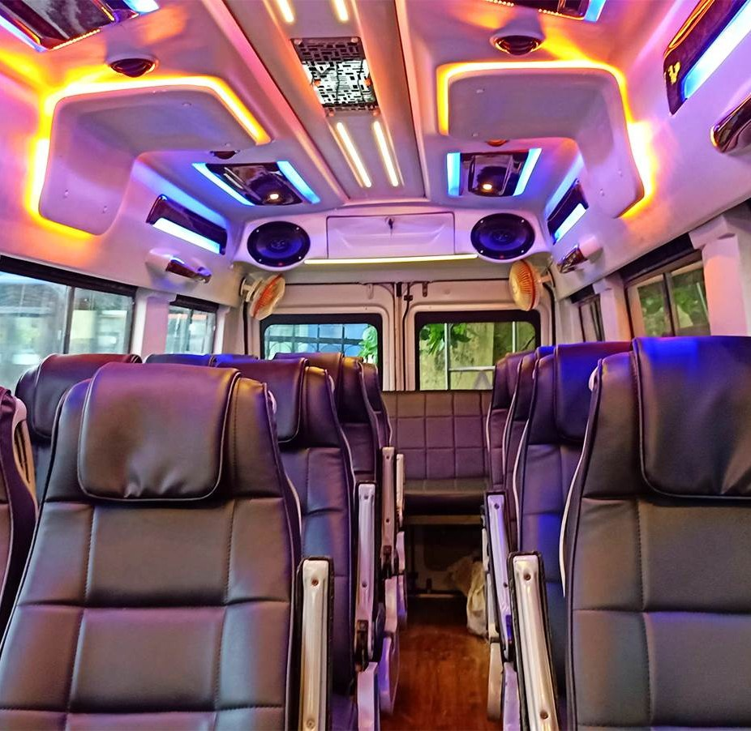
Features
Seating Options: 9 , 12 , and 16 seater configurations
Luxurious Interiors: Plush
seating, ample legroom, and AC Entertainment: TV, DVD player, and music system
Safety: GPS, f i rst aid kit, and
experienced drivers

Slide 4
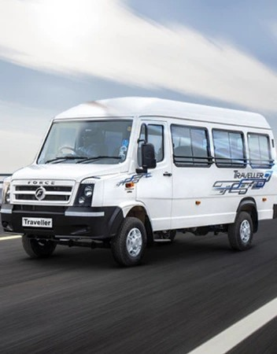
Why Choose Us?
Flexibility: Various seating capacities Reliability: Well- maintained vehicles with regular inspections
Customization: Tailored packages for different travel needs
24 / 7 Support: Dedicated customer service

Slide 5

Destinations & Services
Destinations: Popular
tourist spots in North India, airport transfers, corporate events, weddings,
pilgrimages
Additional Services: Optional tour guides,
catering services, ample luggage space

Slide 6





Contact: Progressive Cab - Luxury Tempo Traveller Rentals
91-9810125805, 8882562010
pcrs.vinod@gmail.com
55, 2nd Floor, Regal Building, Parliament Street, Connaught Place, New Delhi, Delhi 110001
Book Your Journey Today

Slide 7

THANK YOU
www.tempotravellerrentindelhi.com

