Slide 1

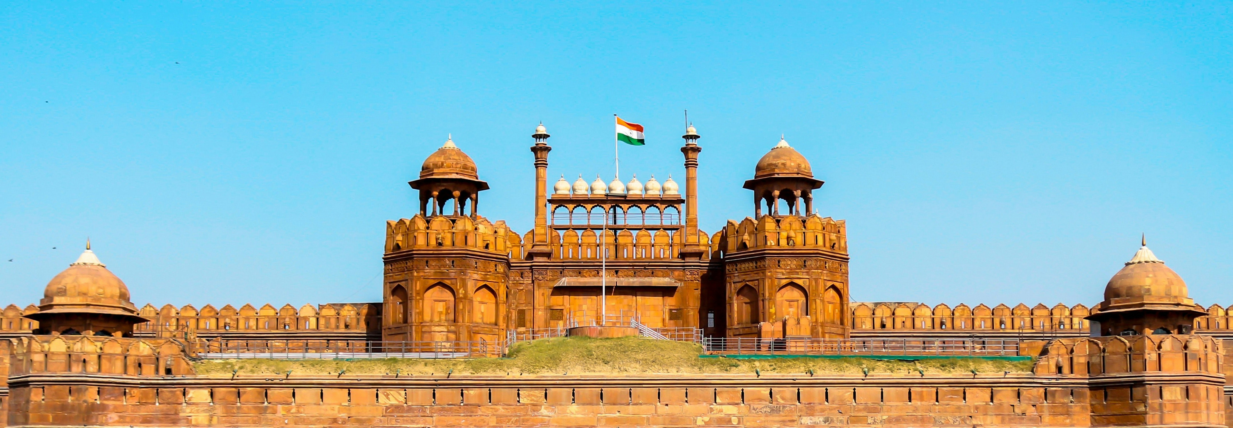
What are the Highlights of a Visit to the Red Fort in Delhi?

Slide 2
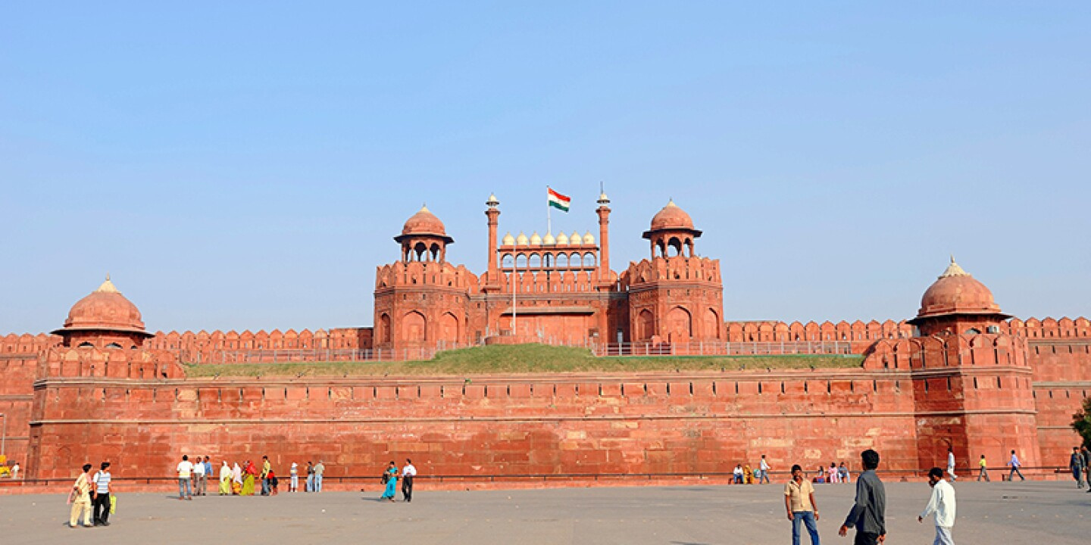
ABOUT US
Progressive Tours and Travels (A unit of Progressive Cabs Pvt Ltd) is a leading Delhi based travel agency specialized in offering custom and pre-designed India destination tour packages. Providing our best services in tour and transport services since 2000, we are now one of the best inbound tour operators of India.
India is best destination for various tour segments such as Luxury tours, Group tour, corporate tour, Leisure tours, Heritage tours, trekking tours and adventure tour. We provide the best services to travellers visiting India from around the world. Our customer focus, innovative packages, brief of destination, personalized service, operational excellence and value-oriented pricing keep us apart in this competitive sector.
Design Model

Slide 3
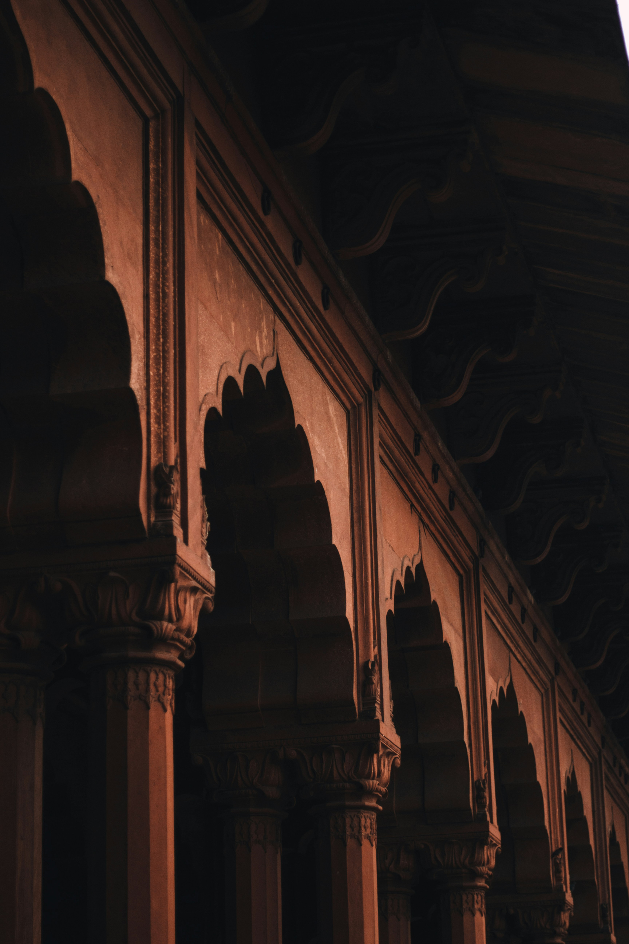
Diwan-i-Aam: The Diwan-i-Aam was a special room in the palace where the emperor met with regular people. It was like a big meeting hall. Here, the emperor would listen to what ordinary citizens had to say and make announcements to them. It was a place where the public could see and hear their ruler in person.

Slide 4
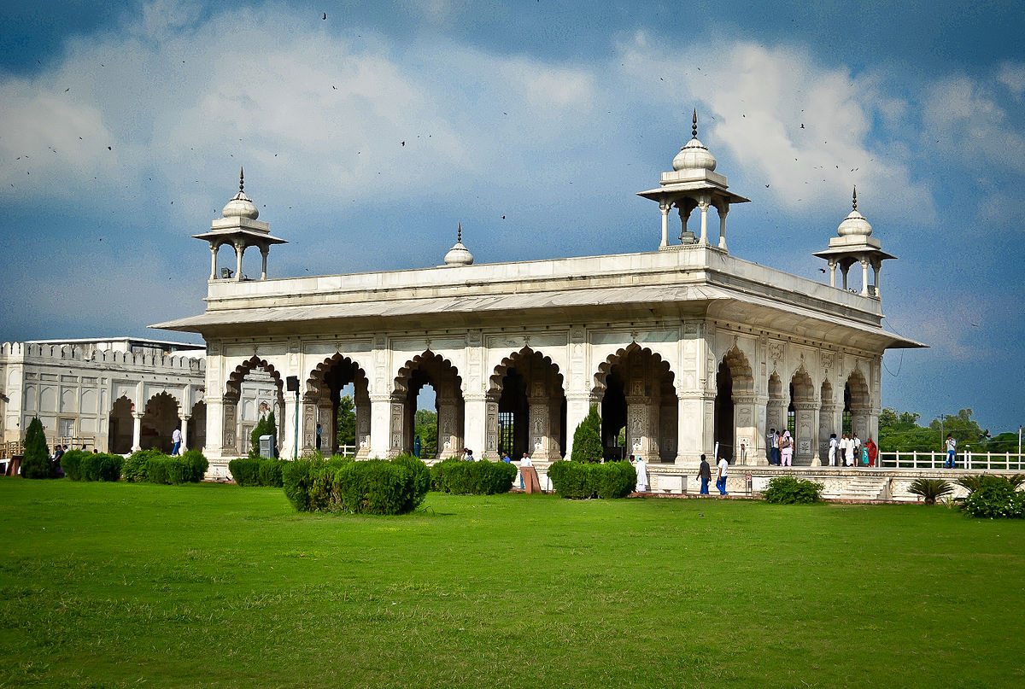
Diwan-i-Khas: The Diwan-i-Khas was a special room in an old palace. It was where the king would meet important people in private. This room was very fancy, with beautiful patterns all over it. The most famous thing in this room was a special chair called the Peacock Throne. This throne was very grand and looked a bit like a peacock, which is why it got its name.

Slide 5
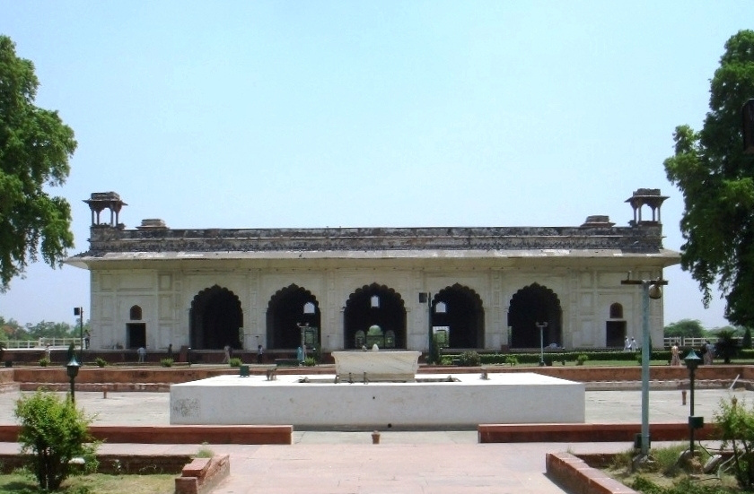
Rang Mahal: The Rang Mahal was a place where kings and queens lived. It is special because it has many bright and beautiful colors inside. The building also has small streams of water running through it, which helped keep the palace cool when the weather was hot. People remember this palace for its colorful decorations and clever way of staying comfortable in warm times.

Slide 6
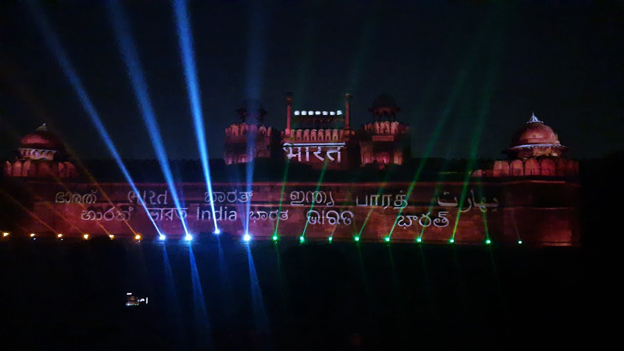
Sound and Light Show: At night, the fort comes alive with special shows. These shows tell the fort's story using bright lights and interesting sounds. As you watch, you hear tales about the fort's past while colorful lights shine on the walls. The lights and sounds work together to make the fort's history feel real and exciting. It's like watching the fort's story come to life right before your eyes.
If you want to visit Red Fort in Delhi, we provide instant booking of Innova on Rent in Delhi. Get local sightseeing and outbound tour packages from Delhi at the best prices.

Slide 7




  Thank You
+91 844 822 8850
info@progressivetourtravels.com
www.progressivetourtravels.com
UG-17, Palika Place, Panchkuian Road, New Delhi 110001
Near R K Ashram Metro Station

