Slide 1
Rajasthan Tour Packages: Discovering Culture, Heritage, and Adventure

Slide 2
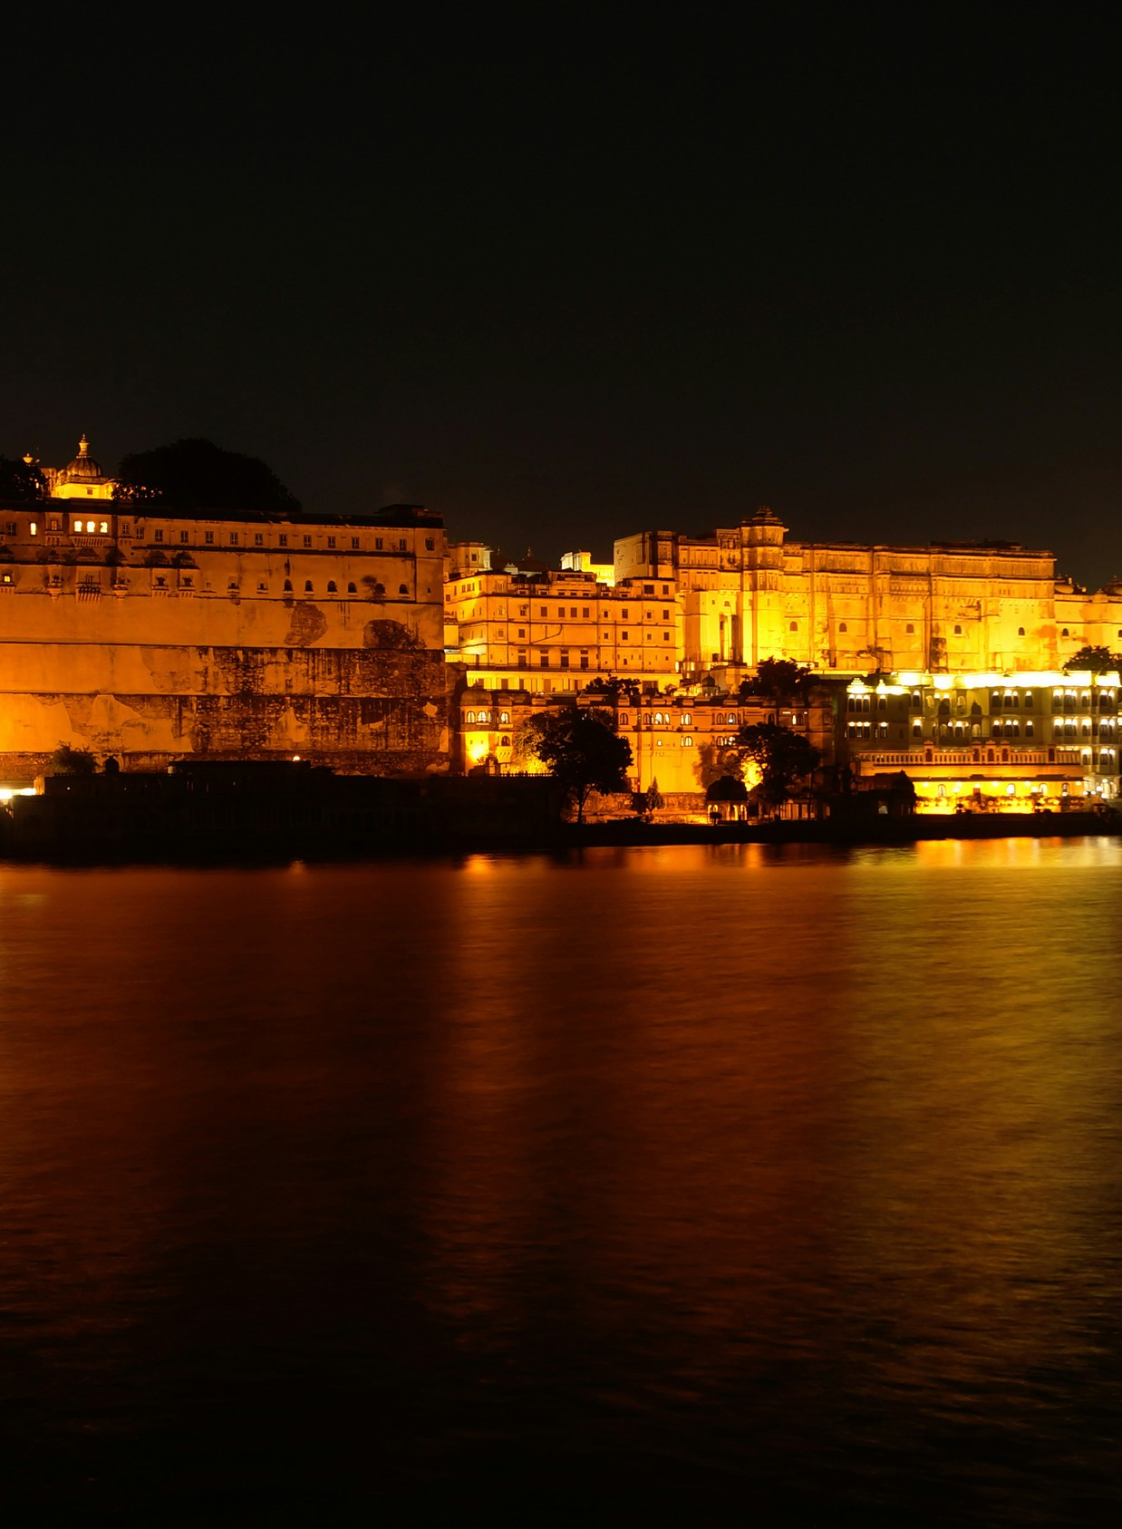
Introduction
Explore Rajasthan, the Land of Colors and Royalty.
A brief review of Rajasthan's cultural diversity and historical importance:
Mention Rajasthan's status as India's "Land of Kings" due to its long history of Rajputana royalty.
Highlight the vibrant culture, architecture, and arts that represent its royal heritage.
Highlight Rajasthan's popularity with travelers for its forts, palaces, and desert scenery.

Slide 3
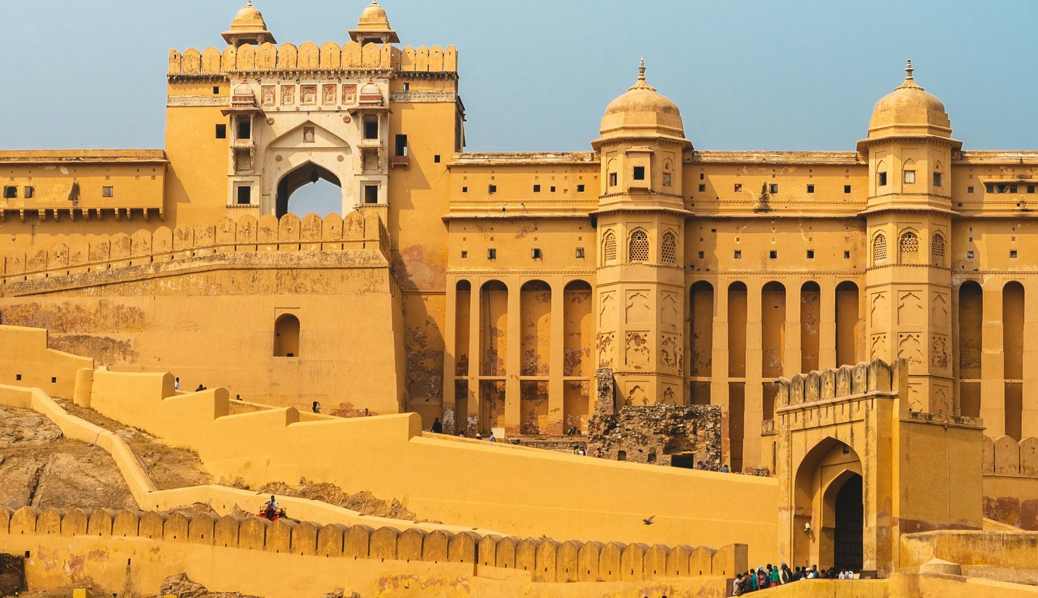
Highlights of Rajasthan
Photos of iconic landmarks like Hawa Mahal, Jaipur City Palace, and Mehrangarh Fort. Bullet points highlighting key attractions:
Rajasthan tour packages Forts and Palaces: Explore
magnificent forts like Amber Fort, Chittorgarh Fort, and palaces such as Udaipur's City Palace.
Desert Landscapes: Discover the Thar Desert with camel safaris, desert camps, and breathtaking sunsets.
Cultural Riches: Witness traditional Rajasthani dance forms like Ghoomar, Kalbelia, and puppet shows.

Slide 4
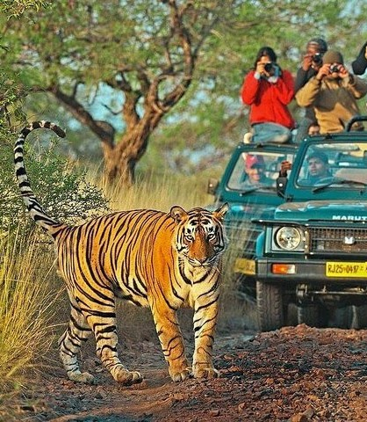
Types of Tour Packages
Choose Your Adventure - Tour package options:
Heritage Tours: Guided trips to historical landmarks and palaces. Desert Safaris: Enjoy camel rides and sleeping under the stars.
Wildlife Expeditions: Visit Ranthambore National Park to see tigers and Bharatpur Bird Sanctuary to observe birds.

Slide 5
shows a map of Rajasthan, highlighting major cities such as Jaipur, Udaipur, and Jodhpur.
Brief descriptions and photographs of each city's distinct attractions:
Jaipur: The Pink City is famous for its Hawa Mahal and Amber Fort.
Udaipur: The City of Lakes, which includes Lake Pichola and the beautiful Udaipur City Palace.
Jodhpur: The Blue City, with the majestic Mehrangarh Fort and bustling bazaar.
Popular Destinations

Slide 6
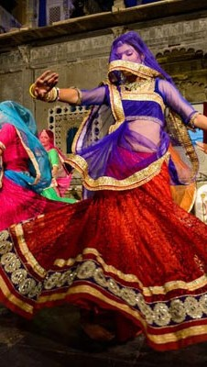
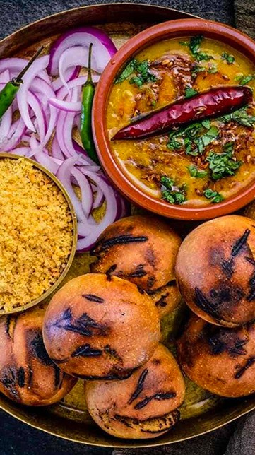
Cultural Experiences
Immerse in Rajasthani Culture Overview of Cultural Activities:
Folk Dance and Music: Experience live performances of Ghoomar, Kalbelia, and traditional Rajasthani music.
Cuisine: Try Rajasthani specialties like Dal Baati Churma and Gatte ki Sabzi in local restaurants and heritage hotels.

Slide 7

Adventure and Wildlife
Photos of wildlife sanctuaries (Ranthambore, Sariska) and adventure activities: Wildlife Safaris: Explore Ranthambore National Park for tiger sightings and Sariska Tiger Reserve for diverse wildlife.
Adventure Activities: Try hot air ballooning over Jaipur or camel safaris in the Thar Desert.

Slide 8

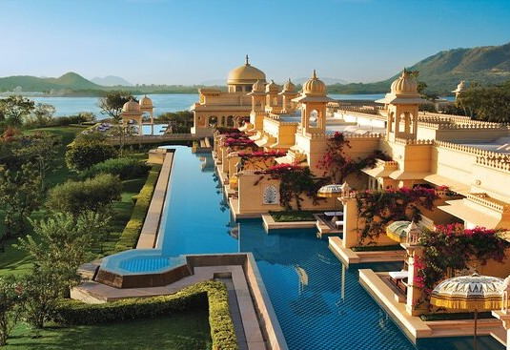

Accommodation Options
Description of accommodation choices: Heritage Hotels: Experience royal hospitality at converted palaces and havelis like Taj Lake Palace in Udaipur.
Luxury Resorts: Relax at luxurious resorts offering spa treatments and scenic views. Budget-Friendly Options: Choose from guesthouses and budget hotels for economical stays.

Slide 9
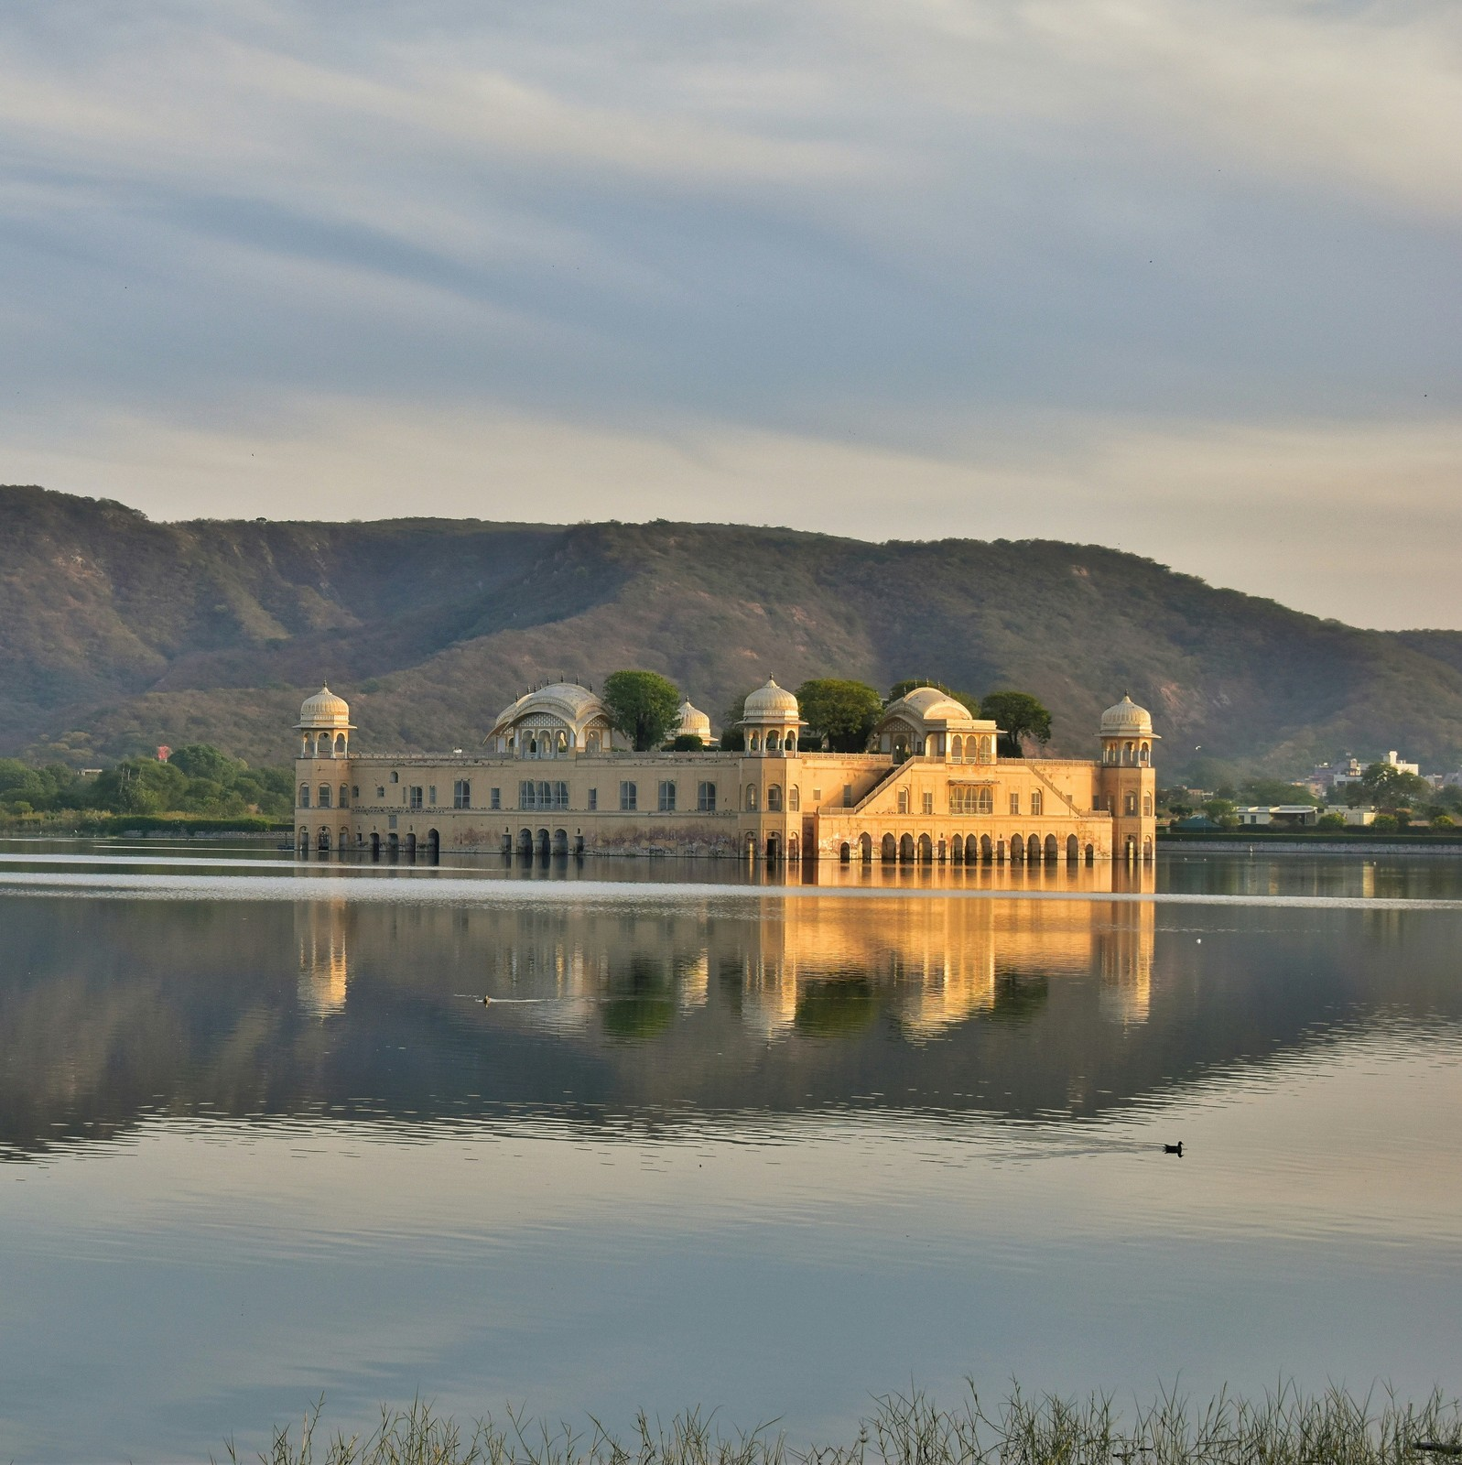
Planning Your Trip
Ready to Go?
Practical tips for planning:
Best Time to Visit: Visit from October to March for pleasant weather.
Transportation: Options include flights to Jaipur or Udaipur, and well- connected road and rail networks.
Packing Essentials: Sunscreen, comfortable clothing, and footwear suitable for sightseeing and desert activities.

Slide 10
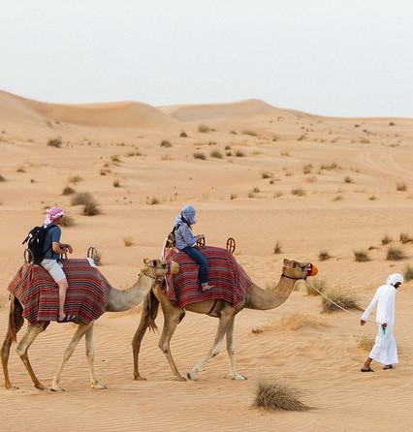
Customer Testimonials
Hear from Our Guests
Quotes or brief testimonials from previous travelers highlighting their experiences:
The heritage tour exceeded our expectations. The guides were knowledgeable, and the forts were breathtaking.
Camping in the desert was a once- in-a-lifetime experience. The starry sky and camel ride were unforgettable.

Slide 11

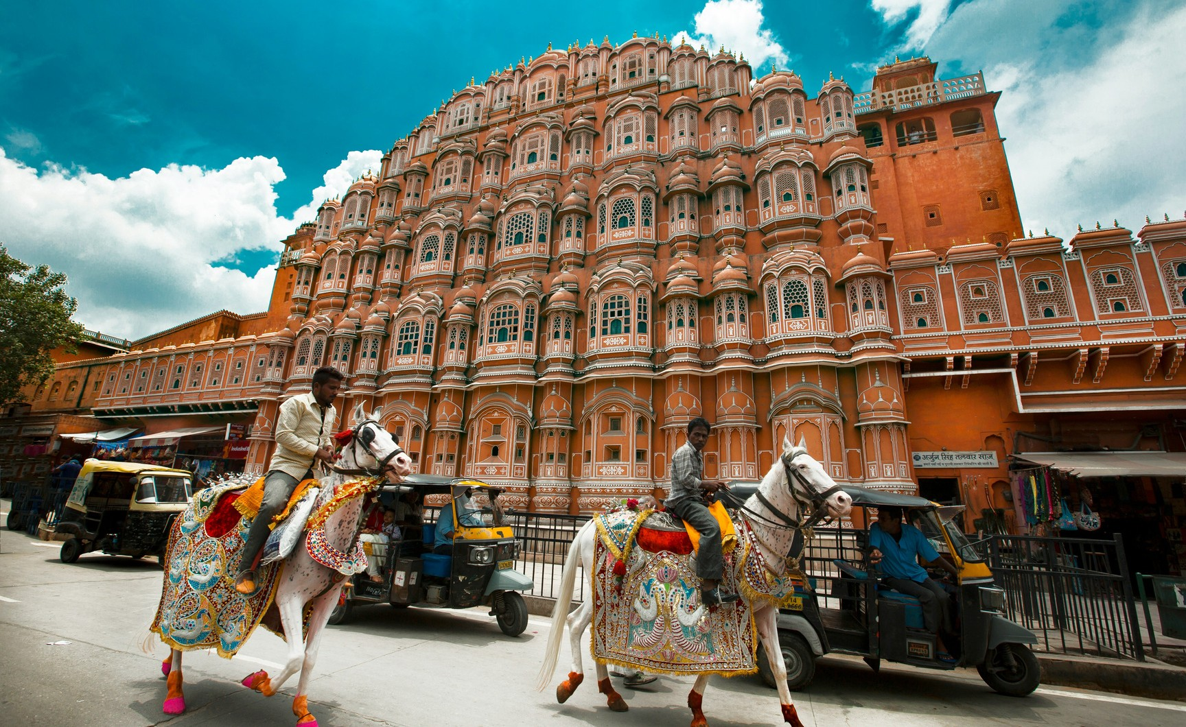
Thank You
Contact Us
+91-9810115661
Phone Number
delhirajasthancartour@gmail.com
Email Address
www.delhirajasthancartour.com
Website

