Slide 1


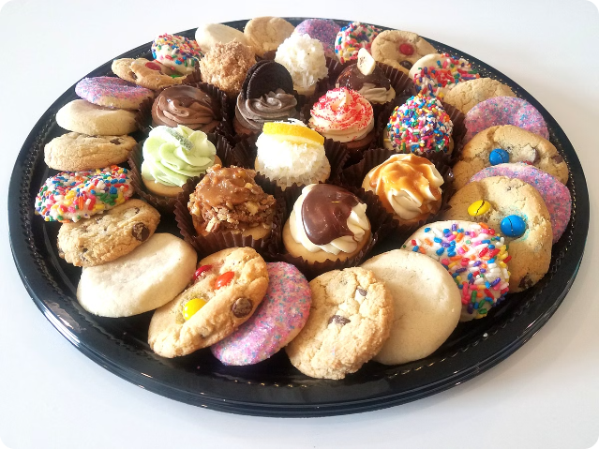
Local Cookies: Baking Happiness
Local Cookies is a bakery dedicated to creating delicious and unique cookies that bring joy to customers. From classic flavors to innovative creations, there's a cookie for everyone at Local Cookies.

Slide 2


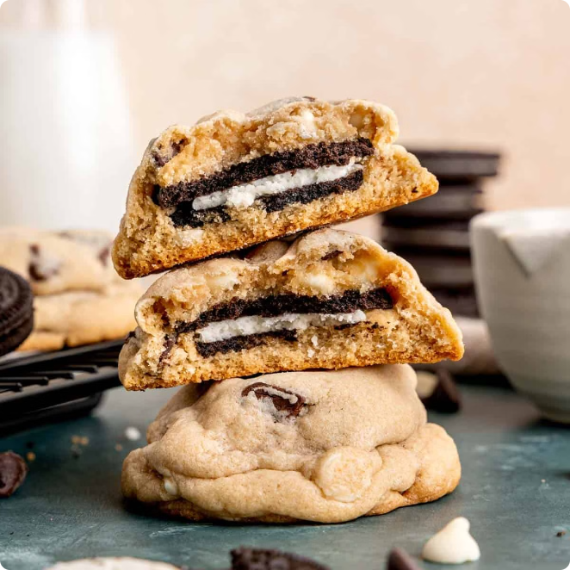
Stuffed Cookies: Indulgent Fillings
Chocolate Chip
A classic cookie elevated with a gooey chocolate center.
Peanut Butter
Rich peanut butter filling adds a satisfyingly salty-sweet flavor.
Oatmeal Raisin
Warm spices and raisins are complemented by a creamy surprise.
Snickerdoodle
Cinnamon-sugar goodness meets a smooth, sweet center.

Slide 3
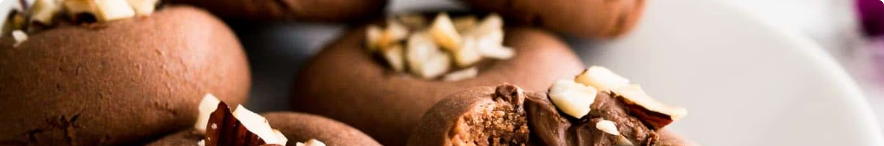

Nutella Cookies: A New Way to Enjoy Nutella
1
Convenient
2
Delicious
Enjoy Nutella without the mess of spreading.
The nutty and chocolatey flavors combine perfectly with cookie dough.
3
Customizable
4
Perfect Treat
Add toppings like chocolate chips, sprinkles, or nuts.
Enjoy Nutella cookies as a snack, dessert, or even a breakfast treat.

Slide 4
Peanut Butter, Nutella, Caramel, Nuts: Stuffed Cookie Delights
Peanut Butter
Nutella
Caramel
Creamy and nutty, peanut butter adds a satisfying richness.
The hazelnut and chocolate flavor combination is a classic favorite.
Sweet and gooey caramel adds a touch of decadence.

Slide 5

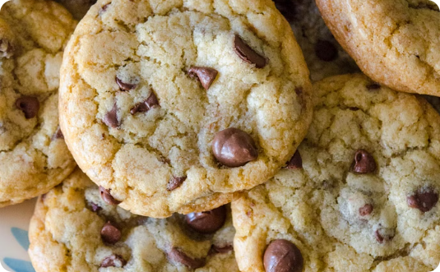
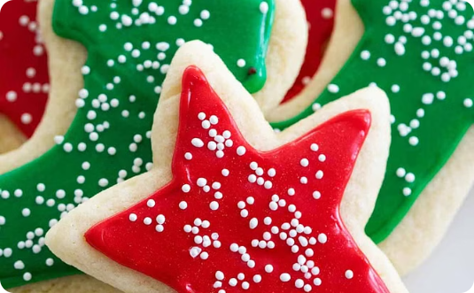
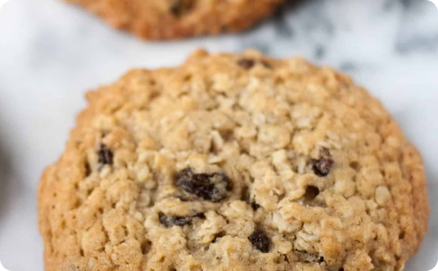
Discover the Flavors at Local Cookies
Chocolate Chip
Sugar Cookies
Oatmeal Raisin
Classic and always delicious, with a crispy edge and chewy center.
Sweet and simple, perfect for decorating and customizing.
Warm spices and chewy raisins make for a comforting and satisfying cookie.

Slide 6


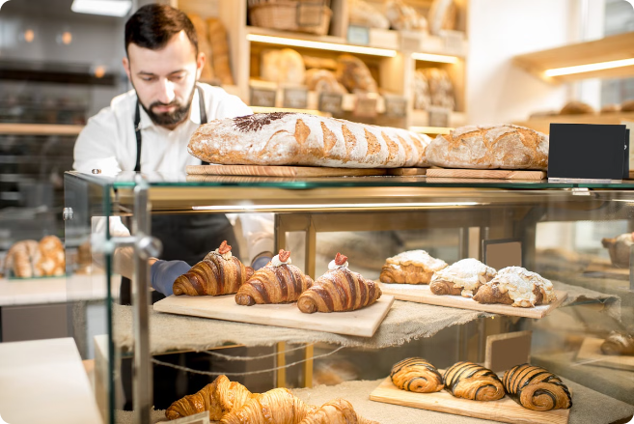



Baking with Love: The Local Cookies Difference
Fresh Ingredients
High-quality ingredients are essential for delicious cookies.
Handmade with Care
Every cookie is baked with attention to detail and a passion for quality.
Customer Satisfaction
Local Cookies strives to create cookies that exceed expectations.

Slide 7
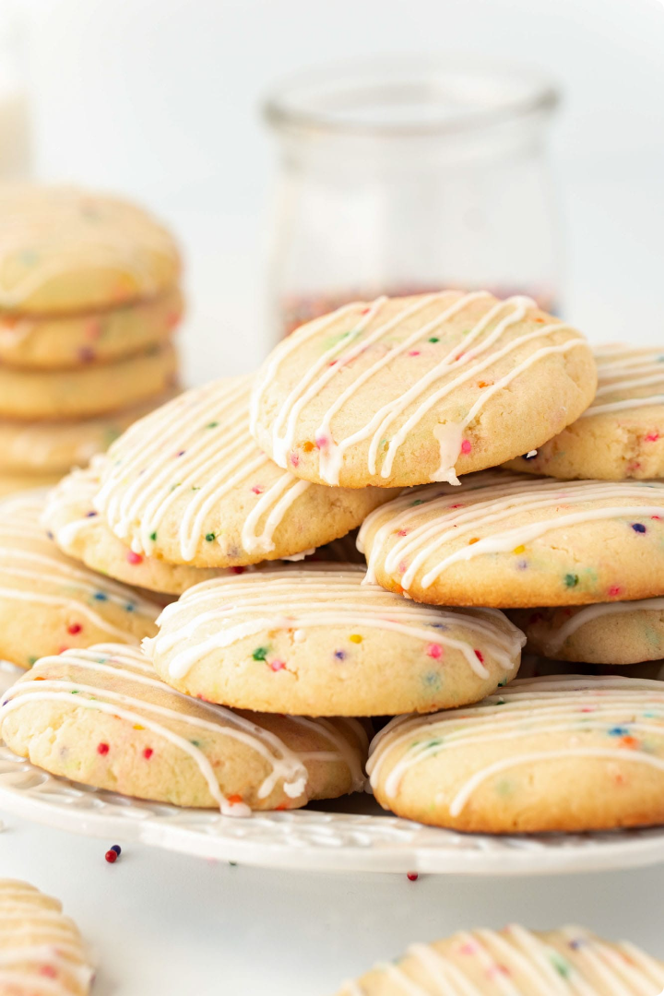
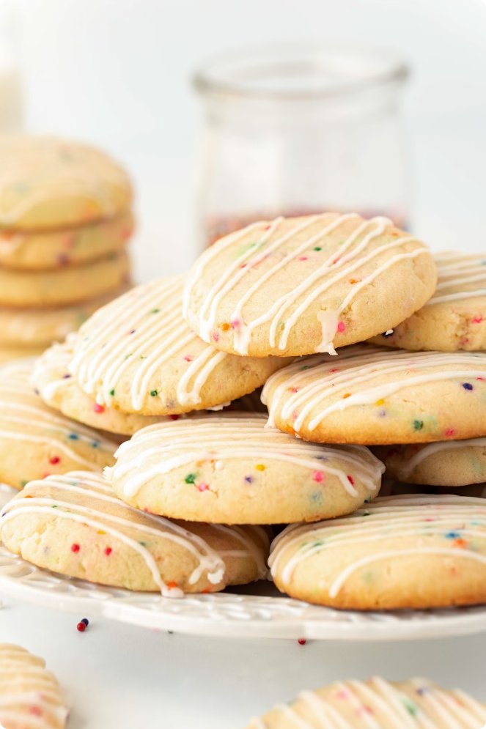




Satisfying Cravings, One Cookie at a Time
Comforting
Local Cookies' cookies are designed to provide a sense of warmth and satisfaction.
Joyful
The cookies are meant to bring happiness and smiles to customers' faces.
Special Occasions
Local Cookies' cookies are perfect for birthdays, holidays, and special celebrations.

Slide 8


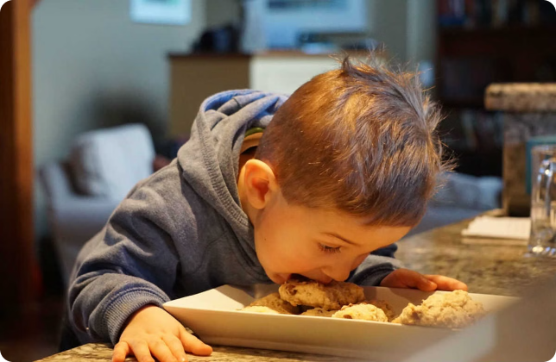
Bringing Smiles to Customers' Faces
Customer Service
Friendly and helpful staff are always willing to assist.
Unique Flavors
Local Cookies offers a wide variety of flavors to satisfy every craving.
Presentation
Cookies are beautifully packaged and presented, making them perfect for gifts.

Slide 9


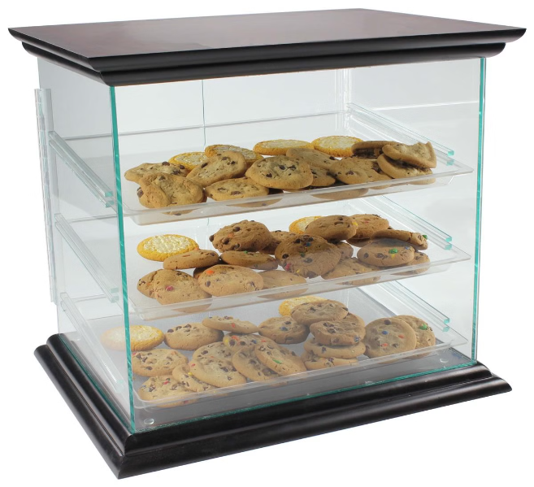
Explore the Variety of Cookies at Local Cookies
1
Classic
Chocolate chip, oatmeal raisin, and sugar cookies are always popular choices.
2
Stuffed
Indulge in cookies filled with delicious surprises like peanut butter, Nutella, and caramel.
3
Seasonal
Local Cookies offers seasonal flavors like pumpkin spice and gingerbread.

Slide 10

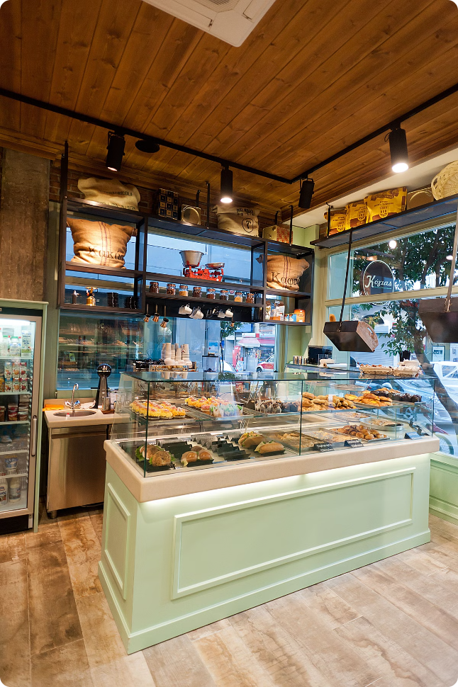

Visit Local Cookies to Savor the Goodness
Local Cookies is committed to providing customers with the best possible cookie experience. Visit Local Cookies today to discover a world of delicious flavors and exceptional service.
Buy the Best Cookies in Sharjah at Local Cookies
Address: Muwaileh Commercial - Industrial Area - Sharjah - United Arab Emirates
Phone: +971 6 530 0115
Email: Hello@localcookies.ae

