Slide 1



Piccola Cucina Casa: Discover the Flavors of Italy in Brooklyn
Nestled in the heart of Brooklyn, Piccola Cucina Casa invites you to embark on a culinary journey through the diverse regions of Italy. This new addition to the Piccola Cucina group promises an authentic and immersive dining experience.

Slide 2



A Culinary Destination in Brooklyn
Located at 141 Nevins Street, If you are looking for where to eat in Brooklyn , Piccola Cucina Casa is poised to become a must-visit destination for food enthusiasts in Brooklyn. Featuring a prime location in the vibrant borough, the restaurant offers easy access for locals and visitors alike.

Slide 3



A Seasonal Menu Celebrating Italian Culinary Diversity
1
Grilled Octopus from Puglia
Savor the flavors of southern Italy with this tender and flavorful dish.
2
Schnitzel Milanese from Lombardy
Experience the rich culinary heritage of northern Italy in every bite.
3
And More...
Piccola Cucina Casa's seasonal menu showcases a wide array of regional Italian specialties.

Slide 4
A Culinary Journey Through Italy
Puglia
Lombardy
And Beyond
Discover the bold and authentic flavors of the southern Italian region of Puglia.
Indulge in the rich and comforting dishes that have made Lombardy a culinary powerhouse.
Piccola Cucina Casa's menu celebrates the diverse culinary traditions of Italy's many regions.

Slide 5


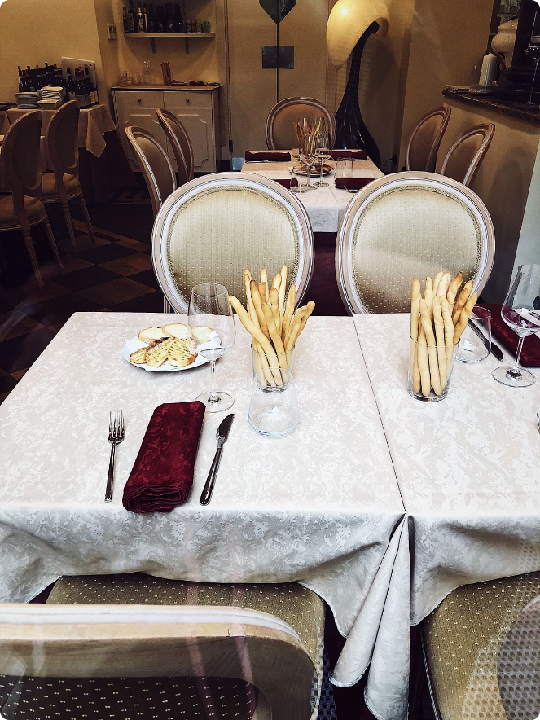
Dining at Piccola Cucina Casa
1
Ambiance
Immerse yourself in a warm and inviting atmosphere that captures the essence of Italian hospitality.
2
Service
Experienced servers will guide you through the menu, ensuring a personalized and attentive dining experience.
3
Flavors
Savor the harmonious blend of traditional and innovative flavors that define the Piccola Cucina Casa experience.

Slide 6


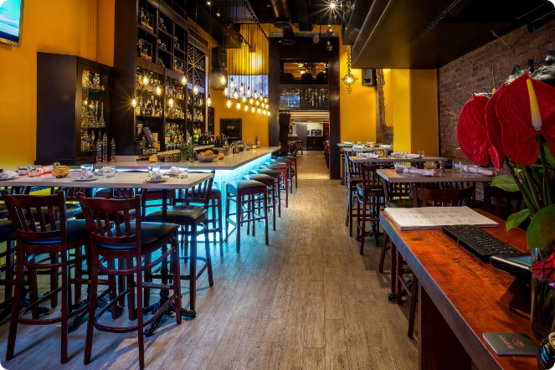



Piccola Cucina Casa: A Foodie's Delight
Flavors
Explore the rich and diverse culinary traditions of Italy.
Beverages
Pair your meal with a carefully curated selection of Italian wines and cocktails.
Sweets
Indulge in decadent Italian desserts that are sure to delight your senses.
Ambiance
Immerse yourself in the warm and inviting atmosphere of Piccola Cucina Casa.

Slide 7
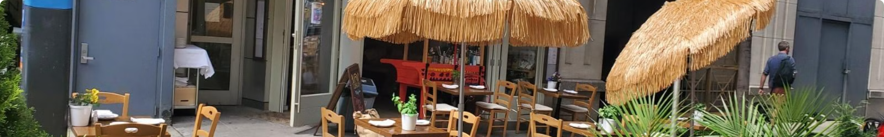




Discover the Best Restaurants in Brooklyn
Piccola Cucina Casa
Explore More
Foodies Rejoice
The newest culinary destination as Best Restaurants in Brooklyn, offering a taste of Italy.
Check out other top-rated restaurants in the borough for a diverse dining experience.
Brooklyn has become a hub for exceptional and innovative cuisine.

Slide 8

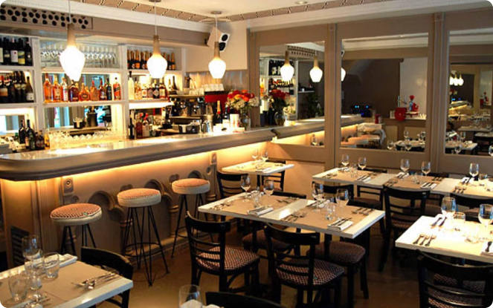
Piccola Cucina Casa: Where Tradition Meets Innovation
Authentic Italian Flavors
Savor the rich culinary heritage of Italy's diverse regions at Piccola Cucina Casa.
Seasonal Ingredients
The menu at Piccola Cucina Casa showcases the best of what's fresh and in-season.
Warm Hospitality
Experience the true essence of Italian hospitality in the heart of Brooklyn.
Culinary Exploration
Discover new and exciting dishes that celebrate the breadth of Italian cuisine.

Slide 9

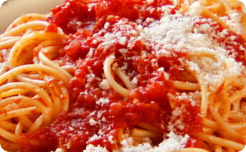
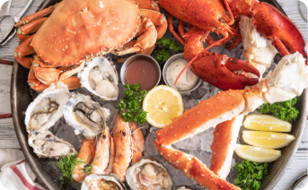
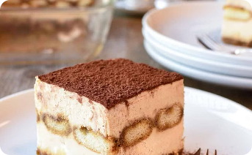
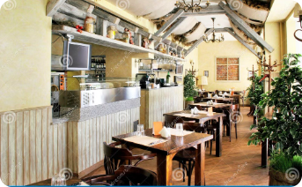
Brooklyn's Culinary Destination: Piccola Cucina Casa
Pasta Perfection
Seafood Specialties
Decadent Desserts
Inviting Ambiance
Savor handcrafted pasta dishes that capture the essence of Italian tradition.
Delight in the fresh and flavorful seafood offerings at Piccola Cucina Casa.
Indulge in authentic Italian sweets that will leave you craving more.
Experience the warm and welcoming atmosphere that defines the Piccola Cucina Casa.

Slide 10


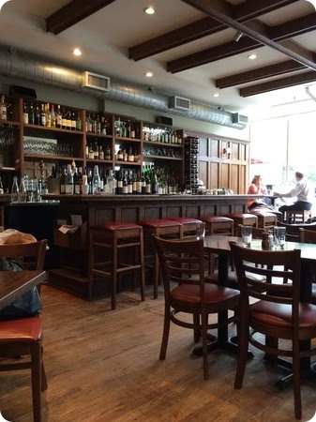
A Foodie's Guide to Brooklyn
Piccola Cucina Casa
where to eat in Brooklyn
Address
141 Nevins Street, Brooklyn,
New York 11217, USA
Telephone
(001) 929-295-0015
E-mail
info@piccolacucinagroup.com

