Slide 1
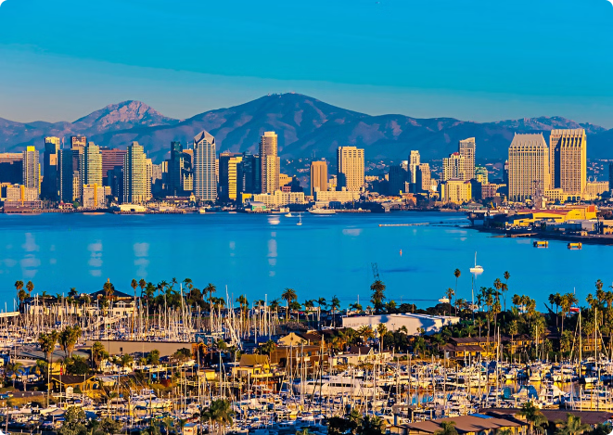
Maurer Construction: Trusted Home Remodeling Experts in San Diego
Maurer Construction has established itself as a trusted partner for homeowners in San Diego seeking top-quality home remodeling services. With years of expertise and a commitment to excellence, they transform visions into reality, delivering exceptional results on every project.

Slide 2
Commitment to Quality and Reliability
1
Quality Craftsmanship
2
Reliable Processes
3
Durable Materials
Maurer Construction's team of skilled professionals takes pride in their work, ensuring every detail is executed with precision and care.
From project planning to final touches, Maurer Construction's proven processes guarantee a smooth and efficient remodeling experience.
They select the highest-quality materials to ensure your home remodel stands the test of time.

Slide 3
Expertise in General Contracting
Comprehensive Services
Project Management
Design Expertise
Maurer Construction offers a wide range of General Contractor Services San Diego, from kitchen and bathroom renovations to whole-home transformations.
Their experienced project managers coordinate every aspect of your remodel, keeping timelines on track and budgets under control.
Maurer's in-house design team collaborates with you to bring your vision to life, ensuring a seamless integration of form and function.

Slide 4
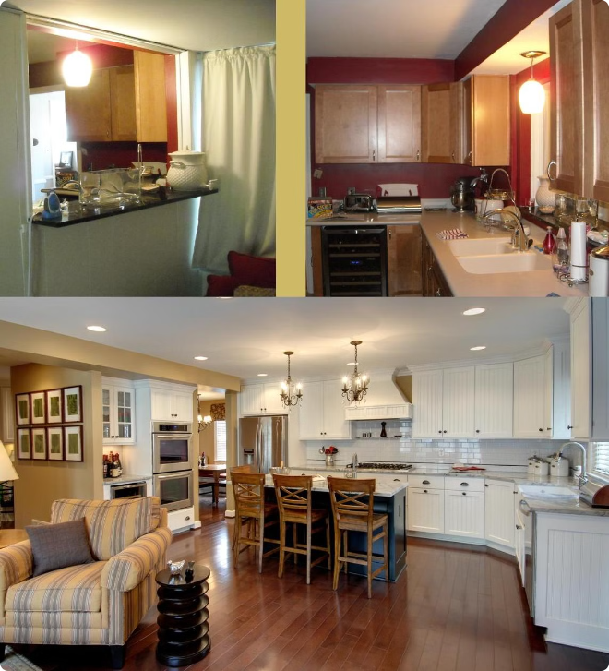
Transforming Visions into Reality
1
Vision
Maurer Construction starts by understanding your unique needs and aspirations for your home remodel.
2
Design
Their skilled designers transform your ideas into detailed plans, ensuring your vision comes to life.
3
Execution
The Maurer team brings your design to life with precision and attention to detail, delivering exceptional results.

Slide 5
Small Renovations to Complete Overhauls
Versatile Services
Customized Solutions
Maurer Construction has the expertise to handle projects of all sizes, from minor updates to whole-home transformations.
They work closely with you to develop a tailored approach that meets your specific needs and budget.
Attention to Detail
Seamless Execution
No matter the scope, Maurer Construction applies the same meticulous care and craftsmanship to every project.
Their skilled team ensures a smooth and efficient remodeling process from start to finish.

Slide 6
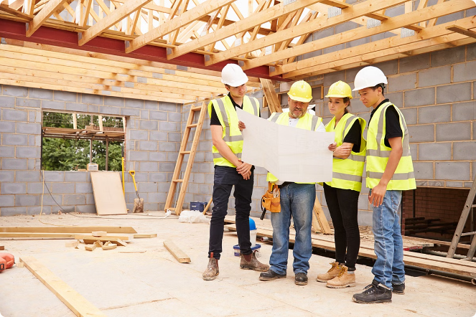
Personalized Approach to Every Project
Communication
Open and transparent communication keeps you informed every step of the way.
Collaboration
Maurer's team works closely with you to ensure your vision is brought to life.
Attention to Detail
They meticulously plan and execute every aspect of your remodel with care.
Satisfaction
Maurer Construction is committed to exceeding your expectations.

Slide 7
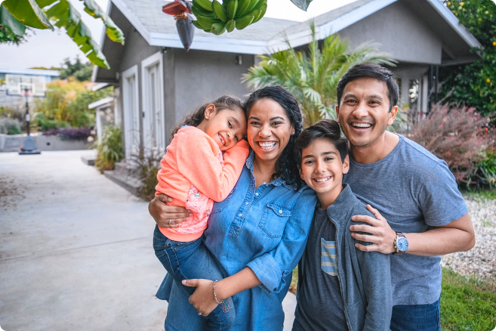
Exceptional Customer Service
Responsive
Maurer Construction's team is dedicated to addressing your concerns promptly and effectively.
Flexible
They adapt to your needs and work with you to find the best solutions for your project.
Trusted
Clients rave about Maurer's professionalism, integrity, and commitment to their satisfaction.

Slide 8
Experience the Maurer Construction Difference
Quality Craftsmanship
Reliable Processes
Exceptional Service
Innovative Design
Project Management
Customer Satisfaction

Slide 9
Know More
To learn more about how Maurer Construction can transform your home,
visit their website at ​http://www.maurerconstructioninc.com​
or call them at (619) 275-4875
to schedule a consultation.
3077 Clairemont Drive #533 San Diego, CA 92117

