Slide 1


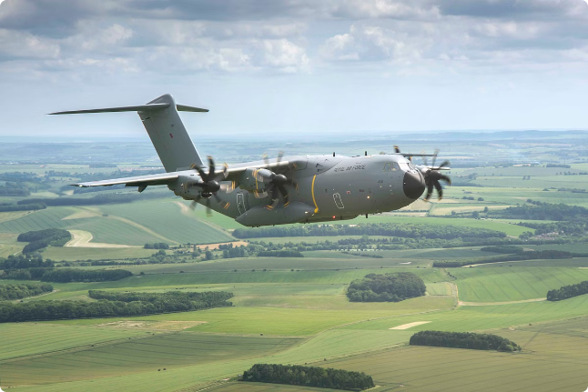
Britannia 2000 Holding: The Best Defence Contractors in the UK
Britannia 2000 Holding is a leading Defence contractor in the UK, specializing in advanced communication and surveillance technology. With over 30 years of experience, they provide high-quality equipment to the military, ensuring superior performance and operational success.

Slide 2



30 Years of Expertise in the Industry
1
Early Years
Founded in 1993, Britannia 2000 Holding started by providing niche communication solutions for the British military. Their focus on quality and innovation quickly gained recognition.
2
Growth and Expansion
Throughout the 2000s, Britannia 2000 Holding expanded their product portfolio, offering a wider range of advanced communication and surveillance systems.
3
Global Reach
Today, Britannia 2000 Holding is a respected global player, delivering cutting-edge solutions to international defense forces, ensuring operational efficiency and effectiveness.

Slide 3


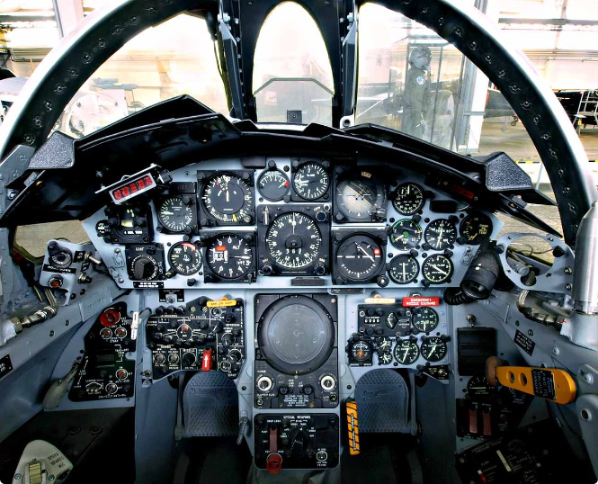
Cutting-Edge Technology for High-Quality Equipment
1
Advanced Signal Processing
2
Robust and Secure Systems
Britannia 2000 Holding utilizes the latest signal processing techniques to ensure clear and reliable communication in even the most challenging environments.
Their equipment is designed to withstand harsh conditions and provide secure communication channels for sensitive information.
3
Constant Innovation
4
Experienced Engineers
Britannia 2000 Holding is committed to continuous research and development, constantly improving their products to meet the evolving needs of the military.
Their team of engineers brings extensive expertise in software, hardware, and system integration, ensuring optimal performance and reliability.

Slide 4

Serving the Military with the Best Quality Equipment
Airborne Surveillance
Command and Control
Ground-Based Operations
Britannia 2000 Holding provides advanced Airborne video and data links, enabling real-time surveillance and reconnaissance for military operations.
Their mission system interface unit facilitates seamless communication and information sharing between different units, improving operational efficiency.
They offer video downlink receivers for ground-based monitoring and tracking, ensuring situational awareness and effective response to threats.

Slide 5


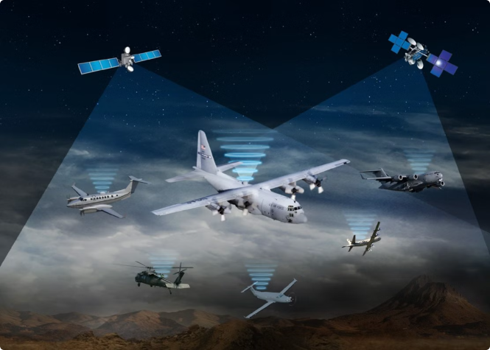
Airborne Video and Data Links
High-Bandwidth Transmission
Real-Time Data Sharing
These systems ensure secure and reliable transmission of high-resolution video and data, providing critical information for mission success.
They enable seamless sharing of real-time data between airborne platforms and ground stations, facilitating informed decision-making.
Enhanced Situational Awareness
Flexibility and Scalability
Airborne video and data links provide comprehensive situational awareness, enabling effective reconnaissance and targeting.
Britannia 2000 Holding's airborne video and data links are designed to be flexible and scalable, adapting to various mission requirements.

Slide 6


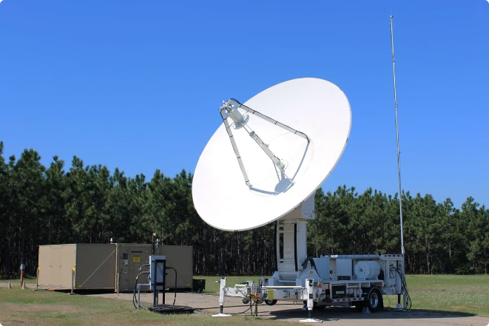




Video Downlink Receivers
Satellite Communication
Signal Processing
Britannia 2000 Holding offers robust video downlink receivers for receiving data from satellites, enabling secure and reliable communication.
Their receivers utilize advanced signal processing algorithms to ensure clear and reliable reception of video and data signals.
High-Resolution Display
Network Integration
They offer high-resolution displays for clear visualization of received data, enhancing situational awareness and analysis.
Their video downlink receivers seamlessly integrate with existing networks, enabling efficient data sharing and analysis.

Slide 7


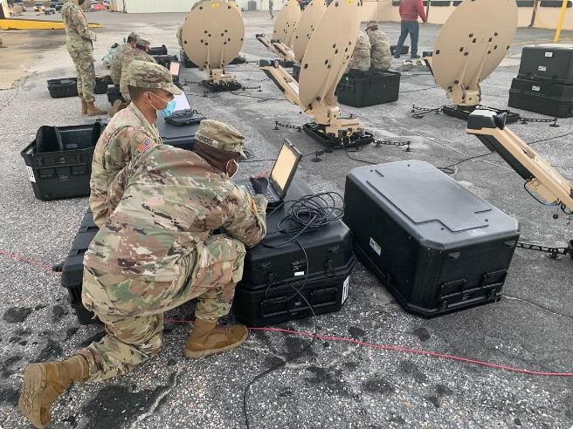



Mesh Networking
Decentralized Network
Britannia 2000 Holding's mesh networking technology creates a decentralized and resilient communication network.
Increased Bandwidth
Their solutions offer significant bandwidth increases, enabling high-throughput data transmission for critical operations.
Enhanced Security
Mesh networking provides enhanced security features, protecting sensitive data from unauthorized access.

Slide 8

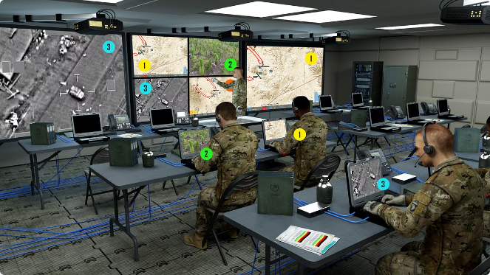
Mission System Interface Unit
Features
Benefits
Data Fusion
Provides a unified view of all available information, enabling informed decision-making.
Real-Time Data Sharing
Facilitates seamless sharing of real-time data between different units and platforms.
Flexible Integration
Adapts to various mission requirements and integrates with existing systems.
User-Friendly Interface
Ensures intuitive operation and efficient data management.

Slide 9

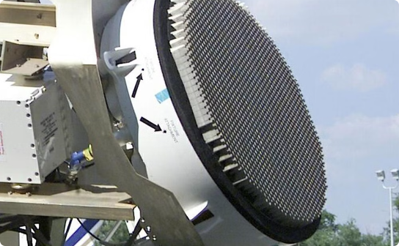
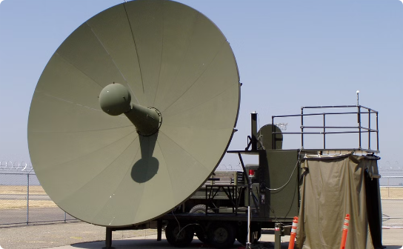

Tracking Antenna Systems
Precise Tracking
Wide Coverage
Advanced Signal Processing
Britannia 2000 Holding's tracking antenna systems provide precise tracking capabilities for various targets, ensuring accurate data acquisition.
Their systems offer wide coverage areas, enabling comprehensive surveillance and monitoring of critical regions.
They utilize advanced signal processing techniques to ensure reliable and accurate data acquisition in challenging environments.

Slide 10


Commitment to Innovation and Excellence
Britannia 2000 Holding is dedicated to continuous research and development, constantly pushing the boundaries of communication and surveillance technology.
Defence Contractors | Airborne mission computers UK & USA
Mobile: +44 7717 292751
Telephone: +44 1344 885058
Email: sales@b2kholdings.co.uk
Address: 4, Millside Park, Winkfield, Windsor SL4 4PX, United Kingdom

