Slide 1
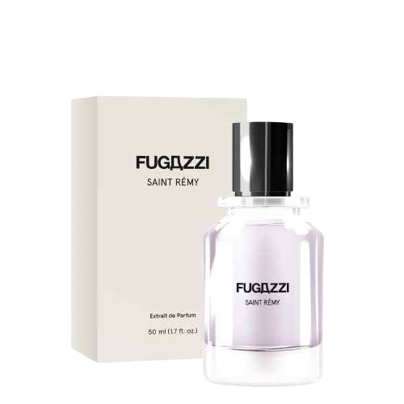

Slide 2
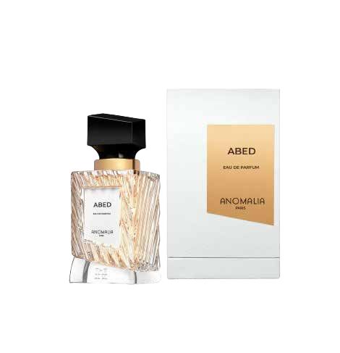
Discover the World of Elegance at Woman Parfume Store: Your Ultimate Luxury Perfume Store
When it comes to indulging in the ﬁnest fragrances, nothing quite compares to the experience of exploring a luxury perfume store. At Woman Parfume Store, we take pride in offering an exquisite collection of perfumes that transcend the ordinary, capturing the essence of sophistication and elegance. Whether you are a perfume connoisseur or someone looking for the perfect scent to complement your style, our store promises a journey of sensory delight.

Slide 3
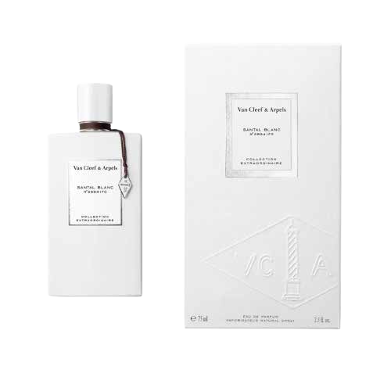
The Allure of Luxury Perfumes
Luxury perfumes are more than just scents; they are works of art crafted by master perfumers who meticulously select and blend rare and precious ingredients. These perfumes often contain a higher concentration of essential oils, resulting in longer-lasting and more complex fragrances. At Woman Parfume Store, we curate our collection to include only the most exquisite luxury perfumes, ensuring that each bottle is a masterpiece in its own right.

Slide 4
FOLLOW US
https://www.tiktok.com/@womanprofumeriabeauty?_t=8eg1KHPLSE4G_r=1
https://www.instagram.com/womanparfumery/
https://www.facebook.com/womanthebeautycenter/?locale=it_IT

Slide 5
CONTACT US
Via San Martino 1, S.Agata
351 5390974
womanprofumeria@gmail.com

