Slide 1


Rudraja Engineers
Pioneering solutions for smart plant instrumentation

Slide 2


Smart Plant Instrumentation Training
1
Process Instrumentation
Gain expertise in advanced sensor technologies and control systems.
2
Automation Principles
Understand the fundamentals of PLC programming and SCADA systems.
3
Hands-on Workshops
Apply learnings through interactive lab exercises and real-world simulations.

Slide 3
Design Instrumentation Training
Piping and Instrumentation
Loop Diagrams
Project Management
Interpret P&ID diagrams and design optimal instrument layouts.
Develop comprehensive loop drawings for process control systems.
Integrate instrumentation design into the broader engineering project lifecycle.

Slide 4
Intools Training
1
Process Configuration
2
Logic Programming
Set up and configure process parameters in the Intools platform.
Develop custom control logic and algorithms using Intools' advanced programming tools.
3
Data Integration
4
Reporting and Analytics
Integrate Intools with SCADA, ERP, and other enterprise systems.
Generate comprehensive reports and leverage Intools' data visualization capabilities.

Slide 5
PLC Automation
Comprehensive PLC Training
SCADA System Integration

Slide 6



Electrical and Instrumentation Works
Site Surveys
Design and Engineering
Installation and Commissioning
Conduct comprehensive assessments of existing electrical and instrumentation infrastructure.
Develop tailored solutions that optimize system performance and reliability.
Execute flawless implementation and ensure seamless integration with plant operations.

Slide 7

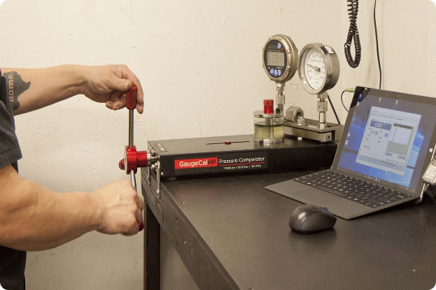
NABL Calibration
Precision Measurements
Utilize state-of-the-art calibration equipment and procedures to ensure accurate and reliable instrument readings.
Compliance and Traceability
Maintain NABL accreditation and provide comprehensive documentation to meet industry standards.
Customized Schedules
Develop tailored calibration plans to fit your specific production requirements and maintenance cycles.

Slide 8





Contact Us
+91- 8978571343
+91-9381009400
Call us for more information
info@rudrajaengineers.com
Send us an email
Address
Plot No:111, Ganesh Nagar, Near Ganesh Temple, VCS Garden street Industrial
Area, Vadlapudi, Vizag – 530046

