Slide 1
NANITAL ADVENTURE
EXPLORE THE HIMALAYAS BY TEMPO TRAVELLER
Tempo traveller Rent in Delhi

Slide 2
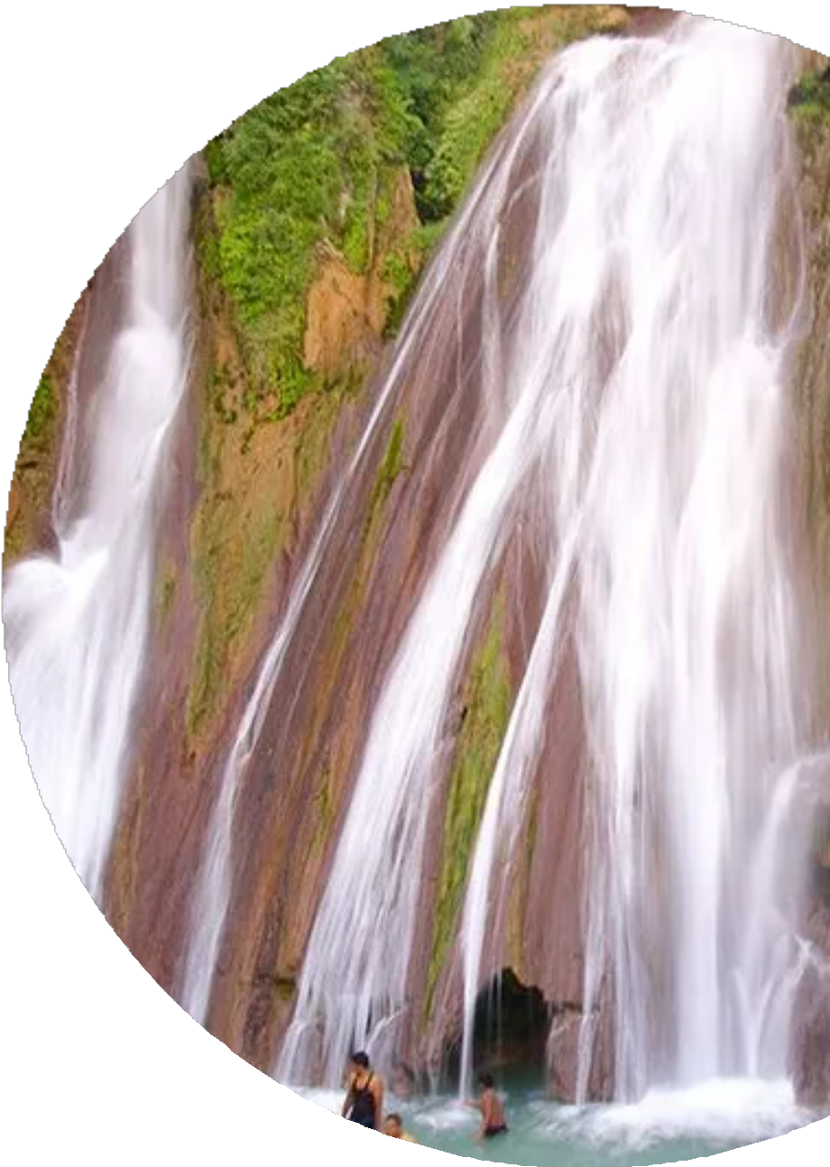
ABOUT US
Progressive Cab Rental Services was established in 2001 with a prime motive to offer domestic and inbound tour packages to our guests and build a strong presence in road trips across North India. Progressive Cab Rental Services has self-owned fleet of Tempo Travellers, luxury cars and buses which are clean, comfortable and well maintained. Trustworthy service and reasonable pricing, on route service, professional driver, friendly behaviour had made our company- a leading van rental agency in Delhi. We believe in keeping our customers happy by providing them services at most reasonable rates. We provide 24 x 7 hour services that include travel planning and transport facility. We ensure quality of service with 100% customer satisfaction.

Slide 3
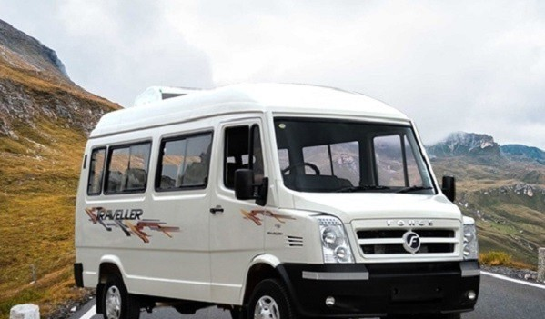
ESCAPE TO THE HIMALAYAS
Nanital Tour from Delhi by Tempo Traveller.
Calling all adventure seekers and nature lovers.Are you ready to trade the bustling streets of Delhi for the refreshing embrace of the Himalayas? This exciting tour whisks you away to the enchanting hill station of Nanital, nestled amidst breathtaking mountains and serene lakes. Get ready for stunning landscapes, cool mountain air, and unforgettable experiences.

Slide 4
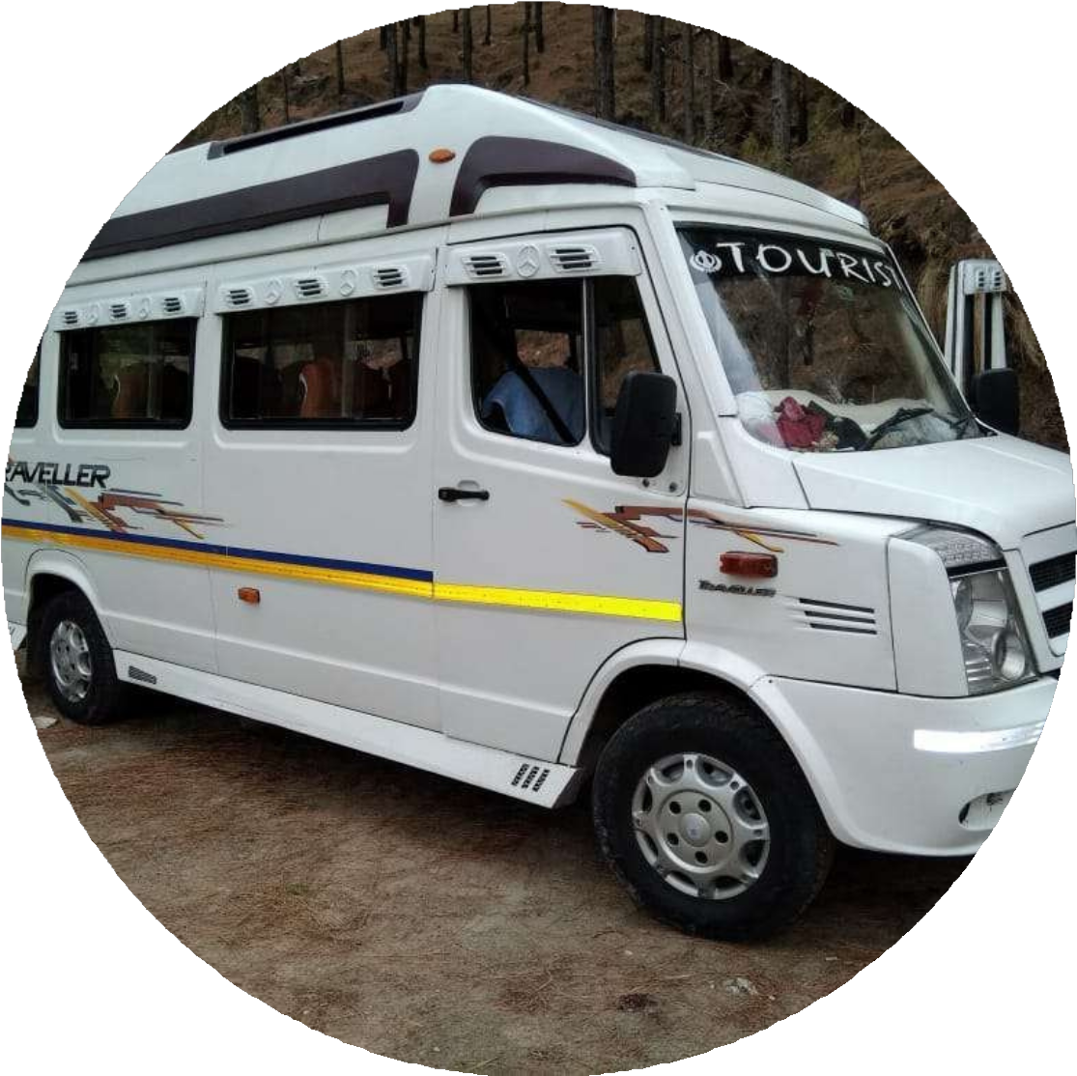
YOUR COMFORTABLE RIDE: TEMPO TRAVELLER
Travel like royalty on our spacious and comfortable tempo traveller!
This air-conditioned vehicle will be your home away from home during the journey, offering ample legroom, luggage storage, and a chance to relax and enjoy the scenic landscapes.
Sit back and relax in style as we embark on our journey to Nanital. Our air-conditioned tempo traveller provides a comfortable and convenient way to travel. With plenty of legroom, luggage storage, and scenic views out the window, you will arrive in Nanital feeling refreshed and ready to explore.

Slide 5
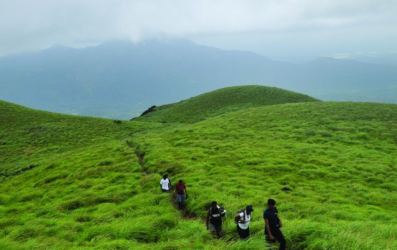
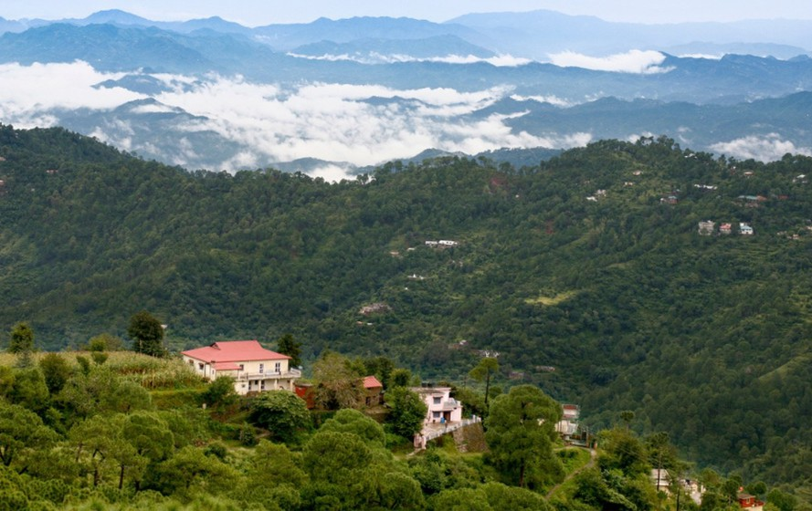
MAGICAL JOURNEY THROUGH THE HIMALAYAS
Prepare to be mesmerized by the beauty of the Himalayas! Our journey to Nanital takes us through scenic mountain ranges, offering breathtaking views and a chance to breathe in the fresh mountain air.
Get ready for a beautiful journey unlike any other!As we wind our way through the Himalayas, you'll be captivated by the majestic mountains, lush greenery, and fresh mountain air. Keep your cameras ready, because you won't want to miss capturing these breathtaking landscapes!

Slide 6

REACHING THE QUEEN OF HILLS, NANITAL
Greetings from "Queen of Hills" Nanital! This small hill station, hidden up in the heart of the Kumaon Himalayas, provides a cool respite from the heat and an opportunity to get back in touch with the natural world.
Our journey culminates in the picturesque town of Nanital, aptly nicknamed the "Queen of Hills." Surrounded by snow-capped peaks and nestled beside serene Lake Naini Tal, this charming destination offers a welcome respite from the heat and a chance to reconnect with nature.

Slide 7
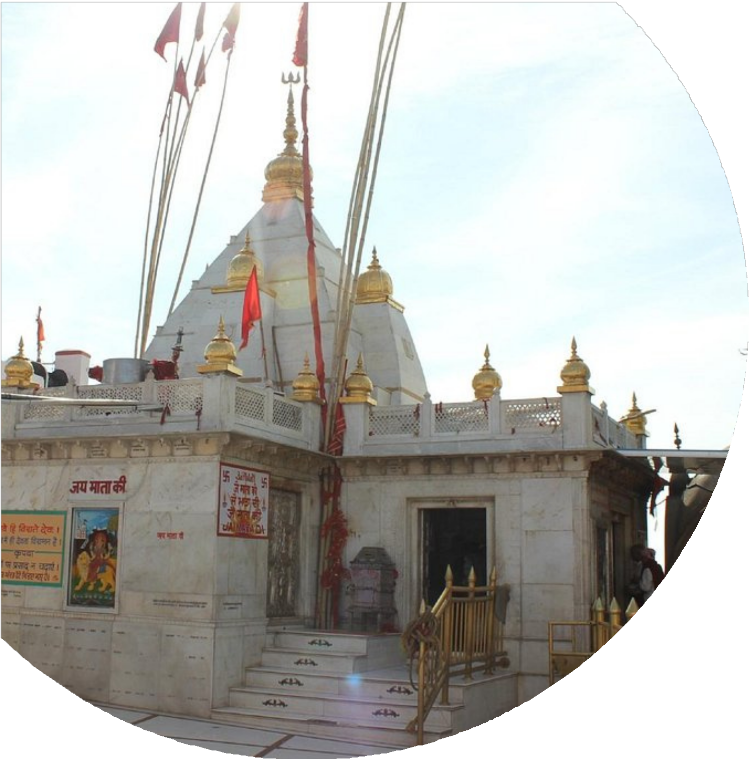
EXPLORE NANITAL - YOUR PERFECT DAY
Morning: Take a relaxing boat trip on the pristine Lake Naini Tal, taking in the breathtaking scenery and calm mood.
Afternoon: Visit the revered Hindu temple destination Naina Devi Temple to ask for blessings.
Evening: Make lifelong memories by gazing at Snow View Point's magnificent panoramic views.
At night, take an easy walk down the lively Mall Road, which is lined with eateries and stores.
With a full day at your leisure, you can create your own unforgettable Nanital experience! Here are a few ideas to get you started:
Morning: Start your day with a serene boat ride on Lake Naini Tal, allowing you to soak in the breathtaking beauty of the surroundings.
Afternoon: Head to the Naina Devi Temple, a revered Hindu pilgrimage site, and seek blessings while experiencing the rich cultural heritage.
Evening: Capture breathtaking panoramic views from Snow View Point, creating memories that will last a lifetime.
Night: Explore the lively Mall Road, a shopper's paradise with a variety of shops and restaurants to satisfy your cravings.

Slide 8
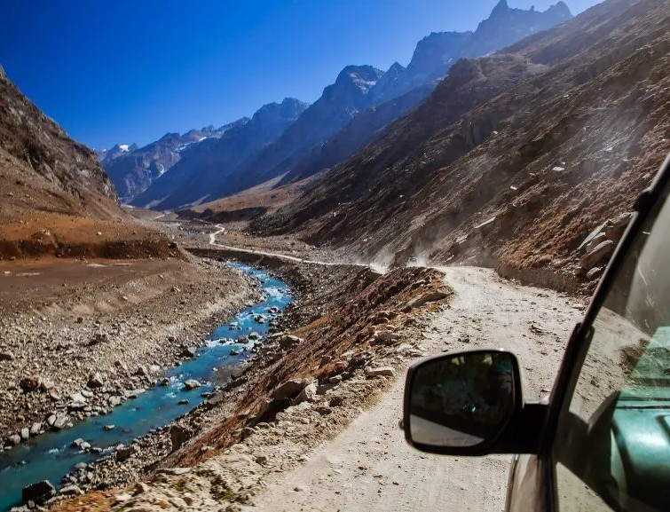
RELAXING JOURNEY BACK TO DELHI
After a day filled with adventure and exploration, we'll enjoy a relaxing journey back to Delhi in our comfortable tempo traveller. With a heart full of memories and a camera full of breathtaking photos, we'll bid farewell to Nanital and embark on our

Slide 9

www.tempotravellerrentindelhi.com
THANK YOU
+91-9810125805 , 8882562010
info@tempotravellerrentindelhi.com
55, 2nd Floor, Regal Building, Parliament Street, Connaught Place, New Delhi, Delhi 110001

