Slide 1




Venops: Comprehensive OIG Screening Solutions
Venops provides a robust suite of compliance tools to help healthcare providers navigate the complex regulatory landscape. From in-depth OIG exclusion monitoring to seamless CMS Open Payments data integration, Venops ensures organizations remain compliant and avoid risks.
by Venops

Slide 2
CMS Open Payments Data Integration
Data Aggregation
Compliance Tracking
Reporting & Analytics
Venops aggregates CMS Open Payments data, providing a comprehensive view of financial transfers between healthcare providers and pharmaceutical/device companies.
Organizations can monitor payments, gifts, and other transfers of value to identify potential conflicts of interest and maintain compliance.
Robust reporting and analytics tools enable data-driven decision making and proactive compliance management.

Slide 3
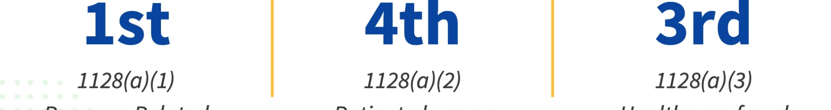

Sanction Checks and OIG Exclusion Monitoring
Ongoing Monitoring
Venops continuously screens healthcare providers and associated entities against the OIG exclusion list and other sanction databases.
Comprehensive Checks
Thorough OIG exclusion and sanction checks are performed during onboarding and on a recurring basis to mitigate risk.
1
2
3
Real-Time Alerts
Immediate alerts are triggered when a provider is added to the exclusion list, enabling swift action to maintain compliance.

Slide 4
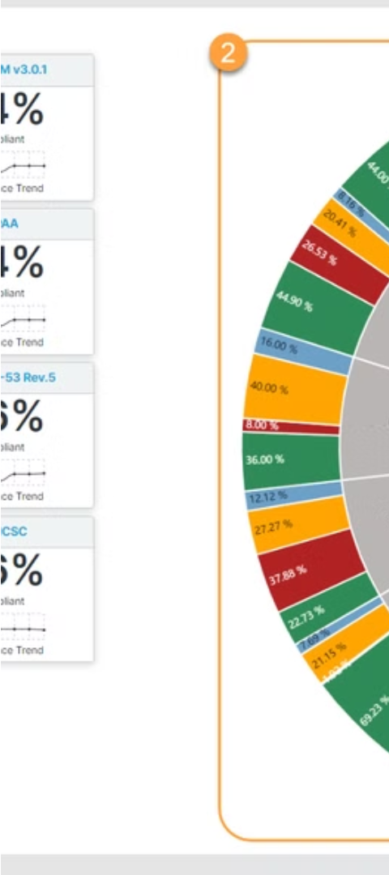
Compliance Tools: CMS Open Payments, Exclusions List OIG
1
CMS Open Payments Integration
2
OIG Exclusions List Monitoring
Automated data aggregation and reporting for CMS Open Payments compliance.
Continuous screening against the OIG exclusions list to avoid doing business with excluded entities.
3
Comprehensive Compliance
Venops provides a single platform for managing multiple compliance requirements.

Slide 5
Thorough OIG Checks for Healthcare Providers
Initial Onboarding
Ongoing Monitoring
Comprehensive OIG checks are conducted during the provider onboarding process to ensure compliance.
Regular OIG exclusion screenings are performed to proactively identify any changes in provider status.
Customized Alerts
Compliance Assurance
Tailored alerts notify organizations of any OIG exclusions or sanctions, enabling swift remediation.
Venops' thorough OIG checks give healthcare organizations confidence in their compliance posture.

Slide 6



Avoid OIG Excluded Entities with Venops
Risk Mitigation
Compliance Assurance
Comprehensive Screening
Eliminate the risk of doing business with OIG excluded entities.
Maintain compliance and avoid penalties for engaging with excluded providers.
Venops screens against the complete OIG exclusions list, leaving no gaps in coverage.

Slide 7





Remain Compliant with Venops' Comprehensive Services
OIG Exclusion Monitoring
Continuous screening against the OIG exclusions list to identify any changes.
CMS Open Payments Tracking
Automated data aggregation and reporting for CMS Open Payments compliance.
Comprehensive Compliance
A single platform to manage multiple regulatory requirements and obligations.

Slide 8
Stay Compliant with Venops
OIG Exclusion Monitoring
Continuous screening against the OIG exclusions list
CMS Open Payments Integration
Automated data aggregation and reporting
Compliance Management
Single platform to handle multiple regulatory requirements

Slide 9

Contact Us
Best platform for OIG exclusion list and Monthly OIG screening | VENOPS
EMAIL THE TEAM WITH QUESTIONS OR REQUESTS :- memberservices@venops.com
WHERE WE ARE IN THE WORLD :- 1395 South Marietta Parkway Bldg. 400, Suite 104 Marietta Ga 30067
CALL TO SPEAK WITH OUR OFFICE M-F FROM 8:30-5:00 EST :- 855 567 3552

