Slide 1

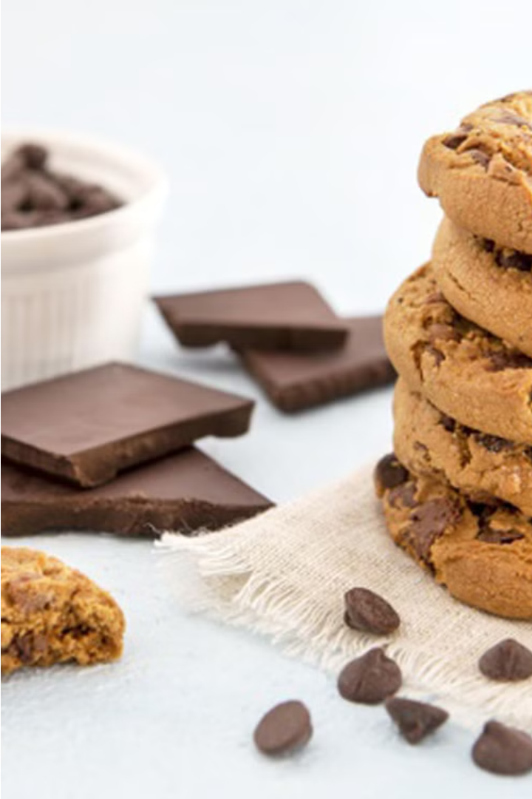


Local Cookies in Dubai
Discover a delightful array of freshly baked treats from Local Cookies in Dubai, offering a tempting selection for every occasion.
by Local cookies

Slide 2
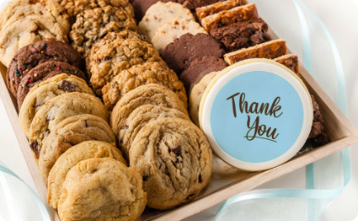
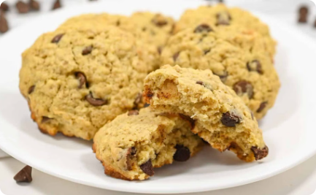
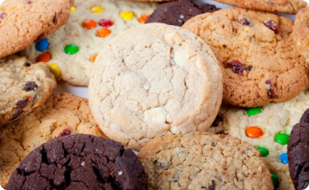
Delightful array of treats
Classic and Indulgent
Handcrafted with Care
Something for Everyone
From timeless chocolate chip to decadent stuffed cookies, Local Cookies offers a wide range of sweet treats to delight every palate.
Each cookie is meticulously crafted using the finest ingredients to ensure maximum flavor and texture in every bite.
Whether you crave a rich, buttery indulgence or a healthier option, Local Cookies has an array of flavors to satisfy any craving.

Slide 3
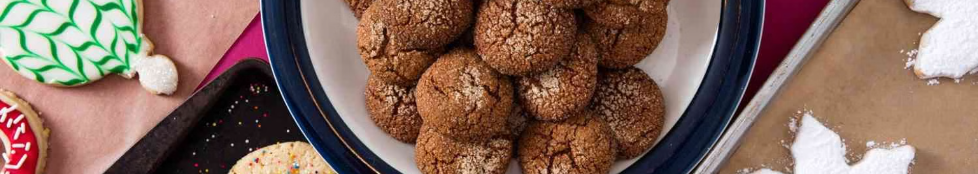

Classic to Indulgent Cookies
Classic Chocolate Chip
Decadent Stuffed Cookies
Delightful Variety
Explore our ever-expanding menu, from classic flavors to unique twists, catering to every cookie connoisseur.
A timeless favorite, featuring rich chocolate chunks nestled in a buttery, crispy-edged cookie.
Indulge in our signature stuffed cookies, with molten centers of gooey caramel, creamy Nutella, or melty chocolate.

Slide 4

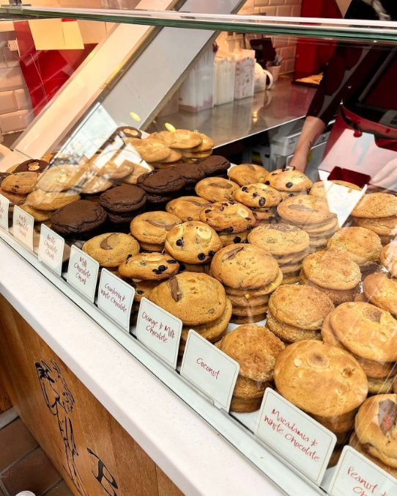
Ben's Cookies
Ben's Cookies are renowned for their rich and buttery flavor, making them a true indulgence. Crafted with premium ingredients and baked to perfection, each bite delivers a velvety smooth texture that melts in your mouth.

Slide 5



Healthier Options
Pistachio Cookies
Nutella Cookies
Healthier Choices
Indulge in the delicate, nutty flavor of pistachio cookies, a guilt-free treat that satisfies your cravings.
Savor the rich, chocolatey taste of Nutella cookies, a decadent option that won't derail your health goals.
Explore a range of healthier cookie options that cater to your dietary needs and preferences.

Slide 6
Corporate Gifts and Anniversary Celebrations
Corporate Gifts
Anniversary Celebrations
Looking to impress clients or reward hardworking employees? Local Cookies in Dubai offers exquisite corporate gifting boxes filled with an assortment of their most popular cookie flavors. These make the perfect addition to any business event or holiday celebration.
Commemorate special occasions with a thoughtful gift from Local Cookies. Their gathering boxes are beautifully curated to delight the senses, featuring an array of indulgent cookies that are sure to make any anniversary celebration even sweeter.

Slide 7
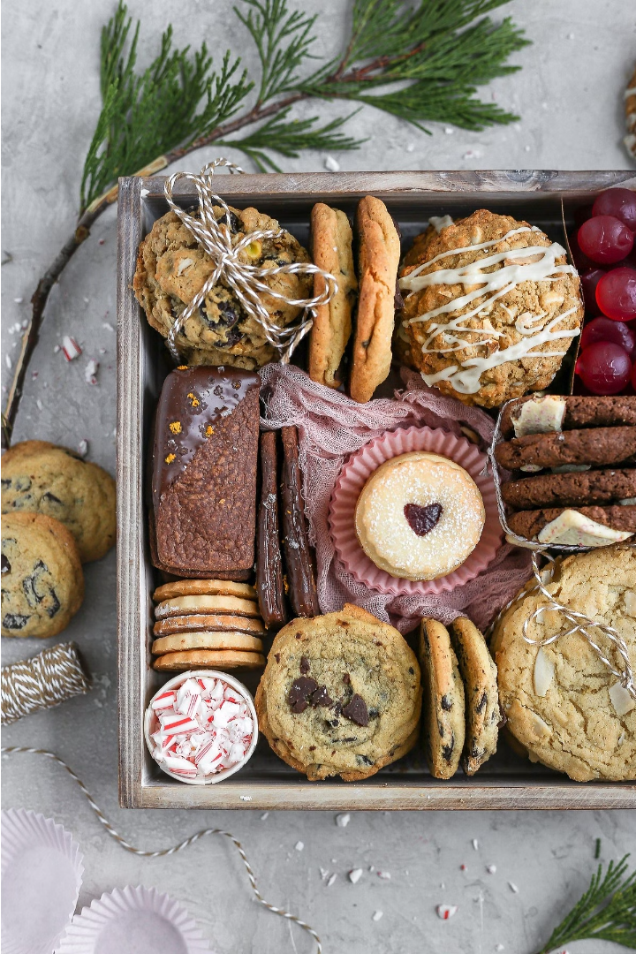
Exquisite Gathering Boxes
Elevate any corporate event or special celebration with Local Cookies' luxurious gift boxes. Carefully curated with a delightful assortment of their signature cookies, these bespoke boxes make for an impressive and thoughtful gesture.
Wrapped in premium packaging and tied with elegant ribbons, these gathering boxes exude an air of sophistication. Whether presented as executive gifts or to commemorate a milestone, they are sure to delight recipients and leave a lasting impression.

Slide 8
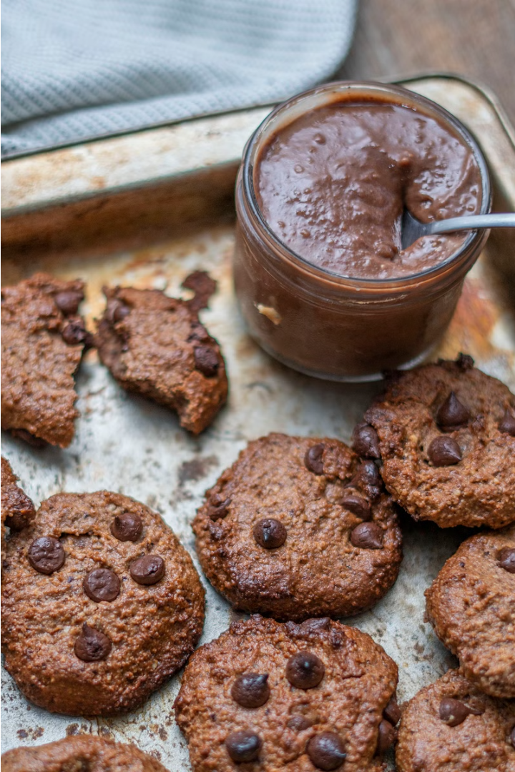
Satisfying Cravings Guilt-Free
Indulge in delectable Nutella and pistachio cookies that satisfy your sweet tooth without the guilt. These healthier treats are made with wholesome ingredients, allowing you to enjoy the rich flavors without compromising your wellness goals.

Slide 9
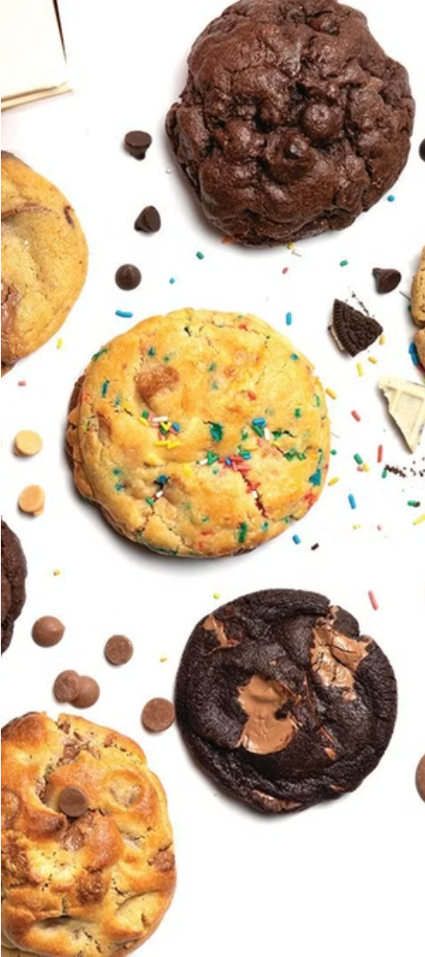
Something for Every Palate
Classic Favorites
Unique Flavors
From the beloved chocolate chip to the indulgent stuffed cookies, Local Cookies offers timeless treats that satisfy traditional cravings.
For the adventurous, the menu features unexpected delights like pistachio and Nutella cookies, catering to diverse tastes and dietary preferences.
Signature Selections
Local Cookies' renowned Ben's Cookies stand out with their rich, buttery goodness, making them a must-try for any cookie connoisseur.

Slide 10
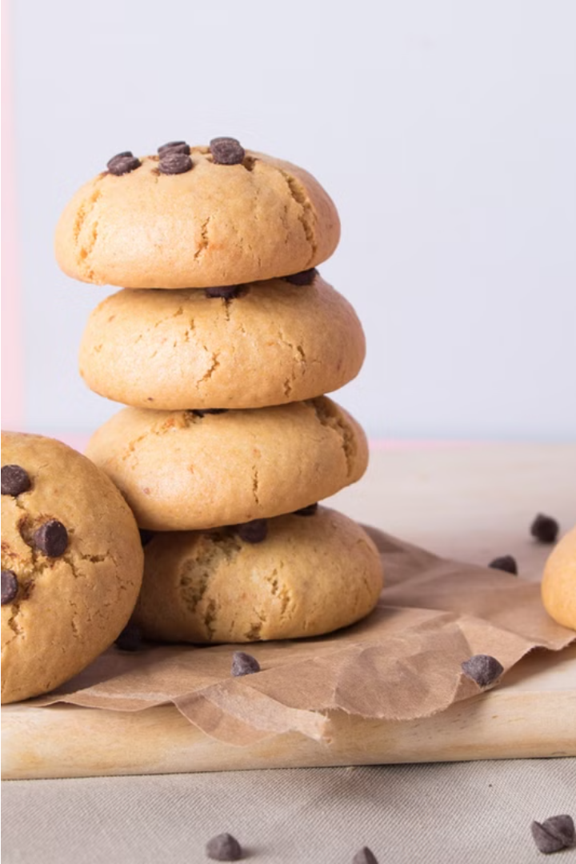
Contact Us
Get in touch with our friendly team to learn more about our delectable cookie offerings and how we can cater to your special events and corporate gifting needs.
Buy the Best Cookies in Sharjah at Local Cookies
Address: Muwaileh Commercial - Industrial Area - Sharjah - United Arab Emirates
Email : Hello@localcookies.ae
Phone : +971 6 530 0115

