Slide 1

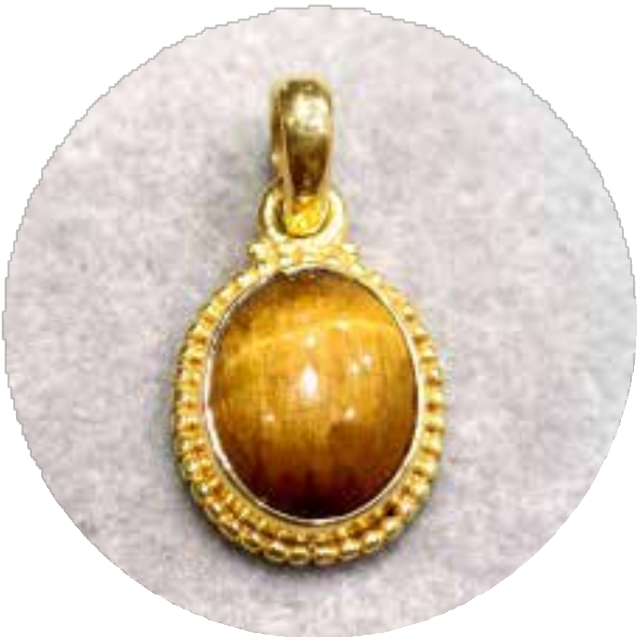
https://www.silverjewelrydoctor.com/blog/sterling-silver-earrings-wholesale

Slide 2
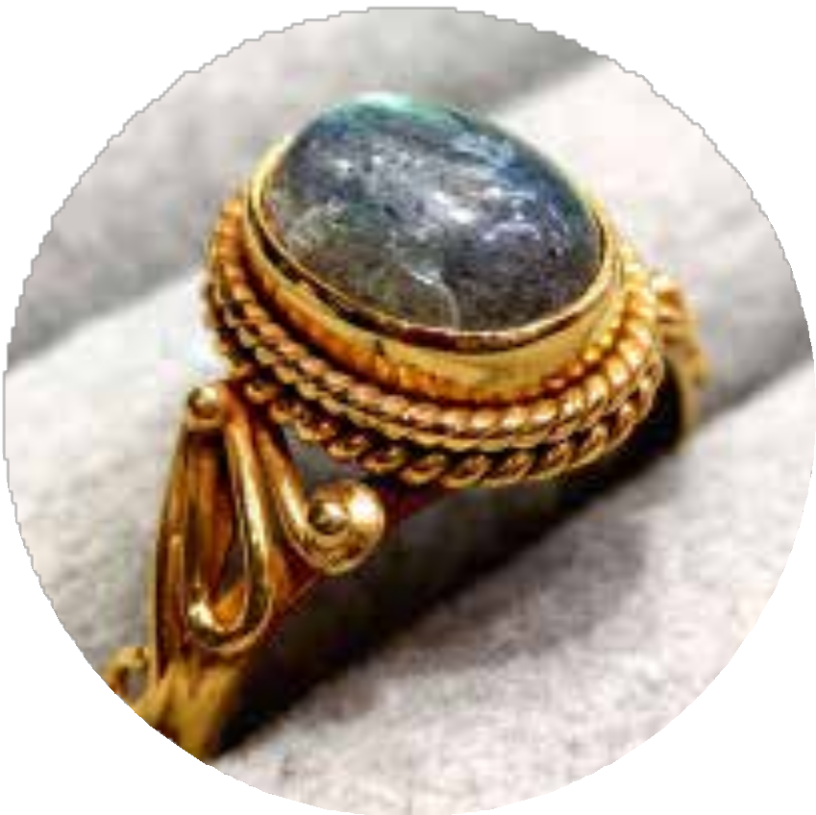
ABOUT US
Wholesale Silver Jewelry Doctor has carved a reputable niche for itself within the realm of silver jewelry and handicraft manufacturing, celebrated for its unwavering commitment to quality and exceptional services. As a purveyor of high standards, the company is dedicated to offering a splendid array of wholesale silver jewelry that possesses the innate ability to transform one's personality through the allure of silver and gemstone adornments.
https://www.silverjewelrydoctor.com/blog/sterling-silver-earrings-wholesale

Slide 3
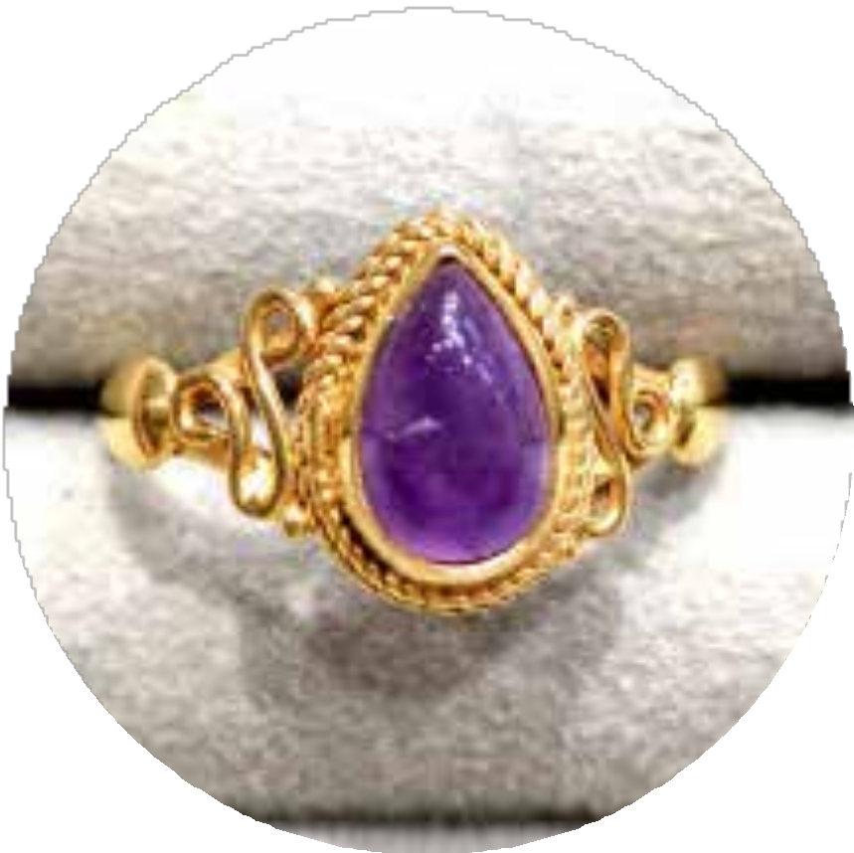
Silver earrings have always been a favourite among fashion enthusiasts. Retailers who stock high-quality, trendy designs often see substantial proﬁts. Here’s how you can enhance your inventory to maximize your retail gains.
Why Silver Earrings Are A Must-Have?
Silver earrings never go out of style. They appeal to a broad spectrum of people, from teenagers to sophisticated adults. Therefore, adding sterling silver earrings wholesale to your inventory ensures you cater to diverse tastes.
Silver is a classic metal, offering both elegance and versatility. It pairs well with almost any outﬁt, from casual to formal. Hence, customers appreciate the metal's longevity and lustre.
https://www.silverjewelrydoctor.com/blog/sterling-silver-earrings-wholesale

Slide 4
FOLLOW US
https://www.facebook.com/silverjewelrydoctor
https://twitter.com/silverjdoctor https://www.instagram.com/silverjewelrydoctor/
https://in.pinterest.com/SilverJDoctor/
https://api.whatsapp.com/send?phone=66838021472 https://line.me/R/ti/p/%40806vlafh
https://www.silverjewelrydoctor.com/blog/sterling-silver-earrings-wholesale

Slide 5
CONTACT US
2 kb, raj apartment, keshav path, ahinsa circle, c-scheme, jaipur, rajasthan, india
+66838021472
Mysilvershop@gmail.com
https://www.silverjewelrydoctor.com/blog/sterling-silver-earrings-wholesale

Slide 6
https://www.silverjewelrydoctor.com/blog/sterling-silver-earrings-wholesale

