Slide 1
BLOCKCHAINX
"INNOVATIVE BLOCKCHAIN SOLUTIONS FOR THE MODERN WORLD"

Slide 2

ABOUT BLOCKCHAINX
BlockchainX is a leading blockchain development company dedicated to providing innovative solutions that empower businesses to harness the power of blockchain technology.
Mission: To revolutionize industries through decentralized technology.
Vision: To be the global leader in blockchain solutions, driving transparency, security, and efficiency across sectors.

Slide 3

MARKET OVERVIEW
The blockchain industry is experiencing exponential growth, with a market size projected to reach $10 billion by 2025.
Key trends driving demand include increased need for security, transparency, and decentralized applications.
Blockchain technology is transforming industries such as finance, healthcare, supply chain, and more.

Slide 4






OUR SERVICES
Blockchain Consulting
Smart Contract Development
Decentralized Applications (DApps)
Blockchain Integration
Tokenization Services
Blockchain Maintenance

Slide 5





TECHNOLOGIES WE USE
Ethereum: Smart contract and DApp development.
Hyperledger: Enterprise-grade blockchain solutions.
Solidity: Programming language for developing smart contracts.
IPFS: Decentralized storage solutions.

Slide 6





CASE STUDY

Slide 7
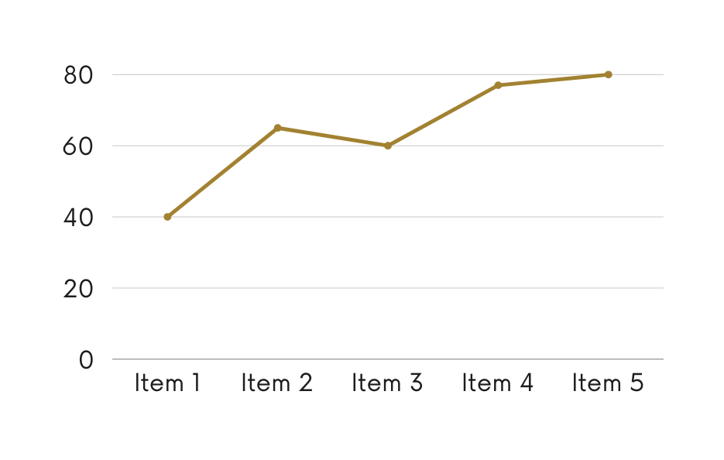
EXPERTISE
Combined experience of over 8 years in technology and blockchain development.
Proven track record of delivering successful blockchain projects across various industries.

Slide 8




Expertise
Our team consists of industry-leading experts in blockchain technology.
Innovation
We leverage cutting-edge technology to deliver innovative solutions.
WHY US?
Business Development
We prioritize our clients' needs and deliver customized solutions.
Proven Success
Numerous successful projects and satisfied clients worldwide.

Slide 9



LOCATIONS
Address: Branch Office - US.
8 The Green, STE A
Dover, De, Kent
United States - 19901.
No. 3 Gem Colony,Near Siva Hospital, Ganapathy,Coimbatore, Tamil Nadu,India - 641 006.

Slide 10




Phone: 7708889555
Email: contact@blockchainx.tech
Website: www.blockchainx.com

Slide 11
THANK YOU
FOR COMING

