Slide 1

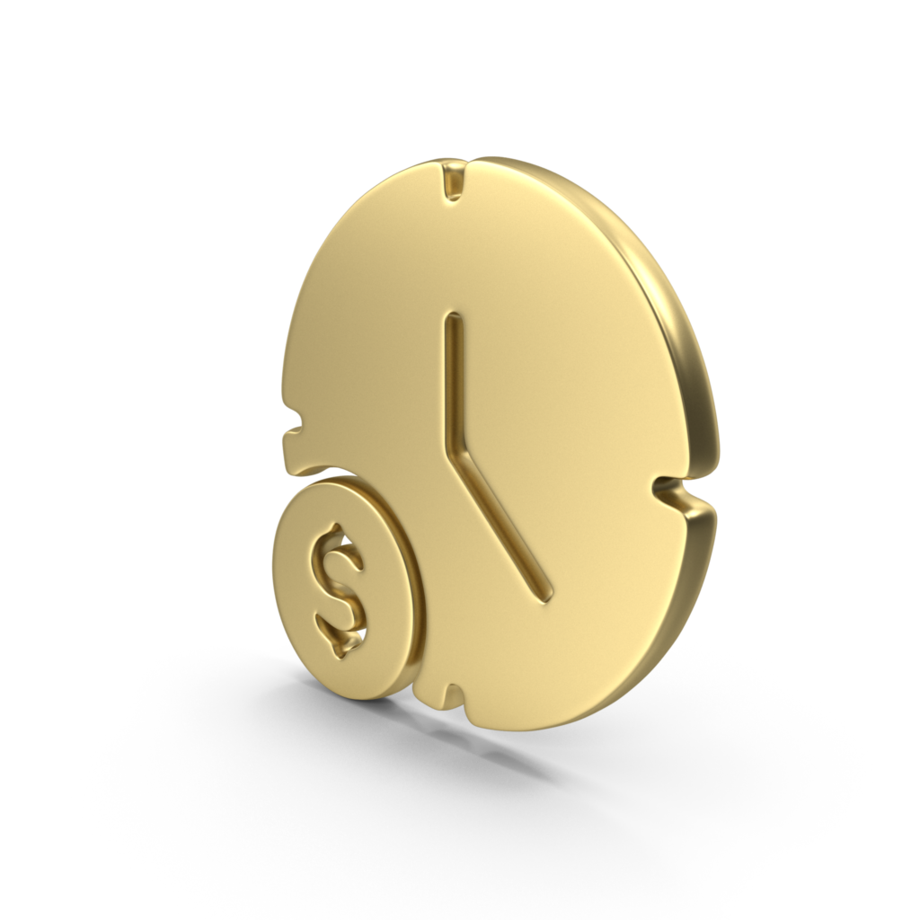


CASH IN MINUTES
PERSONAL LOANS

Slide 2

Overview
  About Us
  Introduction
  Personal Loans: Everything You Need to Know
  Why Use Personal Loans?
  Types of Personal Loans
  Benefits of Personal Loans
  Why Choose Personal Loans?
  How To Apply For Personal Loans at Cash in Minutes
  Why Choose Us For Personal Loans For Bad Credit?
  Contact Details

Slide 3


About Us
Here is a little about us at Cash in Minutes delivers the cash you need quick when needed the most. We know that unforeseen expenses can lead to financial hardship and that life can be unpredictable.
So, to assist people in those difficult circumstances and help them get back on their feet, we launched Cash in Minutes.
Personal Loan from $100 to $1500 Cash Loan in Minutes

Slide 4

Introduction
Personal loans or installment loans at Cash in Minutes means instant cash advances in minutes. Our personal loans come at a fixed interest rate with regular and equal monthly payments. We offer an extended repayment period so you can repay your payments at your own pace.

Slide 5

Personal Loans: Everything You Need to Know
You can get a personal loan to manage your financial situation whether you need more funds to cover an unforeseen expense, buy something major, or deal with a difficult financial period.
As the name implies, Cash in Minutes provides people in need with speedy personal loans. We don’t care if you have bad credit. Even those with bad credit can get quick personal loans from us so they can get through a difficult period without worrying about their finances.
Continue reading to learn more about the best personal loans, including how to apply for them, their types, advantages, and more.

Slide 6

Why Use Personal Loans?
There are several situations where personal loans can be helpful. You could need a personal loan to finance the expenses of upgrading your home, buying a car, handling an unforeseen expense, or getting something fixed.
The majority of people use personal loans to pay for weddings or trips. So you can depend on personal loans to aid in achieving your financial objectives and maintain your financial stability.

Slide 7

Types of Personal Loans:
Payday Loans
Payday loans are brief loans for those who urgently want a small amount of cash. Payday loans must be repaid when your next paycheck arrives. They can very easily be repaid in a few weeks.
Cash in Minutes has several types of personal loans online to meet your unique needs:
Installment Loans
These types of loans are long-term and their repayments are spread out over a set period of time. Installment loans involve borrowers acquiring a predetermined sum of money and paying it back over time in a series of equal payments. Because the payback period can be stretched out across months or even years, installment loans are perfect for bigger sums of money.

Slide 8




Benefits of Personal Loans
Personal Loans For Bad Credit
Flexible Repayment Terms
Easy Application Process
At Cash in Minutes, we realize that anyone might have a bad credit score. So we provide personal loans for those with terrible credit or no credit history.
Depending on the kind of loan you accept, Cash in Minutes gives you the option of paying back your loan in a series of installments over multiple months, years, or as soon as your next paycheck comes in.
Personal loan applications are really simple to complete at Cash in Minutes. As soon as you apply, their team will contact you with more information.

Slide 9


Why Choose Personal Loans?

Slide 10


When you need immediate cash, personal loans can be just what you’re looking for. They are especially suitable for those with bad credit. They can also be used in a variety of circumstances and are more versatile than credit cards.
Fixed monthly payments
Lowest interest rates
Don’t require collateral
The best personal loans have fixed interest rates and monthly payments throughout the loan term.
Find out which lender offers the most affordable interest rates while searching for the right personal loan. By doing this, you’ll have significantly more money saved at the end of your term.
Personal loans don’t demand collateral like secured loans do, such as your home or car.

Slide 11
How To Apply For Personal Loans at Cash in Minutes
The personal loan application process at Cash in Minutes is very simple and easy to understand.
Just adhere to these simple steps:
Visit our website and complete the online personal loan application.
Provide your name, job info, and mailing address, as well as any essential information.
Within hours of getting your submission, we will analyze it and get back to you with an answer.

Slide 12

Why Choose Us For Personal Loans For Bad Credit?
At Cash in Minutes, we are aware that for many people, the cost of living has essentially caught up to their level of income. Due to this, saving money is quite difficult. We provide fast personal loans to meet your demands anytime you need cash immediately and lack the time to deal with lengthy procedures.
Regardless if you have poor credit, you are welcome. When you need it, our hard-working crew makes certain that the cash is in your account. We stand out from other lenders in that we don’t separate those with good credit from those with bad credit.
Also, we provide some of the lowest interest rates in the Utah Valley, which makes us the most in-demand lenders in the area. As a result, anytime you contact us for a personal loan, you can expect to receive quick and very inexpensive loans with the most competitive interest rates.
We take pride in providing individuals in need with the simplest, cheapest, and quickest personal loans. You may easily and quickly apply for personal loans, thanks to our simple application process. So if you are concerned that your credit history may not be the best for obtaining a loan, don’t be. Just complete your online application and Cash in Minutes will assist you within hours to maintain your financial position. We have a track record.
Apply at Cash in Minutes now to get a decision by the end of the day if you want flexible repayment options, the lowest interest rates, better possibilities of getting a loan, and a rapid application procedure (or even earlier). Regardless of your credit record, we want to help you in regaining your financial stability.

Slide 13





THANK YOU
For watching this
Contact Details
+1 (801) 919-3200
www.mycashinminutes.com
424 North Freedom Blvd Provo, Utah 84601

