Slide 1
What is dialer software?
A dialer is a type of call center software used to automate the dialing of customer phone numbers and to document the outcome of these calls easily.
www.gsmgateway.in

Slide 2
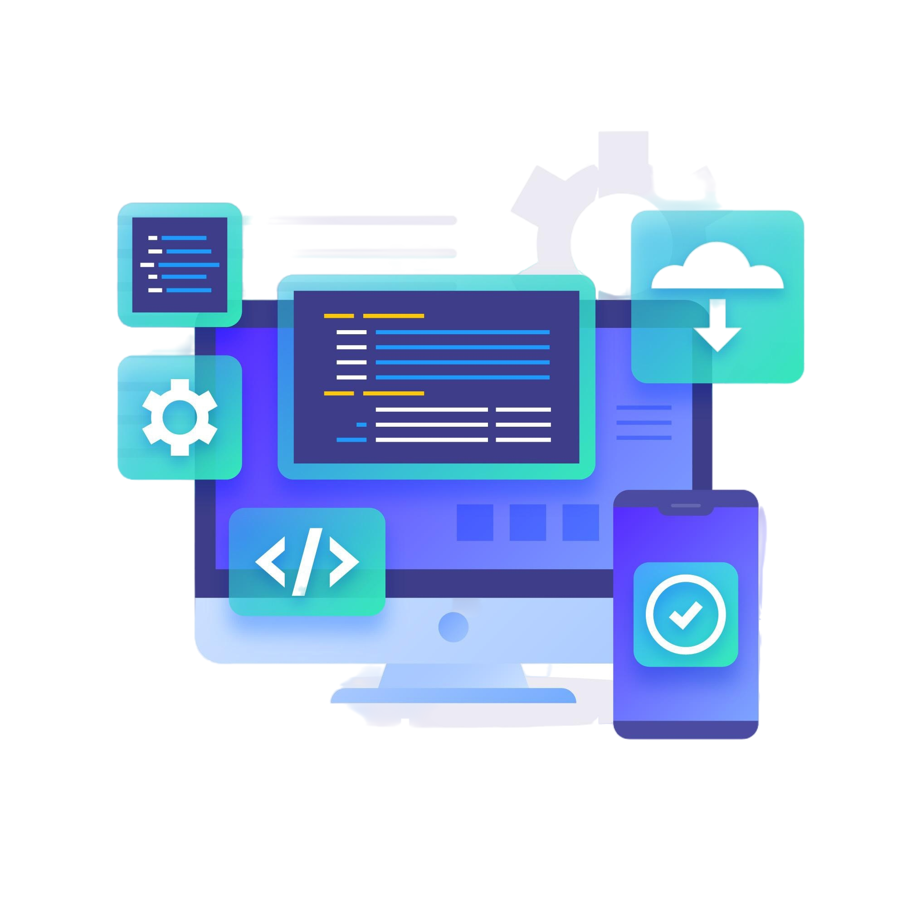
Dialer Software
One technique for managing the phone call method is dialer software. Call centers and sales teams frequently employ it to boost productivity and efficiency. The following are the main features and advantages of dialer software.
www.gsmgateway.in

Slide 3
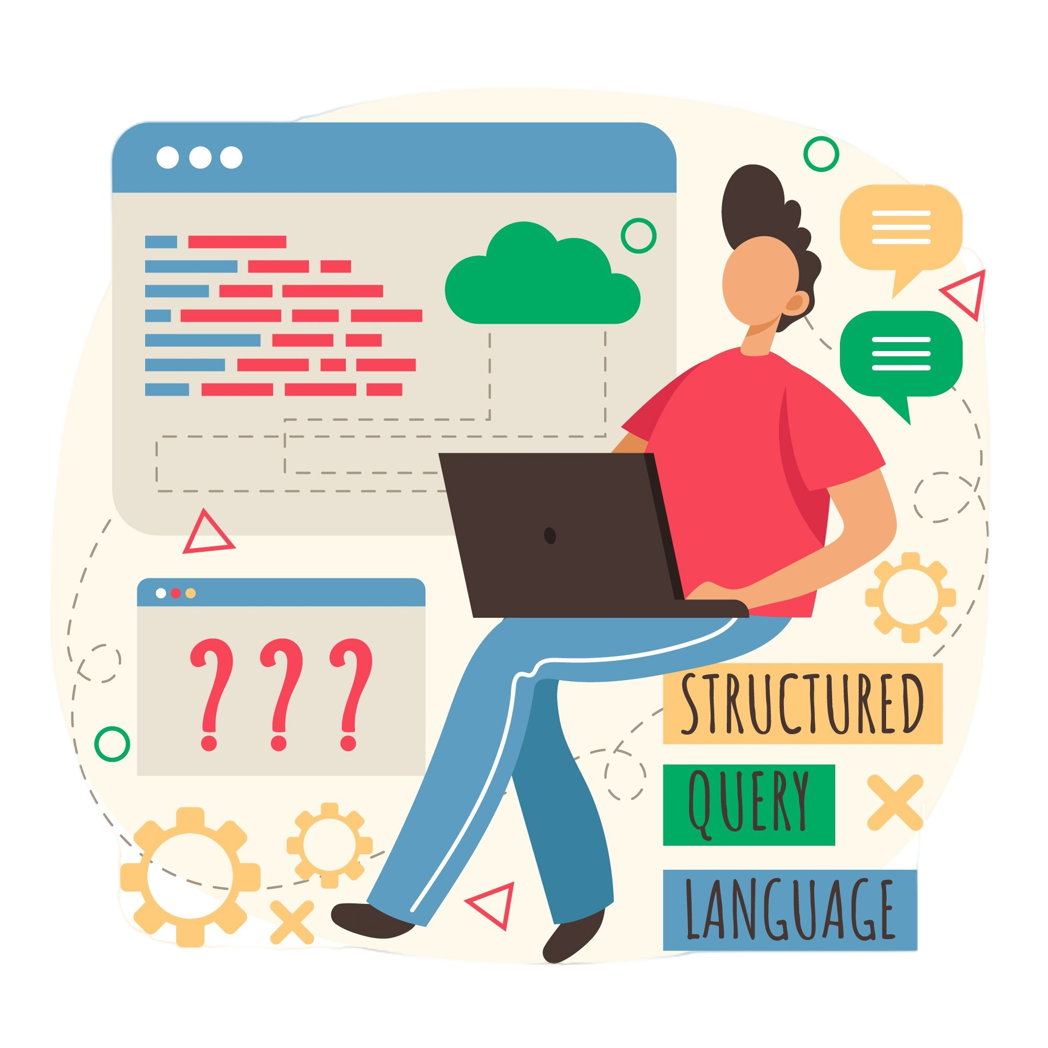
Types of Dialers:
Predictive Dialers: Dial multiple numbers simultaneously and connect agents only when a call is answered.
Power Dialers: Dial one call at a time when agents are ready.
Preview Dialers: Allow agents to view the information before dialing.
Dialer software is essential for improving efficiency, reducing idle time, and enhancing customer interactions in high-volume calling environments.
www.gsmgateway.in

Slide 4

Here are the key functions and benefits of dialer software:
Automated Dialing: Automatically dials numbers from a predefined list, eliminating the need for manual dialing.
Call Management: Manages incoming and outgoing calls, including call routing, forwarding, and voicemail management.
Integration: Integrates with Customer Relationship Management (CRM) systems to streamline workflows and ensure customer information is up-to-date.
www.gsmgateway.in

Slide 5
Thank you, Neeraj Negi
For More Information Related to Dialer Software
Call Now: +91 906667770
Visit Now: www.gsmgateway.in
The Best Dialer System for your Business will ultimately depend on your unique
Requirements and operational needs.

