Slide 1
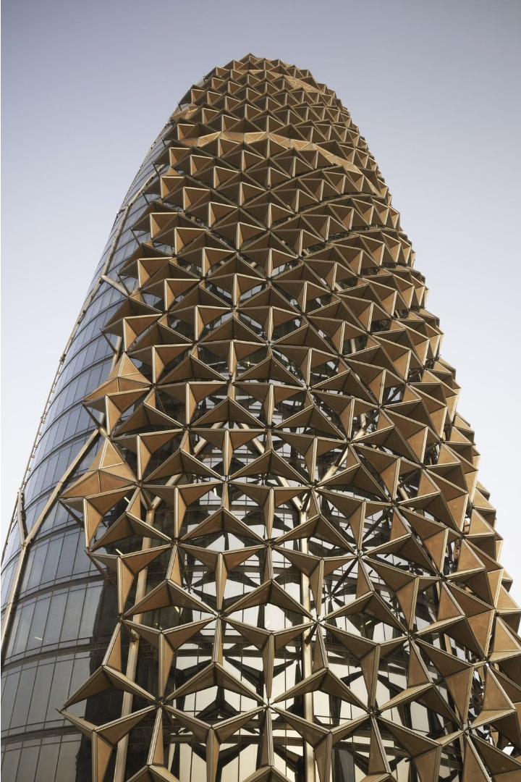
Dubai's Steel Construction Industry
Dubai, renowned for its rapid development and architectural marvels, has a thriving steel construction industry. Leveraging advanced technologies and a skilled workforce, the emirate offers top-tier steel building installation and steel construction services, ensuring durable and visually stunning structures.

Slide 2
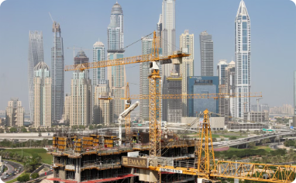
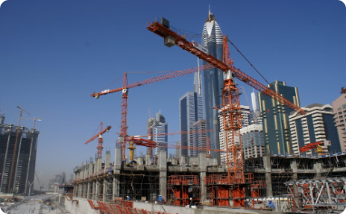
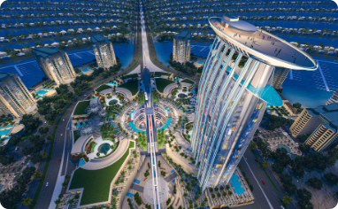
Rapid Development and Technological Advancements
Rapid Urban Transformation
Skilled Workforce
Advanced Technologies
Dubai's steel construction industry is powered by a highly skilled international workforce, harnessing cutting-edge technologies and techniques to deliver world-class projects.
Dubai's construction industry has undergone rapid transformation, with soaring skyscrapers and vast infrastructure projects reshaping the city's iconic skyline at a breathtaking pace.
Dubai embraces the latest advancements in construction, from 3D modeling and BIM to automated equipment, ensuring efficient, data-driven processes and superior quality.

Slide 3
Top-Tier Steel Building Installation Services
Expertise in Steel Erection
Advanced Installation Techniques
Steel Construction in Dubai boasts a highly skilled workforce adept at the precise installation of complex steel frameworks. From high-rise towers to sprawling industrial facilities, their expertise ensures each structure is erected with meticulous care.
Leveraging the latest technologies, Dubai's steel installation teams employ cutting-edge methods to efficiently assemble steel components. This includes the use of specialized cranes, hoists, and rigging equipment to lift and position even the largest steel beams and columns.

Slide 4
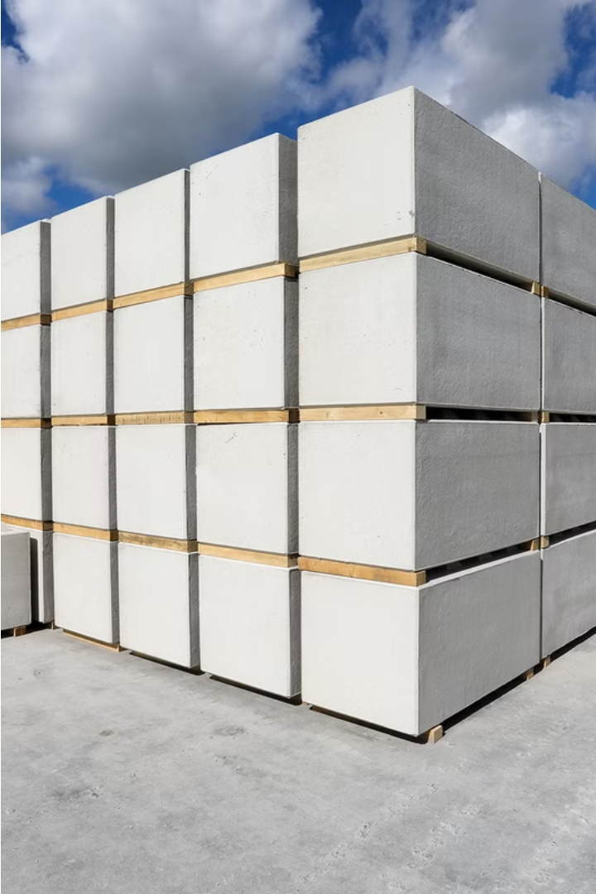
Precast Concrete Blocks for Durable Structures
Precast Concrete Block in Dubai thriving a important component in construction industry. These prefabricated, high-quality blocks offer exceptional durability and strength, ensuring the structural integrity of buildings. The use of precast technology streamlines the construction process, allowing for efficient and rapid development across the city.

Slide 5
ERW Pipes as Vital Construction Components
Durable Design
Versatile Applications
High Standards
ERW (Electric Resistance Welded) pipes feature a robust, seamless construction that ensures long-lasting performance in various construction applications.
These high-quality pipes are essential for a wide range of construction projects, from plumbing and HVAC systems to structural reinforcement and industrial equipment.
Dubai's construction industry relies on the superior quality and reliability of ERW pipes, which are manufactured to the highest international standards.

Slide 6
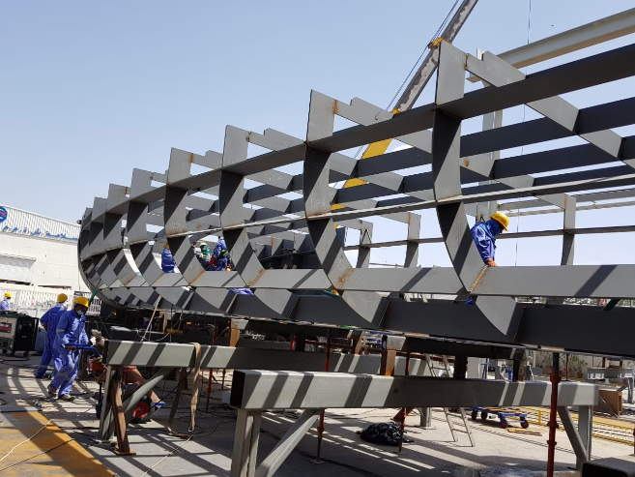
Metal Fabrication Expertise
Dubai's steel construction industry boasts exceptional metal fabrication capabilities. Skilled artisans create intricate metal components, from stainless steel bollards to custom sheet metal designs. Advanced techniques ensure precision and durability for diverse architectural and infrastructure projects.

Slide 7
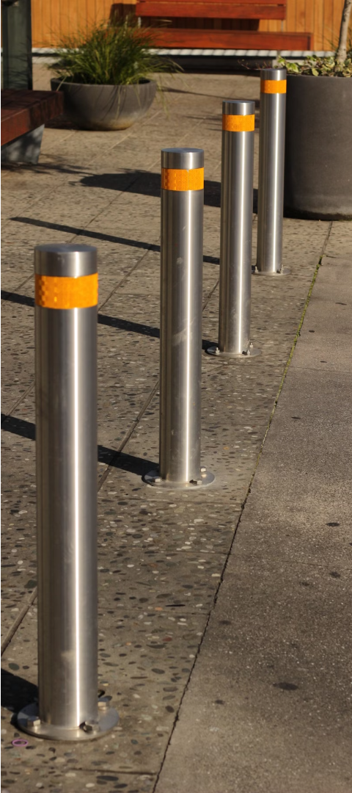
Stainless Steel Bollards and Sheets
Durable Construction
Versatile Design
Stainless Steel Bollard In Dubai offer exceptional strength and corrosion resistance, making them ideal for high-traffic areas and outdoor applications.
Stainless steel sheets can be custom-fabricated into a wide range of products, from sleek architectural facades to robust industrial equipment.
Elegant Aesthetics
The polished, gleaming finish of stainless steel adds a touch of sophisticated elegance to any project, from modern buildings to bespoke furniture.

Slide 8
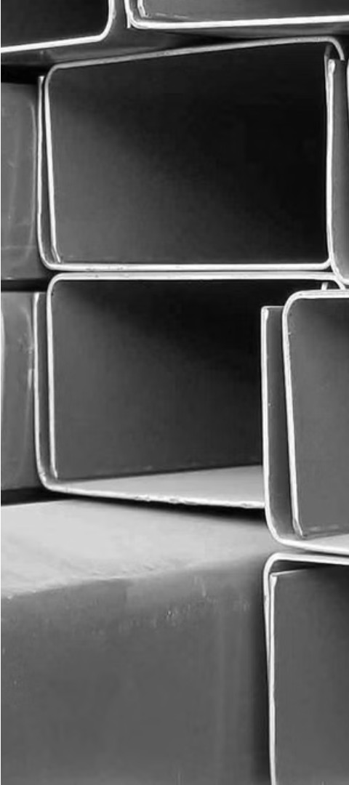
Leading C Channel Suppliers
Diverse Product Range
Competitive Pricing
C channel suppliers in Dubai offer a wide selection of steel profiles to meet various construction needs, from lightweight to heavy-duty options.
With a robust supply chain and efficient operations, these suppliers provide competitively priced C channels, ensuring cost-effective solutions for projects.
Reliable Delivery
Rapid order fulfillment and on-time delivery are hallmarks of leading C channel suppliers, keeping construction projects on schedule.

Slide 9
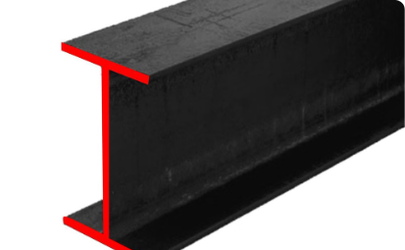
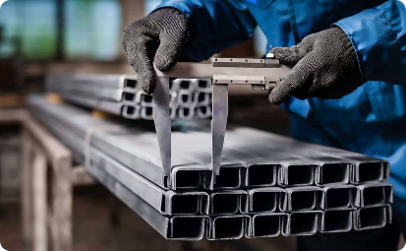
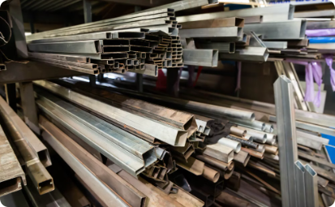
Robust RHS Providers
Comprehensive Inventory
Expert Fabrication
Efficient Installation
These providers leverage advanced fabrication techniques to precisely cut, weld, and finish RHS components, ensuring seamless integration into steel structures.
With a skilled workforce and streamlined logistics, the RHS suppliers facilitate smooth on-site installation, minimizing delays and optimizing construction timelines.
Dubai's leading RHS (Rectangular Hollow Section) suppliers maintain an extensive inventory of high-quality steel sections to cater to diverse construction needs.

Slide 10
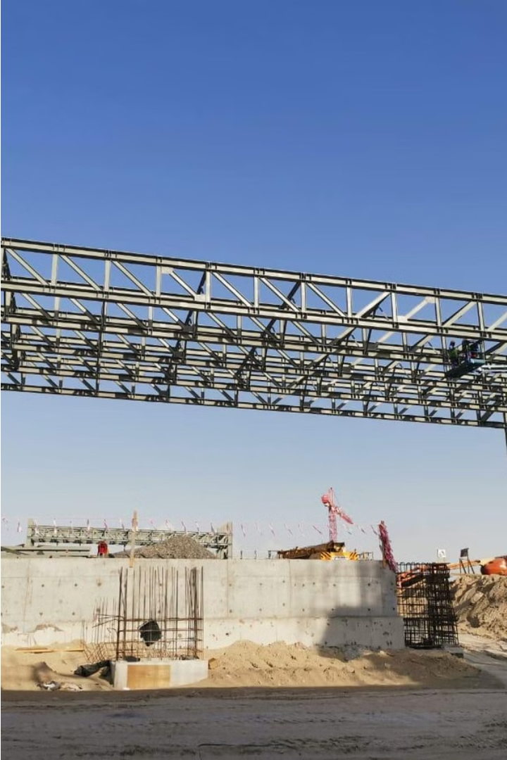
Know More About Us
Fencing Suppliers & Manufacturers in Dubai | UAE
Phone :- +971501922352,+971504328270
E-mail :- metalandmachine@gmail.com saurabh@metalnmachine.com
Location :- Plot no 8 , Block 6, Sector 711, New Industrial Area Umm Al Quwain, UAE

