Slide 1
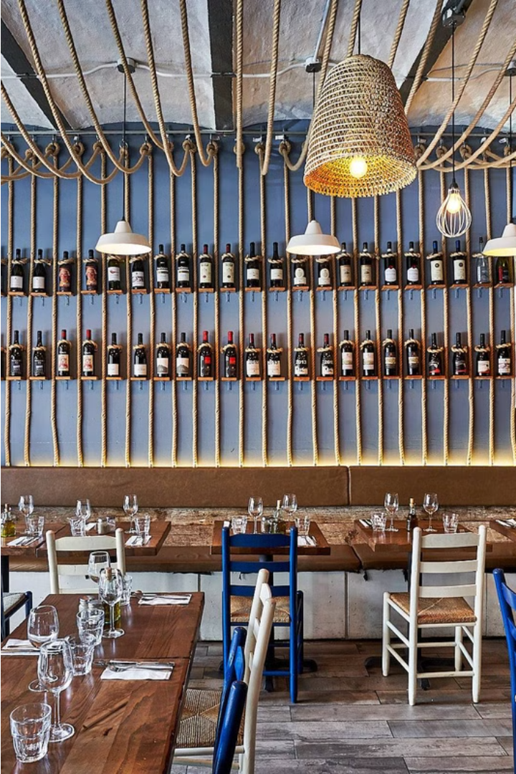


Piccola Cucina: A Culinary Journey
Discover the captivating story of Piccola Cucina, a renowned Italian restaurant that has captured the hearts and palates of New Yorkers and visitors alike.
by piccola cucina

Slide 2
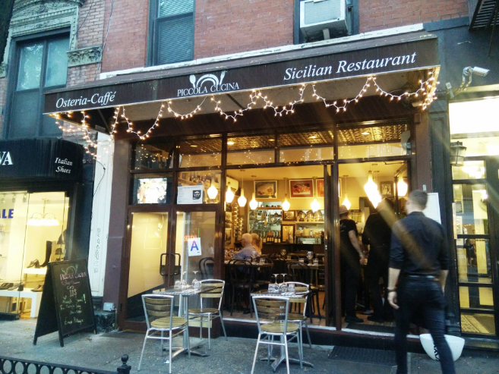
The Success of the Prince Street Location
Piccola Cucina's original Prince Street location quickly became a beloved fixture in the heart of New York City, attracting a loyal following of diners seeking authentic Italian cuisine. The restaurant's commitment to quality ingredients and traditional Sicilian recipes resulted in rave reviews and a reputation as one of the best Italian restaurants in NYC.

Slide 3



Responding to Consumer Demand
Listening to Customers
Expanding Reach
Innovative Approach
At Piccola Cucina, we closely monitor customer feedback and preferences to ensure our offerings meet their evolving needs and desires.
The success of our Prince Street location prompted us to open a new Sicilian-focused restaurant in the vibrant Soho neighborhood to bring our authentic cuisine to more New Yorkers.
Our commitment to culinary excellence and customer satisfaction drove us to develop new menu items and dining experiences that cater to the diverse tastes of our patrons.

Slide 4
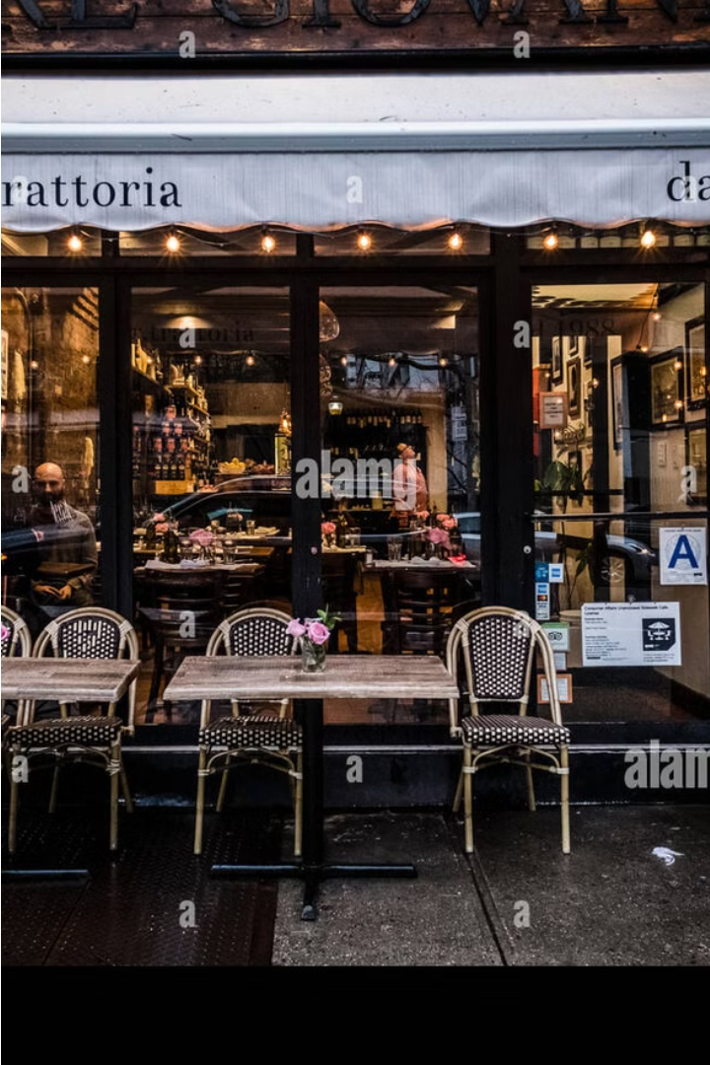
Introducing Piccola Cucina Siciliana Osteria
Responding to the overwhelming success of our flagship Prince Street location, we are thrilled to announce the opening of our newest restaurant, Piccola Cucina Siciliana Osteria, in the heart of the vibrant Soho neighborhood. This new venture allows us to bring our authentic Sicilian cuisine to an even wider audience.

Slide 5

The Heart of Soho: A Distinctive Neighborhood
Nestled in the vibrant center of New York City, Soho is a neighborhood known for its unique character and rich cultural heritage. With its charming cobblestone streets, iconic cast-iron architecture, and array of trendy boutiques and art galleries, Soho offers a truly distinctive urban experience.
Boasting a dynamic mix of high-end fashion, innovative dining, and lively nightlife, Soho has become a sought-after destination for both locals and visitors alike. The neighborhood's distinct blend of historic charm and contemporary flair makes it a true reflection of New York City's diverse and ever-evolving spirit.

Slide 6

Offering the Best Italian Cuisine in NYC
Authentic Flavors
Locally Sourced Ingredients
Handcrafted Specialties
Piccola Cucina Siciliana Osteria brings the authentic tastes of Sicily to the heart of New York City, offering a truly immersive Italian culinary experience.
Our chefs meticulously craft each dish, from handmade pasta to carefully curated wine pairings, delivering an unparalleled Italian dining experience.
We pride ourselves on using the freshest, locally sourced ingredients to create our delectable Italian dishes, ensuring the highest quality in every bite.

Slide 7
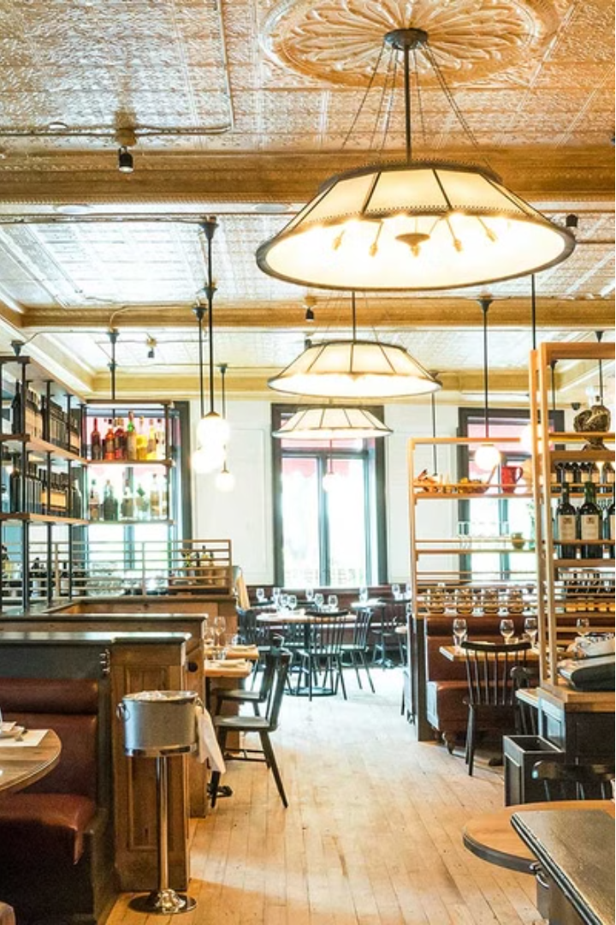
Recognized as the Best Restaurant in NYC
Piccola Cucina's flagship restaurant on Prince Street has been recognized as the best Italian restaurant in New York City, earning critical acclaim from food critics and diners alike.
With its authentic Sicilian cuisine, impeccable service, and charming atmosphere, Piccola Cucina has become a culinary destination for residents and tourists seeking the finest Italian dining experience in the city.

Slide 8

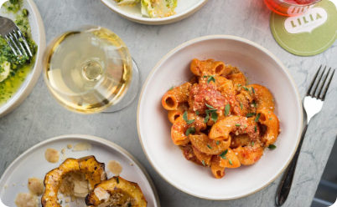
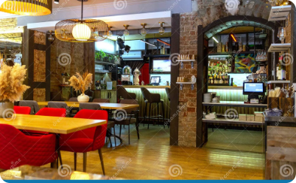
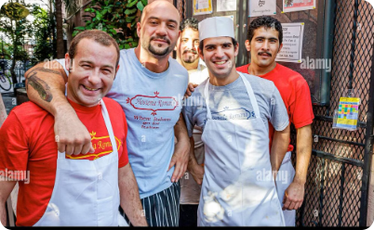
Providing the Best Italian Restaurant Experience
Authentic Italian Cuisine
Warm, Inviting Atmosphere
Exceptional Service
Savor the flavors of Italy with our menu of hand-crafted, traditional dishes made with the freshest ingredients.
Our knowledgeable and attentive staff will ensure your dining experience is memorable from start to finish.
Step into our charming Soho location and experience the comfort and hospitality of a true Italian trattoria.

Slide 9
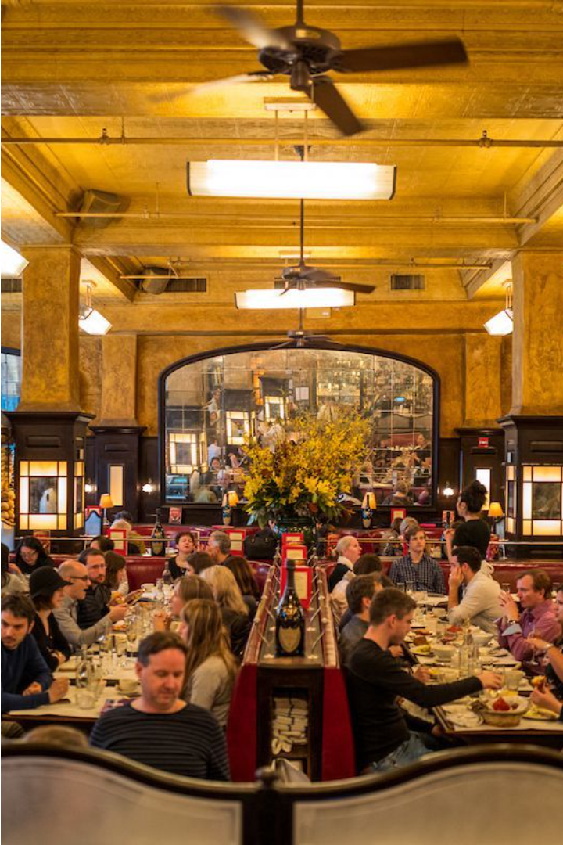
Conveniently Located Near You
Piccola Cucina Siciliana Osteria is situated in the heart of Soho, one of New York City's most vibrant and trendy neighborhoods. Our convenient location makes it easy for you to enjoy the best Italian cuisine in the city.
Whether you're a local or visiting, you'll find our restaurant just steps away from the bustling streets and iconic landmarks of this distinctive district. Stop by for an authentic taste of Sicily in the center of the Big Apple.

Slide 10
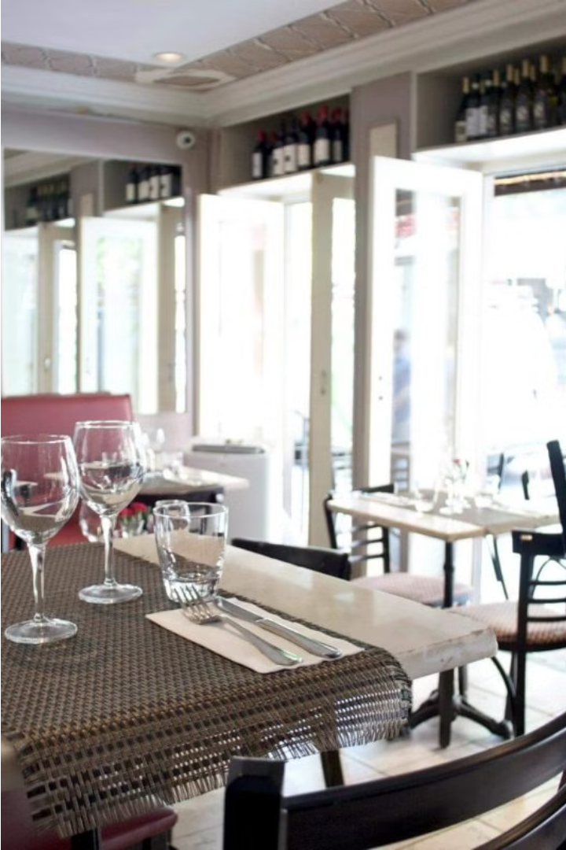
Visit Us
Come experience the best Italian cuisine in New York City at our Piccola Cucina Siciliana Osteria location in the heart of Soho. We're conveniently situated near you, ready to provide an unforgettable dining experience.
Best Restaurants in NYC | Piccola Cucina - New York, Ibiza
Thompson Street 75, New York City, NY 10012. USA
Call for Reservations: +1 (646) 781-9183
E-mail: info@piccolacucinagroup.com

