Slide 1
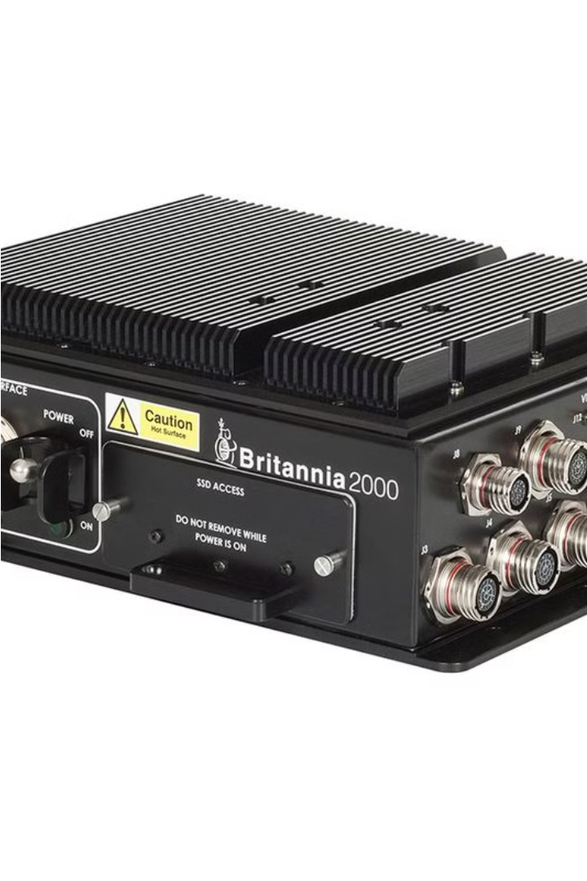


Compact Airborne Mission Computer (CAMC)
The CAMC by B2K Holdings in the UK is a cutting-edge airborne computing system designed for seamless data transmission and reliable performance in the most challenging aerial environments.
by B2K Holdings

Slide 2

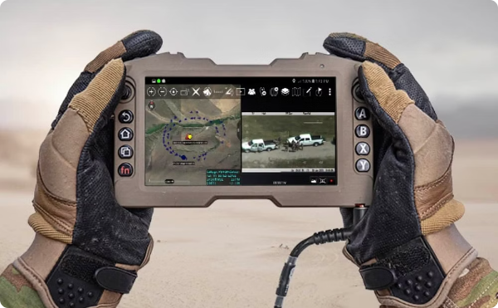
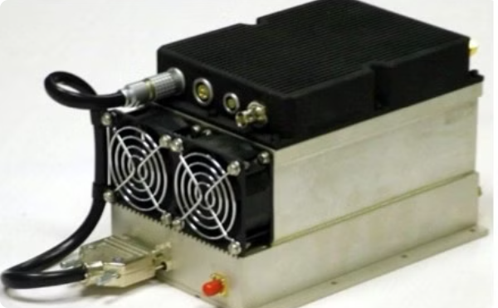
Rugged Displays and Video Downlinks
The CAMC integrates rugged, high-resolution displays and advanced video downlink capabilities, enabling real-time data sharing and mission-critical decision-making from the air.
Rugged Displays
Video Downlinks
Engineered to withstand harsh conditions, the CAMC's displays provide crisp, clear imagery for pilots and operators.
Seamless video transmission from the CAMC ensures that critical data reaches ground control instantaneously.

Slide 3

Reliable Performance
Designed to excel in challenging environments, the CAMC is engineered for uncompromising reliability, ensuring mission success even in the face of extreme conditions.
Rugged Construction
Environmental Resilience
Durable housing and shock-resistant components protect the CAMC from the rigors of aerial operations.
The CAMC is built to withstand temperature extremes, vibrations, and other environmental stresses.
Redundant Systems
Redundant power supplies and failsafe mechanisms guarantee continuous operation and mission-critical reliability.

Slide 4


Advanced Computing Power
The CAMC packs a powerful computing punch, delivering real-time processing and analysis capabilities to support critical decision-making during aerial missions.
1
High-Performance CPU
A cutting-edge processor provides the computing horsepower needed for complex data processing.
2
Parallel Processing
Sophisticated parallel processing architecture enables simultaneous analysis of multiple data streams.
3
Optimized Software
Proprietary software algorithms maximize the CAMC's computing capabilities for mission-critical applications.

Slide 5
Optimal Performance
The CAMC is engineered to deliver uncompromising performance, ensuring that critical aerial operations are executed with the highest levels of efficiency and effectiveness.
Low Latency
High Throughput
Power Efficiency
Rapid data processing and transmission minimize latency, enabling real-time decision-making.
The CAMC's advanced architecture ensures seamless data handling and uninterrupted operations.
Optimized power management extends the CAMC's operational runtime in the air.

Slide 6



Integrated System
The CAMC is designed as a comprehensive, integrated system that seamlessly interfaces with a wide range of aerial platforms and mission-critical applications.
Sensor Integration
Communication Interfaces
Automated Workflows
The CAMC readily integrates with a variety of onboard sensors for comprehensive data collection.
Robust communication capabilities enable secure data exchange with ground control and other assets.
Intuitive software and user interfaces streamline mission planning and execution.

Slide 7



Empowering Aerial Missions
The CAMC is the trusted solution for aerial operators, delivering cutting-edge technology and unparalleled performance to empower mission success in the most demanding environments.
Situational Awareness
Mission Effectiveness
Operational Efficiency
Real-time data processing and analysis enhance situational awareness for informed decision-making.
The CAMC's reliability and computing power enable optimal mission execution and success rates.
Streamlined workflows and reduced latency improve the overall efficiency of aerial operations.

Slide 8


Trusted Solution
With its proven track record of reliability and performance, the CAMC is the trusted choice for mission-critical aerial operations around the world.
1
Proven Reliability
2
Advanced Capabilities
3
Operational Flexibility
Rugged design and redundant systems ensure uninterrupted operation in the most challenging conditions.
Cutting-edge computing power and seamless integration enable mission success in the air.
The CAMC's versatility allows it to be deployed across a wide range of aerial platforms and applications.

Slide 9

Contact Us
To learn more about the Compact Airborne Mission Computer (CAMC) and how it can enhance your aerial operations, please visit our website or contact our sales team.
CAMC - Britannia 2000 Holdings
✉ : sales@b2kholdings.co.uk
📞: +44 7717 292751
☎ : +44 1344 885058
📍:
4, Millside Park, Winkfield, Windsor SL4 4PX, United Kingdom

